Slide 1
Context Window
Context
RAG chunks
Instructions
Output
Query
Role Information
Meta Information
Chat History

Slide 2
Context Window
Role Information/
System
Context
Dataset
Instructions
Response format
Output
Query

Slide 3

Role Information/
System
Context
Dataset
Instructions
Response format
Output
Query
Context Window

Slide 4







Question: Where are my keys?
Embedding & Scoring Strategy
Top P
Top K
Temp
Retriever with
embedding model
Ranking
model
Chunk Selection
Language
Model
Output
(TFIDF, BOW, BERT)
(Cosine)
Searching Strategy
(FAISS, MemVid)
Documents
Chunking
&
Indexing
Database
Chunking Strategy

Slide 5
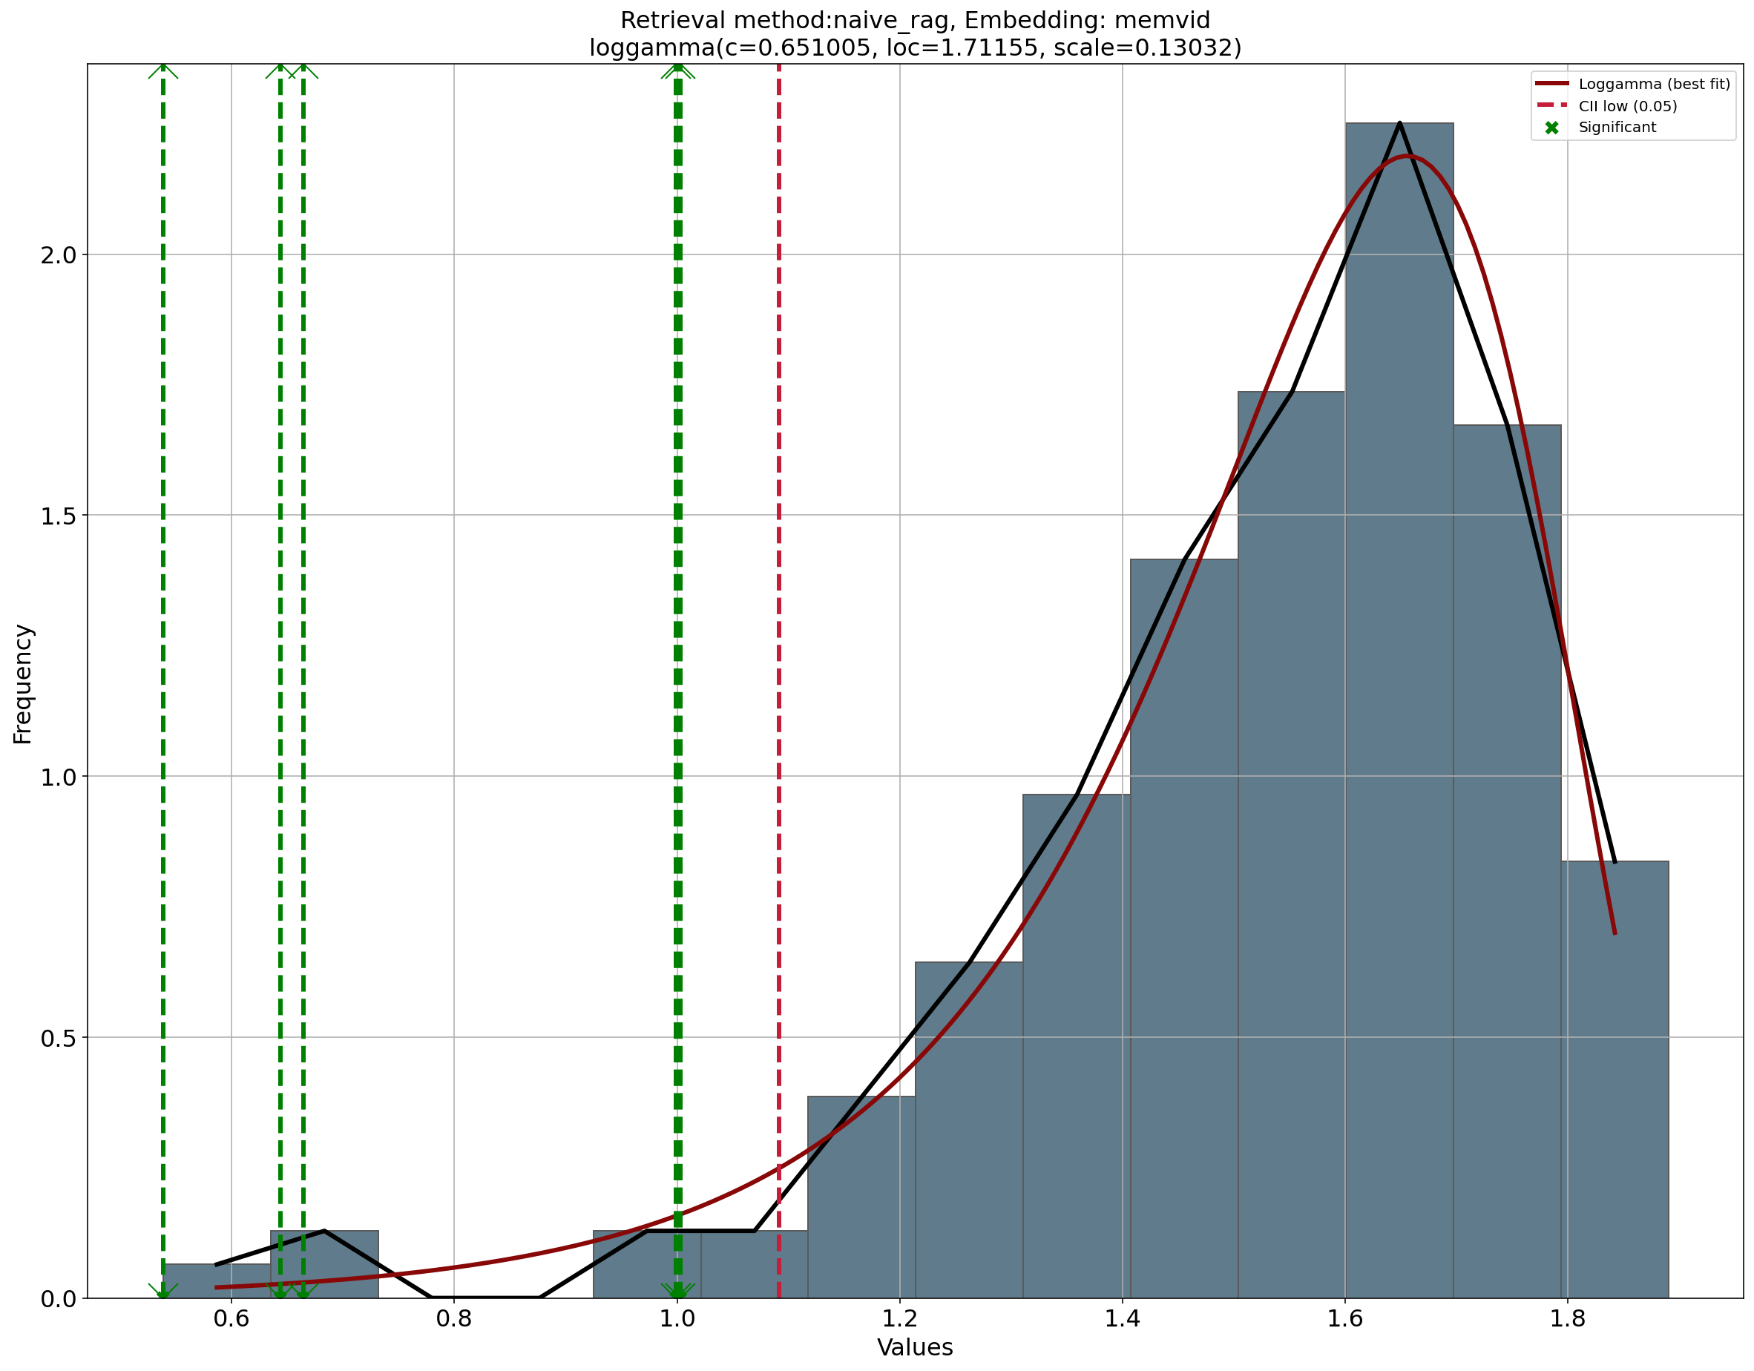


Question: Where are my keys?
Embedding & Scoring Strategy
Context Strategy
Retriever with
embedding model
Ranking
model
Chunk
analyzer
Smart
Context
Creation
(Cosine)
Chunk Selection
(Probability based)
(TFIDF, BOW, BERT)
(Chunk-wise, Global-reasoning)
Searching Strategy
Optimize
Prompt
(FAISS, MemVid)
Top K
Top P
Documents
Temp
Chunking
&
Indexing
Database
Language
Model
Output
Chunking Strategy

Slide 6
Chunk-Loop
Synthesis
- Retrieve last N summaries
- Add current chunk
- Add Instructions + Query
- Send Prompt to LLM
Append partial result to list
- Merge results
- Build prompt
(Select context and Build prompt)
(Store Results)
New Chunk
Optimize
Prompt
Top P
Top K
Document(s)
Temp
Chunking
&
Indexing
Database
Language
Model
Output
Chunking Strategy

Slide 7
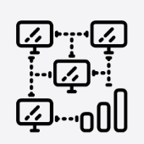



gemma-4-26b-a4b
gemma-4-26b-a4b
Data Science
Agent
Farmer
Agent
Start discussion
on topic of interest.
Discuss the importance of the use of Large Language Models and AI.
Evaluate arguments.
Respond and ask follow-up
question.

Slide 8

gemma-4-26b-a4b
gemma-4-26b-a4b
Data Science
Agent
Farmer
Agent
Start discussion
on topic of interest.
Discuss the importance of the use of Large Language Models and AI.
Evaluate arguments.
Respond and ask follow-up
question.
Summarize arguments, identify (dis)agreements, and Propose one question that helps both agents move toward consensus.
gpt-oss-20b
Moderator
Agent

Slide 9

gemma-4-26b-a4b
gemma-4-26b-a4b
Data Science
Agent
Farmer
Agent
Start discussion
on topic of interest.
Discuss the importance of the use of Large Language Models and AI.
Evaluate arguments.
Respond and ask follow-up
question.
No
Is there agreement?
Yes
Analyze all points, then
Score whether there is agreement.
Summarize arguments, identify (dis)agreements, and Propose one question that helps both agents move toward consensus.
Summary with the
output results
Constructive
Feedback
Scoring
Agent
Moderator
Agent
lfm2-24b-a2b
gpt-oss-20b

