Slide 1

Meet Your Agentic Team
Retrieval agent
Reasoning agent
Scoring
agent
Summary agent
Evaluation agent
Orchestration
agent

Slide 2
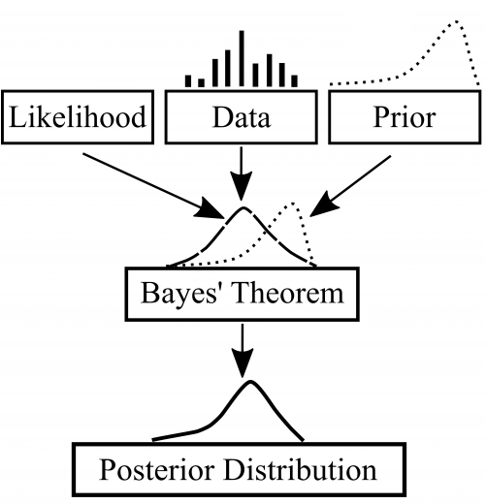
LLMs vs Bayesian
Large Language Models

Slide 3
A1
A2
A3
A4
A5
A6
Retrieval agent
Reasoning agent
Summary agent
Scoring
agent
Evaluation agent
Orchestration
agent
Each agent has a specialized task.
Together they form a system to solve the more complex task

Slide 4
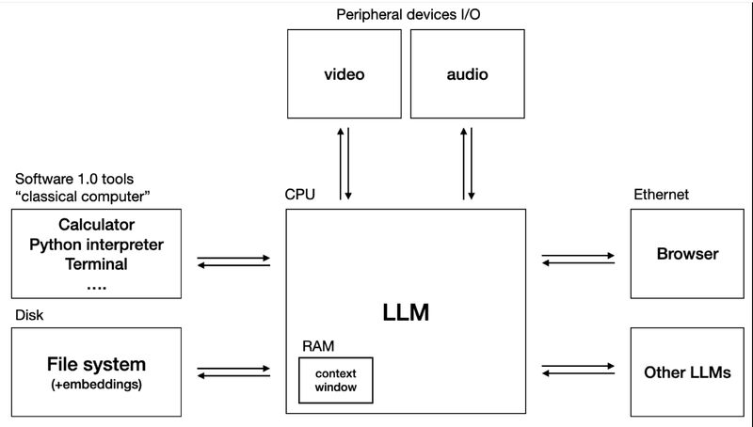



llm0s

