Slide 1

Bayesian
Causal Discovery
(Unsupervised)
Constraint-Based
Strategy
Peter-Clark (PC)
Discrete and
Continuous datasets
Hybrid Strategy
Log Likelihood
Cressie Read
Neyman
Pearson R
Chi2
Statistical tests for
Variable elimination
Freeman Tuckey
…
Log Likelihood
Chi2
Independence
Test
Dataset
Q Sq
Freeman Tuckey
Scoring methods
Discrete
Hybrid
Cressie Read
BDS
Continuous
DAG
Construction methods
Neyman
AIC
Bayes
BDUE
K2
Structure Learning
DBN
Markov
DBN
BIC
Scoring
Methods
Bayes
Parameter
Learning
Directed Acyclic Graph
(DAG)
ML
Search methods
Discrete datasets
Exhaustive
Search
Strategies
Hill-Climbsearch
Score-Based Strategy
Direct-LiNGAM
Probabilistic
Inference
Search methods
Continuous and
hybrid datasets
Chow-Liu
Search methods
Discrete datasets
Requires setting
Root node
ICA-LiNGAM
TAN
NaiveBayes
Overview for Causal Discovery, Bnlearn for Python

Slide 2
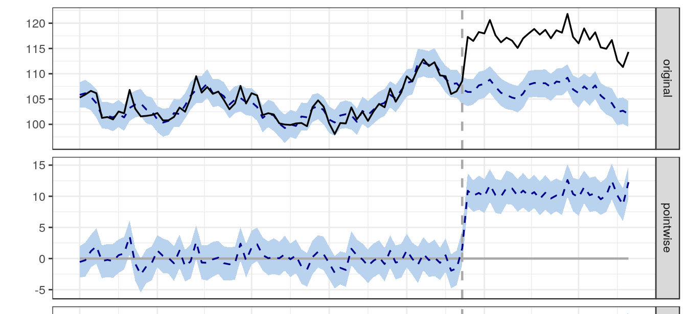
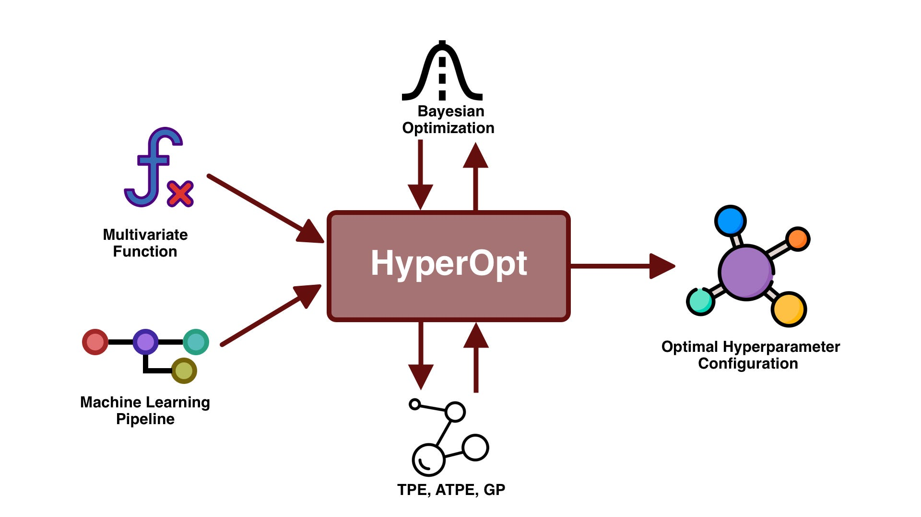
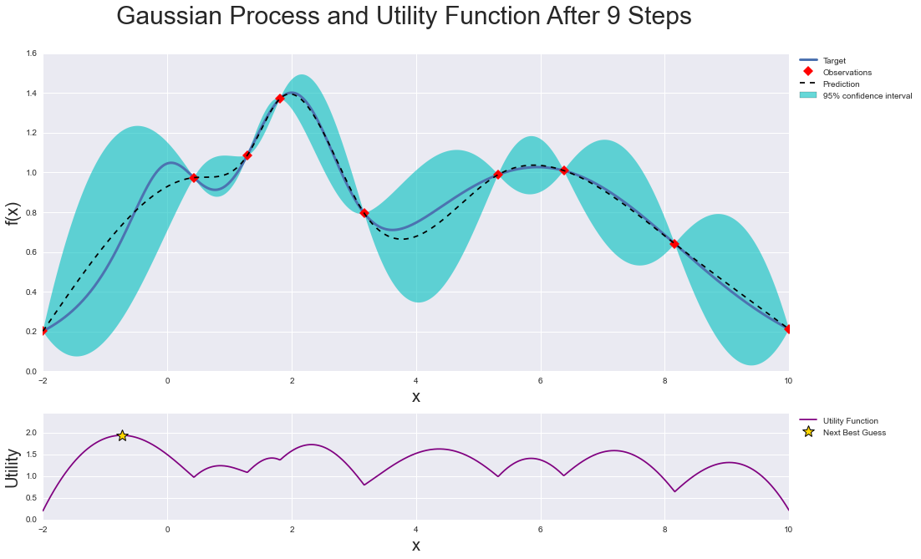

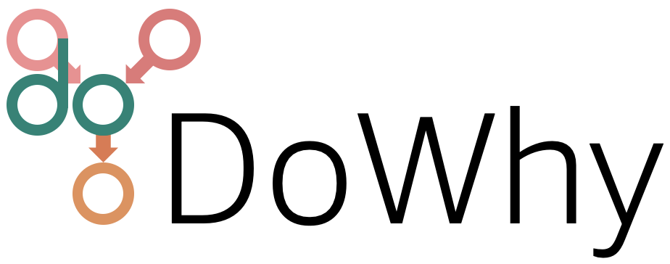

Optimization strategies
Time Series
Dataset
Datetime variable
BayesianOptimization
(Treatment variable)
CausalImpact
HyperOpt
Causal Discovery
(Supervised)
Bayesian
Dataset
Target variable
(Treatment variable)
Causal Discovery
(Unsupervised)
Dataset
Discrete
Hybrid
Continuous

Slide 3
Bayesian
Inferences
Expert Domain Knowledge
Step 1
Collect the relevant knowledge
Qualitative rules
Heuristics
Experience
Causal insights
Step 2
Step 3
Assumptions
…
Machine
Representation
Structured
Representation
Create CPTs and setup Directed Acyclic Graph
Rain
Cloudy
Refine the knowledge
Variables
Probabilities
Make simple one-to-one relationships and determine probabilities
Wet Grass
Relationships
Rain → Wet Grass
Cloudy → Rain
P(Wet Grass | Rain, Sprinkler)

Slide 4
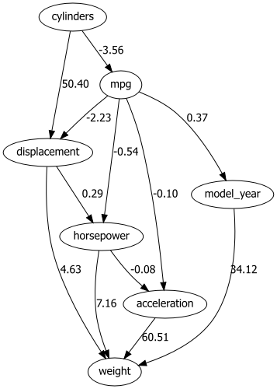
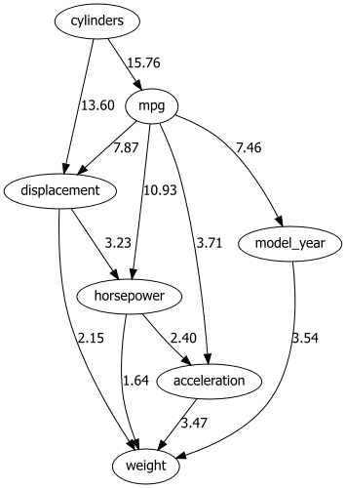
A
B

Slide 5
For 1000 days data is collected for these four variables
Sprinkler
Rain
Cloudy
Wet Grass
Yes?
No?
Yes?
No?
Yes?
No?
Yes?
No?

Slide 6
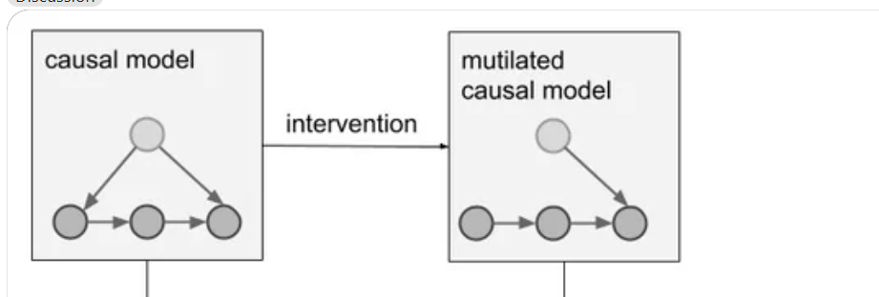
Multilated
Causal model
Causal model
Python
Python
Education
Experience
intervention
Education
Experience
Salary
Salary

Slide 7
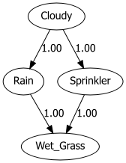
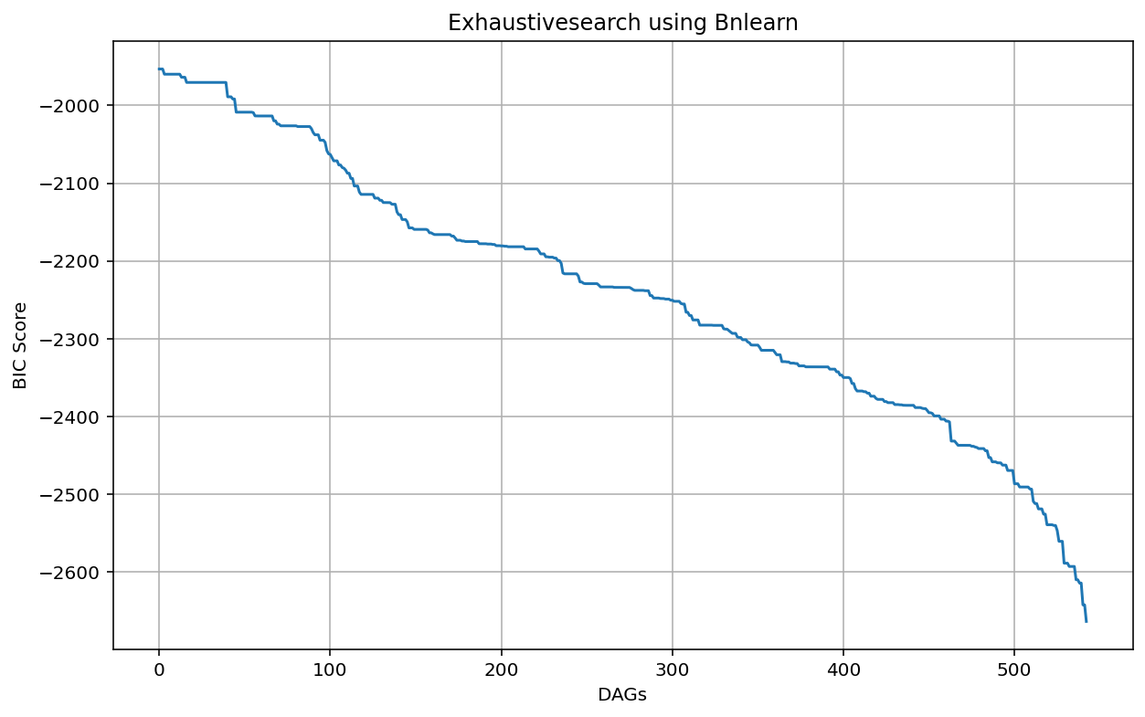
DAG with the best score
DAG with the worst score
Sprinkler
Rain
Cloudy
Wet Grass
DAG 1
Score: ?
543 unique DAGs

Slide 8
Dataset
Optimization strategies
Dataset
Datetime variable
Target variable
Treatment variable
Treatment variable
Time Series
Supervised
Causal Discovery
Bayesian
Manually by user
Discrete
Dataset
Hybrid
Continuous
Directed Acyclic Graph
(DAG)
Scoring
Methods
Parameter Learning
AIC
BIC
K2
Unsupervised
Structure Learning
(Causal Discovery)
BDS
BDUE
Score-Based
Discretize
Methods
Probabilistic Inference
Manually by user
Yi-Chun Chen
Hill-Climbsearch
Search
Strategies
Independence
Test
Exhaustive
Hybrid
Strategy
Constraint-
Based
Discrete datasets
TAN
ICALiNGAM
Chi2
Discrete datasets
Requires setting
Root/ class node
Naivebayes
DirectLiNGAM
Log likelihood
Chow-liu
Continuous and
hybrid datasets
Freeman tuckey
Overview for Causal Discovery
Bnlearn for Python

Slide 9
Dataset (discrete, continuous, and hybrid data types)
Bayesian Approaches (Unsupervised)
Structure Learning (Causal Discovery)
Parameter Learning
Constraint-based Algorithms
Conditional independence tests
Score-based
Algorithms
Bayesian/
Frequentist Approach
Discrete
Continuous
Hybrid
Data types
Chi2
…
Search Strategy
Scoring Method
Parameter Estimator
DirectLiNGAM
Hill-Climbsearch
Exhaustive
Chow-liu
BIC
K2
BDUE
Bayesian
ICALiNGAM
PC
TAN
Naivebayes
BDS
AIC
Maximum Likelihood
User-defined
User-defined
Directed Acyclic Graph (DAG)
Directed Acyclic Graph (DAG)
Cumulative Probability Distribution (CPD)
Inferences
Approximate
Exact
Probabilistic Inference
P(A|B)

Slide 10
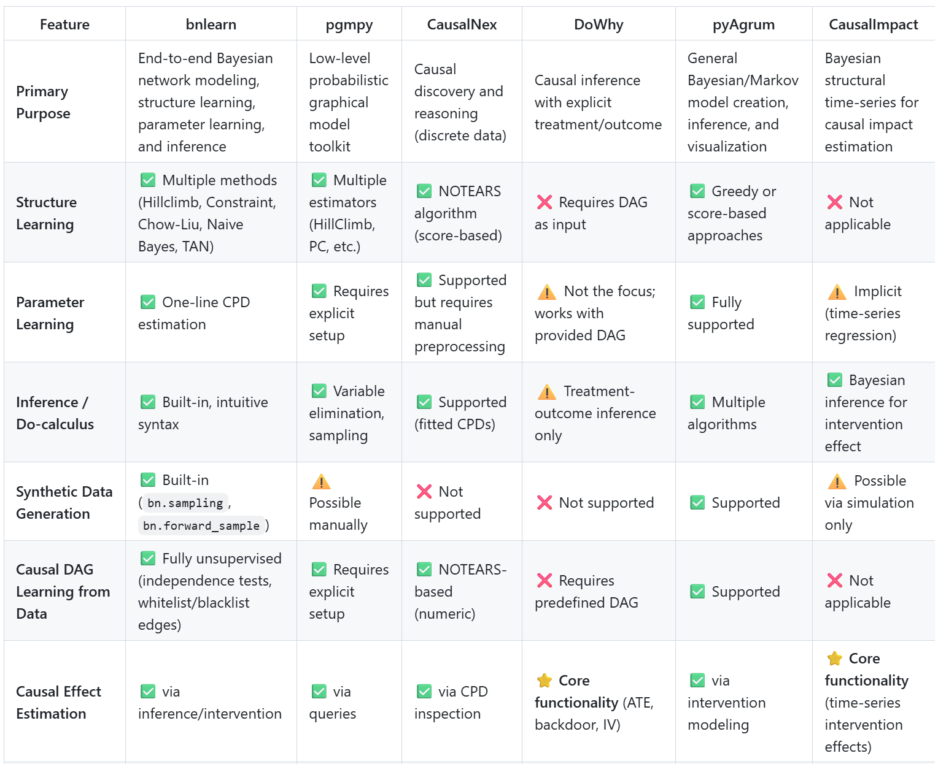
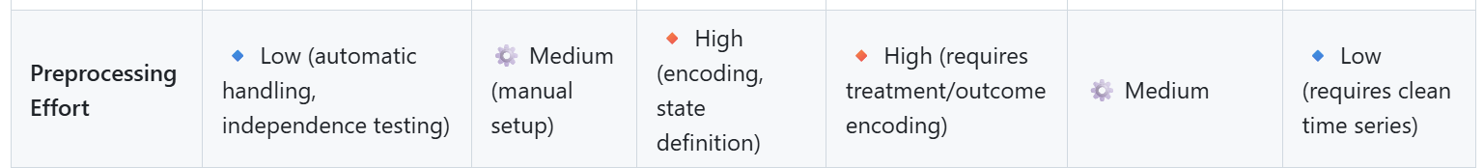

Slide 11
