Slide 1




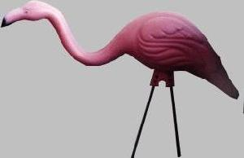


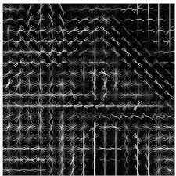
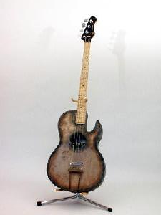
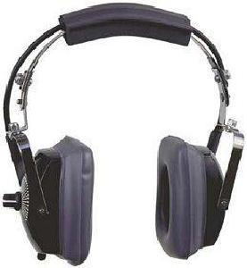

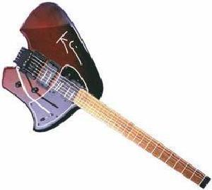
Embedding
Audio file (wav/mp3)
Pre-processing
Feature extraction
Cluster labels
tSNE
Normalize
Denoise
SR
PCA
MFCC
Clustering and evaluation
Path/dir to audio locations
Clustering

