Slide 1
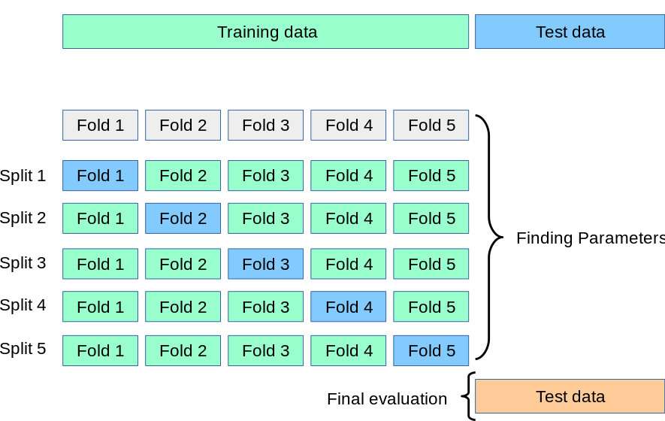
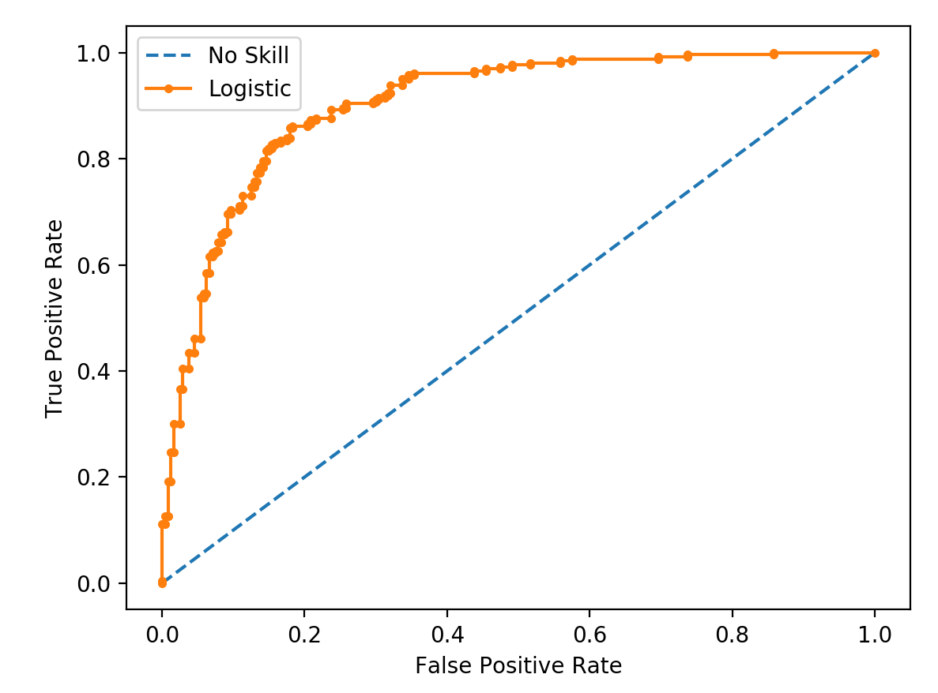
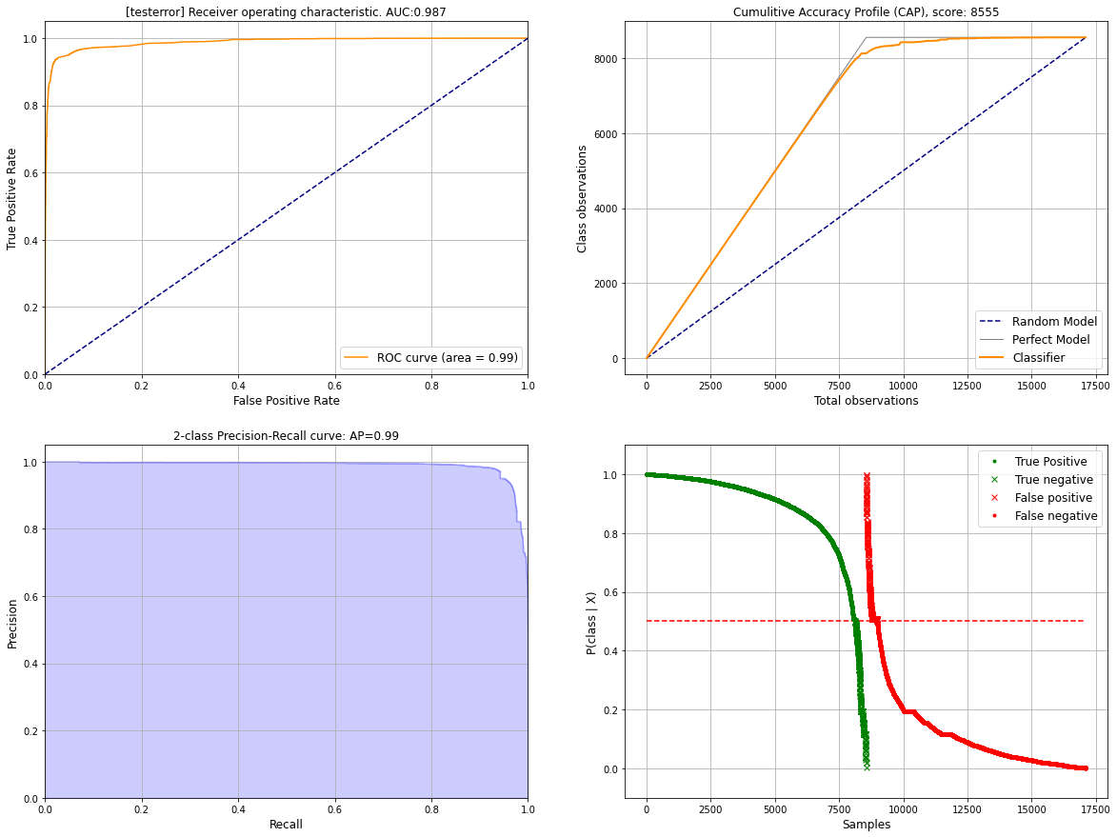
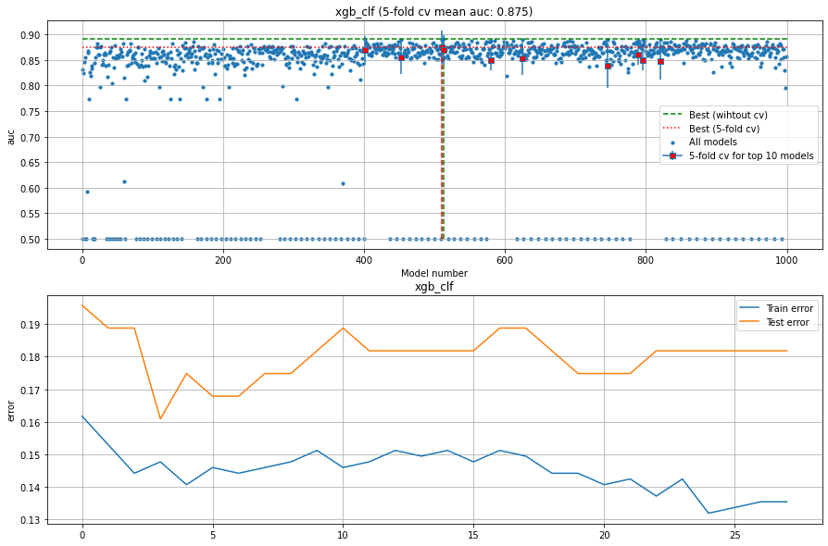
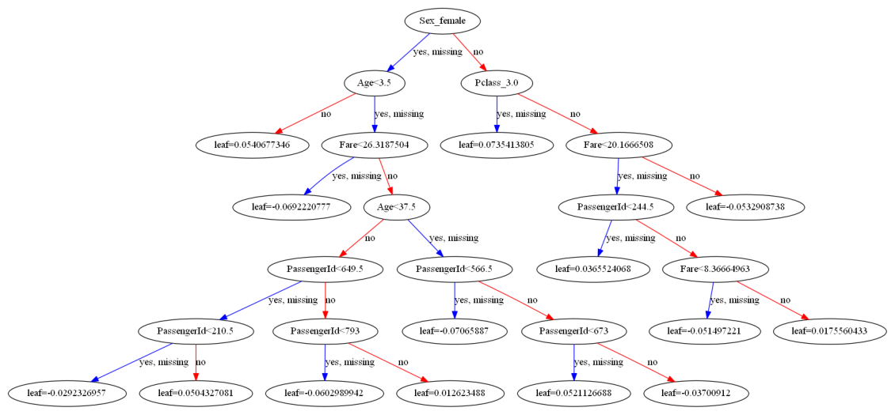
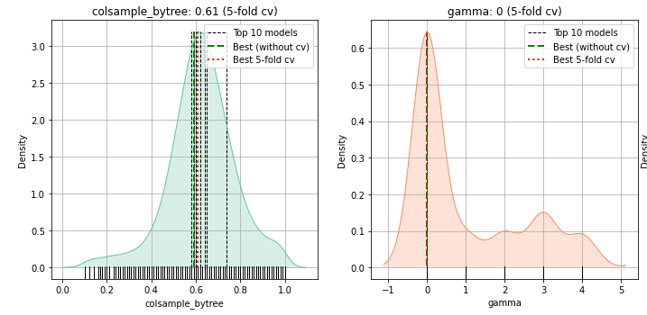
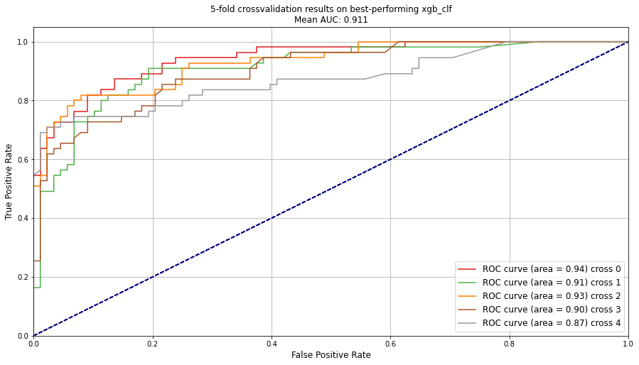
HGBoost
Hyperparameter optimization using HyperOpt
and k-fold cross validation
A
Finding parameters
Train and test set (80%)
Total dataset
Model i
Model i
Model k with hyperparameters
B
Validation set
(20%)
Best model
parameters
Performance on validation set
C
Fit model on entire dataset using optimized parameters
Fitted model
D
Plots to analyse the results

Slide 2
Flowchart Towards a Hyperoptimized Regression Model
Step 1
Import & Preprocess Dataset
Load data, clean, handle missing values
Step 5
Select Best Generalizing Model
Compare CV performance
Avoid overfitting
Step 2
Train / Test / Validation Split
Prevent data leakage
Step 6
Evaluate on Independent Validation Set
Final unbiased performance estimate
Step 3
Select Evaluation Metric
RMSE / MAE / R²
Define target
Step 7
Train Final Model on Full Dataset
Use optimal hyperparameters
Step 4
Nested Cross-Validation Framework
Inner Loop: Bayesian Hyperparameter Optimization
Outer Loop: Cross-validation scoring
Step 8
Visualize Hyperparameter Search Space
Model performance vs parameters
Step 9
Interpret Results
Model behavior , Feature/parameter insights, Practical conclusions

