Slide 1
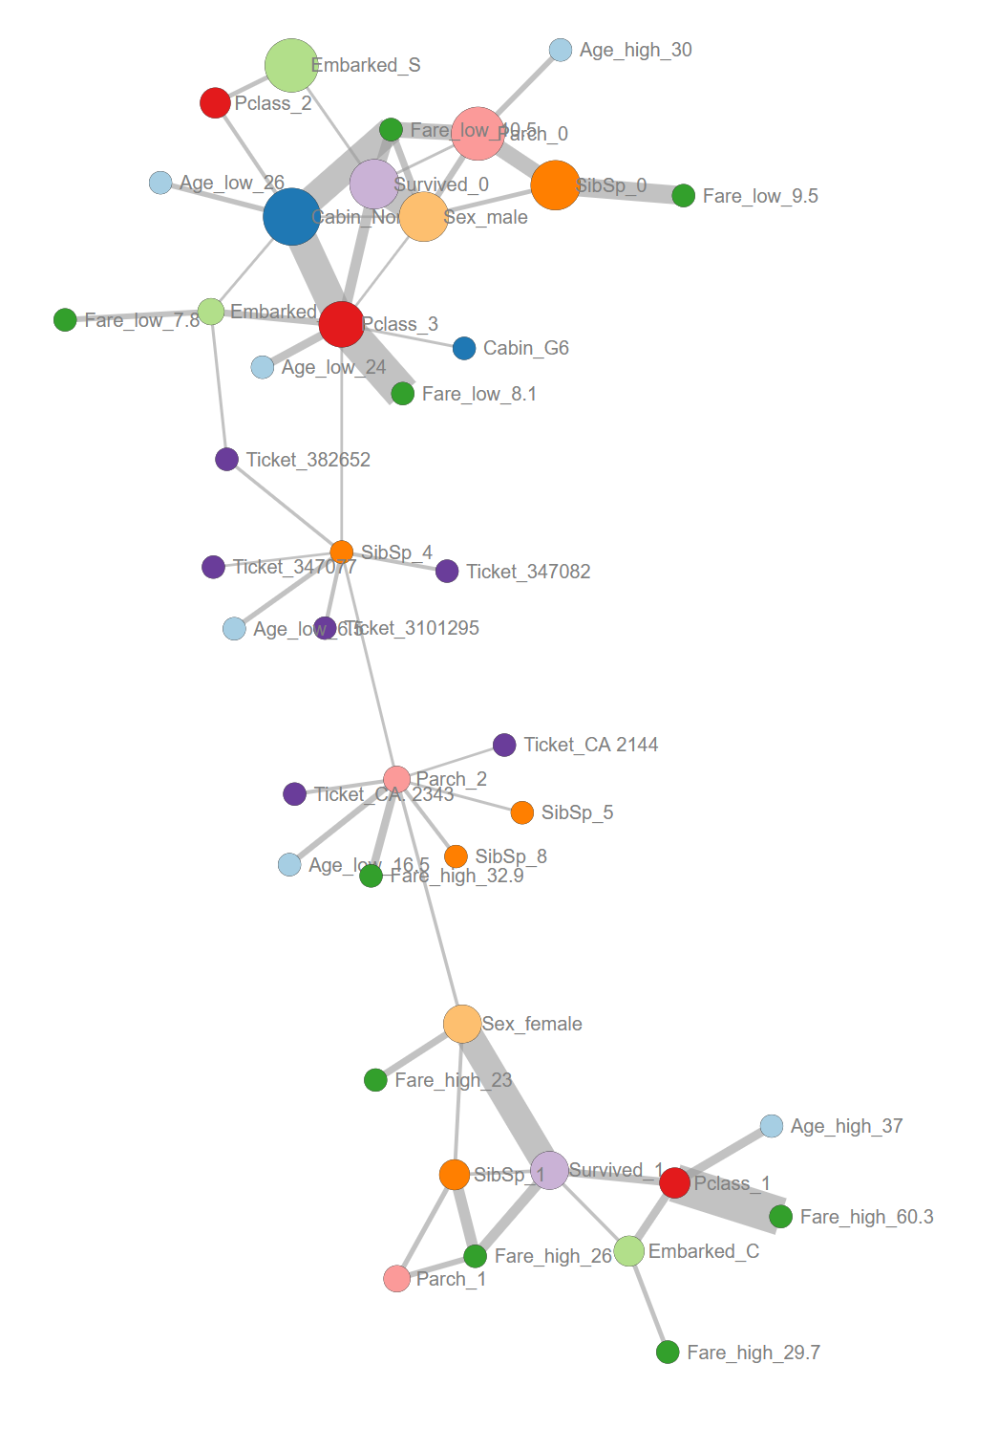
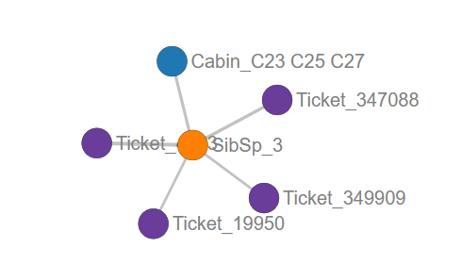
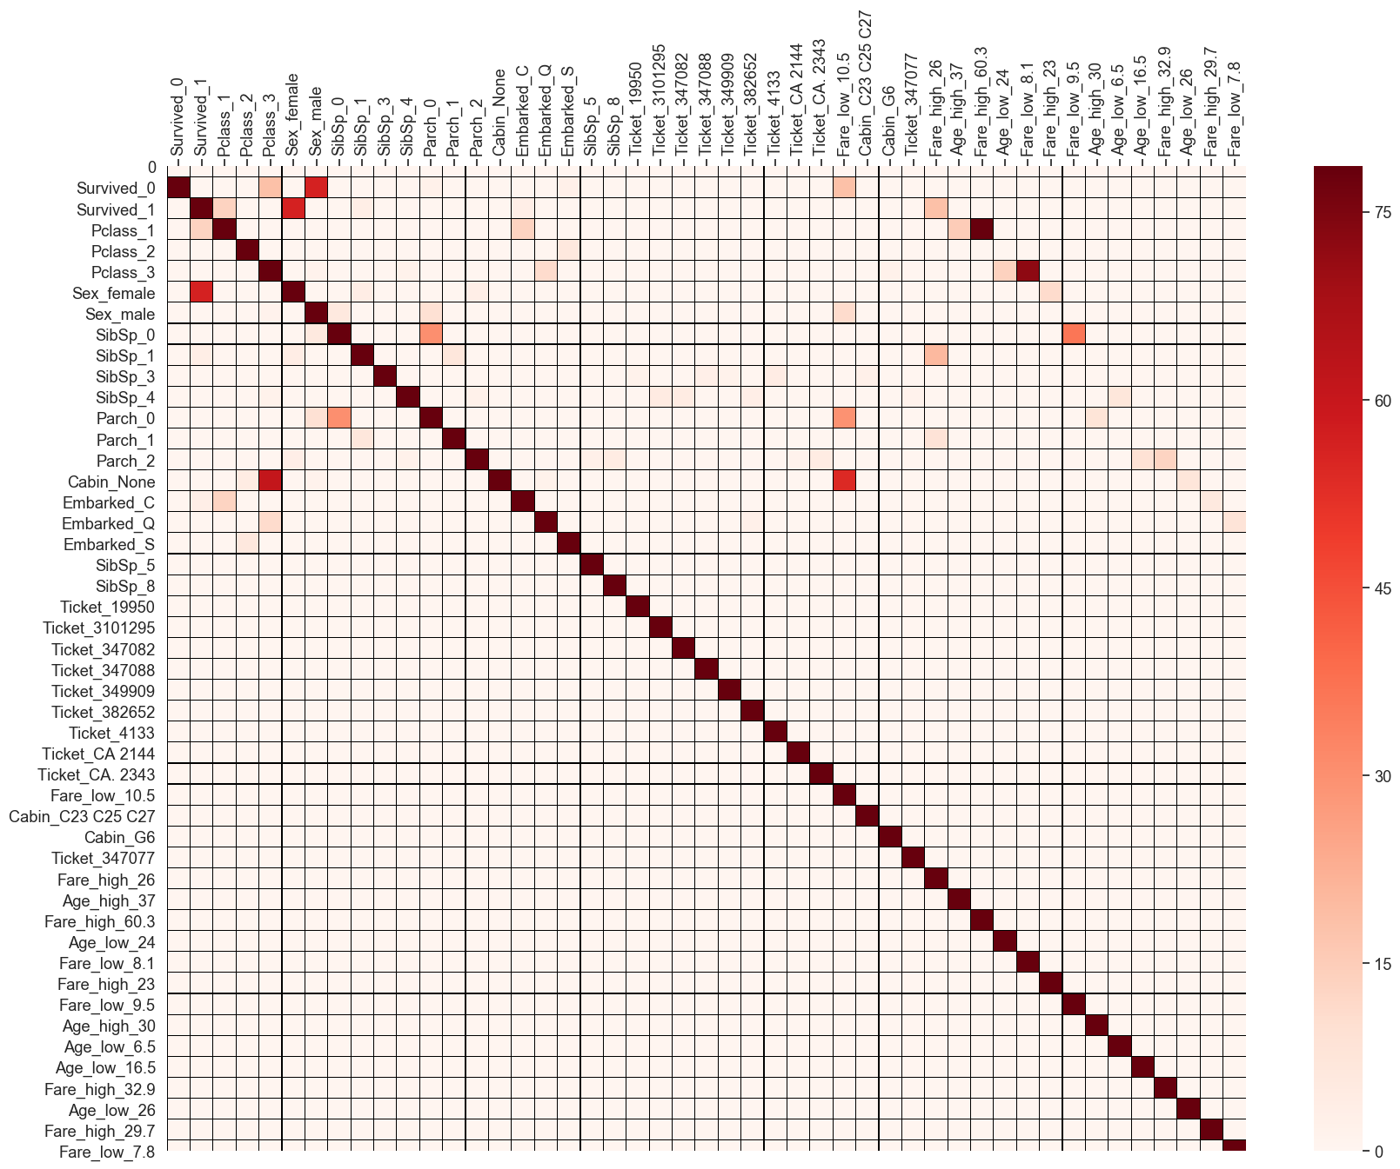
Figure 4
A
Feature | Typing original | Typing HNet | Nr. Unique labels in feature | Minimum samples > 10
Passenger-Id | Integer | category | 891 | -
Name | object | category | 891 | -
Ticket | Object | Category | 681 | -
Age | Float | Numeric | 88
Fare | Float | Numeric | 248
Sex | Object | Category | 2 | male, female
Survived | Integer | category | 2 | 0, 1
SibSp | Integer | Category | 7 | 0,1,3,4
Parch | Integer | Category | 7 | 0,1,2
Pclass | Integer | category | 3 | 1, 2, 3
Cabin | object | Category | 147 | None
Embarked | object | category | 3 | C,Q,S
C
B
Sex
Survived
SibSp
Parch
Pclass
-log10(P_{holm})
Cabin
Embarked
Age
Fare

