Slide 1
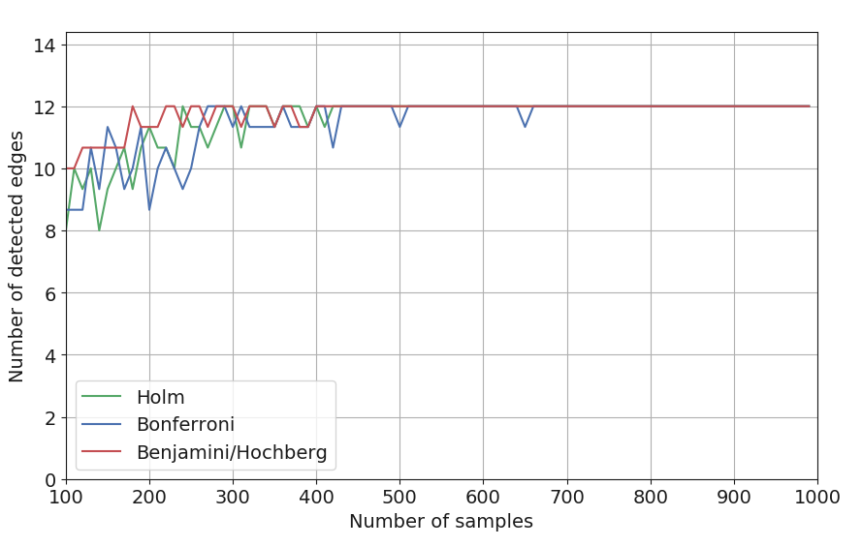
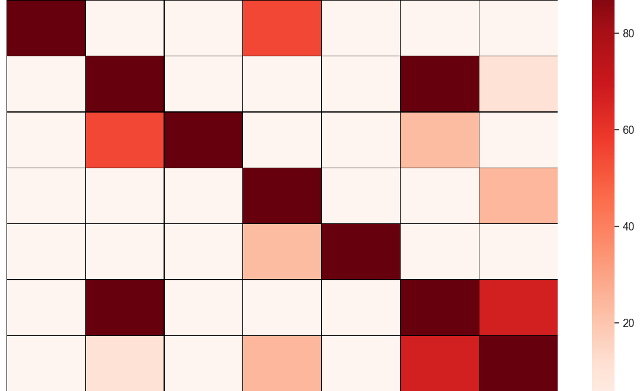
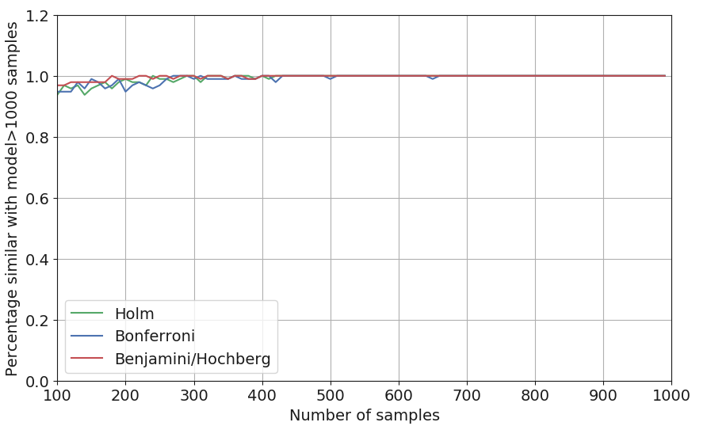
Figure 2
A
B
D
CLOUDY
Cloudy F
Sprinkler F
Sprinkler T
Wet grass T
Cloudy T
Rain F
Rain T
F T
0.5 0.5
Cloudy F
Cloudy
Cloudy T
SPRINKLER
Sprinkler F
RAIN
CLOUDY
F T
F 0.5 0.5
T 0.9 0.1
CLOUDY
F T
F 0.8 0.2
T 0.2 0.8
Sprinkler T
Sprinkler
Rain
Rain F
Rain T
-log10(P_{holm})
Wet grass T
E
Wet Grass
WET GRASS
C
Rain F
RAIN SPRINKLER
F T
1 0
0.1 0.9
0.1 0.9
0.01 0.99
Cloudy T
Sprinkler F
Sprinkler T
F F
F T
T F
T T
Wet Grass T
N>1000 samples
Rain T
Cloudy F
Up to 1000 samples

