Slide 1
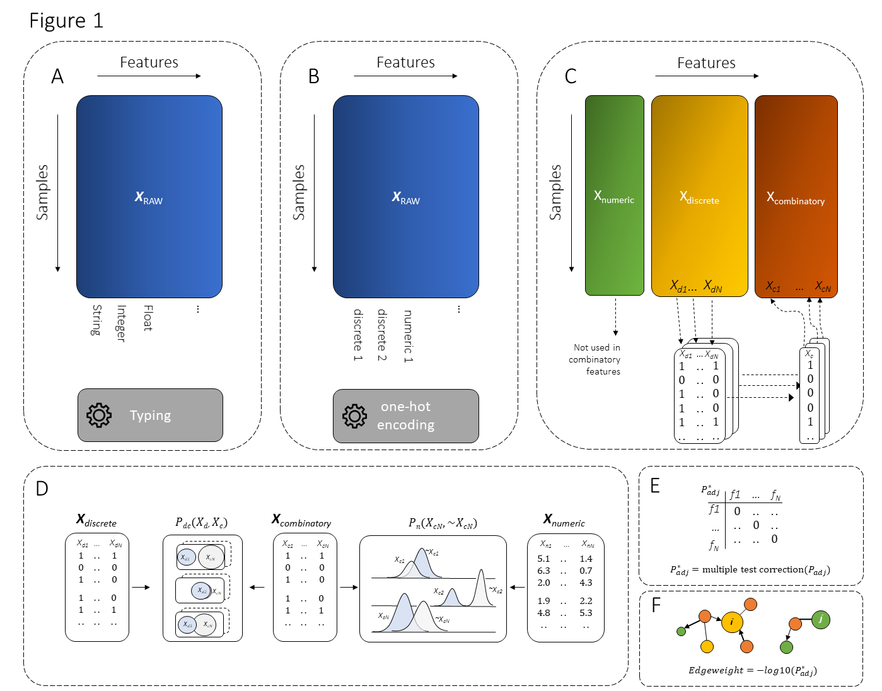
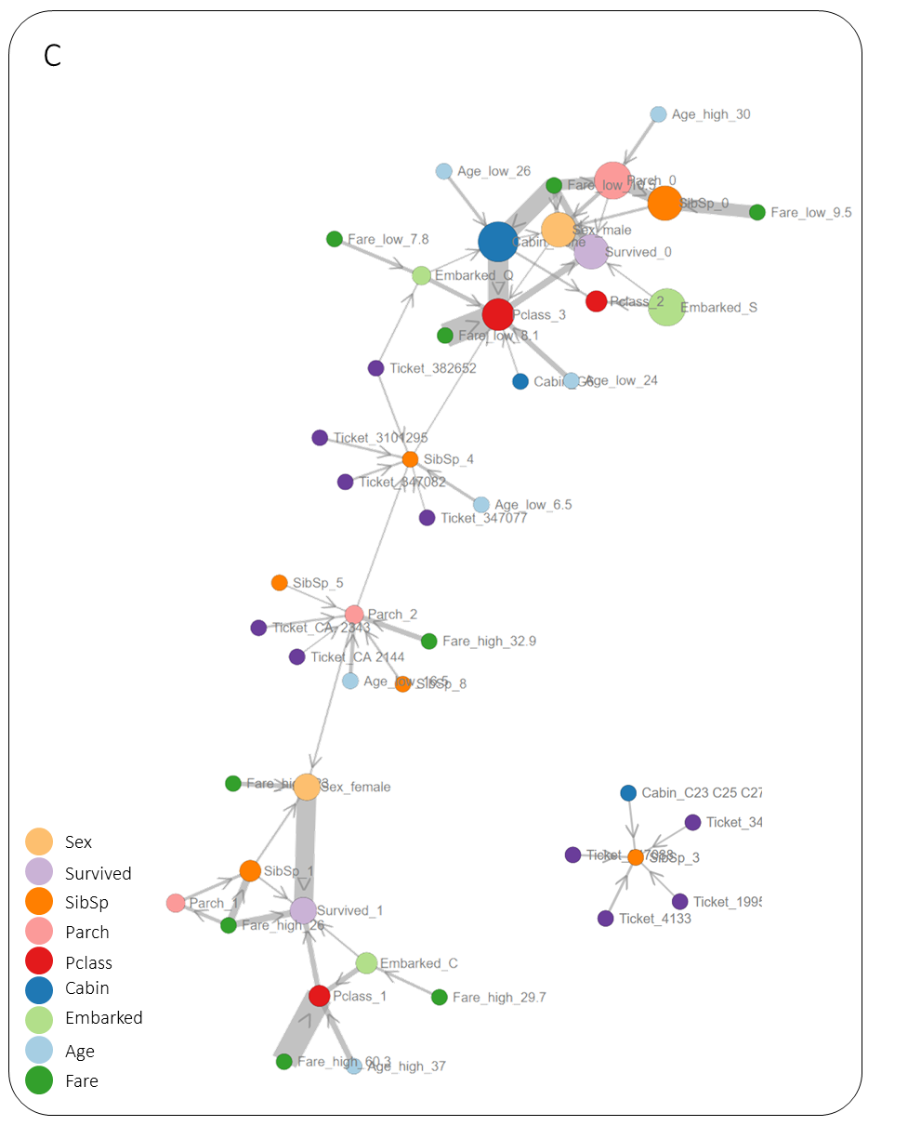
HNet: graphical Hypergeometric NETworks
Schematic overview
Use case: Titanic

