Slide 1
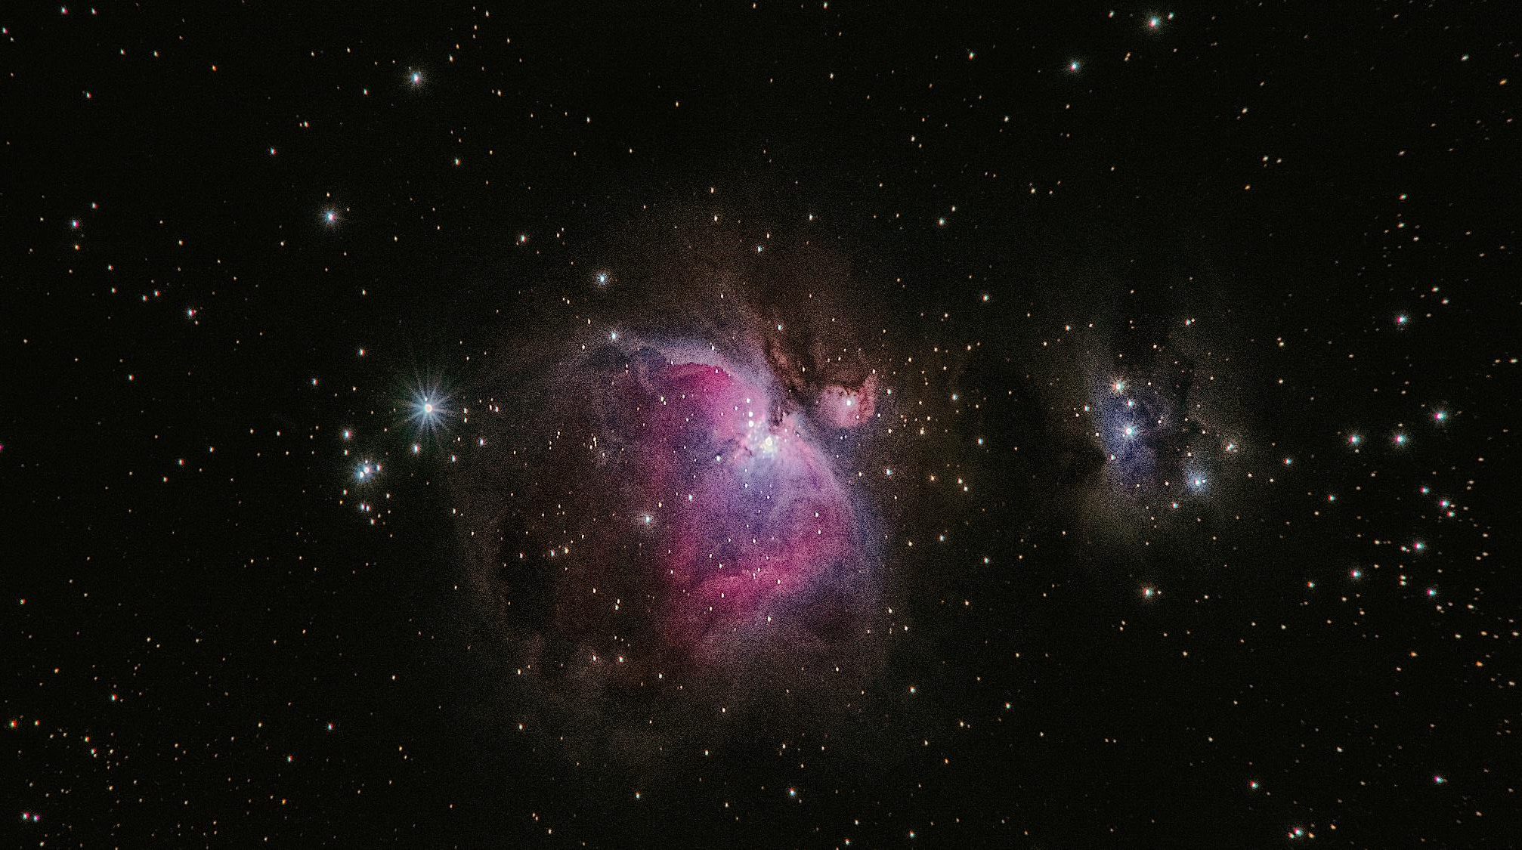

HNet: HYPERGEOMETRIC NETWORKS
To understand and explain by association learning
Photo by Alexander Andrews on Unsplash
Erdogan Taskesen, Rijkswaterstaat, Datalab, PyData, Eindhoven, October 2020

Slide 2



OUTLINE
Aim/Background
HNet approach
In depth
Applications
Use-case: Shooting in the United States by a police officer.
Python modules
Implementation and Libraries

Slide 3

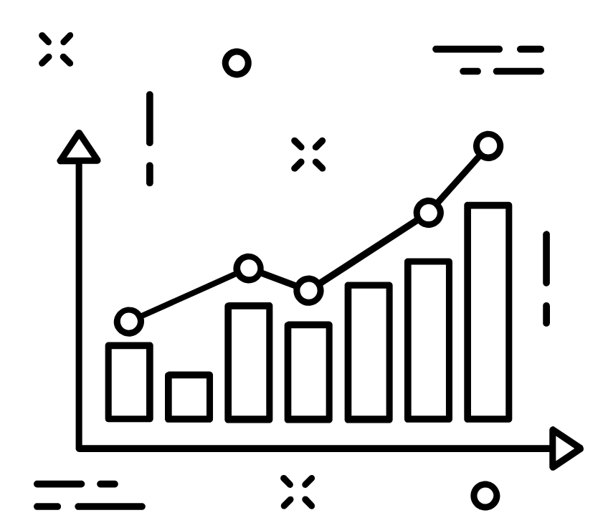

THREE MAJOR STEPS IN DATA SCIENCE PROJECTS
Pre-processing
Analysis/ modelling
Interpretation
Start
100% of the time
Done

Slide 4
IDEAL SCENARIO
Pre-processing
Analysis/ modelling
Interpretation
Start
100% of the time
Done
Pre-processing
`
Analysis/ modelling
Interpretation
Ideal Scenario

Slide 5
REAL SCENARIO
Pre-processing
Analysis/ modelling
Interpretation
Start
100% of the time
Done
Pre-processing
`
~70% of the time
Analysis/ modelling
Interpretation
Real Scenario
Notes:
Why did the pre-processing part take so much time?
This has to do with the data understanding part because;
If we would have been the domain expert too, we would have known (among others):
Which feature to select.
Which plots to make for quality control.
The best way to normalize the data.

Slide 6
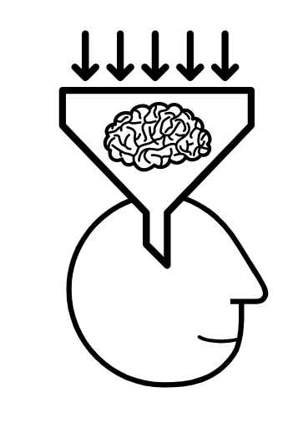
DATA UNDERSTANDING: PRE-PROCESSING
Data understanding
Pre-processing
Analysis/ modelling
Interpretation
Start
100% of the time
Done
The “data understanding“ part is (often) limited to the pre-processing step.
We are limited to a few (personal-picked) combinations.
Does not provide significance
Does not provide “in-depth overview” of the relationships that may exists in the data.

Slide 7
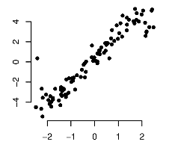
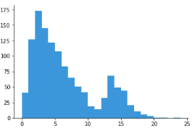
DATA UNDERSTANDING: PRE-PROCESSING
10 features
Sex
Survival
Parch
Age
...
Samples
The “data understanding“ part is (often) limited to the pre-processing step.
We are limited to a few (personal-picked) combinations.
Does not provide significance
Does not provide “in-depth overview” of the relationships that may exists in the data.

Slide 8




DATA UNDERSTANDING: TOWARDS FEATURE RELATIONSHIPS
Data understanding should also be about:
Having a good in-depth discussion with the experts in the field.
Validating the most obvious relationships (is “the data” as expected?)
Setting expectations.
Refinement of the project goals

Slide 9

DATA UNDERSTANDING IS A CHALLANGE
10 features
Datasets comes in many forms and shapes:
Continuous values (e.g., sensor)
Categorical
Boolean
Sex
Survival
Parch
Age
...
Samples
Number of combinations to plot/analyze can be highly time consuming.
$${all combinations= k}^{n}−1$$
Where, n is the unique number of features, and k number of combinations.
Example: In a dataset with n=10 features, there are 99 combinations, when we want to know all combination of k=2.

Slide 10
METHODS TO APPROACH UNDERSTANDING

Slide 11
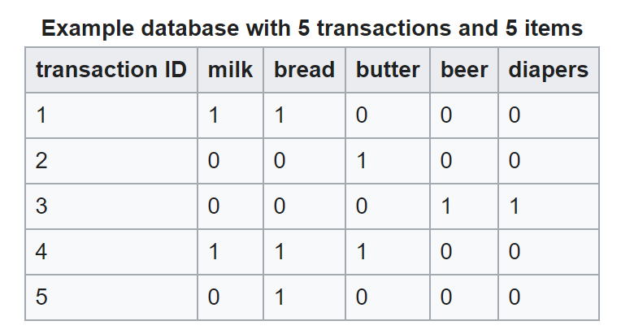
APRIORI ALGORITHM
Designed for finding association rules in data.
Rule-based machine learning method for the discovery of relationships.
Many applications; web usage mining, intrusion detection, marketing.
People who buy diapers also buys beers
Limitations
Search space grows rapidly over the number of features.
Large risk of finding many spurious associations by searching massive numbers of possible associations.
Only discrete values
Requires various trade-offs to select interesting rules from the set of all possible rules.
Minimum Support: indication of how frequently the itemset appears in the dataset.
Minimum Confidence: indication of how often the rule has been found to be true.
If we assume there are no associations, we should nonetheless expect to find statistically sound associations when using significance level of 0.05.
Notes:
Support: <beer><-> <diapers> : has a support of 1/5=0.2 since it occurs in 20% of all transactions (1 out of 5 transactions).
Confidence: <butter, bread> -> <milk> has a confidence of 0.2/0.2 = 1. Thus 100% of the cases this is true
Because it means there is a 5% chance of accepting a rule.

Slide 12
SOLUTION: HNET (HYPERGEOMETRIC NETWORKS)
AIM
To determine a network with significant associations that can shed light on the complex relationships across variables.
Properties
HNet learns the association from datasets with mixed datatypes and with unknown function.
An associations is whether one variable tend to co-occur with certain values of another variable.
Input datasets can range from generic dataframes to nested data structures with lists, missing values and enumerations.
Advantages:
Test for independence (conditional probabilities)
Groups sizes are taken into the computations
Multiple test correction
Alpha to threshold

Slide 13
HNET EXAMPLE (USE-CASE)

Slide 14


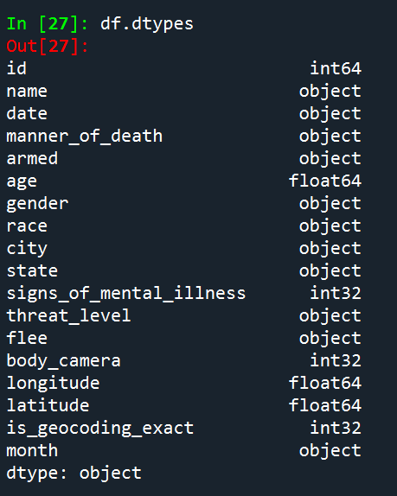
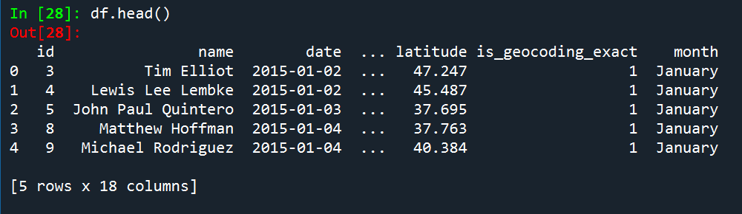
DATA: POLICE SHOOTINGS
$ pip install hnet
$ python
> from hnet import hnet
> hn = hnet(black_list=['id’, ’name’, 'date’])
> results = hn.association_learning(df)
Washington Post's database
“Records of every fatal shooting in the United States by a police officer in the line of duty” (since Jan. 1, 2015)
https://github.com/washingtonpost/data-police-shootings
Gender
City
Age
Race
W, B, A, N, H, O, unknown
Threat level
State
Armed
undetermined, unknown, unarmed
Death
shot, shot and Tasered
Signs of mental illness
Body camera
Criminals
Flee
Foot, car, not
Lon/Lat
Date
df = pd.read_csv(fatal-police-shootings-data.csv')

Slide 15
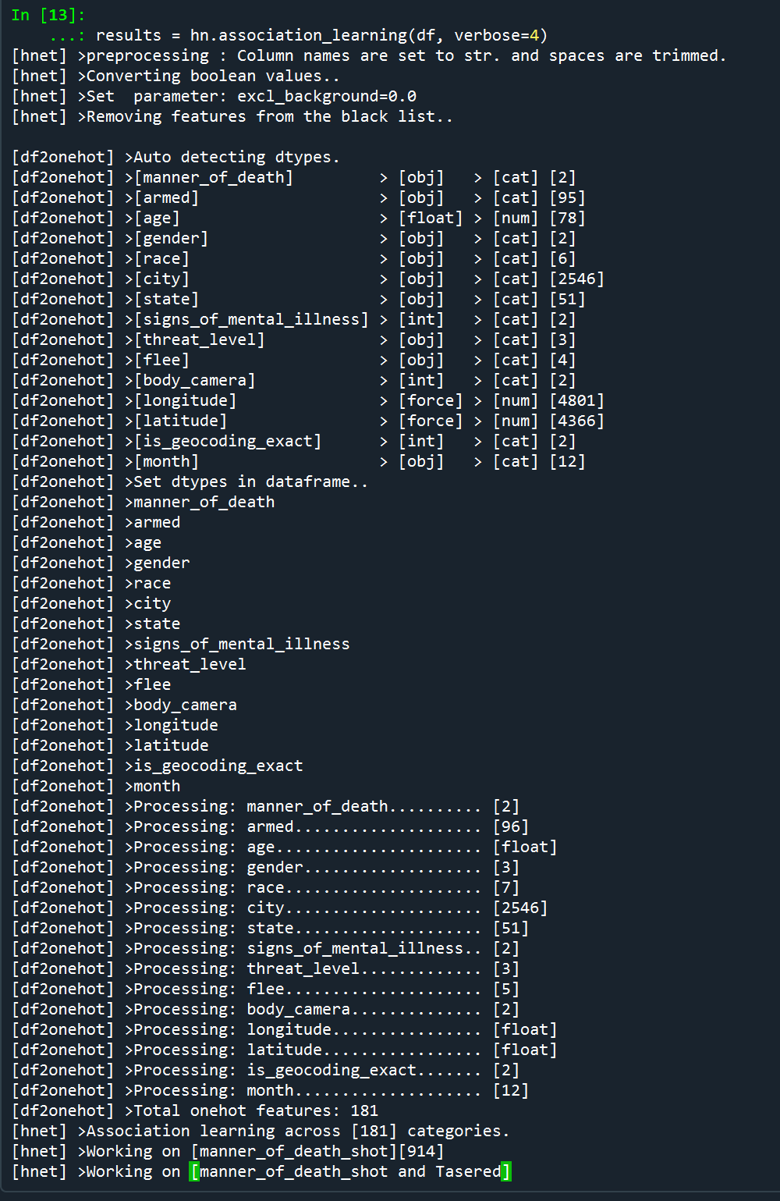
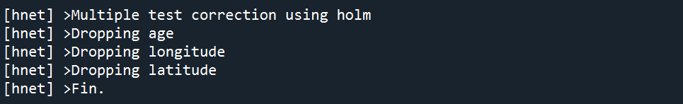
DATA: POLICE SHOOTINGS
Washington Post's database
“Records of every fatal shooting in the United States by a police officer in the line of duty” (since Jan. 1, 2015)
https://github.com/washingtonpost/data-police-shootings
Gender
City
Age
Race
W, B, A, N, H, O, unknown
Threat level
State
Armed
undetermined, unknown, unarmed
Death
shot, shot and Tasered
Signs of mental illness
Body camera
Flee
Foot, car, not
Lon/Lat
Date
df = pd.read_csv(fatal-police-shootings-data.csv')

Slide 16
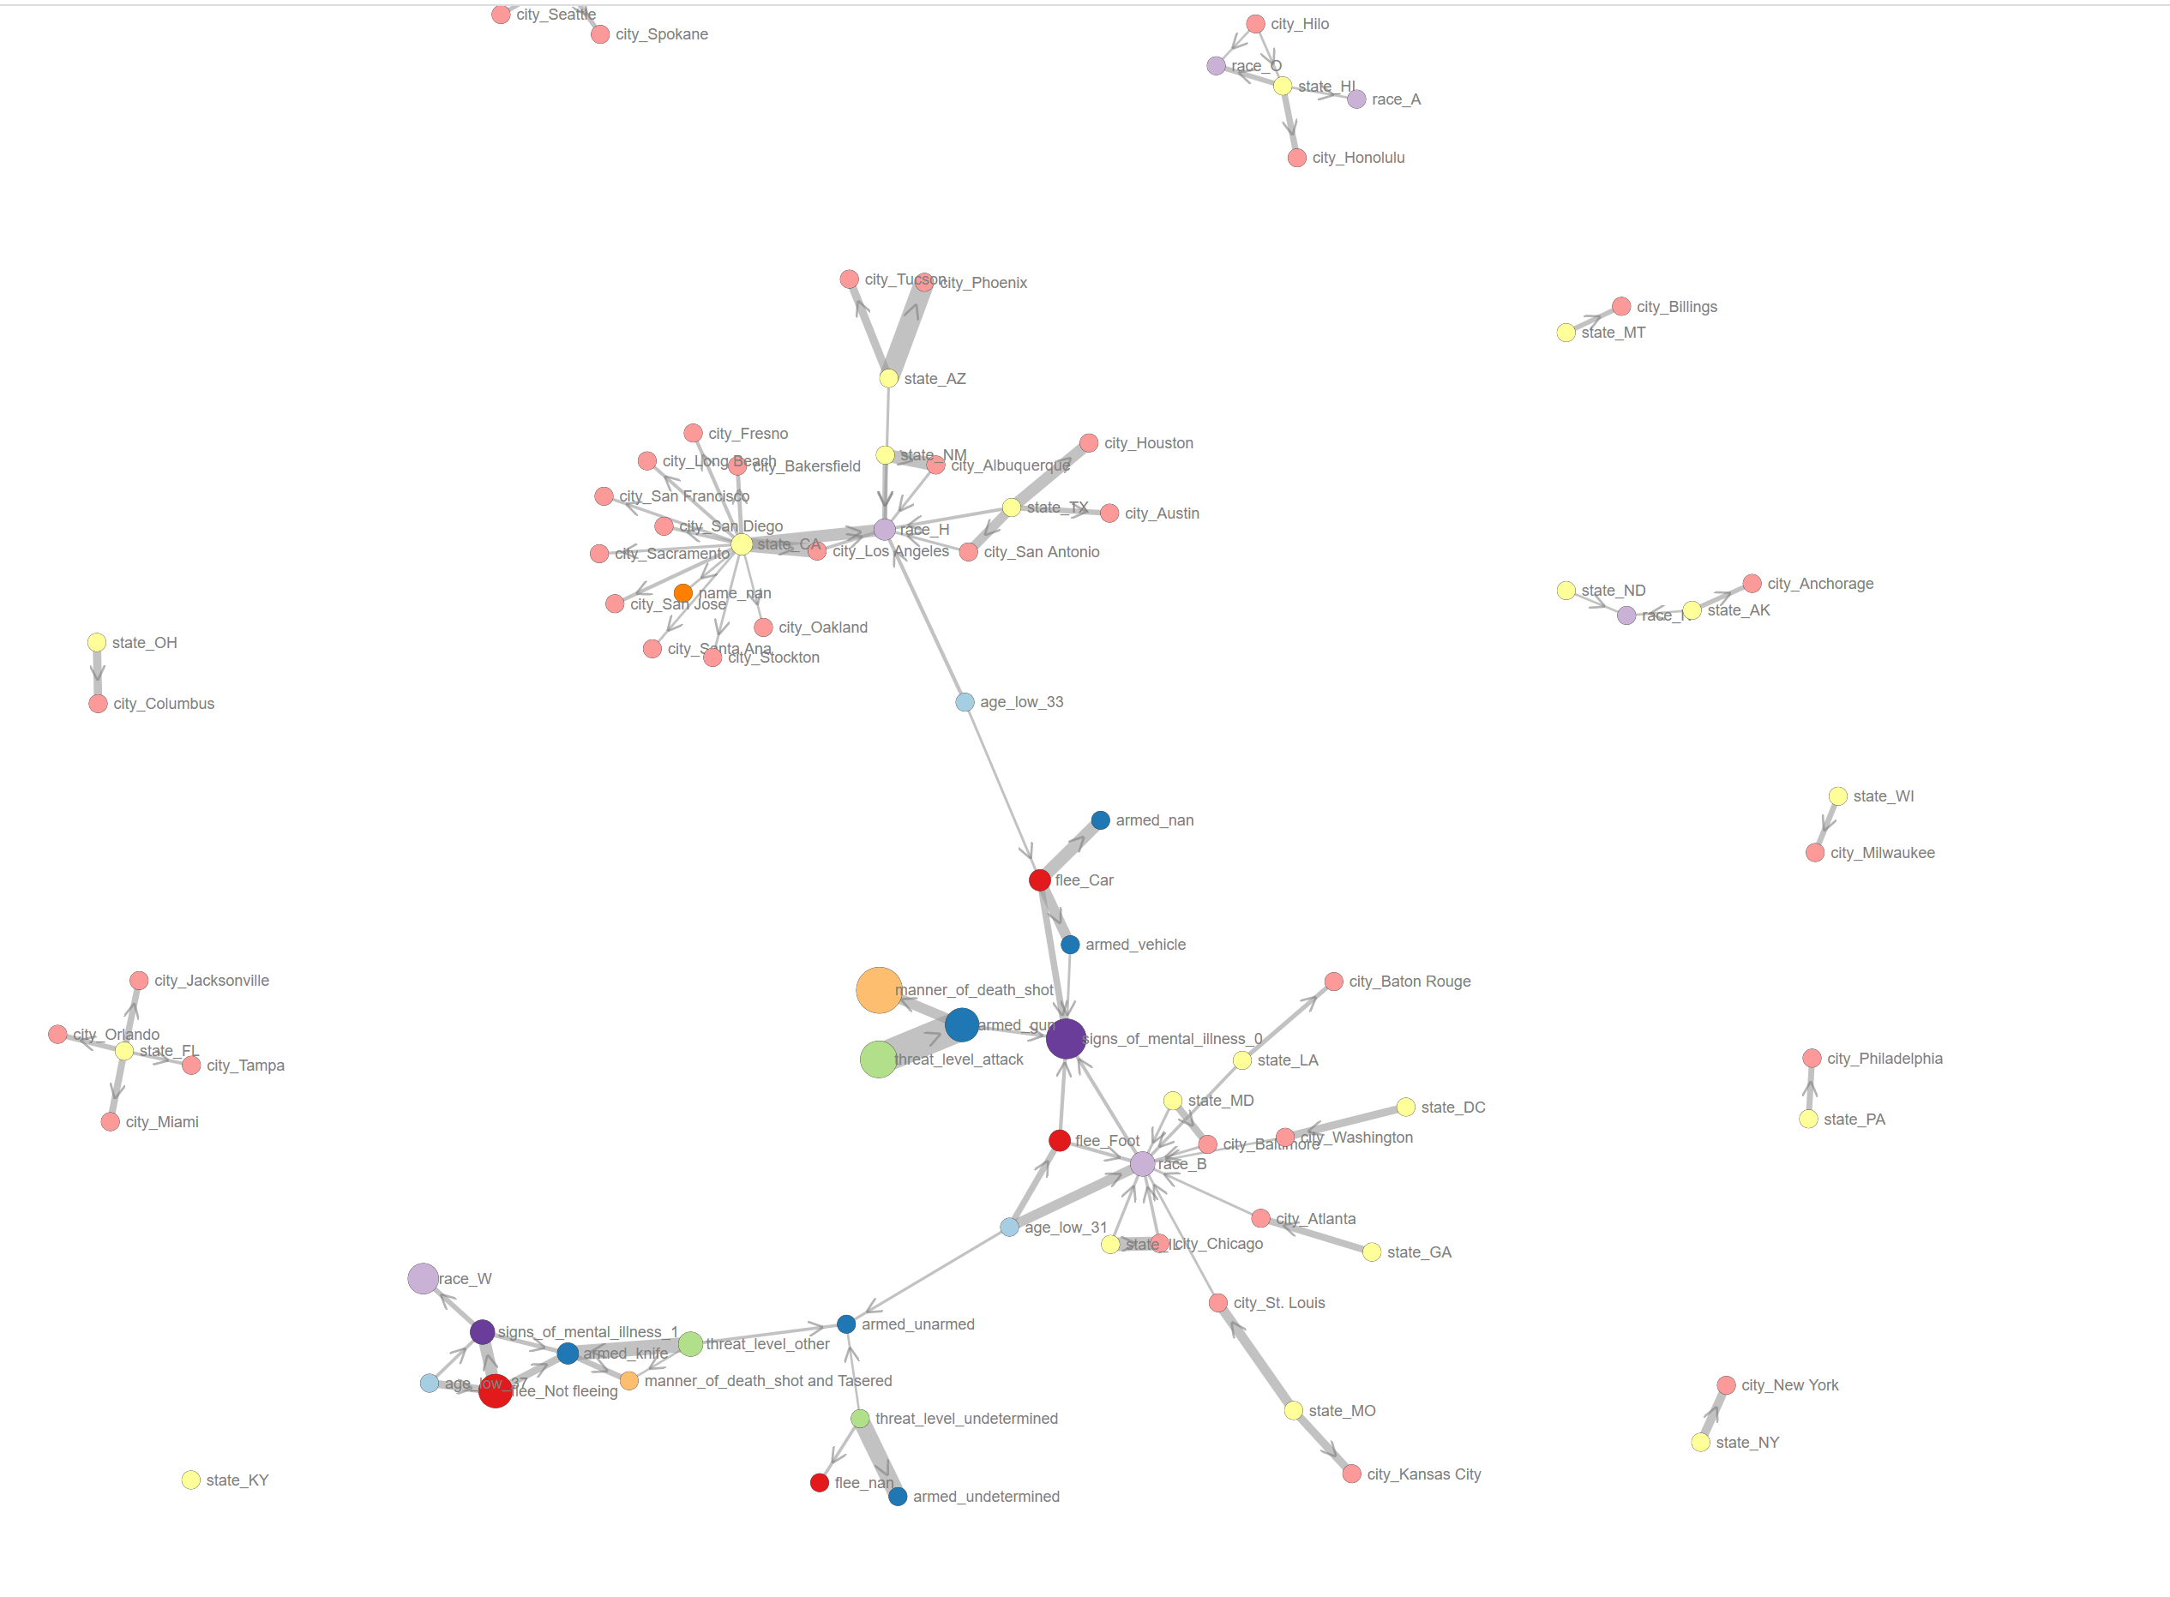
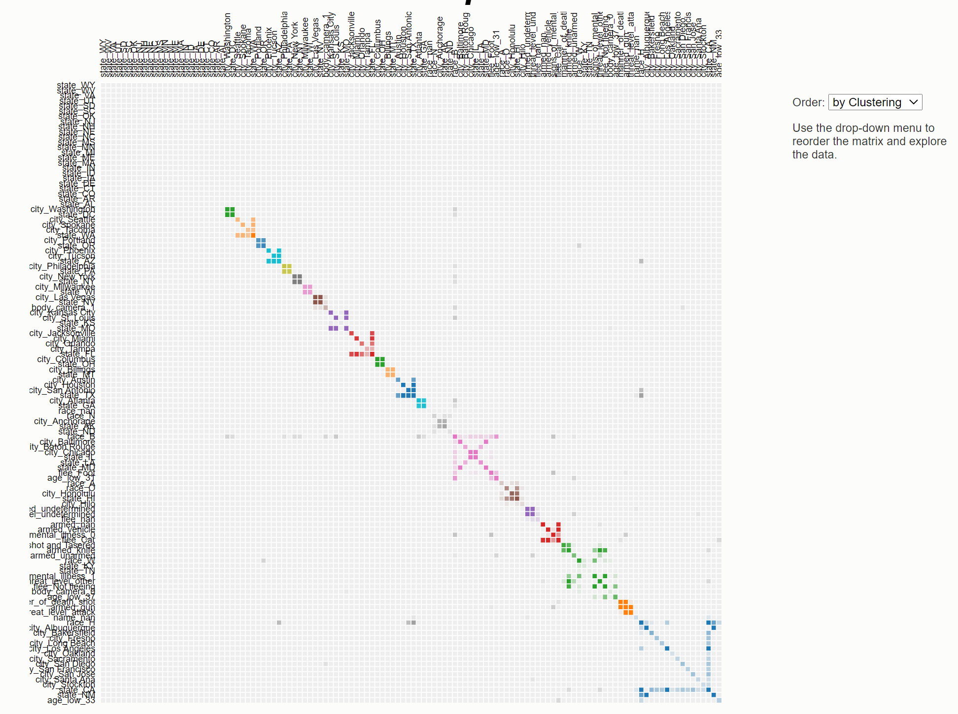
Heatmaps and Network Graphs
Adjacency matrix
Network graphs
Heatmaps
> hn.d3graph()
> hn.d3graph(black_list=[‘city’, ‘state’])
> hn.d3graph(black_list=[‘city’, ‘state’], node_color='cluster’)
> hn.d3heatmap()
> hn.d3heatmap(min_edges=2)

Slide 17
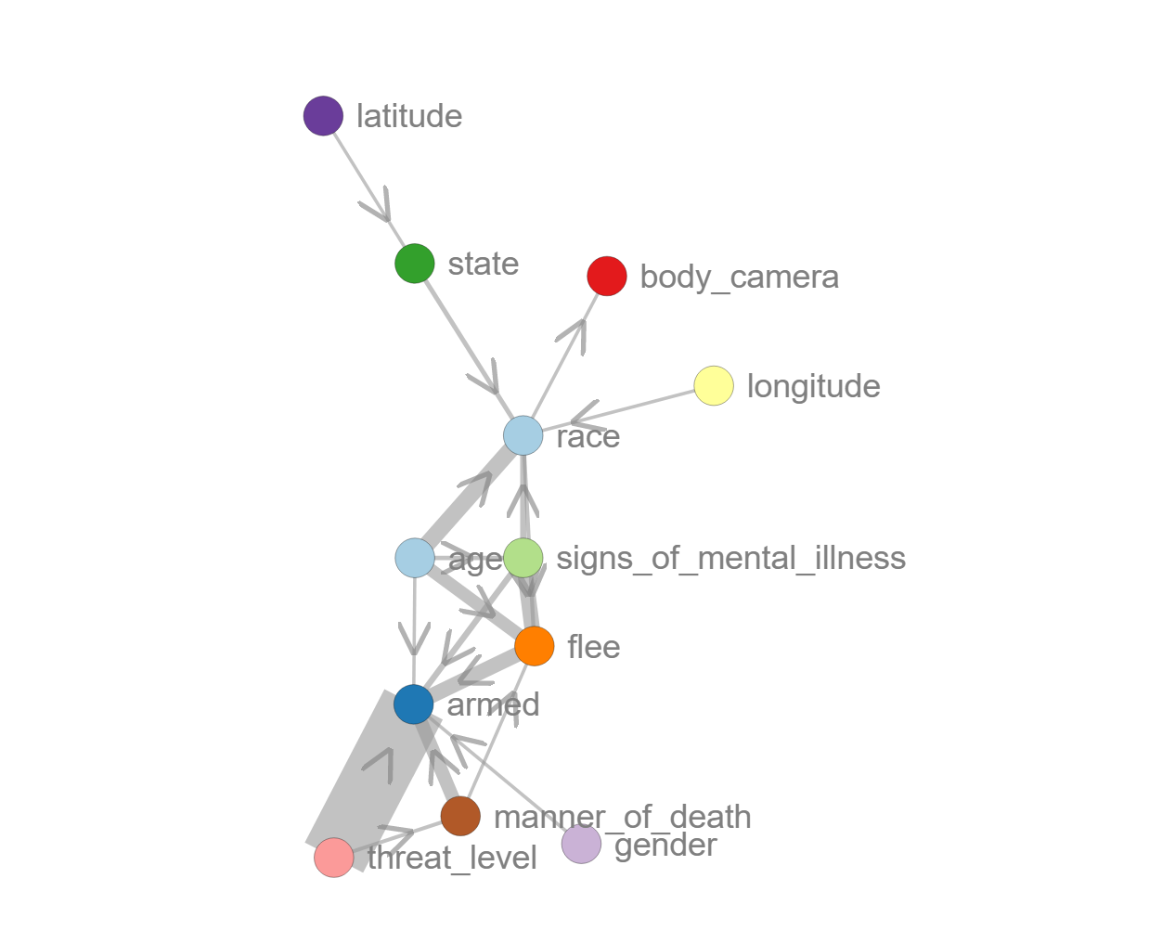
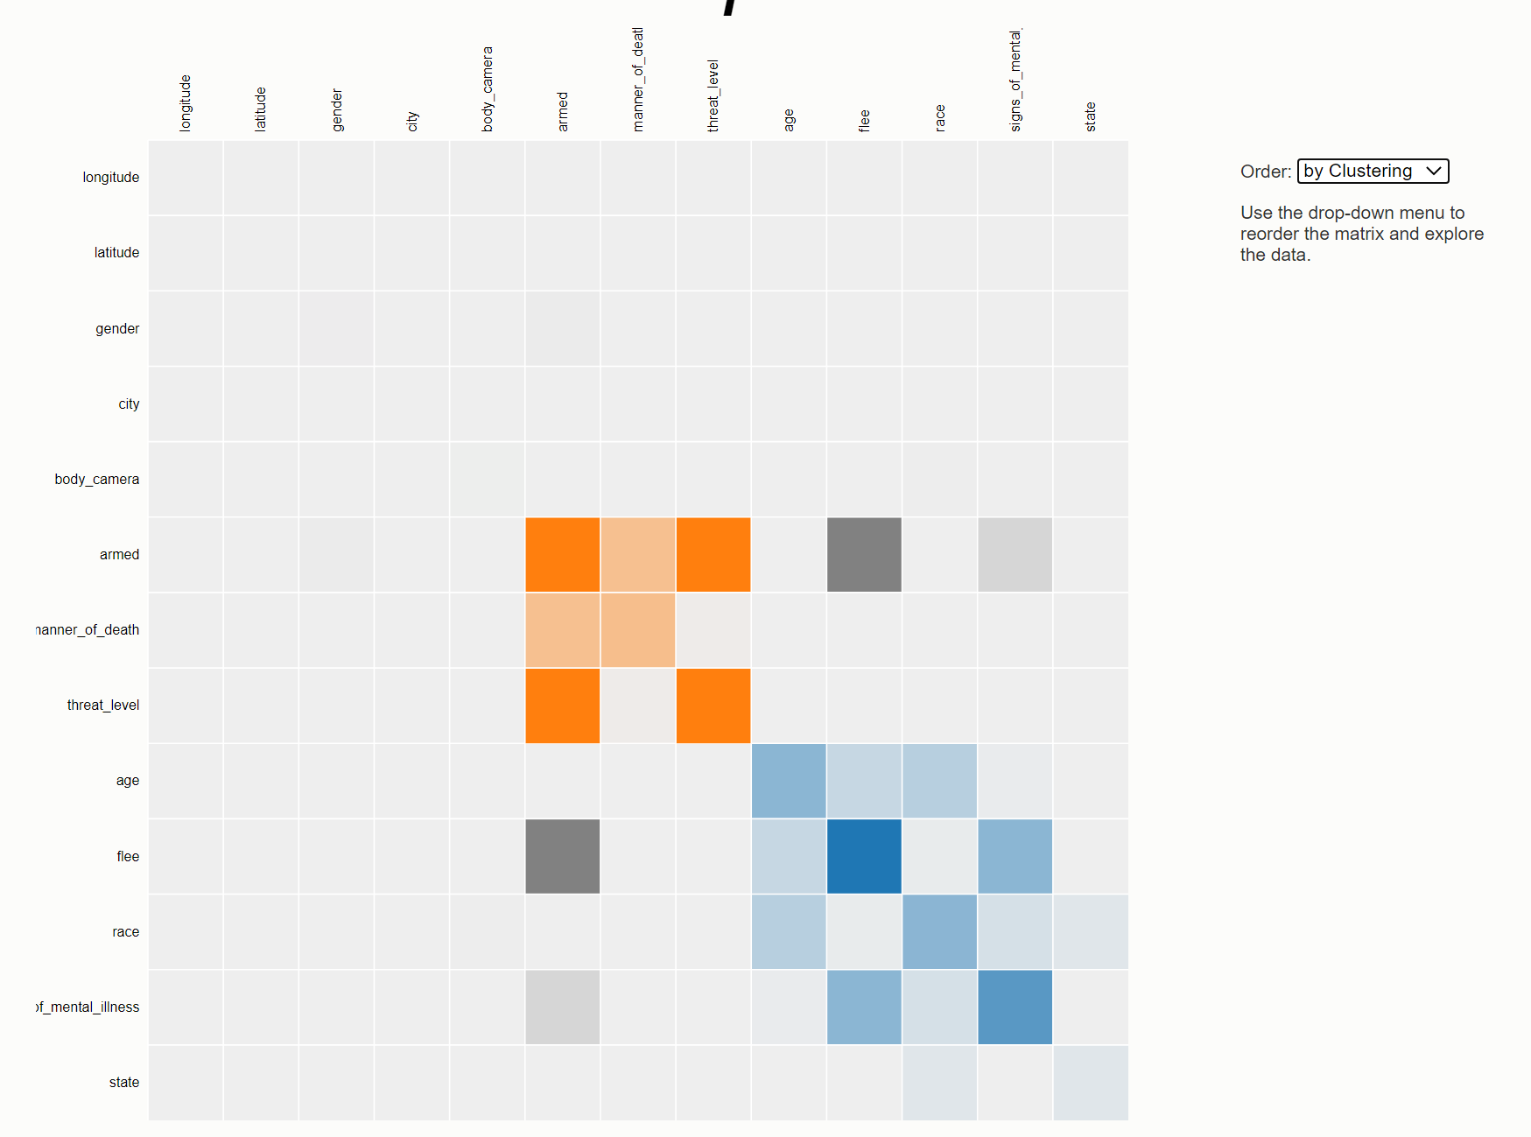
Summarized Heatmaps and Network graphs
> hn.d3graph(summarize=True)
> hn.d3heatmap(summarize=True)

Slide 18
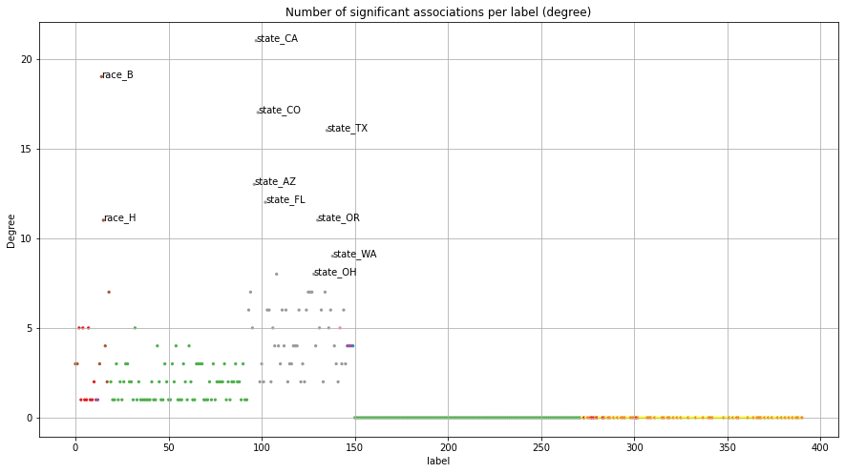
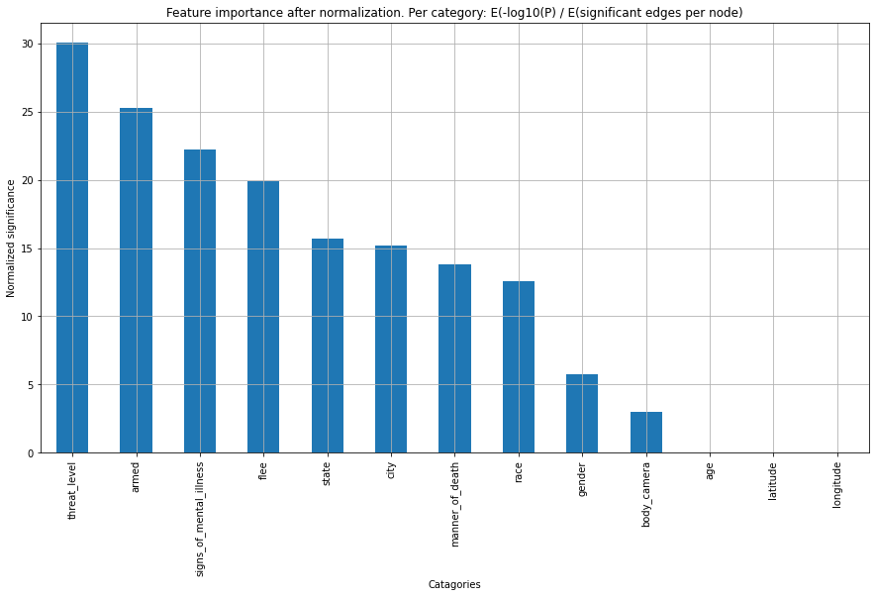
Degree and Feature importance
Degree by significant edges
Feature importance

Slide 19
HNET IN DEPTH

Slide 20







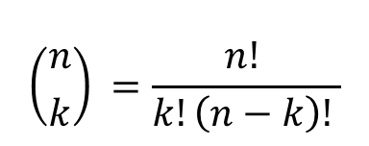




HNET APPROACH (1/3)
[(1, 2),
(1, 3),
(1, 4),
(1, 5),
(1, 6),
(1, 7),
(1, 8),
(1, 9),
(1, 10),
(2, 3),
(2, 4),
(2, 5),
(2, 6),
(2, 7),
(2, 8),
(2, 9),
(2, 10),
(3, 4),
(3, 5),
(3, 6),
(3, 7),
(3, 8),
(3, 9),
(3, 10),
(4, 5),
(4, 6),
(4, 7),
(4, 8),
(4, 9),
(4, 10),
(5, 6),
(5, 7),
(5, 8),
(5, 9),
(5, 10),
(6, 7),
(6, 8),
(6, 9),
(6, 10),
(7, 8),
(7, 9),
(7, 10),
(8, 9),
(8, 10),
(9, 10)]
A
Features
B
Features
C
Features
X_{RAW}
X_{RAW}
X_{numeric}
X_{discrete}
X_{combinations}
Male
Female
by Feet
by Car
Samples
Samples
Samples
1
0
1
0
1
0
1
0
X_{d1}
X_{dN}
X_{c1}
X_{cN}
Samples
0
…
…
1
1
0
Sex
Age
…
…
Flee type
Male
By Feet
Female
By Car
Not used in
combinatory
features
0
1
0
1
X_{d1}
X_{c}
…
X_{dN}
$$\begin{matrix}1 & & \\ 0 & & \\ 0 & & \end{matrix}$$
$$\begin{matrix}1 & .. & \\ 0 & .. & \\ 1 & .. & \end{matrix}$$
$$\begin{matrix}1 & & \\ 0 & & \\ 0 & & \end{matrix}$$
Typing
one-hot
encoding
$$\begin{matrix}1 & .. & \\ 1 & .. & \\ .. & .. & \end{matrix}$$
$$\begin{matrix}0 & & \\ 1 & & \\ .. & & \end{matrix}$$
$$\begin{matrix}0 & & \\ 1 & & \\ .. & & \end{matrix}$$
X_{discrete}
$$Pdc(Xd,Xc)$$
X_{combinations}
X_{d1}
…
X_{dN}
X_{c1}
…
X_{cN}
$$\left({n \atop k}\right) =\frac{n! }{k!\left(n−k\right)! }$$
The order is irrelevant
Unique combinations
Default: k=1
$$\begin{matrix}1 & .. & \\ 0 & .. & \\ 1 & .. & \end{matrix}$$
$$\begin{matrix}1 & & \\ 0 & & \\ 0 & & \end{matrix}$$
X_{d1}
X_{cN}
$$\begin{matrix}1 & .. & \\ 0 & .. & \\ 1 & .. & \end{matrix}$$
$$\begin{matrix}1 & & \\ 0 & & \\ 0 & & \end{matrix}$$
X_{d2}
X_{cN}
$$\begin{matrix}1 & .. & \\ 1 & .. & \\ .. & .. & \end{matrix}$$
$$\begin{matrix}0 & & \\ 1 & & \\ .. & & \end{matrix}$$
$$\begin{matrix}1 & .. & \\ 1 & .. & \\ .. & .. & \end{matrix}$$
$$\begin{matrix}0 & & \\ 1 & & \\ .. & & \end{matrix}$$
X_{d3}
X_{cN}
from itertools import combinations
comb = combinations([1, 2, 3, 4, 5, 6, 7, 8, 9, 10], 2)
list(comb)

Slide 21
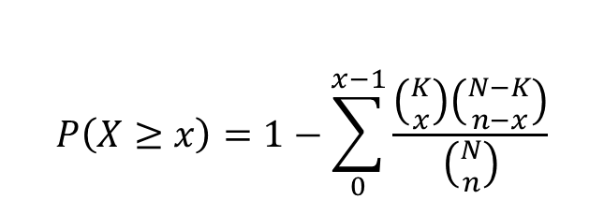
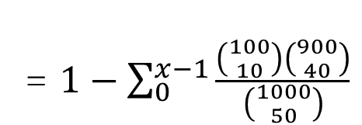
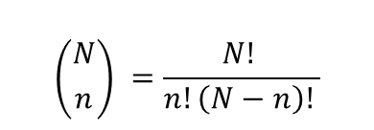

HYPERGEOMETRIC DISTRIBUTION TO TEST FOR ASSOCIATIONS (2/3)
Example
Suppose there are 1000 people in dataset (M), and 100 of them are female (K) and, independently, n=50 did flee by car. What is the probability that at least x=10 females flee by car?
Male
Female
by Feet
by Car
1
0
1
0
1
0
1
0
Null hypothesis: There is no relation between Female and flee by Car.
The probability of observing at least x positive entities in the selection, given,
N is the population size (1000),
K is the number of success states in the population. (100)
n is the sample size/number of draws. (50)
x is the number of successes in sample. (10)
Samples
1
0
1
0
0
1
0
1
P=0.0076
Total number of unique combinations that a female could flee by car
$$P\left(X≥x\right)=1−\sum_{0}^{x−1}{\frac{\left({K \atop x}\right)\left({N−K \atop n−x}\right)}{\left({N \atop n}\right)}}$$
The remaining combinations
x
= $1−\sum_{0}^{x−1}{\frac{\left({100 \atop 10}\right)\left({900 \atop 40}\right)}{\left({1000 \atop 50}\right)}}$
K
n
$$=0.0076$$
N
$$\left({N \atop n}\right) =\frac{N! }{n!\left(N−n\right)! }$$
Total number of unique combinations that anyone could flee by car

Slide 22













HNET APPROACH (3/3)
Sex
Flee type
Multivariate Hypergeometric distribution
Mann-whitney U test for quantitative values
$$Xd$$
Female
By Feet
By Car
Male
$$Pdc\left(Xd,Xc\right)$$
Male
x
v
v
Female
x
v
0.0076
$${Padj}^{∗}=Multiple Testing\left(Padj\right)$$
FWER, FDR (default: Holm)
By Feet
v
v
x
$$nodesize=\frac{1}{N}\sum_{d=1}^{N}{\left(X_{d}\right)}$$
$${edgeweight}^{}=−log10\left({Padj}^{∗}\right)$$
i
j
By car
v
v
x
X_{discrete}
$$Pdc(Xd,Xc)$$
X_{combinatory}
$$Pn(XcN, \sim XcN)$$
X_{numeric}
X_{d1}
…
X_{dN}
X_{c1}
…
X_{cN}
X_{n1}
…
X_{nN}
$$\begin{matrix}1 & .. & \\ 0 & .. & \\ 1 & .. & \end{matrix}$$
$$\begin{matrix}1 & & \\ 0 & & \\ 0 & & \end{matrix}$$
X_{d1}
X_{cN}
$$\begin{matrix}1 & .. & \\ 0 & .. & \\ 1 & .. & \end{matrix}$$
$$\begin{matrix}1 & & \\ 0 & & \\ 0 & & \end{matrix}$$
X_{c1}
~X_{c1}
$$P_{adj}^{∗}$$
f1
…
f_{N}
$$\begin{matrix}5.1 & .. & \\ 6.3 & .. & \\ 2.0 & .. & \end{matrix}$$
$$\begin{matrix}1.4 & & \\ 0.7 & & \\ 4.3 & & \end{matrix}$$
Xni
f1
$$\begin{matrix} & .. & .. \\ .. & & .. \\ .. & .. & \end{matrix}$$
X_{d2}
X_{cN}
X_{c2}
~X_{c2}
…
$$\begin{matrix}1 & .. & \\ 1 & .. & \\ .. & .. & \end{matrix}$$
$$\begin{matrix}0 & & \\ 1 & & \\ .. & & \end{matrix}$$
$$\begin{matrix}1 & .. & \\ 1 & .. & \\ .. & .. & \end{matrix}$$
$$\begin{matrix}0 & & \\ 1 & & \\ .. & & \end{matrix}$$
$$\begin{matrix}1.9 & .. & \\ 4.8 & .. & \\ .. & .. & \end{matrix}$$
$$\begin{matrix}2.2 & & \\ 5.3 & & \\ .. & & \end{matrix}$$
f_{N}
X_{cN}
~X_{cN}
X_{d3}
X_{cN}
Xnj
Notes:
To assess significance across the numeric features (Xn) in relation to the dense matrix (Xc) we utilized the Mann-Whitney U test. Each numeric vector Xn, is split on discrete feature Xc versus ~Xc, and then tested for significance.
All tested edge probabilities between pairs of vertices, either discrete-dis-crete or discrete-numeric, are stored in an adjacency matrix (Padj), and are corrected for multiple testing.

Slide 23
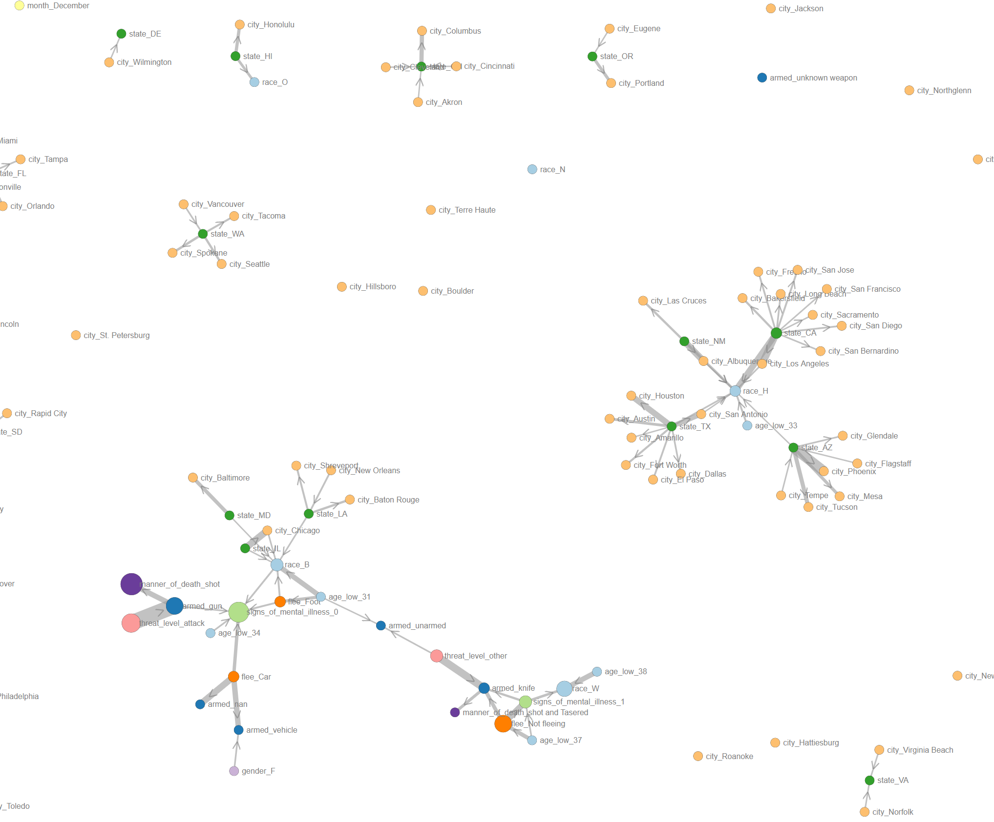
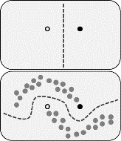


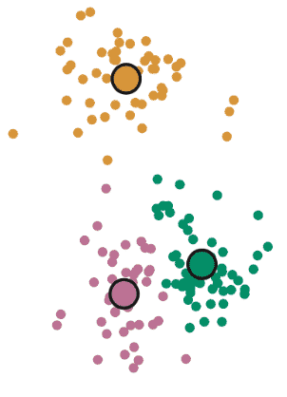
--I have spoken--
--This is the way--
Data specialist
Customer
Some features are known to be associated with others.
Some features may show new associations with others.
Insights can help to refine the project goals, and modeling.

Slide 24
BUILDING BLOCKS OF HNET

Slide 25
HNET IS BUILD ON INDEPENDENT BUILDING BLOCKS
df2onehot * imagesc
classeval * d3graph
pypickle * d3heatmap
HNet
df2onehot
Auto-typing
Cleaning
Deep extract (dicts and lists in lists)
One-hot encoding
Pre-processing
Force columns (int or float) to be numerical based on specified percentage. (default=0.8)
Columns are retained if minimal #samples (default=10)
Allows to exclude “background”
Data

Slide 26
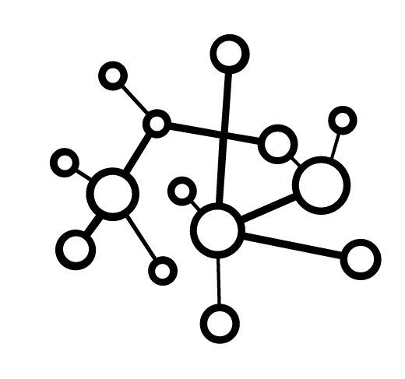

HNET IS BUILD ON INDEPENDENT BUILDING BLOCKS
df2onehot * imagesc
classeval * d3graph
pypickle * d3heatmap
Auto-typing
Cleaning
Deep extract
One-hot encoding
HNet
df2onehot
d3js
HTML graph
Association learning
classeval
Data
Network analysis
d3graph
Static plot
d3heatmap
Pypickle
Dynamic plot
imagesc

Slide 27
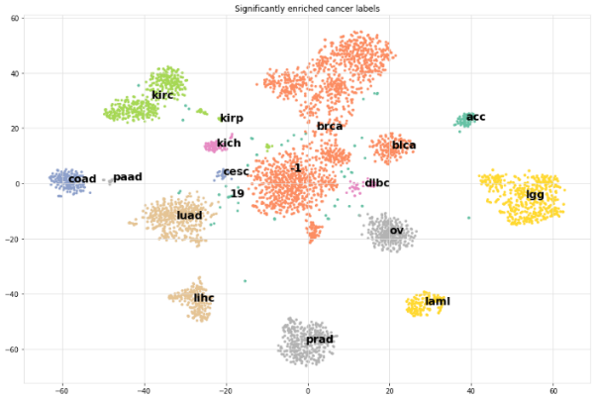
APPLICATIONS
Web usage mining, intrusion detection, marketing. Any categorical/mixed dataset.
To explore and understand the complex associations between your variables.
HNet contains example datasets to play with: Titanic, Student, Fifa, Cancer, Waterpump, Retail
To transform your feature space for further analysis.
Dissimilarity matrix (set alpha=1 in HNet)
Network graph
To explain your clusters by enrichment of the meta-data.
 | category_label | logP | popsize_M | nr_succes_pop_n | samplesize_N | dtype | y | Padj
0 | acc | 71 | 4674 | 77 | 72 | categorical | 0 | 5.15692e-151
1 | dlbc | 24 | 4674 | 27 | 48 | categorical | 1 | 1.29572e-48
2 | kirc | 218 | 4674 | 259 | 398 | categorical | 10 | 1.94633e-216
3 | kirp | 177 | 4674 | 219 | 398 | categorical | 10 | 8.65091e-164
4 | kirc | 15 | 4674 | 259 | 17 | categorical | 11 | 3.24308e-17
5 | kirp | 18 | 4674 | 219 | 26 | categorical | 12 | 5.04005e-18

Slide 28
CONCLUSIONS
HNet learns the association from datasets with mixed datatypes and with unknown function.
For the detection of univariate or multivariate associations, not causality.
Insights can help to understand the feature-relationships, refine the project goals, and modeling
HNet is build on independent libraries (df2onehot, pypickle, classeval, ismember, d3heatmap, d3graph, imagesc)
All libraries are written in Python with pep8 styling, numpy docstrings, unit tests, and sphinx pages.
Future work:
Implementation to store in data in sparse format
Implementation to run on multiple cores
More details can be found in the paper on arXiv: https://arxiv.org/abs/2005.04679
Contributions are welcome: github/erdogant/hnet

Slide 29
Fin
Photo by Alexander Andrews on Unsplash

