Slide 1
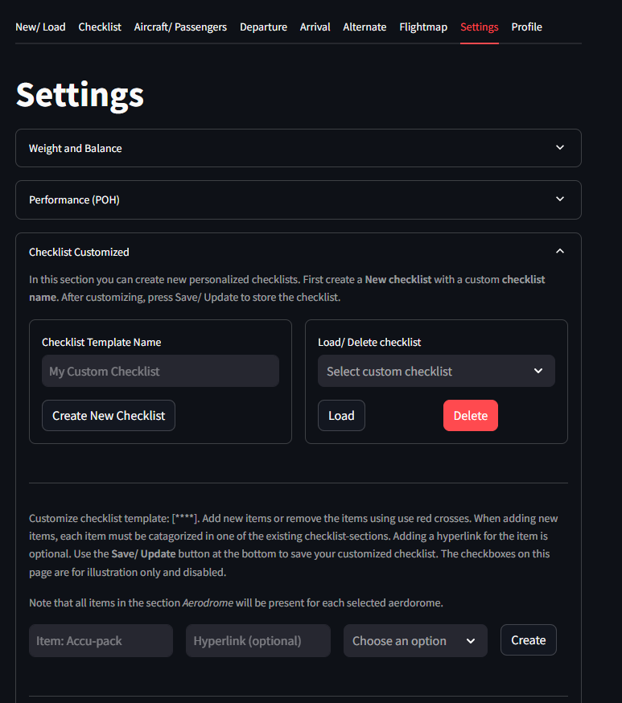
How checklist templates work: CREATE NEW CHECKLIST TEMPLATE
Set the new checklist template name.
Checklist template name can not be empty
Load default checklist dictionary
Aerodromes are loaded (based on user selection) but never stored in the template
Nothing is stored to users flightplan.

Slide 2
How checklist templates work: LOAD/ DELETE
Only users checklists are shown in the selectionbox
Load selected checklist template
Set the template name and items
The aerodromes in the template are empty but for loading we include them for illustration purposes only.
Nothing is stored to the flightplan
Deletes the template from disk or firestore.
This action can not be undone.

Slide 3
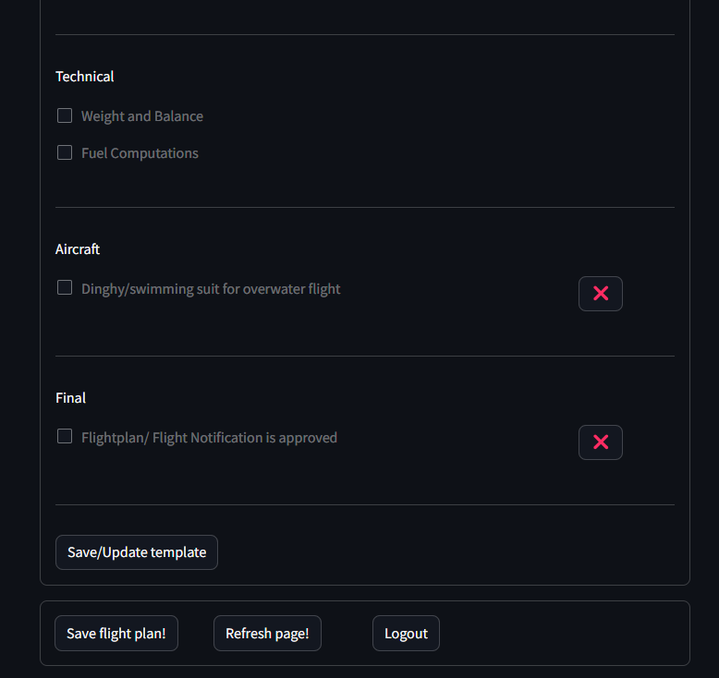
SAVE/UPDATE
Requires to first create new checklist template: Create new checklist
All customized items are stored
No specific aerodrome information is stored in the template.
Stored in firestore or dump to disk
Nothing is stored to users flightplan.

