Slide 1

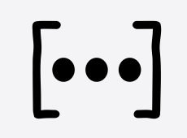

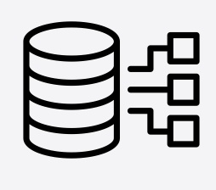
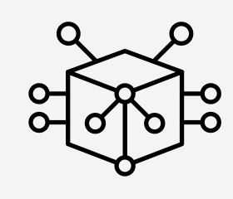
Dataframes
st.cache_data
Anything your can store in database
Variables, vectors and arrays
API calls
st.cache_resource
Database connections
Anything your can not store in database
Machine Learning Models

