Slide 1
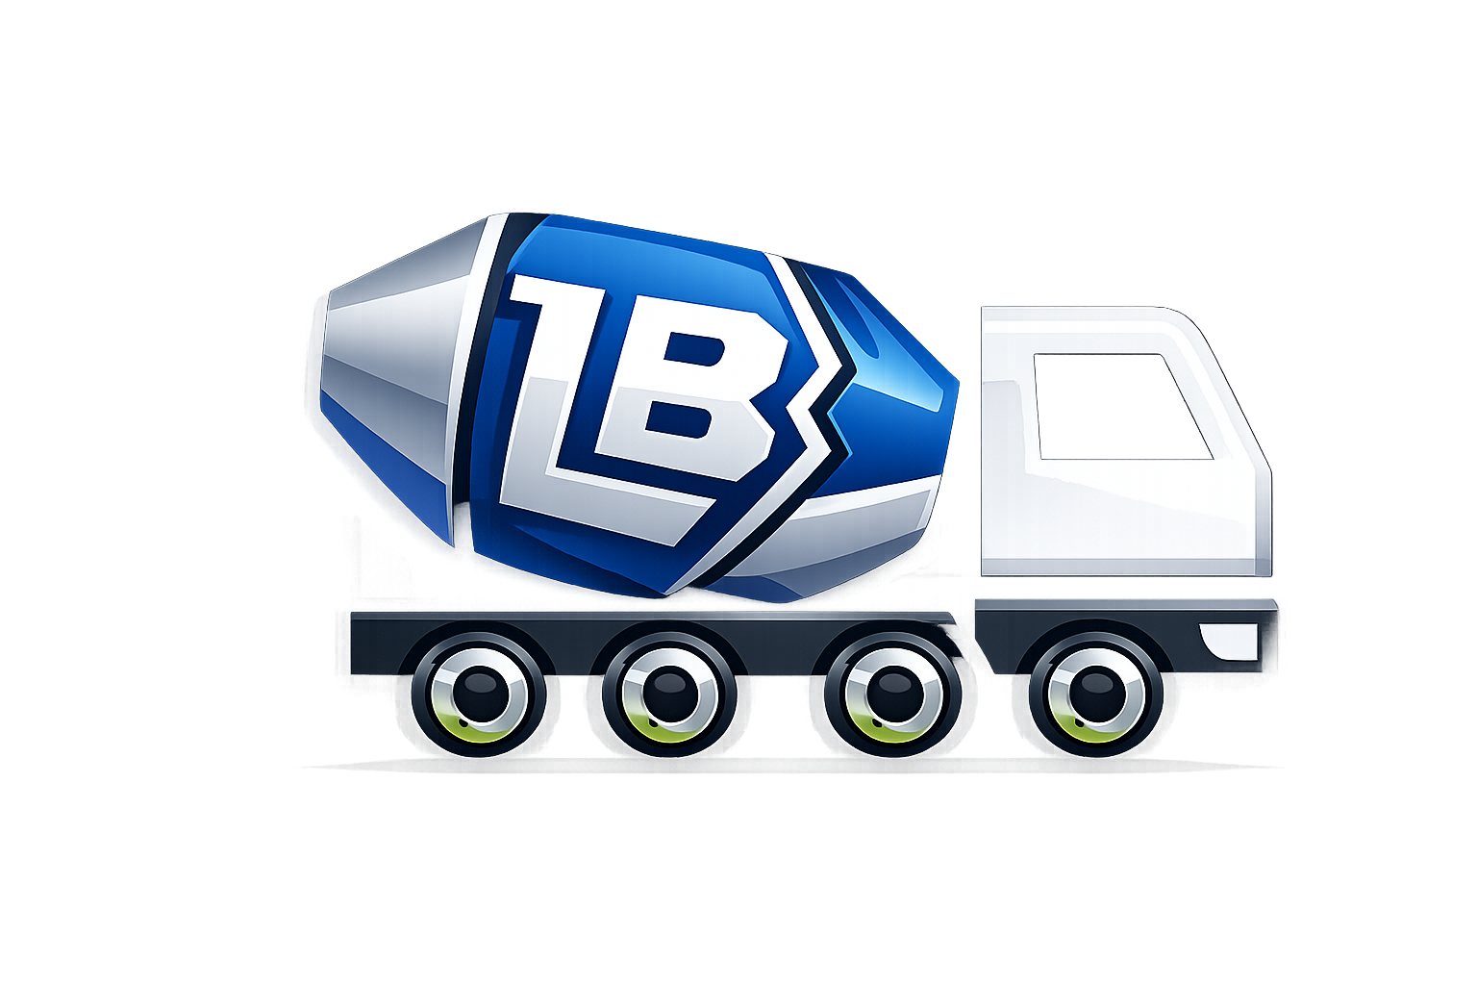
Betonlogisztika
Made by: Sebestyén Fáró, Zsombor Erdősi

Slide 2

Introduction
The idea
Goal of the webapp
Notes:
1. My dad has a business that deals with concrete delivery, and that's why we chose concrete delivery as our topic. Our web application will hopefully be used in the near future to help with the concrete ordering process.
2. The purpose of the web application is to enable all important processes related to concrete ordering to be carried out on an online platform, from registration to order tracking.

Slide 3
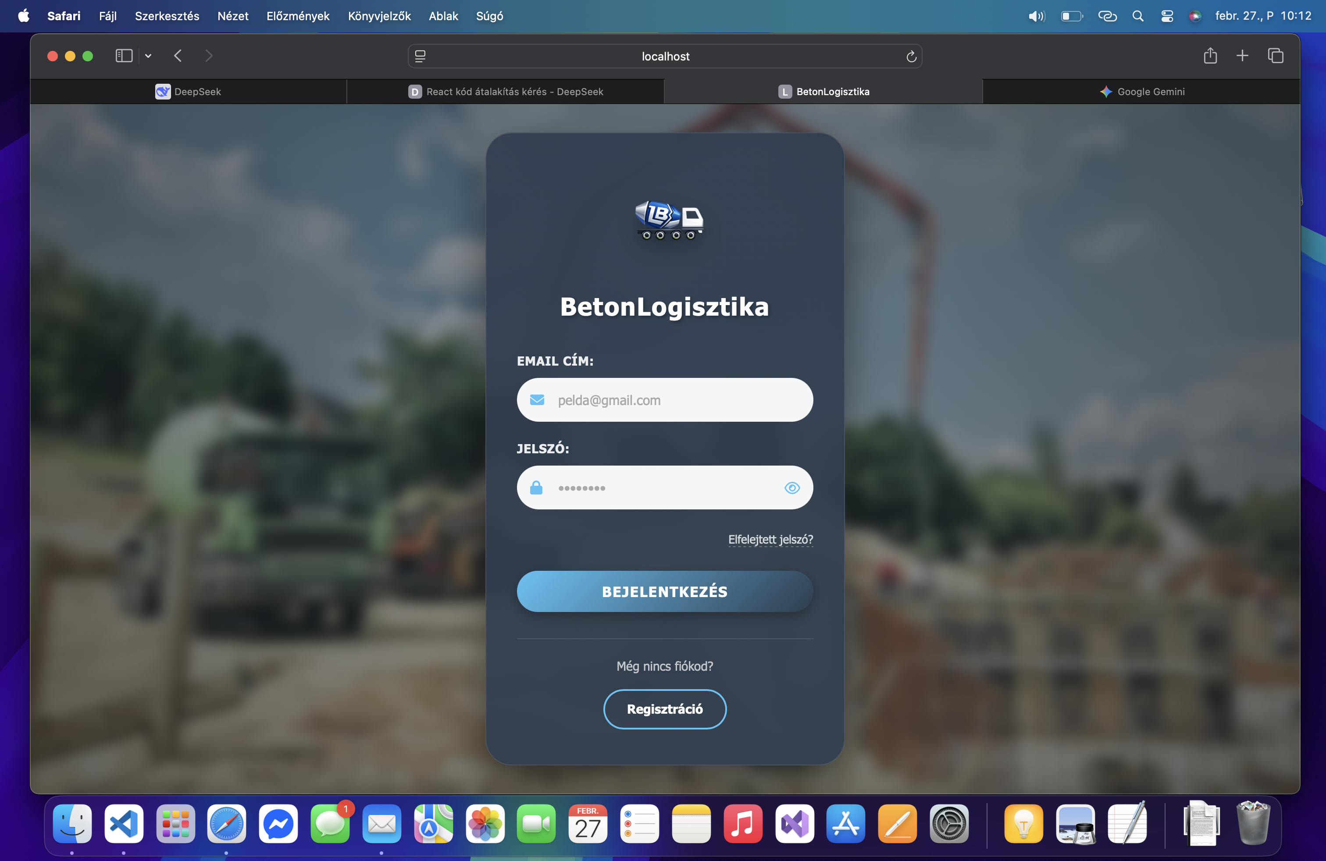
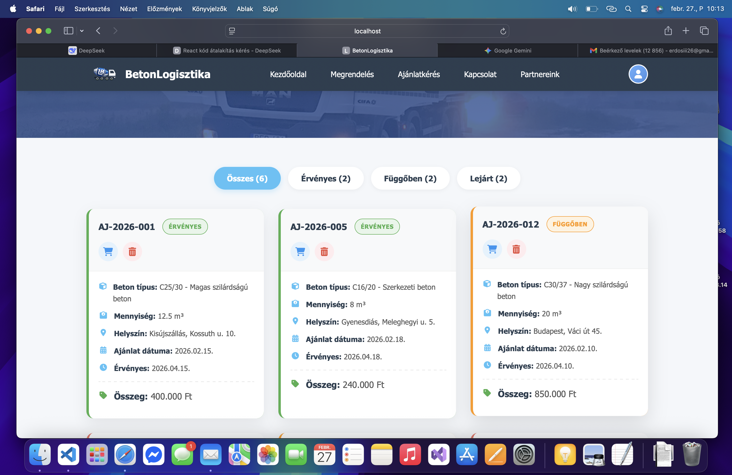
User interface
Login/registration
Home
Request for proposals/Order
Connection
Partners
Notes:
1. After logging in/registering, the user arrives at a home page where they can find information about the business and ask us questions if something is unclear.
In addition, in separate menu items, the customer can request a quote, place an order, contact us, and see what partners we have, located on a map.
2. As soon as someone takes a request for proposals, we (the admin) will be able to see the proposal, after that we can accept , or even denie the request if it’s impossible to carry out.

Slide 4

Used programs
Microsoft Office
GitHub
Visual Studio Code
Docker Desktop
Notes:
Word – Powerpoint – These applications were of great help in creating the document, as we both have ICDL certificates, so we were able to use them with sufficient knowledge and experience.
The main program, this is what we used the most, when we finished our work, we just uploaded it and both of us saw it. This application was indispensable.
We think this is the best development app, we found our bugs easily, thanks to this we were able to work faster.
Docker made it possible to run our frontend, backend, and database workloads simultaneously.

Slide 5
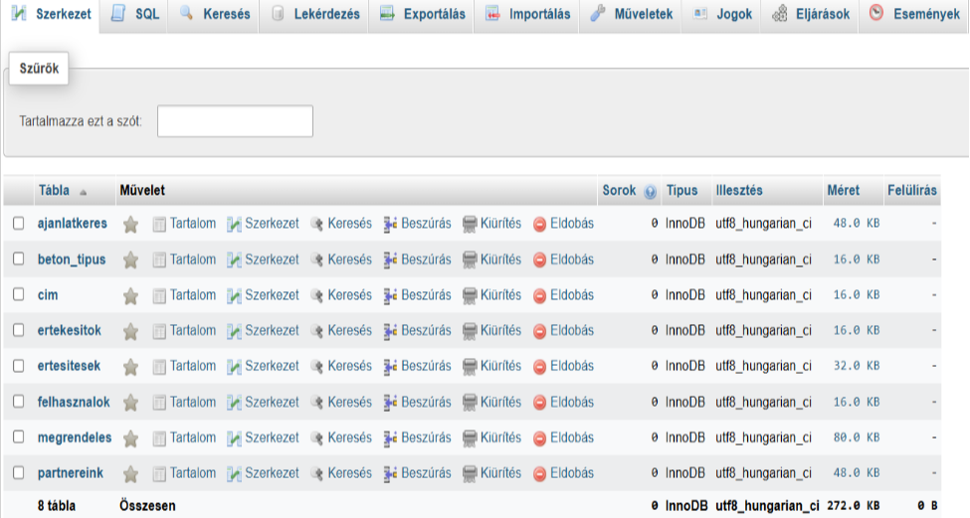
Database structure
Request for quotation
Concrete type
Address
Sales
Notifications
Users
Order
Our partners
Notes:
1. Our database was essential in the creation of our project, as it ensured the structured storage and management of data. With its help, information could be easily accessed, modified and queried, which contributed to the reliable operation of the system. The proper structure of the database provided a basis for the efficient development and testing of the software. While designing our final database, we encountered many problems, so it required continuous development.

Slide 6

Thank you for your attantion!

