Slide 1
Independent Domestication of Two Old World Cotton Species
Original paper by:
Simon Renny-Byfield
Justin T. Page
Joshua A. Udall
William S. Sanders
Daniel G. Peterson
Mark A. Arick, II
Corrinne E. Grover
Jonathan F. Wendel
Re-documented by Justin Conover, Ching-Yi Liao, and Emma Miller

Slide 2
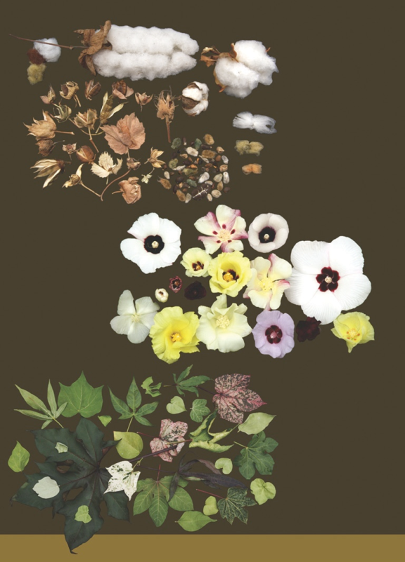
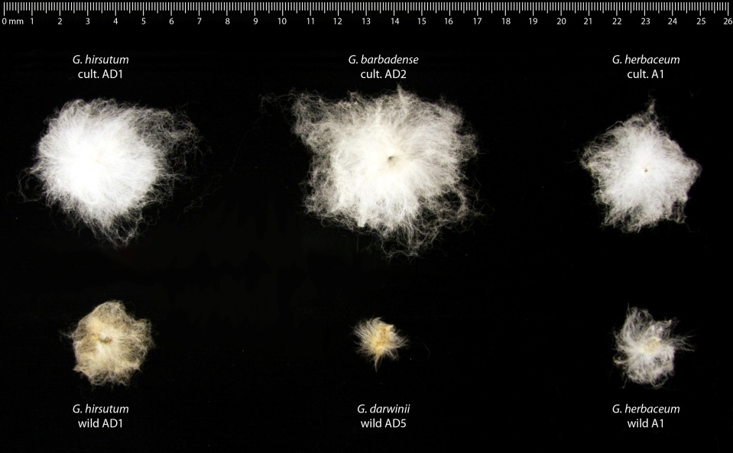
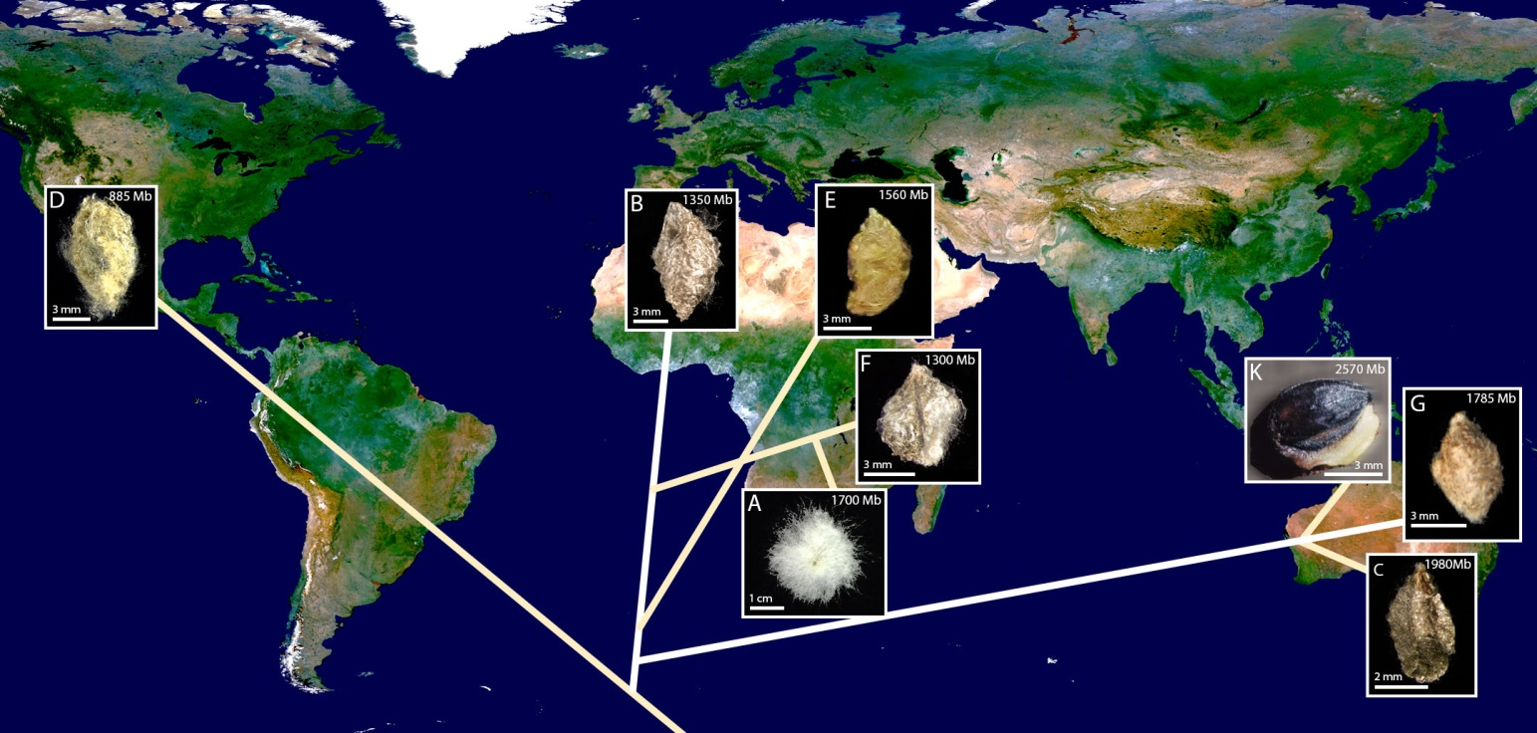
Cotton: Diversity and Domestication
N =13
Transoceanic voyages
Multiple domestications
* There is no wild form of A2
Notes:
Difficult to determine ancestral forms, vastly different from their domesticated relatives
A2 has no wild form that is known, maybe these accessions are more A1 than than their own branch

Slide 3
Hypotheses
G. arboreum is derived from G. herbaceum and are therefore not two distinct species
G. arboreum and G. herbaceum evolved separately prior to domestication
Possible that wild ancestors disappeared due to introgression

Slide 4
Constructing Clusters
RepeatExplorer
Reads grouped together by similar sequences/graph based algorithm
RepeatMasker annotated clusters
Calculated read counts per sample
Look at frequencies of different repeat clusters per species
**** Include figure 2 here

Slide 5
Cluster Abundance
Largest 1000 clusters from all three species
Not able to use the contrast package used by original author.
Built in GLM function produced similar answer.
**** Include figure 3 here

Slide 6
Hierarchical Clustering
Plot clusters in two dimensional space based on repeat content per sample and euclidean distance
*** Include Figure 4 here

