Slide 1
Professor AI
By Yalda Ahmadi, Fabio Tommaselli, Ionut Ovidiu Vrabie

Slide 2
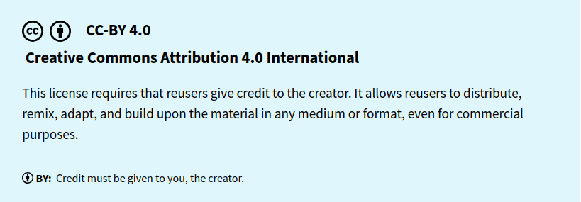

Slide 3
MENU OF TODAY
Introduction
Our Topic
AI vs Professor
Professor with AI
Conclusion

Slide 4
Introduction
Can Artificial Intelligence effectively replace or complement a human professor in teaching technical subjects?

Slide 5
Decoder and Encoder , VHDL coding
We began by comparing two AI models, asking them the exact same three questions. This allowed us to understand the extent to which AI could handle the task on its own, and where human input was still necessary. Specifically, our topics included encoders, decoders, and their implementation in VHDL.

Slide 6
AI vs Professor
AI
Professor
AI often uses real-world examples to make concepts more engaging.
AI provides fast answers and saves users from wasting time on irrelevant information.
AI is available anytime, unlike tutors or professors who have limited schedules, may charge fees, and can face communication barriers.
AI is inclusive, tailoring content for learning disorders and simplifying topics with clear explanations and custom study materials.
The experience that a human being can share can never truly be replicated by a machine.
The professor can sometimes better understand the difficulties students may face before teaching the topics and adjust the lesson accordingly.

Slide 7
What about AI weakness?
AI doesn’t create final products on its own; human input is still needed to turn its clear, structured responses into complete presentations or notes.
AI still struggles with complex problems and needs user guidance; final results often require user refinement.
AI can sometimes create a false sense of possibility, suggesting unrealistic solutions and reinforcing user bias instead of offering the critical feedback found in human interaction.
Because people often seek shortcuts, overreliance on AI can lead to misuse in contexts like exams or interviews, ultimately hindering personal growth and skill development.

Slide 8
What About Both?
Professor + AI

Slide 9
Conclusion

