Slide 1
IPL DATA ANALYSIS
Presented by:- Dyutimaya Das

Slide 2
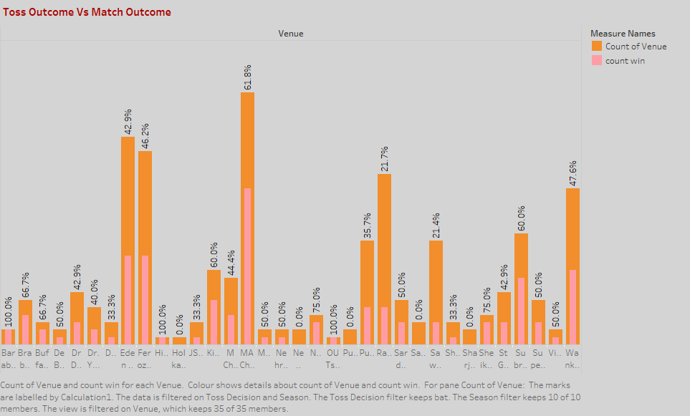
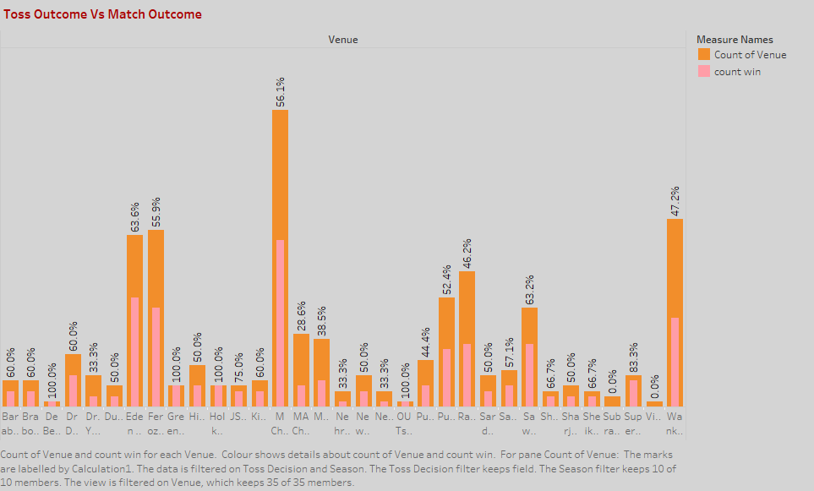
Toss Outcome Vs Match Outcome
Matches Played in a stadium and win percentage on that stadium when Toss decision was Bat .
Matches Played in a stadium and win percentage on that stadium when Toss decision was Field .

Slide 3
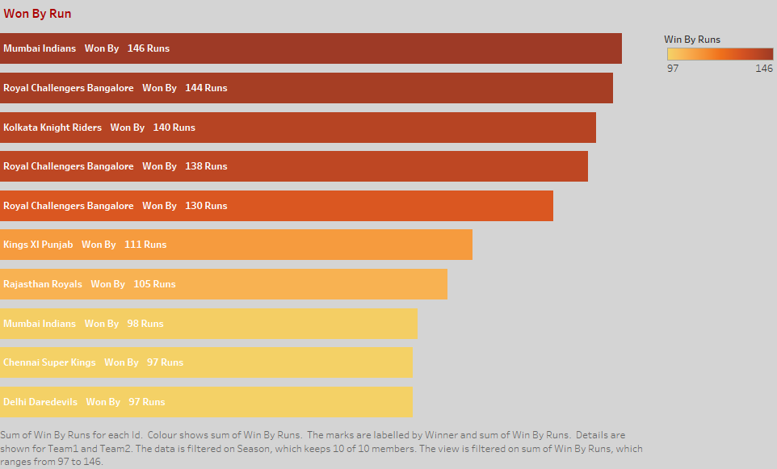
WON BY RUN
All teams those who are won matches by highest run against the opponents .

Slide 4
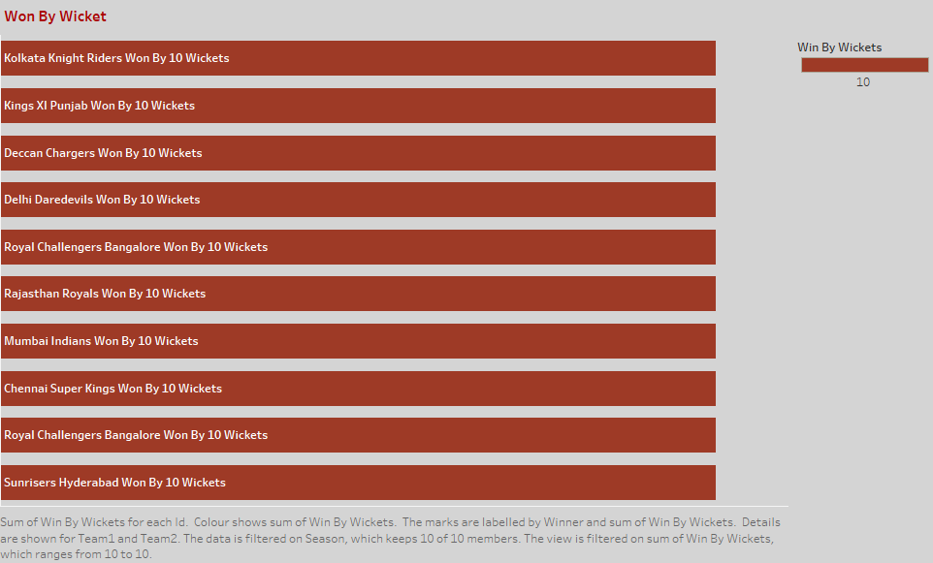
WON BY WICKETS
All teams those who are won matches by highest number of wickets against the opponents .

Slide 5
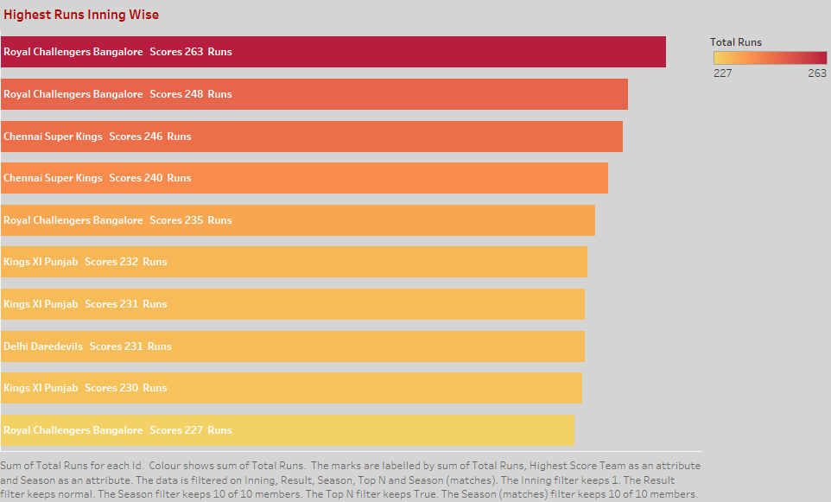
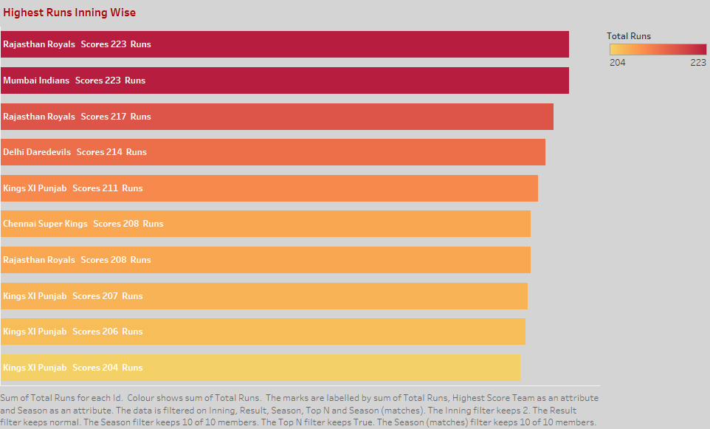
Highest Runs By Innings
Top-10 teams those who are scores highest in innings -1
Royal Challengers Bangalore Scores Highest 263 run in 1st innings
Top-10 teams those who are scores highest in innings -2
Rajasthan Royals Scores Highest 223 run in 2nd innings

Slide 6
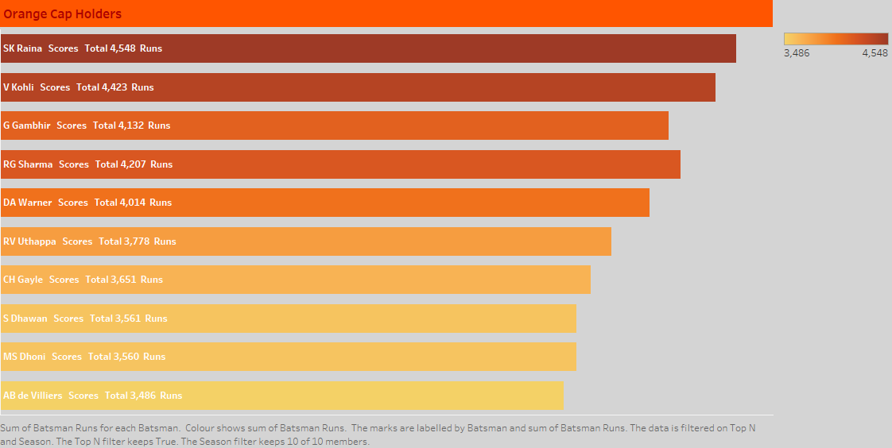
Orange Cap Holders
Top 10 bats man who scores highest and orange cap holder in seasons.
Raina Scores highest among all the batsman's who is belongs to Chennai super kings

Slide 7
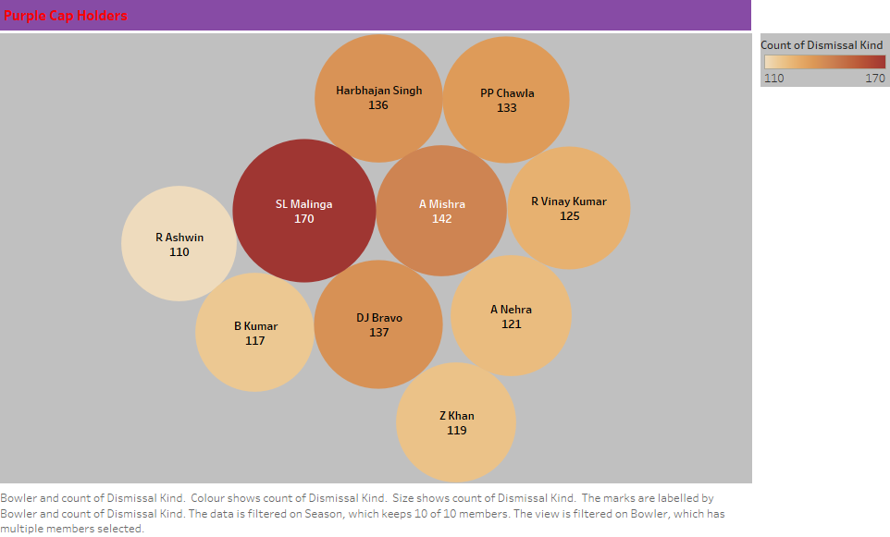
Purple Cap Holder
Top 10 bowlers who took most number of wickets in all seasons and purple cap holder.
SL Malinga took highest number of wickets in total across all seasons

Slide 8
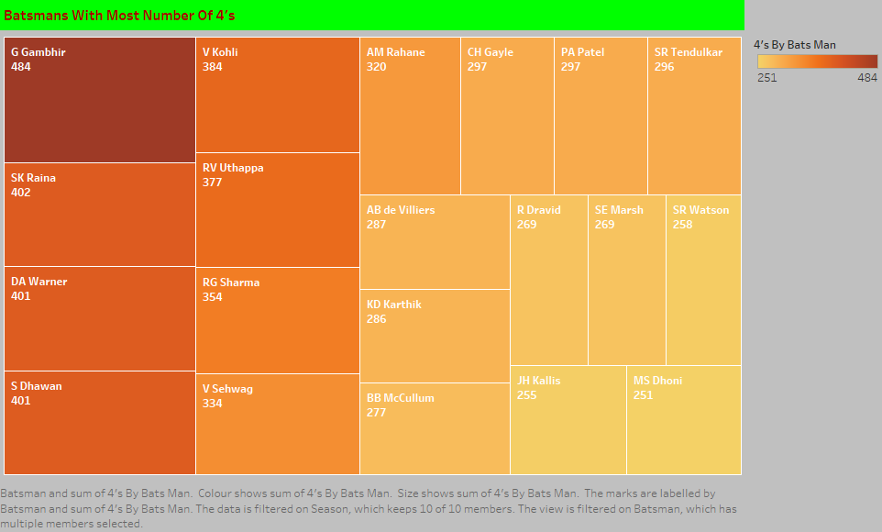
Bats Man With Most No. Of 4’s
Top 20 bats man who scores most number of 4’s across all seasons.
G Gambhir hits most number of 4’s in IPL across all seasons.

Slide 9
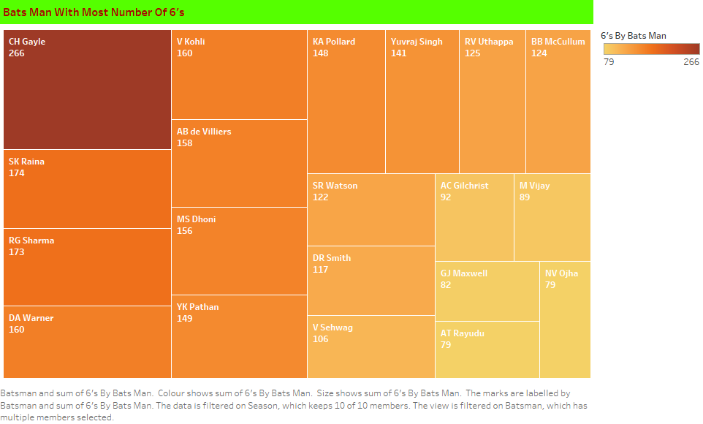
Bats Man With Most No. Of 6’s
Top 20 bats man who scores most number of 6’s across all seasons.
CH Gayle hits most number of 6’s in IPL across all seasons.

Slide 10
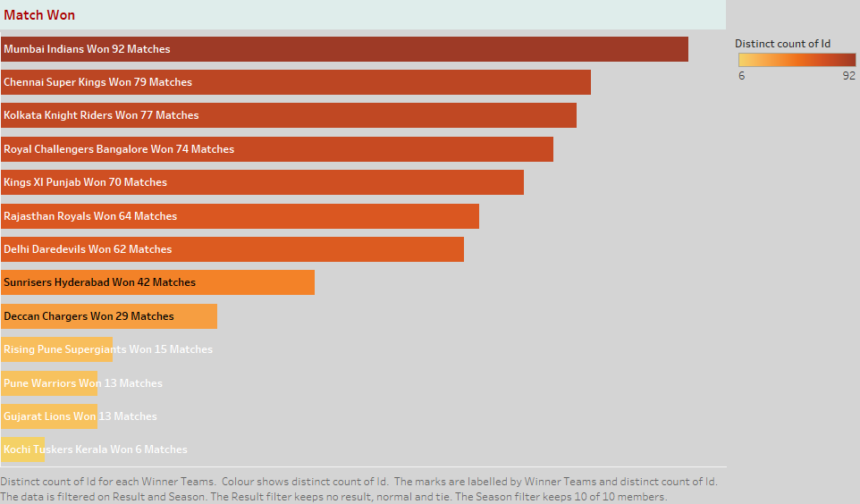
Match Won Total
Teams those who are won highest matches across all seasons .
Mumbai Indian won highest number of matches across all seasons

Slide 11
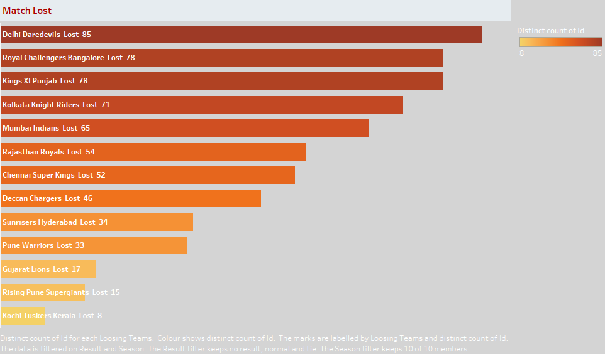
Total Matches Lost
Teams those are lost highest number of matches across all seasons.

Slide 12
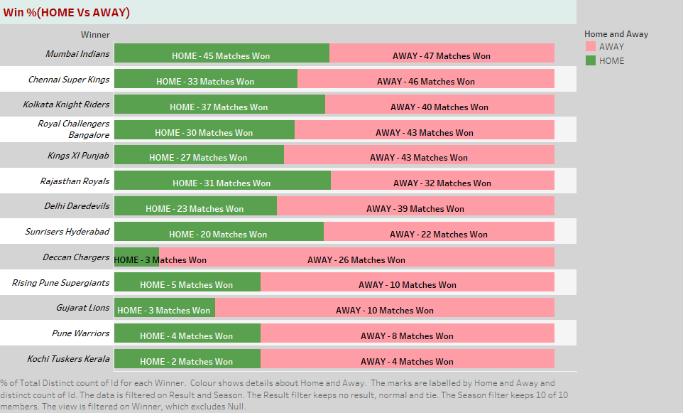
Win %(HOME VS AWAY)
Teams which are won matches in home ground and from other grounds.
HOME indicates matches played in home ground and number of wins
AWAY indicates matches played at out side and number of wins.

Slide 13
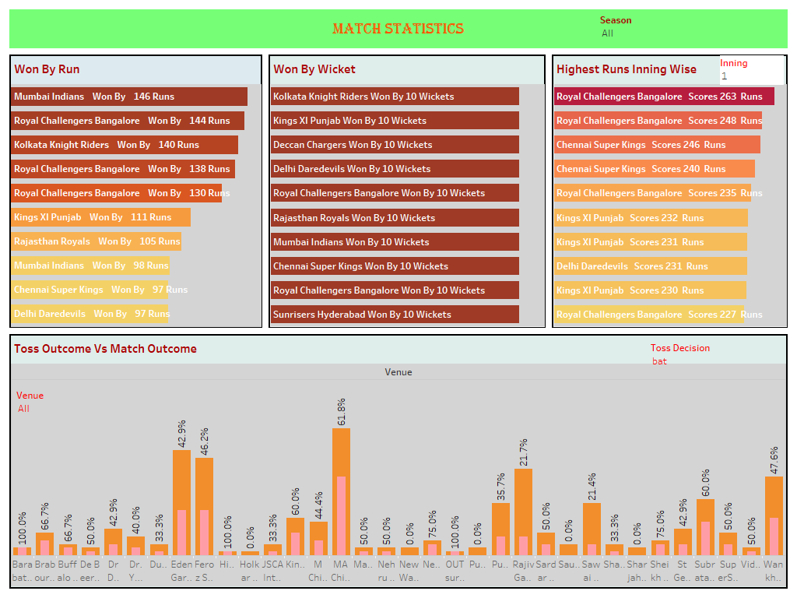

Slide 14
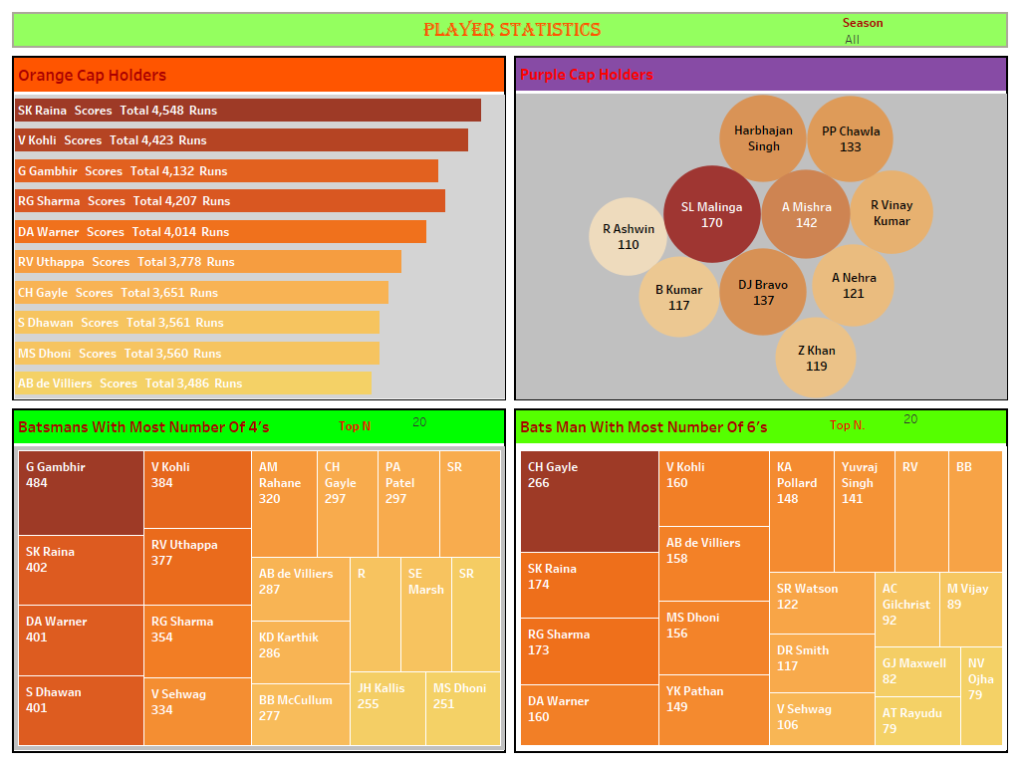

Slide 15
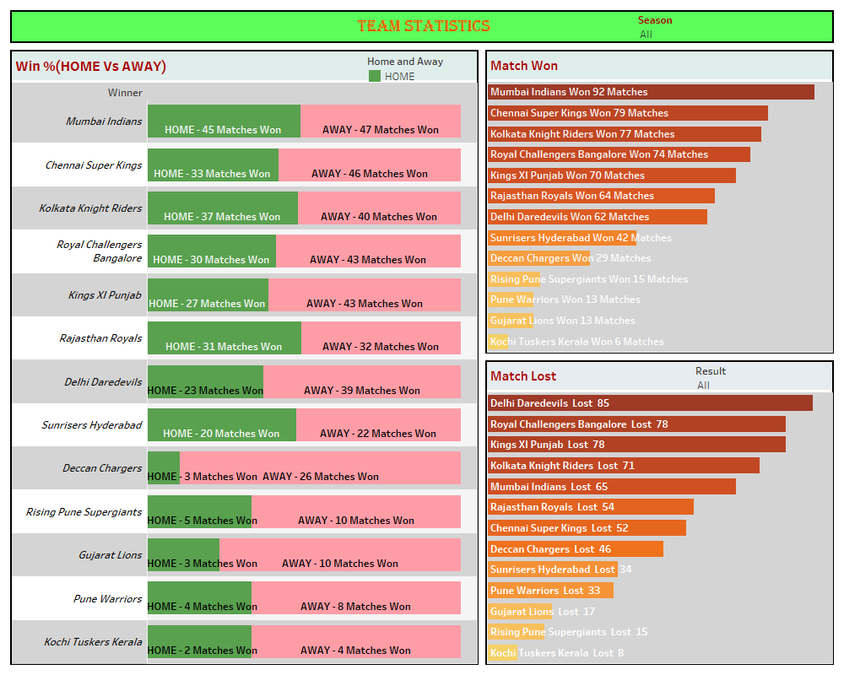

Slide 16
THANK YOU
THANK YOU
THANK YOU

