Slide 1

Best of 2023
E Reader Channel

Slide 2
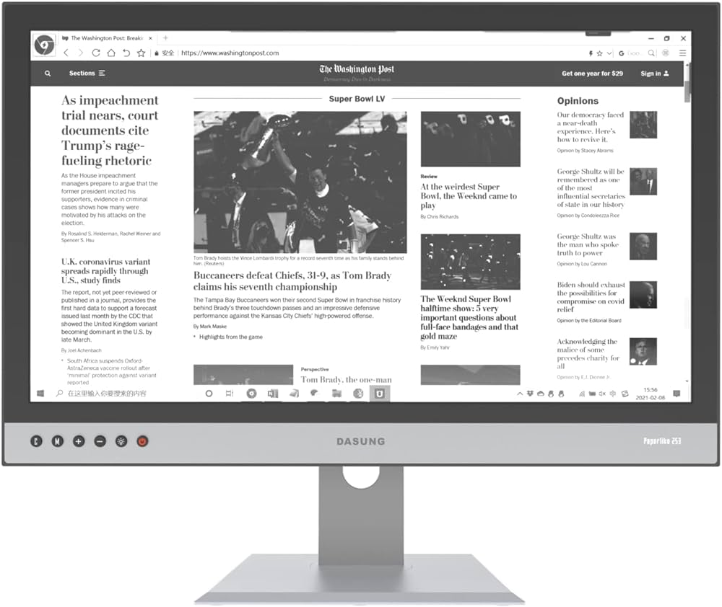

Slide 3
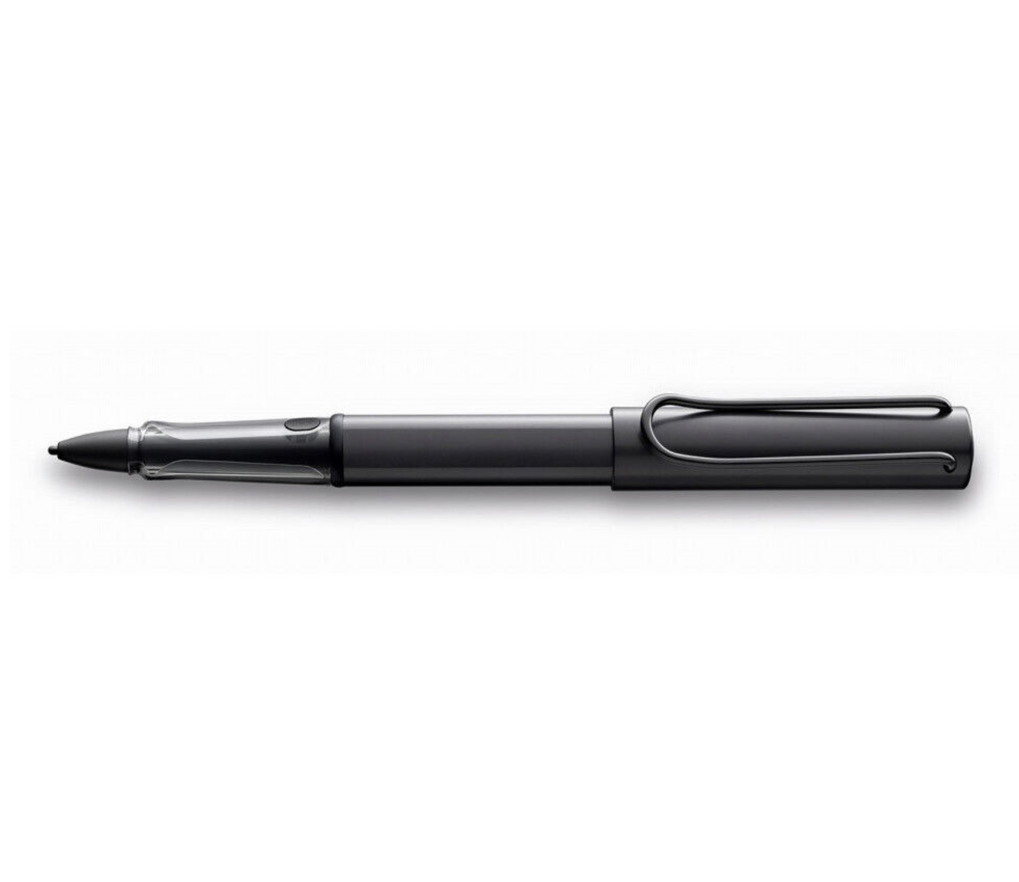

Slide 4


Slide 5


