Slide 1
Safety Training

Slide 2

Why Safety is big business…One word: OSHA
What is:
OSHA stands for
Occupational Safety & Health Administration

Slide 3
OSHA is part of the US Dept of Labor. The administrator for OSHA is the Assistant Secretary of Labor for Occupational Safety and Health. They answer to the Secretary of Labor, who answers to the President .
OSHA directs national compliance initiatives in occupational safety and health. OSHA helps business protect their workers and reduce the number of workplace deaths, injuries and illnesses.

Slide 4
Why this is important to us..
The OSHA Lockout Standard
OSHA's Volume 29 Code of Federal Regulation (CFR) 1910.147 standard addresses the control of hazardous energy when servicing or maintaining equipment.
Basically, this means that there are codes and regulations in place for properly locking out a machine so that someone can safely work on it and not worry about someone starting it up and hurting/killing them in the process. We are the ones that sell the products to them to meet those codes.

Slide 5
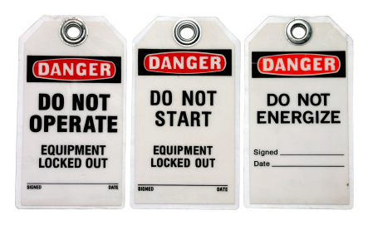
Lockout Tagout (LOTO)
Lockout / Tagout refers to the specific equipment de-energization and re-energization practices and procedures that will keep employees safe. As nearly every machine in operation will inevitably need maintenance, quality inspections and even total parts overhauls – customers will need the products required by OSHA to properly lock out the machines.
A fully de-energized machine is one that is completely disconnected from its source of power - be that electricity, gas, steam, pneumatics or hydraulics - and has gone through a proper process of total equipment shutdown that has ensured that there is no risk for any release of stored energy in the system. This lockout procedure is not only required by OSHA, but it is a valuable process for streamlining maintenance procedures to ensure total safety and maximum uptime of the facility.

Slide 6
The Facts About LOTO
LOTO is the #1 most cited violation for general industry by OSHA. Don’t overlook the importance of Lockout Tagout compliance.
Lockout / Tagout is being adopted on a global scale across industries as a best practice for increasing facility safety.
OSHA estimates that its Control of Hazardous Energy Standard prevents 120 fatalities and 50,000 injuries annually. Lockout / Tagout is designed for employees' safety.
Lockout / Tagout can significantly cut costs by minimizing lost time and insurance costs. If the bottom line is important to our customers facility, then keeping machines safely maintained will cut more than just operating costs.
Lockout / Tagout can improve productivity by minimizing equipment downtime while streamlining an effective maintenance program. With safety first, workplace productivity can be improved.

Slide 7
The Four Steps to Lockout / Tagout OSHA Compliance
Step 1: Create Energy Control Policy and Lockout Procedures
Step 2: Energy Control Point Identification
Step 3: Proper Lockout Tools and Warning Devices
Step 4: Employee Lockout Training and Communication

Slide 8
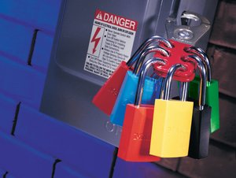
Step 1: Create Energy Control Policy and Lockout Procedures
Section 1910.147(C)(4) 'ENERGY CONTROL PROCEDURES' requires that you comply using a lockout / tagout program that includes the following:
Lockout procedures must be documented and must identify the equipment covered.
A separate procedure must be created for each piece of equipment to be locked out. There are exceptions where multiple machines may be grouped under a single procedure.
The procedure must include specific steps for shutting down, isolating, blocking and securing equipment to control hazardous energy.
The employer shall conduct and certify periodic inspections at least annually.

Slide 9
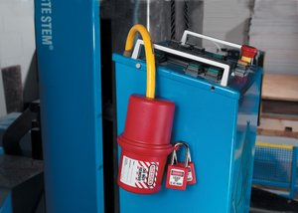
Step 2: Energy Control Point Identification
Section 1910.147(C)(5)(III) - ENERGY SOURCE IDENTIFICATION of the OSHA Lockout / Tagout code applies to the identification and marking of the machinery’s energy control (such as the electrical circuit switches). The lockout signs will warn against hazardous conditions if the machine or equipment is energized. These lockout signs, lockout devices, tagout signs, disconnect labels and power source labels, including their means of attachment or adhesion, should be substantial enough to prevent inadvertent or accidental removal.
Additionally, OSHA 1910.333(e) and (f) require that all disconnecting means show the magnitude and shall be legibly marked to indicate the purpose, unless located and arranged so the purpose is evident. This means that authorized workers will need to know the voltage and the purpose of an electrical control point so that they can properly follow the correct procedures for locking out the affected equipment.

Slide 10
Step 3: Proper Lockout Tools and Warning Devices
Proper and religious application of lockout hardware is often times the determining factor of a lockout program’s success. Having the right tools for the job is important no matter what the industry is; but when it comes to lockout safety, it’s critical that the right lockout tools and warning devices available.
Each worker will have exclusive control of the locks they use, so no worker should be able to open another worker's lock. This will assure the lockout procedure meets OSHA requirements and establishes responsibility and accountability among workers.
It’s also important to document specifically what lockout devices are acceptable for use at each and every lockout point. With such a wide range of sizes and shapes of valve operating handles, circuit breaker switches and various other energy control means, this is where we come in.

Slide 11
Step 4: Employee Lockout Training and Communication
Assured safety and efficiency are ultimately made possible with lockout training practices. Workers need to be trained to protect themselves and others during machine servicing and maintenance by being educated on lockout tagout policy and the established lockout procedures. There are three categories of workers who will require formal training for lockout: "Authorized," "Affected," and "Other.“
Authorized Workers must receive training on the recognition of applicable hazardous energy sources, the type and magnitude of the energy available in the workplace, and the methods and means necessary for energy isolation and control.
Affected Workers (often the equipment operator) must receive training on the purpose and use of the energy control procedure.
Other Workers (those whose work activities are or may be in an area where energy control procedures may be utilized) must be instructed about the procedure and about the prohibition relating to attempts to restart or re-energize machines or equipment that are locked out or tagged out.

Slide 12
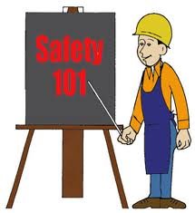
Products
Now that we know the basics of WHY people need LOTO procedures.. Now we can discuss WHAT they need from us in order to be compliant.

