Slide 1
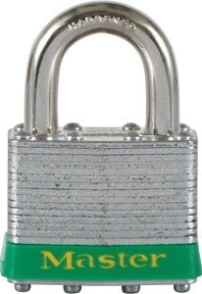

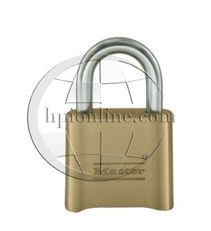
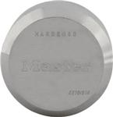

Introduction to padlocks

Slide 2
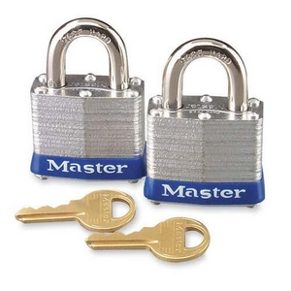
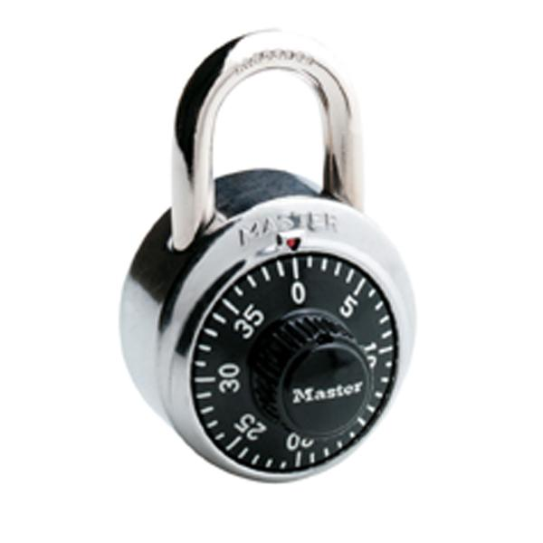
Two main “types” of padlocks
Keyed padlocks
Combination padlocks

Slide 3
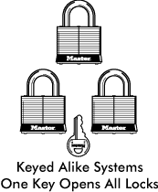
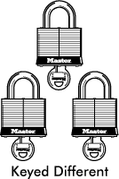
Keyed Padlock keying codes:
“KA”= keyed alike
“KD”=Keyed Different

Slide 4
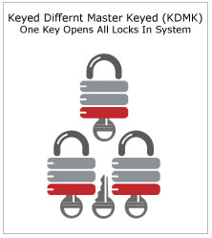
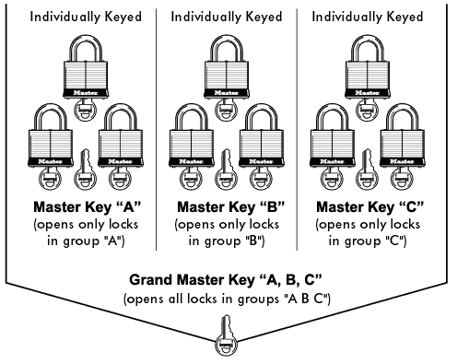
Keyed Padlock keying codes:
“MK”=Master Keyed
“KAMK”=Keyed alike/master keyed

Slide 5
Keyed Padlock keying codes:
“KZ”= zero bitted (a blank slate)
Review:
KA-keyed alike
KD-Keyed different
MK-Master Keyed KAMK-Keyed alike in groups/common master key
KZ- “Zero bitted”-the blank slate

Slide 6
Combination Padlocks:
3 main types:
-Fixed integrated combination: combination comes preset and cannot be changed.
-Resettable: Customer chooses and sets his/her own combination. This can be “reset” as the customer sees fit.
-Hybrid: A combination lock with a “master key” override.

Slide 7

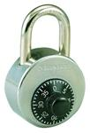
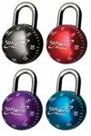
Combination Locks
Fixed integrated combo locks:
-Combination is preset by the factory and cannot be changed.
-Usually have a serial number that corresponds to the combination.*
-Customization options: color dials, combo alike* *
Notes:
*

Slide 8

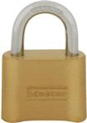

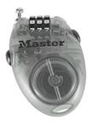
Resettable combination Locks
-Combination is set by the user, and can be reset by the user as many times as they like*
-There is no “master” combination for these locks*

Slide 9
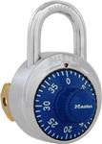
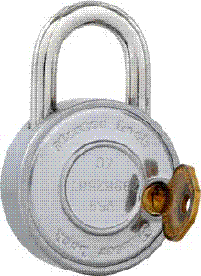
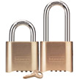
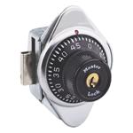
Hybrid (combo with key override)
Fixed integrated and “set your own” versions
*Added convenience and control!

Slide 10
Lock bodies-a defining category
Laminated: Steel and Brass
Solid body: Steel, brass, aluminum , and xenoy.
Die-Cast-Economical
“Weather proof”

Slide 11
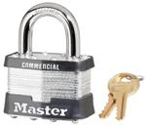
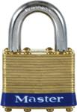
Laminated steel and brass
Strong, classic design. Economical.
-Steel for strength.
-Brass for added corrosion resistance.

Slide 12
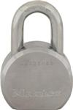
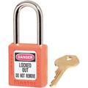



Solid Body locks
Increases strength and options available.
Materials: Aluminum, Steel, Brass, and xenoy.

Slide 13
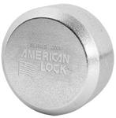
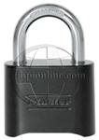
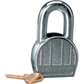
Die-Cast
Decreased cost and strength from the solid body locks.

Slide 14
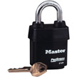
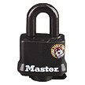
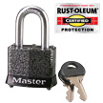
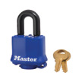
“Weather Proof”

Slide 15
Shackles, also known as “Shanks”
The “U” part of the lock. Various sizes, materials, and levels of security:
-Standard Steel
-Boron alloy
-Brass
-Shrouded (high security)
-Hidden (high security)
-Adjustable/removable.

Slide 16
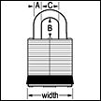
Shackles: Measurements
A= Shackle diameter
B= Vertical Clearance
C= Horizontal Clearance

Slide 17
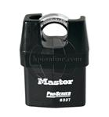
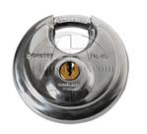

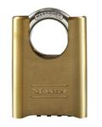
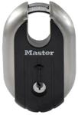
Shrouded Shackle locks:

Slide 18
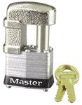
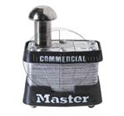
Hidden Shackle locks:

Slide 19


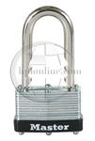
Adjustable/ removable shackles

Slide 20
Master Lock shackle sizes:
Vertical clearances (“B” dimension)
LS: 3/4”, 15/16”,1”
LF: 1-1/2”-1-9/16” depending on model
LH: 2”
LJ: 2-3/8”- 2-1/2” depending on model
LT: 3”
LN: 5-3/8” -5-3/4” depending on model
*not all options available for all locks….

Slide 21
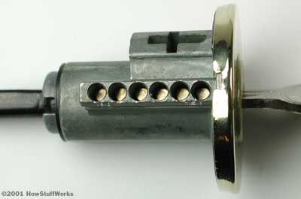
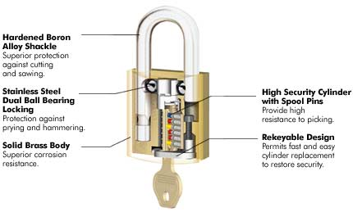
Cylinders: The “guts” of the lock

Slide 22
Cylinders: Types
Pin Tumbler-most common. More pins=more “pick” resistance.
Warded
Tubular (American pg.13)
Blade (American pg.14,20)

Slide 23
Additional features/customizations:
Key retaining: “NR” in part number
Bump Stop-gaining popularity.
Laser engraving
Color coding
Charting
Key marking
Restricted/reserved keyways
Chain/cable attachments (Sav-Lok)

Slide 24
The catalogs and part numbers:
Master Lock- Sample part numbers for commercial and retail:
“6121KABLJNR”
American Lock: Sample part numbers:
“A5561MKLZ21KEY”

Slide 25

ABUS locks
German Lock company.
High security and quality
Focus on Bikes/Motorcycles
Review catalog
www.abuslocks.com

Slide 26
Hodge Locks
H40KA is equivalent to 4140KA
HRS410
HRS411

Slide 27
Waste/Shred industry:
Warded “KA” locks
Economy brass “KA” locks
Set your own combo locks
Hybrid set your own combo locks
Laminated steel pin tumbler locks.
LOTO-lock out tag out

Slide 28
Institutional/Gyms:
Low security: 1850D, 1500D, 4140KD
Medium: 1502, 1525, A400(K), 78/50C, 1630—(built in)
High: 2002, 2010, 1690(built in)
Gyms like the “carded” or “display packaged” , schools like the “charted” and “key control locks.

Slide 29
General Industry
Keyed alike locks (Economy to high end) great opportunity for the “MK” up-sell.
Trucking industry likes the “pro-series”-all weather.
Lock out tag out locks (solid body American locks, color coded, “KA” in sets)
Storage: 40KADPF, 40D, shrouded locks.
Work vans: 6270 w/ 770 HASP

Slide 30
Web sites and resources:
www.Masterease.com : Master Lock’s order tracking site
www.Masterlock.com : Manufacturers home page.
www.masterlocks.com : HPI’s Master & American main site.
www.buildalock.com: HPI’s custom order premium site
www.hpionline.com: portal site for HPI
www.A2Zhardware.com : coming soon!

