Slide 1
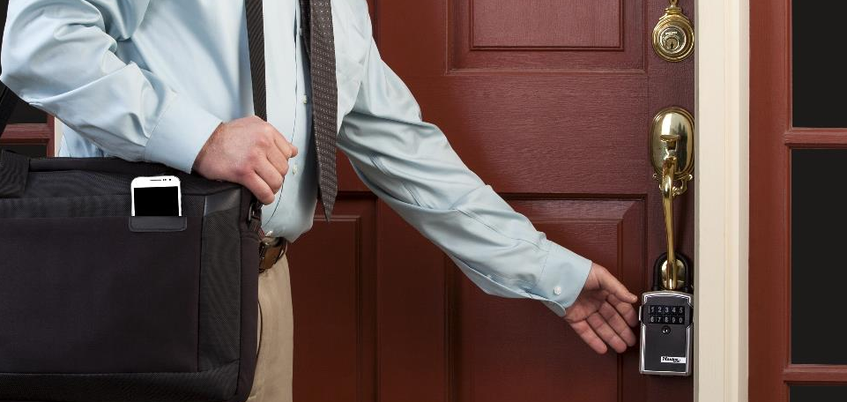
Master Lock Bluetooth Lock Boxes
SMART. SIMPLE. SECURE.
PROPERTY ACCESS MANAGEMENT

Slide 2
Lock Box Market
Brand Usage –All Users
2016 Shifts
2016 Shifts
Master Lock is the market leader in Lock Box sales
Electronic Lock Boxes are sold uniquely through real estate associations today.
26% of the market opens up to traditional distribution with the introduction of the Master Lock Bluetooth Lock Box family
Sources: Internal Estimates Based on National Association of Realtors Sales Data and Quantitative study
conducted by Burke Research for Master Lock, February 2014.

Slide 3
Lock Box Market Overview - US
US Retail Market Size
(in Retail $)
The total lock box market is estimated to be 4.0M units and $160M in retail sales annually.*
Electronic $42MM, or 26%
Mechanical $118MM or 74%
Master Lock is a full line supplier offering combination, push button, and now electronic lock boxes.
*Source: Internal Estimates Based on National Association of Realtors Sales Data and Quantitative study
conducted by Burke Research for Master Lock, February 2014.

Slide 4
Master Lock Bluetooth Lock Box
Completely New Sales Opportunity for Distribution
$42 million in current sales going directly to real estate associations
End-User Functionality: Better Experience
Open and manage lock boxes with smartphone
Convenience
Optional manual code access via keypad when a smartphone is not available
Use the app or the web to track usage
Security and durability
End-User Value Proposition
No monthly data package or shared access fees
No activation or monthly usage fees
No long-term contracts

Slide 5
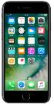

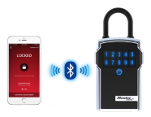
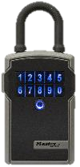
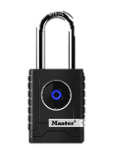


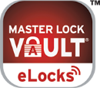


Master Lock Bluetooth Lock Box
The Growing Family of Smart Security Products from Master Lock
The Key is Your Smartphone
Padlock Family
New Lock Box Family
Free Master Lock Vault eLocks app
Bluetooth Indoor & Outdoor Padlock
Model No. 4400 & 4401
Bluetooth Portable & Wall Mount Lock Box
Model No. 5440 &
5441

Slide 6
Master Lock Bluetooth Lock Box
Video Page

Slide 7
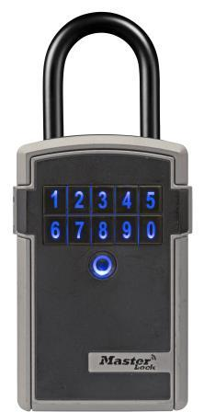
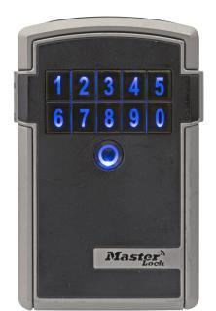


Master Lock Bluetooth Lock Box
Open and Manage Lock Boxes with Smartphone
Use the free Master Lock Vault eLocks app
Schedule access now and in the future
Provide permanent or temporary access
Convenience
Easy to use and access with no need for secondary key card
Grant or revoke access to an individual without affecting other authorized users
Large storage capacity for keys and key cards
Easy to replace, long-life battery (CR123A)
Optional Manual Code Access Via Keypad When a Smartphone is Not Available
Use the App or the Web to Track Usage
Security and Durability
Solid Body with protective coating prevents scratches
Weather resistant to -40°
Value
No monthly data package or shared access fees
No activation or monthly usage fees
No long-term contracts
The Key is Your Smartphone
Portable
5440D
List Price $172.50
Wall Mount
5441D
List Price $162.50
Available to Ship May 1, 2017

Slide 8


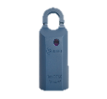


Master Lock Bluetooth Lock Box
Master Lock Bluetooth Lock Box vs. Supra
Master Lock Bluetooth Lock Box Advantages
No ongoing cost of ownership
Supra monthly data fees
Supra key activation fees
Access
Master Lock is easier and faster
Supra limits access to member key holders only
Master Lock does not require long and expensive contracts
Supra requires multi-year restrictive and costly contracts
 | Master Lock | iBox | iBox BT | iBox BT LE
Access | No Adapter Needed No PIN code needed when using phone Access time ≈5 seconds Grant permanent access “Jump” option in case of dead battery Backup codes saved on vault Optional manual code access via keypad when a smartphone is not available | Requires FOB or eKey Adapter Must enter PIN code Access time ≈30 seconds Cannot grant permanent access No “jump” option in case of dead battery No back up codes & no key pad | Requires FOB or eKey Adapter Must enter PIN code Access time ≈30 seconds Cannot grant permanent access No “jump” option in case of dead battery No back up codes & no key pad | No Adapter Needed Must enter PIN code Access time ≈30 seconds Cannot grant permanent access No “jump” option in case of dead battery No back up codes & no key pad
Purchase Price | $99 | ≈$89 | ≈$102 | ≈$116
Additional Hardware Costs | None | eKey ≈$50 | eKey ≈$50 | None
Additional Data Costs | None | eKey Service ≈$23/mo ≈$50 activation | eKey Service≈ $23/mo ≈$50 activation | ≈$50 activation
Grant Access | Share with anyone | Key Holders Only | Key Holders Only | Key Holders Only
Distribution Model | National Distribution | Restrictive Association Contracts | Restrictive Association Contracts | Restrictive Association Contracts
Master Lock wall mount version also available.

Slide 9


Master Lock Bluetooth Lock Box
Master Lock Bluetooth Lock Box vs. SentriLock
Master Lock Bluetooth Lock Box Advantages
No ongoing cost of ownership
SentriLock annual system fees
SentriLock activation fees
Access
Master Lock is easier and faster
SentriLock limits access to member card holders or short term guest access
Master Lock does not require long and expensive contracts
SentriLock requires multi-year restrictive and costly contracts
 | Master Lock | NXT
Access | No Adapter Needed No PIN code needed when using phone Access time ≈5 seconds Grant permanent access “Jump” option in case of dead battery Backup codes saved on vault Optional manual code access via keypad when a smartphone is not available | Requires Key Card Must enter PIN code Access time ≈30 seconds Cannot grant permanent access No back up codes
Purchase Price | $99 | ≈$70-90
Additional Hardware Costs | None | Key Card ≈$20 Activation ≈$50 Reader ≈$55 Activation ≈$50
Additional Data Costs | None | System Fee ≈$137/yr
Credentials | Share with anyone | Key Holders Only
Distribution Model | National Distribution | Restrictive Association Contracts
Master Lock wall mount version also available.

Slide 10
Master Lock Bluetooth Lock Box
Master Lock Investing in Demand Generation for the Bluetooth Lock Box

Slide 11
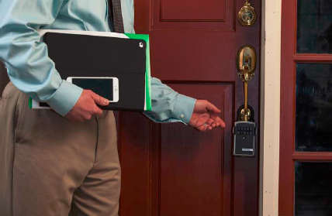
Real Estate Sales
Real Estate Professionals
Share access with:
Real estate agents
Inspectors
Contractors
Home owners
Secondary codes for users without a smart phone
Remove access for individuals without affecting other users
Track access via the free Master Lock Vault eLocks app
No monthly data fees
No activation fees
No long term contracts

Slide 12
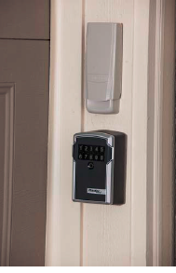
Rental Property
Property Managers/Owners
Share access with:
Potential renters
Inspectors
Contractors
Tenants
Secondary codes for users without a smart phone
Remove access for individuals without affecting other users
Track access via the free Master Lock Vault eLocks app
No monthly data fees
No activation fees
No long term contracts

Slide 13
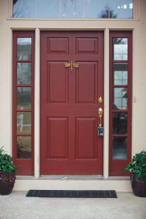
Vacation Property
Property Managers/Owners
Share access with:
Renters
Inspectors
Cleaning crews
Contractors
Owners
Secondary codes for users without a smart phone
Assign future start and end dates to correspond to arrival and departure dates for renters
Remove access for individuals without affecting other users
Track access via the free Master Lock Vault eLocks app
No monthly data fees
No activation fees
No long term contracts

Slide 14
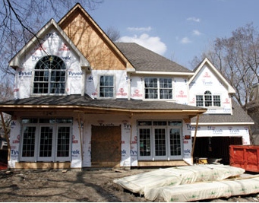
Job Site
Residential Construction and Remodeling
Share access with:
Sub-contractors
Suppliers
Inspectors
Home owners
Secondary codes for users without a smart phone
Remove access for individuals without affecting other users
Track access via the free Master Lock Vault eLocks app
No monthly data fees
No activation fees
No long term contracts

Slide 15
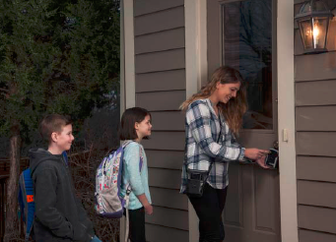
Home
Home owners
Share access with:
Remodelers
Maintenance/Repair Suppliers
Care givers
Dog walkers
Baby sitters
Extended family
Secondary codes for users without a smart phone
Remove access for individuals without affecting other users
Track access via the free Master Lock Vault eLocks app
No monthly data fees
No activation fees
No long term contracts

Slide 16
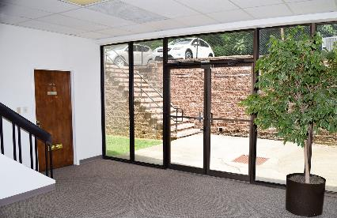
Commercial Property
Commercial Property
Share access with:
Potential tenants
Suppliers
Contractors
Cleaning crews
Secondary codes for users without a smart phone
Remove access for individuals without affecting other users
Track access via the free Master Lock Vault eLocks app
No monthly data fees
No activation fees
No long term contracts

Slide 17
Product Setup data

Slide 18
Bluetooth Lock Box Set-Up Data
Individual
Master Pack
Model # | SKU # | QTY | UPC | Weight lbs. (KG) | Length in. (CM) | Width in. (CM) | Height in. (CM) | Cubic in. (CM)) | QTY | I2of5 | Weight lbs. (KG) | Length in. (CM) | Width in. (CM) | Height in. (CM)) | Cubic in. (CM)
5440D | P42739 | 1 | 29300-9 | 3 (1.4) | 5.25 (13.335) | 2.5 (6.35) | 8.4 (21.336) | 110.25 (1806) | 2 | 29300-6 | 7.5 (3.4) | 6.32 (16.05) | 6.22 (15.80) | 10.41 (26.44) | 409 (6,705)
5441D | P42740 | 1 | 29302-3 | 3 (1.4) | 5.25 (13.335) | 2.5 (6.35) | 8.4 (21.336) | 110.25 (1806) | 2 | 29300-7 | 7.5 (3.4) | 6.32 (16.05) | 6.22 (15.80) | 10.41 (26.44) | 409 (6,705)
5440DHC | P42741 | 1 | 293000-9 | 3 (1.4) | 5.25 (13.335) | 2.5 (6.35) | 8.4 (21.336) | 110.25 (1806) | 2 | 29300-0 | 7.5 (3.4) | 6.32 (16.05) | 6.22 (15.80) | 10.41 (26.44) | 409 (6,705)
5441DHC | P42742 | 1 | 29302-3 | 3 (1.4) | 5.25 (13.335) | 2.5 (6.35) | 8.4 (21.336) | 110.25 (1806) | 2 | 29302-4 | 7.5 (3.4) | 6.32 (16.05) | 6.22 (15.80) | 10.41 (26.44) | 409 (6,705)
5440DAU | P53443 | 1 | 29300-9 | 3 (1.4) | 5.25 (13.335) | 2.5 (6.35) | 8.4 (21.336) | 110.25 (1806) | 2 | 29300-6 | 7.5 (3.4) | 6.32 (16.05) | 6.22 (15.80) | 10.41 (26.44) | 409 (6,705)
5441DAU | P53444 | 1 | 29302-3 | 3 (1.4) | 5.25 (13.335) | 2.5 (6.35) | 8.4 (21.336) | 110.25 (1806) | 2 | 29302-7 | 7.5 (3.4) | 6.32 (16.05) | 6.22 (15.80) | 10.41 (26.44) | 409 (6,705)
5441EUD | P52553 | 1 | 3520190943248 | 3 (1.4) | 5.25 (13.335) | 2.5 (6.35) | 8.4 (21.336) | 110.25 (1806) | 2 | 33520190943249 | 7.5 (3.4) | 6.32 (16.05) | 6.22 (15.80) | 10.41 (26.44) | 409 (6,705)

Slide 19
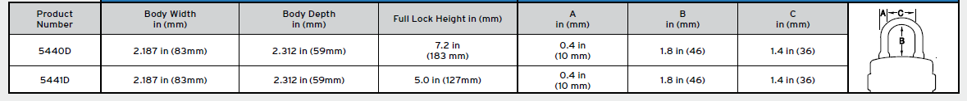
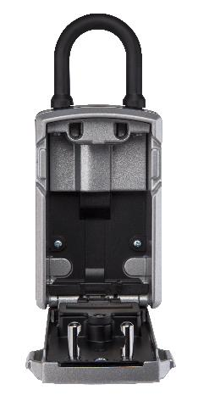
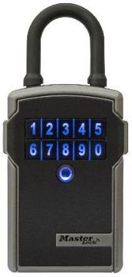
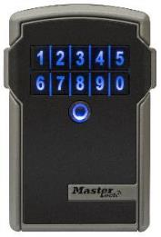
Bluetooth Lock Box Set-Up Data
Lock Dimensions
Shackle Dimensions
Width: 2.5”
Height: 3.6”
Depth: 1.0”
(in main cavity)
Holds assortment of 6 house keys on a key ring.

Slide 20
User Support

Slide 21
Master Lock Bluetooth Lock Box
How-To Videos:
Register and Add Your Lock Box
How to Open the Door and Remove the Shackle
How to Add a Guest
How to Send a Temporary Code
How to Mount on a Wall
How to Replace a Battery
Video Page

Slide 22
faqs

Slide 23
FAQ

Slide 24
FAQ
How do I accept an invitation to access a Master Lock Safe Space Portable or Wall Mount Bluetooth Lock Box? | The Master Lock Safe Space Bluetooth Lock Boxes are designed so that the user can gain access using Bluetooth credentials using a smart phone or by using a traditional manual code entered into the key pad. 1. The owner logs on to the Master Lock eLocks APP and follows the directions to ADD A GUEST, which results in an invitation being sent. 2. Open the link in the invitation. 3. Follow the prompts to either log into an existing Master Lock Vault account or create a new account. 4. The host will receive an email confirmation that you have accepted the invitation. 5. You will see the new lock under LOCKS SHARED WITH YOU in the APP and in their Master Lock Vault account.
What if my phone is lost or stolen? | Reset Keys allows the lock box owner to revoke all Bluetooth® access to the lock, including their own. The owner and all guests will receive updated Bluetooth® credentials on their mobile devices. LOST / STOLEN DEVICE NOTE! The owner of a lost or stolen mobile device should first go to the MasterLockVault.com web site and change their username and passcode. To Reset Keys, the lock box owner must: 1. Make sure that the owner's device that is synced to the lock is within Bluetooth(R) range of the lock box(Reset Keys cannot be performed remotely). 2. Select the Appropriate padlock or lock box from the LOCKS list. 3. Touch MANAGE LOCK in the upper right corner. Enter your passcode, if prompted. 4. Touch the SETTINGS icon in the upper right corner. 5. Touch RESET KEYS. 6. Follow any additional instructions in the APP to save the changes to your lock box. This step must be completed for each lock box the lost or stolen device had access to.
Where can I find the Master Lock Vault eLocks APP? | The Master Lock Vault eLocks APP is available in the Apple APP Store and the Google Play Store. Click below or search for "Master Lock Vault eLocks" in the APP stores. There are two Master Lock Vault APPs, please make sure that you download the eLocks version..
Why do I need a Master Lock Vault account to register my lock box? | The Master Lock Vault account ensures user credentials are securely deployed and provides enhanced functionality and convenience to the Master Lock Vault eLocks APP.

Slide 25
FAQ
How do I obtain an Activation Code for my Bluetooth Smart 5440 or 54401 lock box? | The Activation Code is provided with each lock or lock box in the upper left corner of the instructions. The instructions are included in the lock or lock box package. If you have lost, or no longer have the instructions, Visit a Master Lock distributor/retailer 1. Bring the lock to a Master Lock distributor or retailer. The lock must not be attached to anything. 2. Ask the distributor or retailer to contact Master Lock for the Activation Code on your behalf using the Lock/Device ID which is engraved on the back of the lock or on the bottom of the lock box and noted in the APP under About This Lock as "Device". The Lock/Device ID starts with the letter A and is followed by 5 numbers or letters. US and Canadian distributors may call 1-800-308-9244. Please note that although Master Lock does not charge for this service, some distributors or retailers may charge a fee.
 | – OR –
 | Submit an Activation Code Retrieval Form 1. Print out the Activation Code Request Form from a Printer Friendly Page or download the Bluetooth Activation Request Form. 2. Have your Activation Code Request Form notarized by a Notary Public to prove you are the owner of the lock. You can include up to 6 Activation Codes on one notarized form. *Note for inmates at a correctional facility: In addition to the Activation Code Request Form, you must submit your request on official prison facility letterhead. In lieu of notarization, the Activation Code Retrieval Form must be signed by a prison facility official. 3. mail your form to: The Master Lock Company Bluetooth Padlock Activation Code Request Master Lock Company LLC 6744 S. Howell Avenue Oak Creek WI 53154 Once the request is received, your Activation Code will arrive in Approximately 1-2 weeks (if selecting mail as the delivery method.)

Slide 26
FAQ
What if my Guest does not have a Bluetooth enabled device? | Your Guest can access the lock without a Bluetooth enabled device by entering a Manual Code on the lock keypad. To assign secondary code access with no expiration: 1. If not already logged on, open the Master Lock Vault eLocks APP and touch the appropriate lock box listed in the LOCKS list. 2. Touch MANAGE LOCK in the upper right corner of the APP. 3. Scroll down to Secondary Codes and touch CHANGE SECONDARY CODES then follow the APP instructions to add up to 5 secondary codes. To assign a temporary code access with an expiration: 1. If not already logged on, open the Master Lock Vault eLocks APP and touch the appropriate lock box listed in the LOCKS list. 2. Touch MANAGE LOCK in the upper right corner of the APP. 3. Touch the Settings Icon in the upper right corner of the APP. 4. Touch SHARE TEMPORARY CODES and then follow the APP instructions to share current or future codes.
I replaced the battery in my lock. Why does the lock LED still light yellow? | After installing a new battery, the low battery icon will no longer display in the APP, after the APP and the lock communicate with each other. However, it will take between 2 to 72 hours for the yellow LED to stop displaying on the lock itself.
Master Lock Safe Space Bluetooth Lock Box will not relock. What should I do? | This can occur if the door pins of the lock box are left resting against the lock mechanism without being closed. This has fooled the lock into thinking it is closed completely. 1. Press any button on the lock keypad and when the lock lights green, close the lock and it will light blue when locked. 2. If using a code to open the lock box, enter the key code provided, when the lock lights green, close the lock and it will light blue when locked.
Is it possible to update the firmware on the lock? | Yes, when a firmware update for your lock is available. You’ll be notified within the APP whenever an update is available. You can also manually check for firmware updates by navigating to the ABOUT THIS LOCK page in the lock settings menu.
Are these locks susceptible to Bluetooth “hacking”? | Master Lock utilizes Bluetooth Smart technology to facilitate wireless communication between locks and mobile devices. These locks and lock boxes are designed in a way that prevents the threat of Bluetooth hacking that exists with some other Bluetooth products. To provide leading-edge security, we employ robust, military-grade authentication and encryption mechanisms built upon proven, NIST recommended and FIPS Approved algorithms to deter sniffing, replay and manipulation attempts that Bluetooth technology has been associated with. These mechanisms are regularly audited by independent security professionals.
How do I find the Activation Code in the packaging? | To locate the lock's Activation Code on the instruction sheet included in the lock packaging: 1. On the back of the package, locate the section that says OPEN HERE and cut along the scored, dotted line to allow access to the instruction sheet in the compartment behind the label. 2. Open the compartment door and remove the folded instruction sheet. 3. Locate the Activation Code in the gray box in the top left corner of the instruction sheet and enter it as instructed in the APP.

Slide 27
FAQ
What phones are compatible with Master Lock Bluetooth padlocks and lock boxes? | The Master Lock Safe Space Bluetooth Lock Boxes are designed to work with devices that are built to Bluetooth v4.0 (or higher) specifications and implement the capability to communicate with Bluetooth Smart peripherals. iOS and Android platforms are currently supported. See Compatible Devices.
What if my phone battery dies? | If the phone battery dies, the lock can be unlocked by entering the Primary Code, the current Temporary Code or the Backup Master Code on the lock keypad.
What if my phone's Bluetooth isn't working? | Make sure your phone is sufficiently charged. In phone’s settings, make sure that Bluetooth is turned on. If you can’t turn Bluetooth on, try restarting your phone and then re-launch the APP.
What is the product warranty for Master Lock Safe Space Portable and Wall Mount Bluetooth Lock Boxes? | The Master Lock Safe Space Bluetooth Lock Boxes have a Limited One (1) Year Warranty. Visit masterlock.com for complete warranty details.
What batteries do the Master Lock Safe Space Portable and Wall Mount Bluetooth Lock Boxes use? | Master Lock Safe Space Bluetooth Lock Boxes come with an installed C123A lithium battery.
Can the Master Lock Safe Space Portable and Wall Mount Bluetooth Lock Boxes be used outdoors? | Master Lock Safe Space Bluetooth Lock Boxes are designed to withstand outdoor environments.
What is the size and clearance of the Master Lock Safe Space Portable Bluetooth Lock Box shackle? | The Master Lock Safe Space Portable Bluetooth Lock Box shackle is .394" in diameter and offers 1.8" vertical clearance and 1.40" horizontal clearance.
How do I open the Master Lock Safe Space Portable and Wall Mount Bluetooth Lock Boxes key compartment? | Master Lock SafeSpace Portable and Wall Mount Bluetooth Lock Boxes can be opened using Bluetooth credentials or by entering a numeric code in the key pad. To open using Bluetooth credentials: 1. Make sure that the user has followed the instructions for "How to Register and Add Your Lock" or has accepted an invitation from a lock owner. 2. Make sure that your Master Lock eLocks APP is open and the user is logged in to the APP. 3. Wake the lock by pressing any key on the lock box key pad. 4. When the lock lights green, open within 5 seconds. To open using a traditional code: The lock box can be opened using the primary code, a secondary code, or a temporary code, all of which are found in the APP or distributed from the APP. 1. Enter the code into the lock box keypad. 2. When the keypad lights green open the lock box by pulling on the door tabs.

Slide 28
Trouble shooting

Slide 29
Troubleshooting
Discoveries in the development process
Door will not shut
Problem: If the door is left resting with the prongs in contact with the locking mechanism, the lock box can be fooled into thinking that it is closed and will not allow the door to shut.
Solution: If using a smartphone, wake the lock up, when it lights green, close the door completely and it should re-lock.
Shackle will not shut (i.e. Shackle can be removed by pulling after Customer hears motor run)
Problem: Same as the door symptom. The Lock Box has been fooled into thinking that it is already locked as pins rest against locking mechanism. In other words, pins are in contact with locking mechanism, but not fully engaged, and lock will attempt to lock when the pins are not in correct position.
Solution: If using a smartphone, wake the lock up, when it lights green, close the door completely and it should re-lock. If using manual code, follow the code protocol for removing the shackle and when green re-insert the shackle.
Battery Replacement - after battery is removed, press a button to drain battery charge when changing battery or add to instructions/app instructions
Problem: The lock stores a small charge that, if maintained when the battery is changed, does not allow the lock to recognized that a new battery is in place.
Solution: After battery is removed, press a button to drain battery charge. After draining the battery for 10 seconds insert the new battery.

Slide 30
Trouble Shooting
Discoveries in the development process
Packaging
Problem: Consumers do not always recognize the compartment in the back of the package or read first to see that they should use the lock mechanism to remove the product from the package rather than cutting it off using scissors.
Solution: Packaging update to draw more attention to the compartment in back.
Master Lock Vault vs. Master Lock Vault eLocks app
Problem: Consumers do not always recognize that there are two available Master Lock Vault apps.
Solution: Video shows app icon and calls out that there are two versions. Instructions also call out that there are two apps and includes guidance to the correct version.
When the Keypad is used to remove Shackle, the Shackle does not release.
Problem: The Shackle is not releasing.
Solution: Press CLR and then press FIRST digit of code then release CLR and FIRST digit button and enter remainder of code.
Reason 1: If Customer presses CLR and FIRST digit simultaneously the product does not recognize both inputs.
Reason 2: If Customer presses FIRST digit and then CLR the CLR entry erases the FIRST digit entry.

Slide 31
Discoveries in the development process
Customer hears motor attempting to open but Door or Shackle will not open
Solution: No not pull or apply pressure on either Door or Shackle when entering code.
Reason: The Door or Shackle is pulled against the other components and the components cannot move properly. Even slight pressure will cause this symptom to occur.
Lock Box unlocks with one touch when it “seems” that an authorized user is not near the Lock Box.
Solution: Calibrate the Lock Box so that the required opening distance between the Bluetooth device and the Lock Box is reduced.
Reason: Bluetooth signals can have a long range depending on the device.
Lock Box does not open when using Bluetooth mode.
Solution 1: Turn off Blue tooth mode from other nearby multiple Bluetooth devices.
Reason 1: Bluetooth signals compete for bandwidth and cause interference to read signal of device trying to open Lock Box.
Solution 2: Restart App.
Reason 2: Devices will shut App down when App has not been used after a period of time.
No power.
Solution 1: check battery is properly oriented / installed.
Reason 1: Product will not operate correctly when battery is not installed appropriately.

Slide 32
Trouble Shooting
Discoveries in the development process
Symptom: cannot jump
Check jump battery is properly oriented, is aligned with the charging contacts, and is charged.

