Slide 1
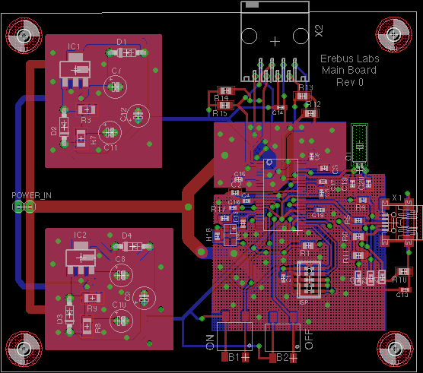
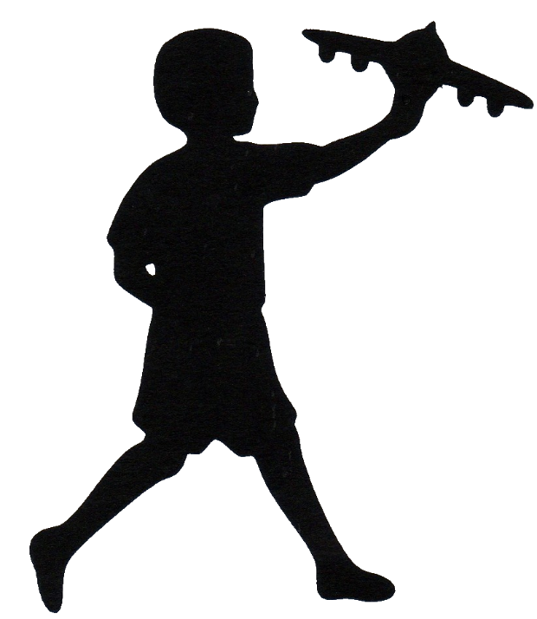
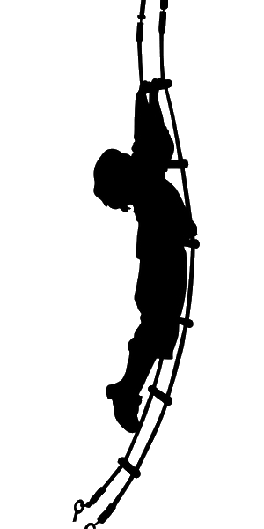
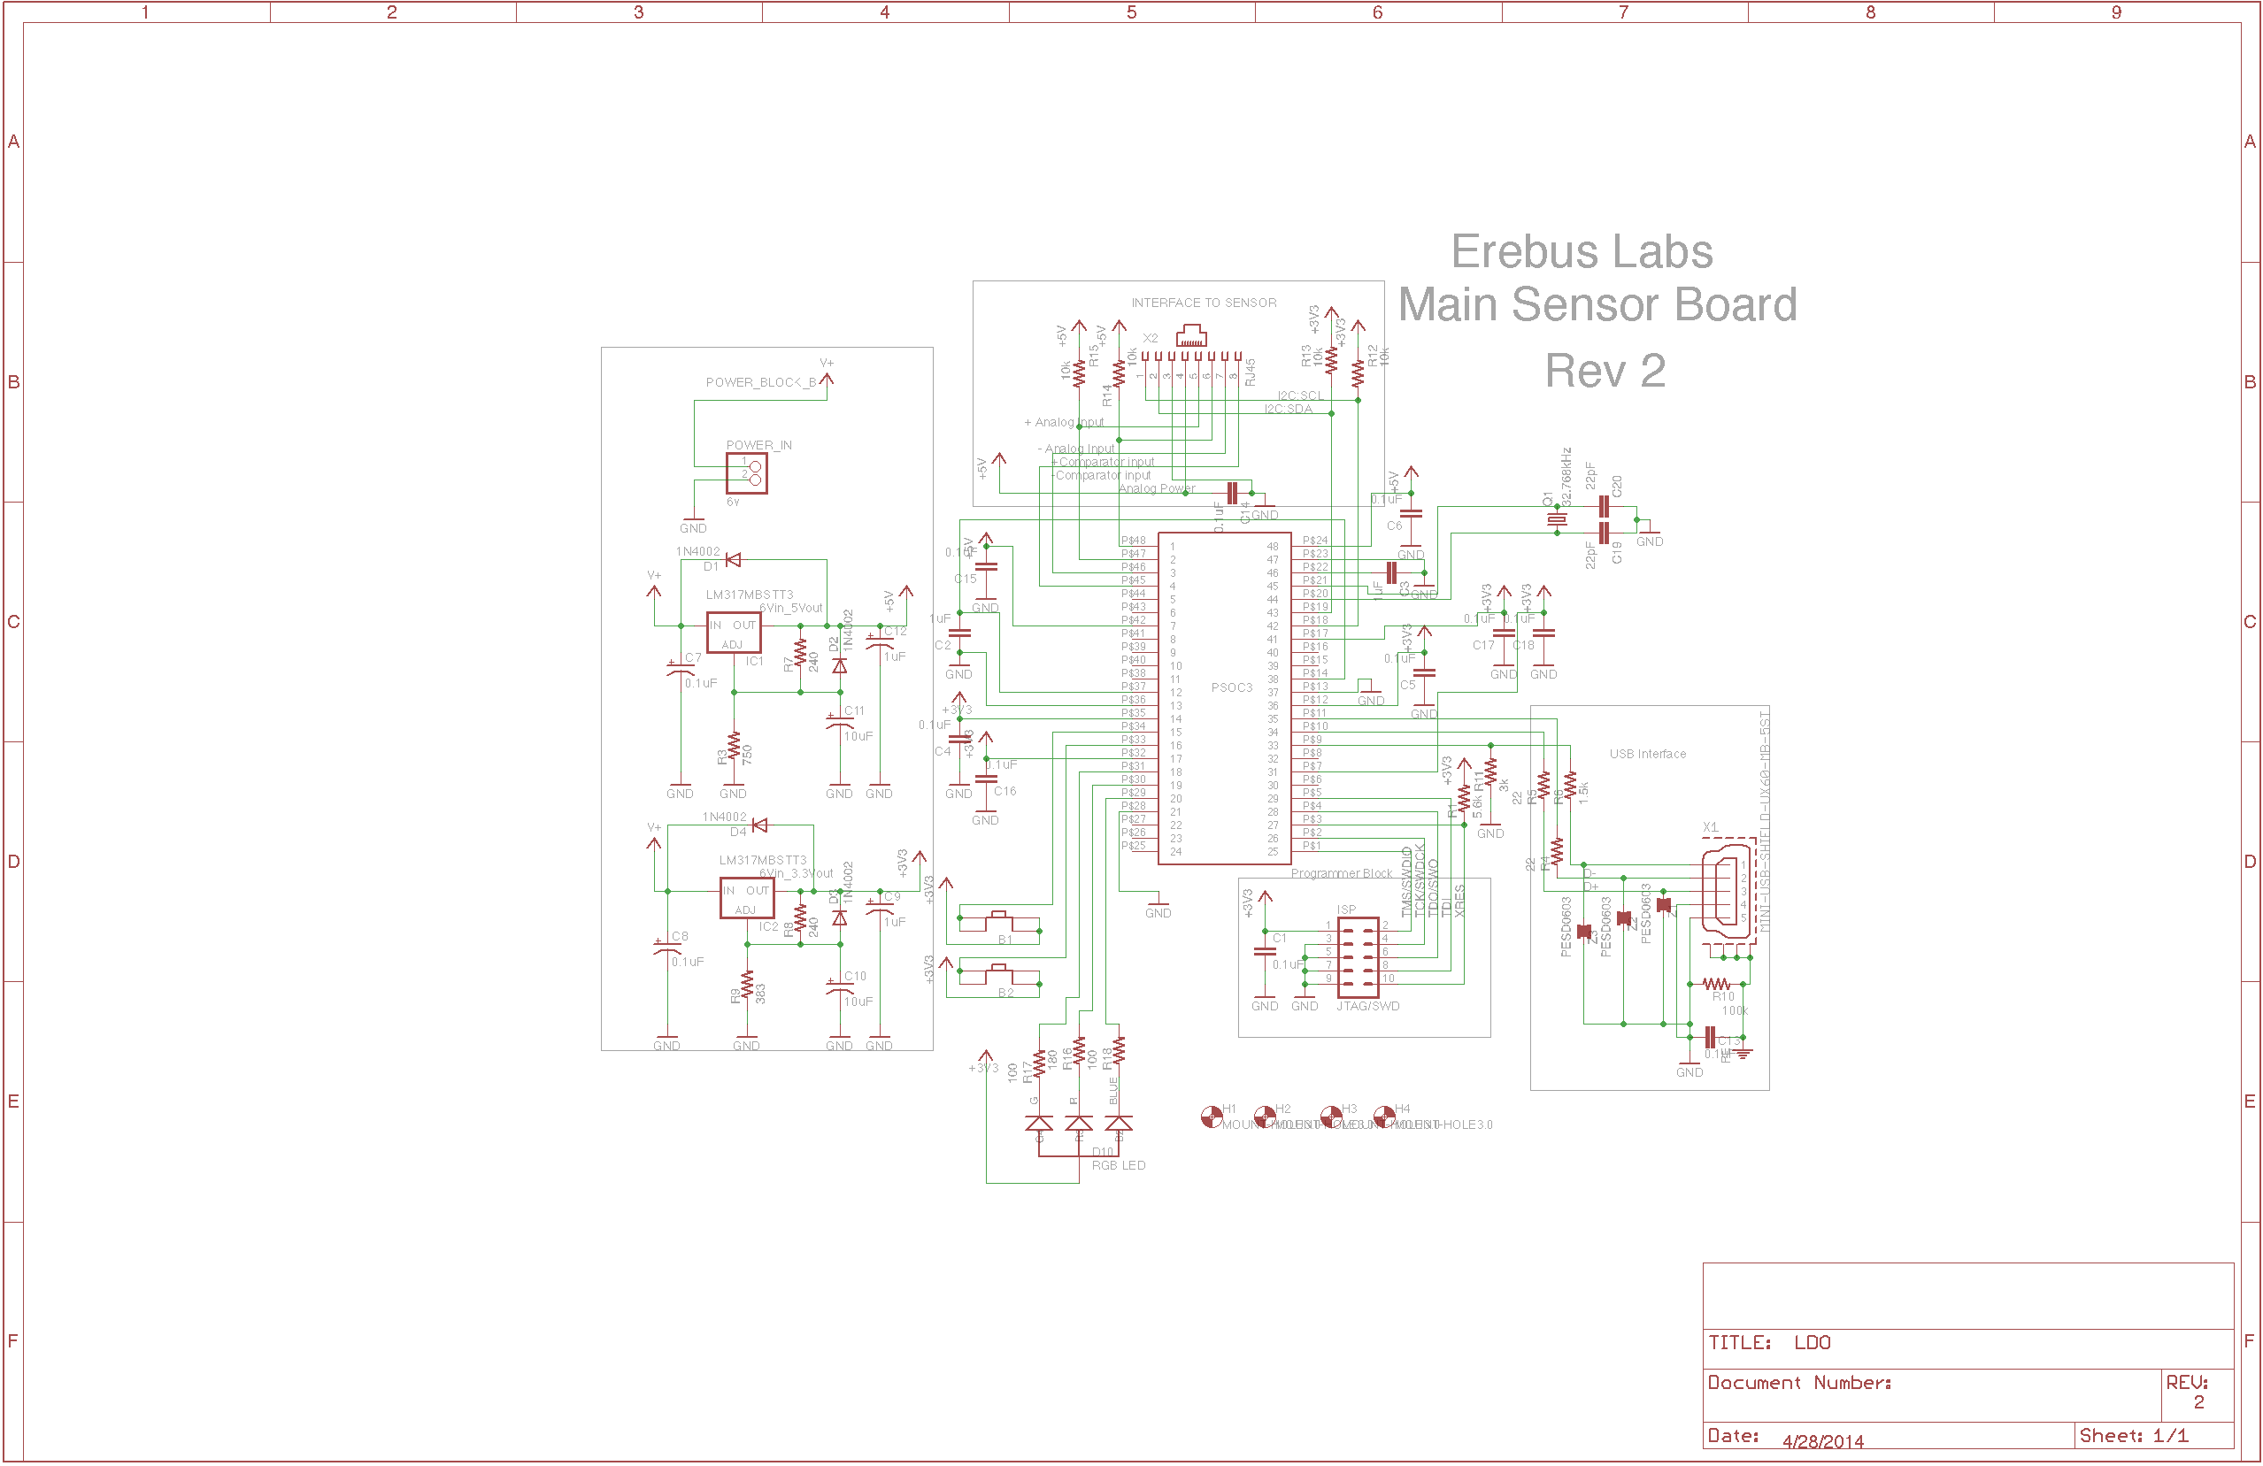
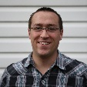
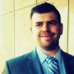
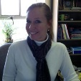
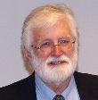

Erebus Labs STEM Sensor
Meet The Team
Scott Lawson:
Computer Engineering
Max Cope:
Electrical Engineering
Chris Clary:
Electrical Engineering
Bryan Button:
Electrical Engineering
Mike Borowczak, Ph.D.:
Sponsor
Andrea Burrows, Ed.D.:
Assistant Professor of Secondary Education, UW
Sponsor
James E. Morris, Ph.D.:
Professor or Electrical and Computer Engineering
Advisor
Department of Electrical and Computer Engineering

