Slide 1
Erebus Labs STEM Sensor
Scott Lawson – CpE
Chris Clary – EE
Max Cope – EE
Bryan Button – EE

Slide 2
Introduction
Objective
Hardware
Software
Lessons Learned
Thoughts for Rev. 2
Q&A

Slide 3
Objective
Introduction
Create an Environmental Sensor System
Hardware/Software
Documentation
Keep it Simple
Keep it Open
Keep it Cheap
Get Kids Interested in STEM!
Notes:
Talking points:
%16 of American high school seniors are proficient in mathematics and interested in a STEM career

Slide 4
Hardware

Slide 5
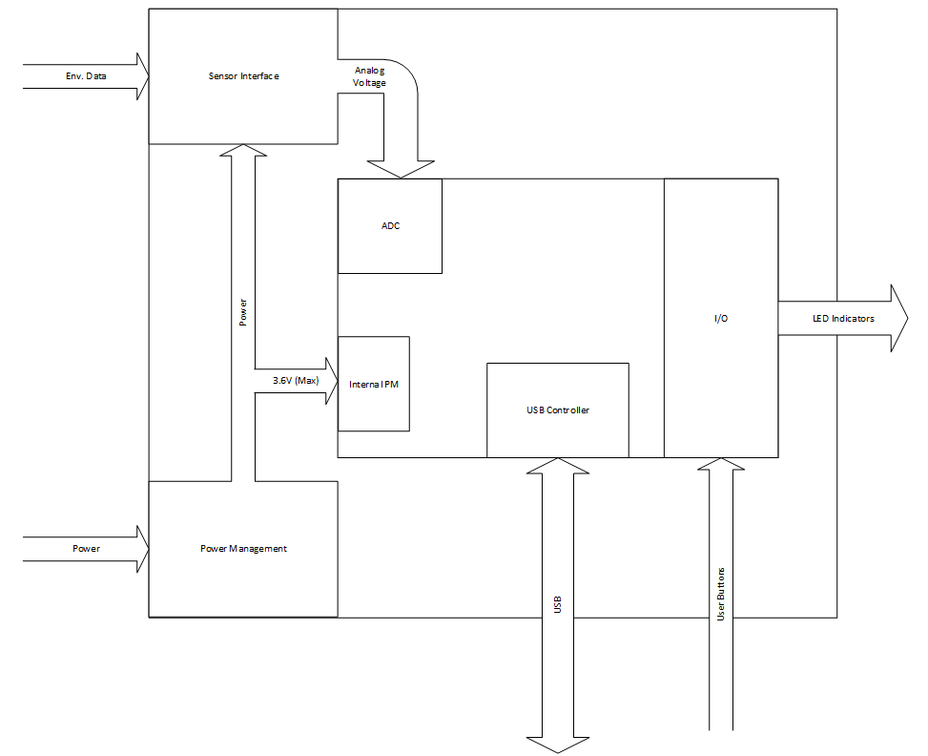
Hardware Overview
Hardware

Slide 6
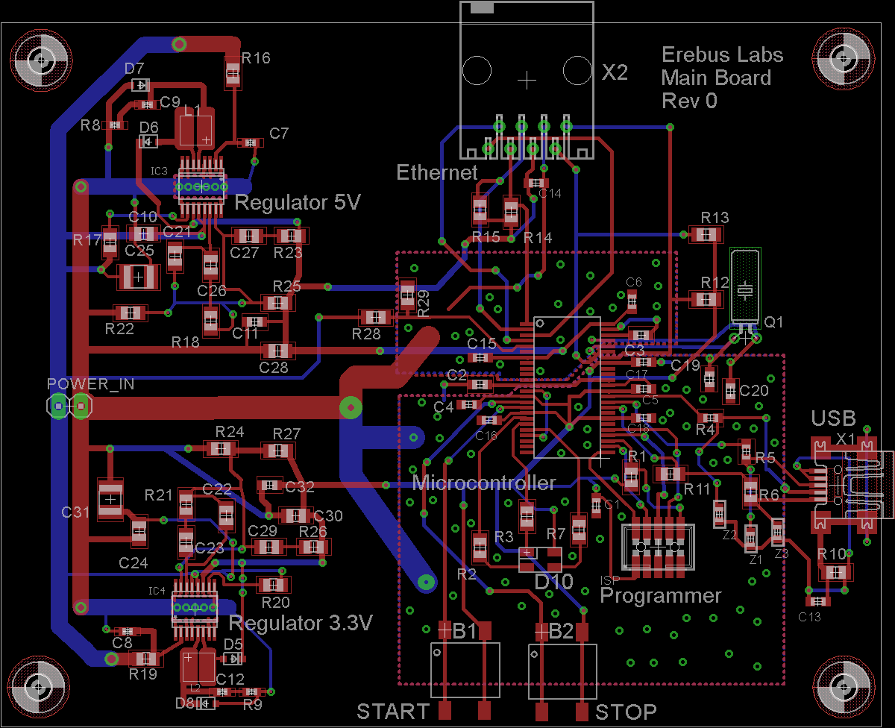
Main Board (Base Station)
Hardware
Sensor Port
PSoC 3 Microcontroller
USB Interface
Switching Power Supply
Notes:
Chris starts
Discuss GPs
Note power and interface and discuss in detail when they come up

Slide 7
Power Supply
Hardware
Linear Power Supply
Less Noise
Lower Battery Life
Switching Power Supply
Noise Not An Issue
Better Battery Life
One Part for 3V and 5V
More Complex
Notes:
Tradeoffs (LDO vs Swiching)
Switching regulators didn’t work on breadboard

Slide 8
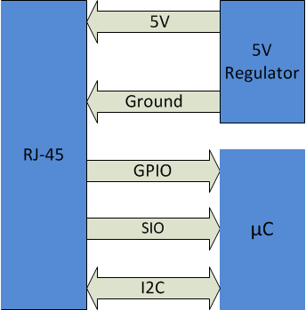
Interfaces
Hardware
Ethernet for Sensor Port
Cheap Cables
Easy to Work With
Many Lengths Available
USB
Standard for Most Computer Interface Applications
Micro USB = Small Footprint
Notes:
Ethernet:
Cheap cables are important for keeping costs low.
Easy to work with in consideration of use by children (not to hard to make your own cable).
Length kept in mind for future applications (e.g. sensor in a well)
More sensors could be put onto a single module
USB:

Slide 9
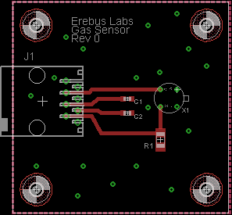
Low-Oxygen Sensor
Hardware
Figaro TGS 2600
Technically “Air Contaminant Sensor”
Resemblance to VOC Sensor
Easy to Find Applications or Experiments
Notes:
Labeled as an air contaminant sensor, the device senses contaminants due to the displacement of oxygen (or just normal breathing air) causing a change in the flow of electrons. Different sensitivity characteristics for different gasses.
Wanted to do a sensor that detected the quality of a substance similar to the original request for a VOC sensor for wells.
Experiments include things such as detecting change in air quality in high traffic areas over certain times or seeing how rapidly the quality of air changes when enclosed with a burning candle (and how long it takes for air to return to normal).

Slide 10
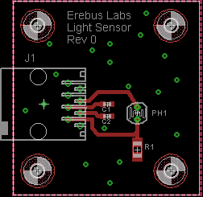
Light Sensor
Hardware
Easy to Implement
Simple to Understand
Many Use Cases
Proof of Concept Sensor

Slide 11
Other
Hardware
Two Buttons (Start & Stop)
LED System Indicator
Start Sampling
Stop Sampling
Powered with 4x AA Batteries

Slide 12
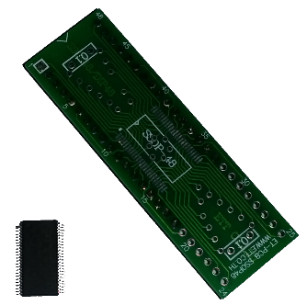
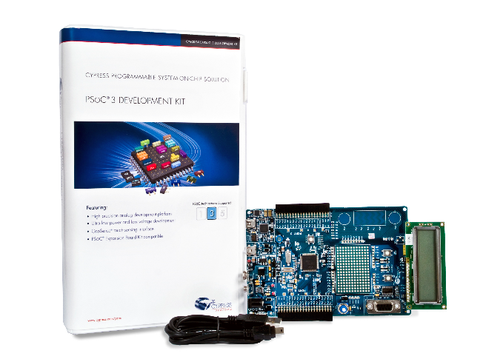
Cypress PSoC 3
Hardware
One Chip Solution
Real Time Clock
USB Controller
Hardware Emulation
Flexible Architecture
Universal Digital Blocks
Programmable Interconnects
Development Kit – Rapid Prototyping
Notes:
Max starts
One Comp E. Three with basic programming skills.
All had experience with Arduino. Simple IDEs
Needed something easy to program and could handle all we needed.

Slide 13
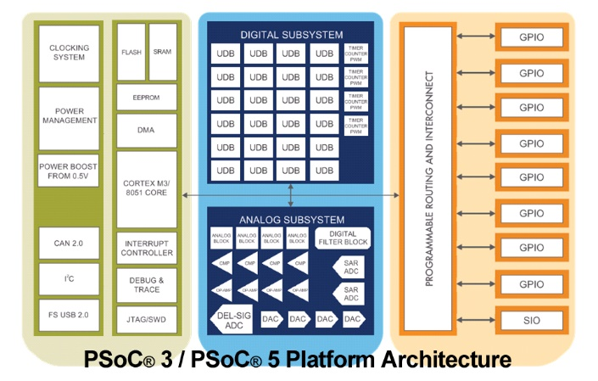
PSoC Architecture
Hardware
Notes:
Universal GPIO
Analog Digital
Multiplexed ADC
Programmable Gain
Configurable Logic

Slide 14
Software

Slide 15
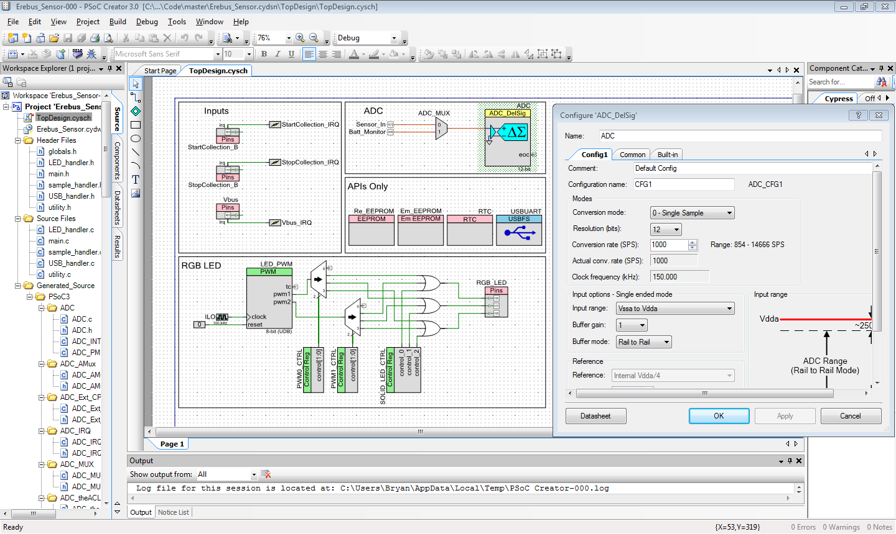
PSoC Creator
Software
Free Development Environment
Drag-and-Drop Programming
Extensive APIs
Notes:
EDE free to use. Graphical interface to simplify programming workload and design.
APIs. Option Windows. Build Project creates foundational code. Can modify from there.

Slide 16
Firmware
Software
EX: Sample Every 3 Seconds
RTC Interrupts
Sample Counter Increments
If Counter == Sample Interval
Take Sample
Notes:
Keep basic.
Wakes up every second to check for interrupt.
Pointers
Flash
Interrupts.
RTC Sampling
Buttons interrupt.
Once set up sleeps . Every second wakes up to check for flags.

Slide 17
Firmware
Software
Serial Over USB
LED System Indicator
Sample
Error
USB Connected
Max Speed 1 Sample Per Second
Notes:
Will not show up as USB. Virtual COM Port.
Sample:
Blue blink
Errors:
* Low Battery (blink yellow)
Memory Full (red)
USB
Solid teal
1 Second check. No faster
Counter logic for timed samples

Slide 18
Firmware
Software
Emulated EEPROM
Emulated Inside Flash
Wear Leveling
Power Management
No Power Switch
Minimal Current Use
Timestamps Using Real Time Clock
Notes:
Scott starts

Slide 19
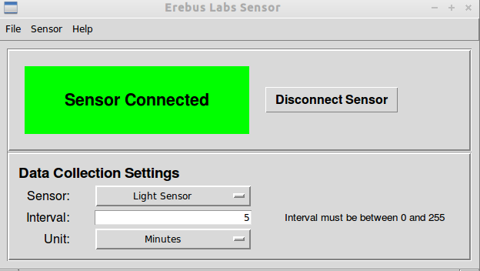
GUI
Software
Simple & Minimalistic
Sample Settings
Reference and Documentation

Slide 20
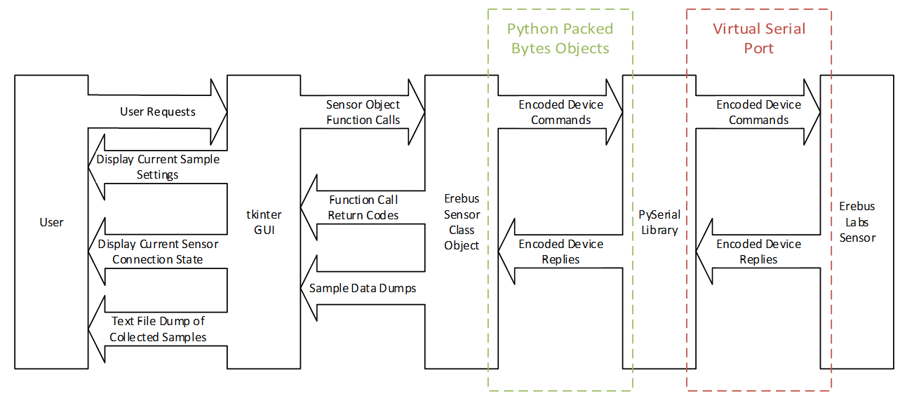
Software/Hardware Interaction
Software

Slide 21
Documentation
Notes:
Hand out documents
Stop example experiment and process data

Slide 22
User Documents
Documentation
Technical Reference Manual
System Architecture
User Manual
Fundamentals of Electronics
Notes:
Start handing out documentation

Slide 23
Project Documents
Documentation
Design Specification
Budget
Timeline
Requirements
Test Plan

Slide 24
Lessons Learned (Thoughts for Rev. 2)
Notes:
Bryan starts

Slide 25
Lessons Learned
Thoughts
Don’t Focus on Single-Chip Solution
Distribution = Power Savings
Use Separate EEPROM
Storage not Lost Due to Firmware Size
Wear Leveling
Use Off-Chip RTC
Button-Cell Battery Backup
Notes:
Current RTC loses time when power is lost

Slide 26
Revision 2
Thoughts
Critical Battery Shutdown
Enclosure Mounted Buttons
Power-Wire Strain Relief
Weather Proof Box
VOC Sensor
Multiple Sensor Ports
Jumper for Power

Slide 27
Q&A
Notes:
Answer questions

