Slide 1

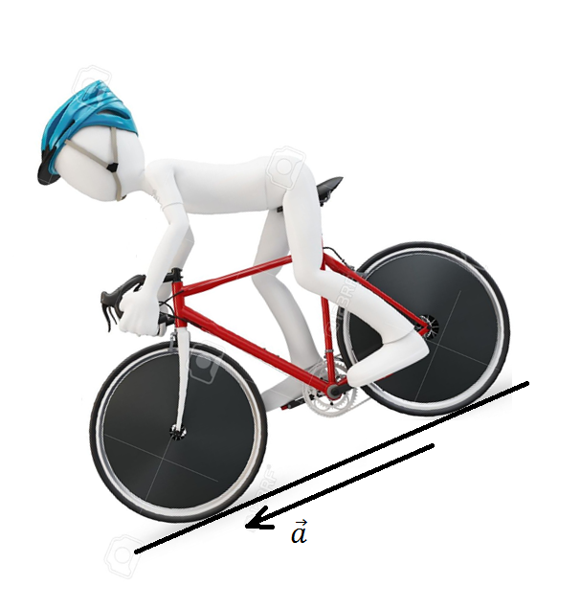

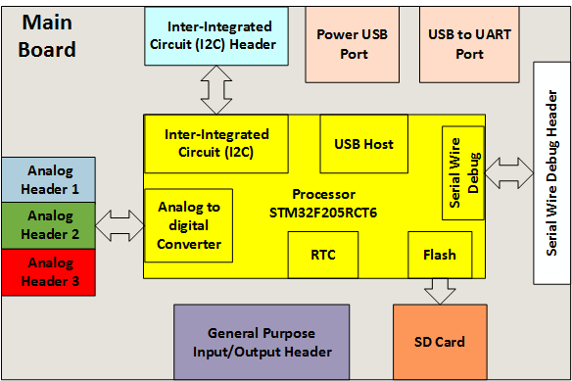
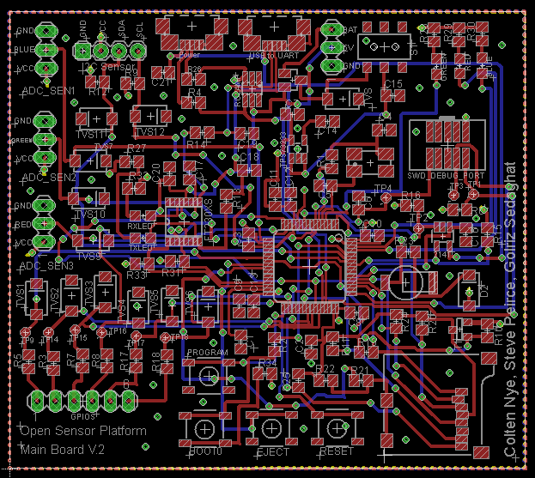
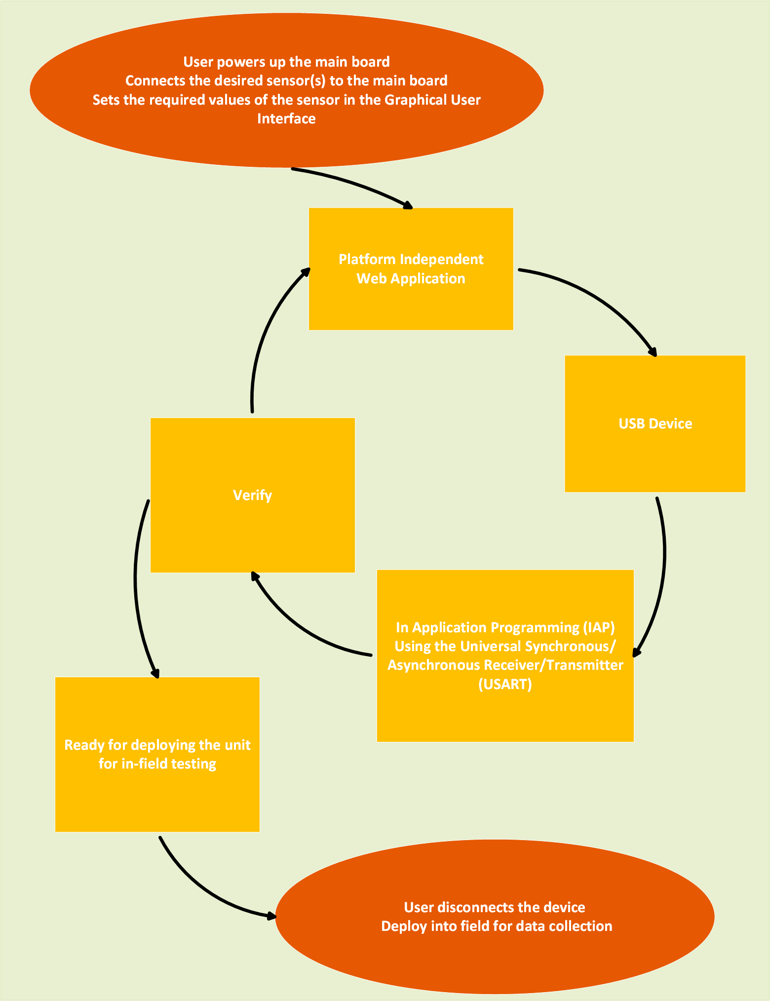
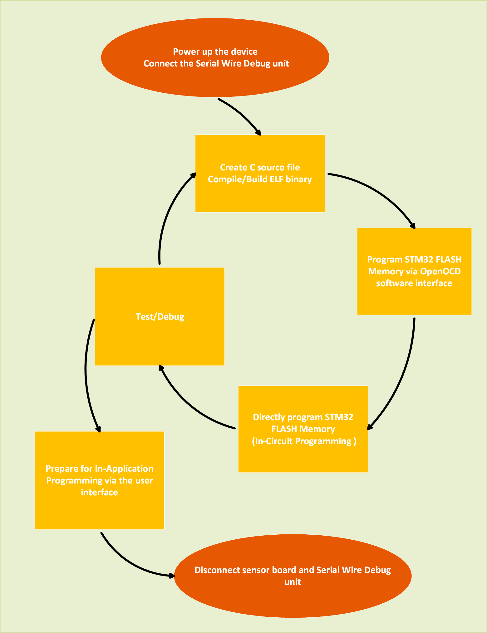
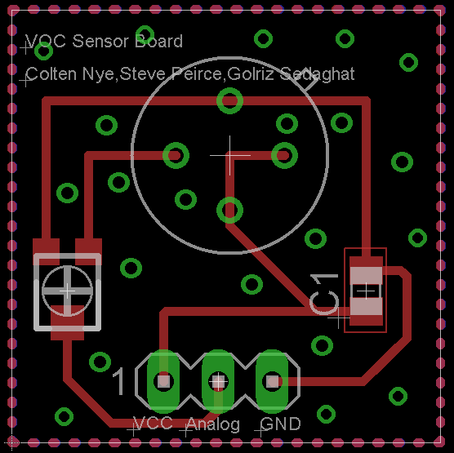
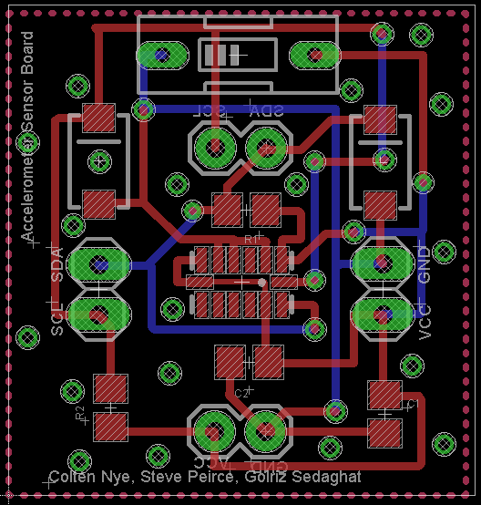



2015 PSU ECE Department Capstone Project
Sensor Platform
Colten Nye, Steve Peirce & Golriz Sedaghat | cnye@pdx.edu, jpei2@pdx.edu & golriz@pdx.edu
Advisor | Dr. Lisa Zurk | zurkl@pdx.edu
Sponsors | Dr. Andrea Burrows & Dr. Mike Borowczak | mike@erebuslabs.com & aburrow1@uwyo.edu
Overview
Implementation
Current hardware sensor solutions either require programming/electronics
experience beyond the reach of many K12 (K20) students, parents, teachers
and faculty – or they so turn-key that there is little to no “STEM” required to
get a solution up and running.
In this project we have designed and implemented an open-source sensor
platform; allowing a target audience of K-12 students and their teachers to collect data either by employing the supported sensors associated with the platform or connecting their own sensor modules via an open-source interface specification should the desired sensors not yet be supported. Once collected, students are able to process and analyze the data using their preferred methods.
Our final implementation consists of main board and two modular sensor boards: accelerometer and Volatile Organic Compound (VOC) sensor.
Planning Overview
User State Diagram Programmer State Diagram
Future Work
Lessons Learned
Deliverables & Related Resource
Maseeh College of Engineering and Computer Science

