Slide 2


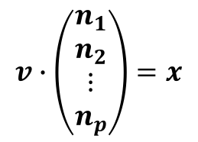
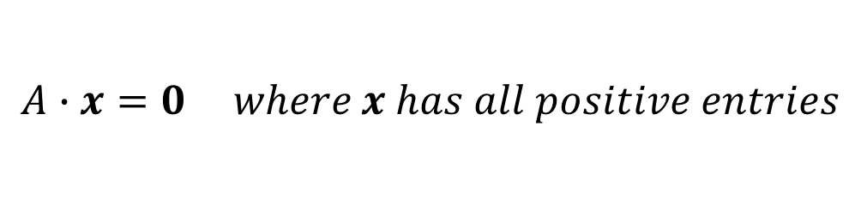
Prelude
What we want:
$$A∙x=0 where x has all positive entries$$
We can get a basis $n_{i}$ of the null space of $A$
And any null space vector can be created from a linear combination of the $n_{i}$
So another way to get what we want is to find the $v$ in the following equation such that vector $x$ has all positive entries:
$$v∙\left(\begin{matrix}n_{1} \\ n_{2} \\ \begin{matrix}⋮ \\ n_{p}\end{matrix}\end{matrix}\right)=x$$

Slide 3


Problem 1.0 Statement
Given a matrix $M$ find a vector $v$ such that:
$$v∙M=x where x has only positive entries$$
$x$ will be called the positive of $M$
and $v$ will be said to generate a positive for $M$

Slide 4



Approaching Problem 1.0
Let $c_{i}$ be the columns of $M$. Then:
$$v∙M=v∙\left(\begin{matrix}c_{1} & c_{2} & \begin{matrix}… & c_{p}\end{matrix}\end{matrix}\right)=\left(\begin{matrix}v∙c_{1} & v∙c_{2} & \begin{matrix}⋯ & v∙c_{p}\end{matrix}\end{matrix}\right)=\left(\begin{matrix}\begin{matrix}\left|v\right|\left|c_{1}\right|\cos{θ_{1}} & \left|v\right|\left|c_{2}\right|\cos{θ_{2}}\end{matrix} & \begin{matrix}⋯ & \left|v\right|\left|c_{p}\right|\cos{θ_{p}}\end{matrix}\end{matrix}\right)$$
Where $θ_{i}$ is the interior angle between $v$ and $c_{i}$.
Now, because $\left|v\right|\left|c_{i}\right|$ is always positive, we require that all of the $\cos{θ_{i}}$ are positive. Therefore our problem becomes becomes finding a $v$ such that the interior angle between it and every $c_{i}$ is less than or equal to $\frac{π}{2}$

Slide 5
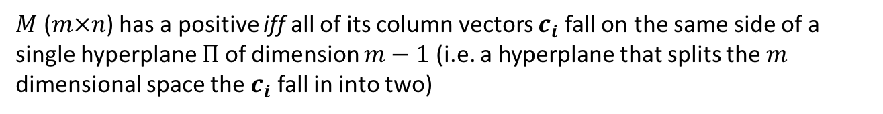
Conjecture
$M$ ($m×n$) has a positive iff all of its column vectors $c_{i}$ fall on the same side of a single hyperplane $Π$ of dimension $m−1$ (i.e. a hyperplane that splits the $m$ dimensional space the $c_{i}$ fall in into two)
Of course if $Π$ can be found, the normal vector on the same side as the $c_{i}$ generates a positive of $M$

Slide 6

Problem 2.0 Statement
Given a matrix $M$ ($m×n$) find all ($m−1$) dimensional planes $Π_{k}$ such that for each $Π_{k}$ all column vectors $c_{i}$ of $M$ are on one side of $Π_{k}$:

