Slide 1
מבוא לתיכנות מונחה עצמים – תהליכי ניתוח ותיכנון
מקורות:
Craig Larman, “Applying UML and Patterns”
Dr. Rahmi Marasli, CMU course
Dr. Mira Balaban, BGU course
GWT Lecturer, “UML Tutorials”,
https://www.youtube.com/watch?v=y7grsHY9Fa0&list=PLoWne5q-c9E_Q2_eAUZKPDA5K0V-O5zXs

Slide 2
תרשים סדרת-פעולות
Analysis
Design
Software
Requirements
Specification
Use Cases
Conceptual
Model
System
Sequence
Diagrams
Collaboration
/ sequence
Diagrams
Contracts
Design
Class
Diagrams
What are the business needs ?
(long text)
What are the domain process ?
(text +
visual notation)
How software objects interact to fulfill task ?
(visual)
What is the specification for the software classes ?
(visual)
What are the concepts, terms ?
(visual)
What are the system events, operations ?
(visual)
What do the system operations do ?
(text)

Slide 3
תרשים סדרת פעולות - דוגמה
Corresponds to:
Buy Item Use Case
:System
Cashier
enterItem(UPC,quantity)
Repeat until no more items
endSale()
makePayment(amount)

Slide 4
תרגום תרחיש-שימוש לתרשים-סדרת-פעולות
Actor Actions:
This use case begins when a Customer arrives at a POST checkout system with items to purchase
2. Cashier records the identifier for each item. If there is more than one of the same item, Cashier enters the quantity
4. On completion of item entry, Cashier indicates to POST that item entry is complete
6. Cashier tells Customer the total
System Response:
3. Determines item price and adds item info to the running sales transaction
Description and price of the current item is presented
5. Calculates and presents sale total
:System
Cashier
enterItem(UPC,quantity)
endSale()
makePayment(amount)

Slide 5
תרשים סדרת פעולות
Corresponds to:
Buy Item Use Case
System
BLACK BOX
Actor
Cross reference to use case
:System
Cashier
System event
enterItem(UPC,quantity)
Repeat until no more items
Text to clarify logic, control, iterations, etc..
endSale()
makePayment(amount)

Slide 6
הוספת הפעולות שמבצעת המערכת
external actor to
Process Sale Scenario
system
: Cashier
:System
makeNewSale()
box may enlose an
iteration area
the * [...] is an iteration
enterItem(itemID, quantity)
marker and clause
indicating the box is for
description, total
iteration
* [more items]
endSale()
a message with
return value(s)
parameters
associated with the
total with taxes
it is an abstraction
previous message
representing the
an abstraction that
system event of
ignores presentation
makePayment(amount)
entering the
and medium
payment data by
some mechanism
the return line is
change due, receipt
optional if nothing is
returned

Slide 7
איך לקרוא לפעולות בתרשים?
- לפי הכוונה ולא לפי הפעולה הפיסית. דוגמאות:
יותר טוב
פחות טוב
endSale() ESCPressed()
makePayment(amount) enterAmountTendered(amount)
enterPayment(amount)

Slide 8
חוזי-פעולות:
מה כל פעולה אמורה לבצע.
לכל פעולה יש דרישות (pre-conditions)
והבטחות (post-conditions).
Analysis
Design
Software
Requirements
Specification
Use Cases
Conceptual
Model
System
Sequence
Diagrams
Collaboration
/ sequence
Diagrams
Contracts
Design
Class
Diagrams
What are the business needs ?
(long text)
What are the domain process ?
(text +
visual notation)
How software objects interact to fulfill task ?
(visual)
What is the specification for the software classes ?
(visual)
What are the concepts, terms ?
(visual)
What are the system events, operations ?
(visual)
What do the system operations do ?
(text)

Slide 9
חוזים – דוגמה – הפעולה enterItem
Name: enterItem(upc:number, quantity:integer)
Responsibility: Enter (record) sale of an item and add it to sale. Display item description and price.
Type: System
Cross References: System Functions: R1.1, R1.3, R1.9.
Use Cases: Buy Items
Notes: Use fast dbase access
Exceptions: If UPC is invalid, indicate an error
Pre-Conditions: UPC is known to system - דרישות

Slide 10
חוזים – דוגמה – הפעולה enterItem
Post-Conditions - הבטחות
  If new sale, a Sale was created (instance creation)
  If new sale, new Sale was associated with POST (association formed)
  A SalesLineItem was created (instance created)
  SalesLineItem was associated with Sale (association formed)
  SaleLineItem.quantity was set to quantity (attribute modification)
  SaleLineItem was associated with ProductSpecification based on UPC match (association formed)

Slide 11
חוזים – סעיפים בחוזה
Name: Name of operation, and parameters
Responsibilities: An informal description of responsibilities this operation must fulfill
Type: Name of type (concept, software class, interface)
Cross References: System function reference numbers, use cases, etc.
Notes: Design notes, algorithms, etc.
Exceptions: Exceptional cases

Slide 12
חוזים – סעיפים בחוזה
Output: Non-UI outputs such as messages or records that are sent outside of system
Pre-Conditions: Assumptions about the state of system before execution of operation
Post-Conditions:
  The state of system after completion of operation

Slide 13
איך כותבים חוזה?
מזהים פעולות בתרשים-סדרת-פעולות.
לכל פעולה שמתבצעת ע”י המערכת, יוצרים חוזה.
כותבים את סעיף ה”אחריות” (Responsibility) – מה תפקיד הפעולה בסדרת-הפעולות?
כותבים את סעיף ה”הבטחות”(Post-conditions) – מה המצב אחרי שהפעולה הסתיימה בהצלחה?
כותבים את סעיף ה”דרישות” (Pre-conditions) – מה צריך להיות המצב לפני שהפעולה התחילה, כדי שהיא תוכל להתבצע בהצלחה?

Slide 14
מתרחישי-שימוש לחוזי-פעולות
Operation:
enterItem
…
Post-conditions:
1. …
Buy Item
…
Typical Course
of Events:
…
Cashier System
System
enterItem()
endSale()
makePayment()
enterItem
endSale
makePayment
Operation:
endSale
…
Post-conditions:
1. …
System
Sequence
Diagram
Use
Case
System
Operations
Contracts

Slide 15
חוזי-פעולה – דוגמאות נוספות

Slide 16
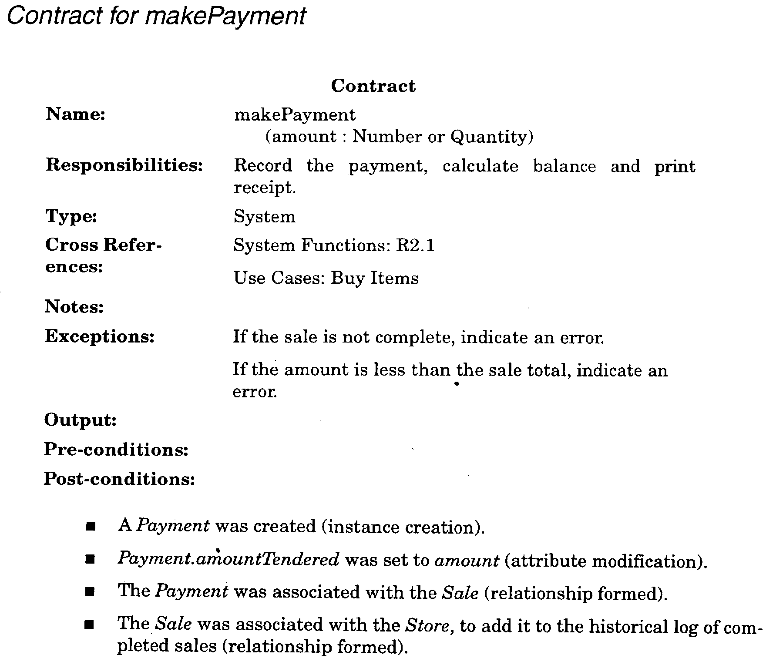

Slide 17
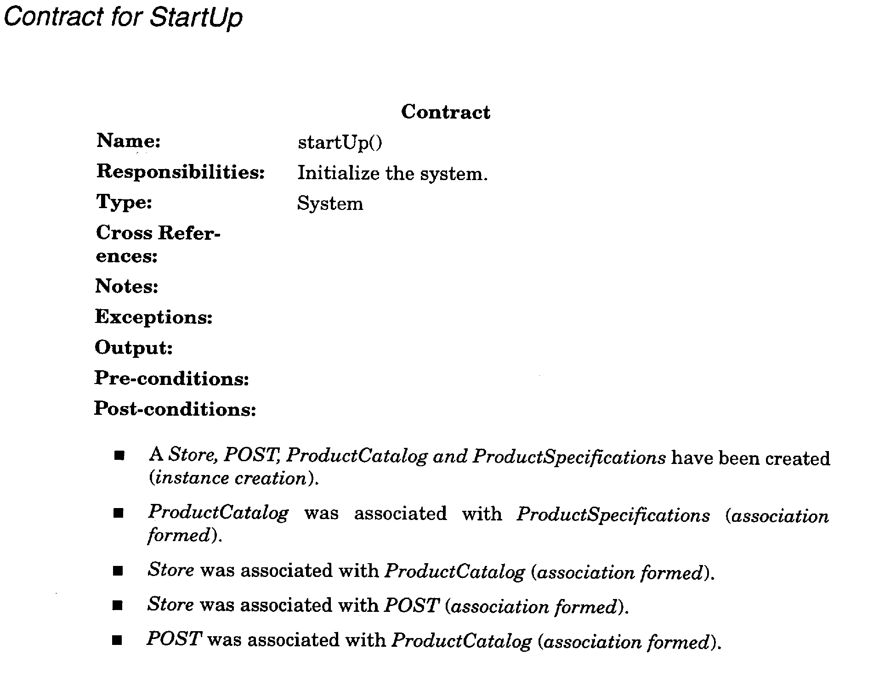

Slide 18
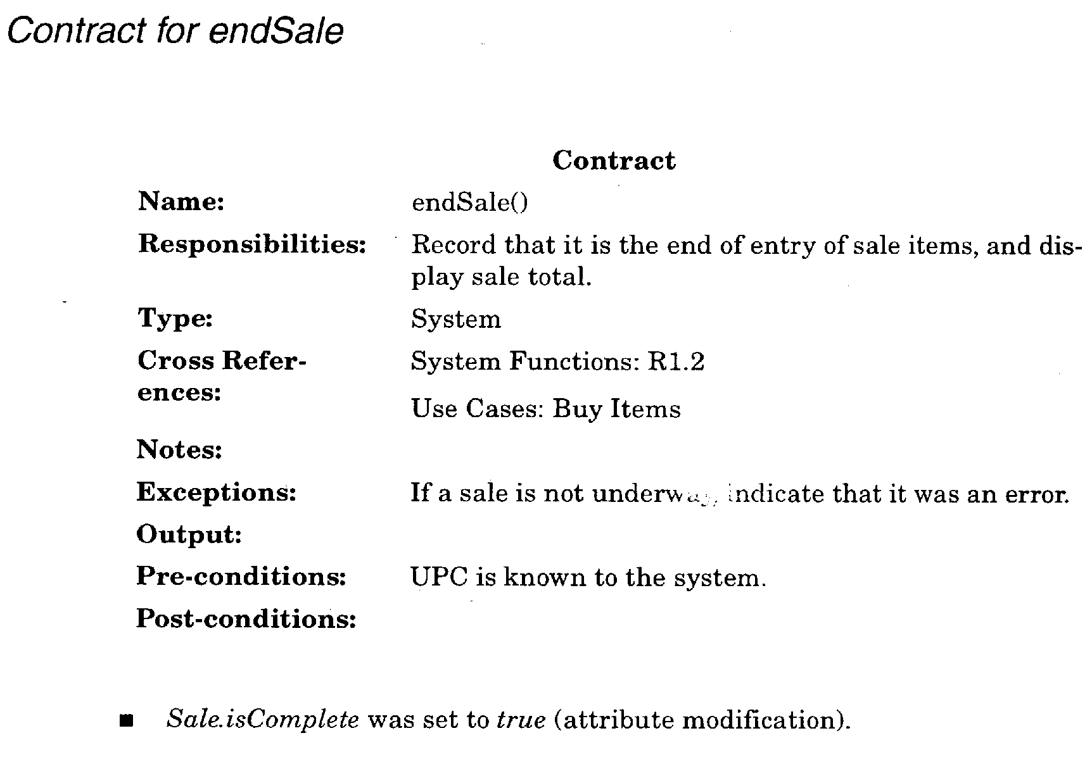

Slide 19
מתרחיש-שימוש לחוזה-פעולה - דוגמה
מערכת כניסה (login)
לרשת מחשבים

Slide 20
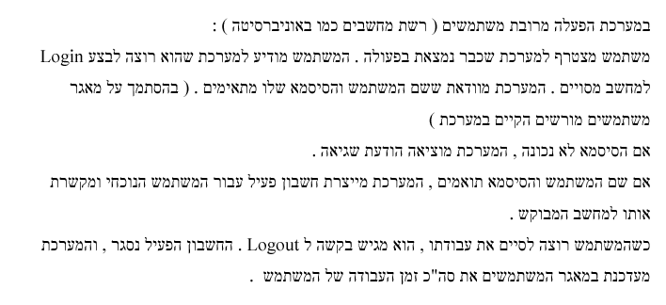
תרחיש שימוש

Slide 21
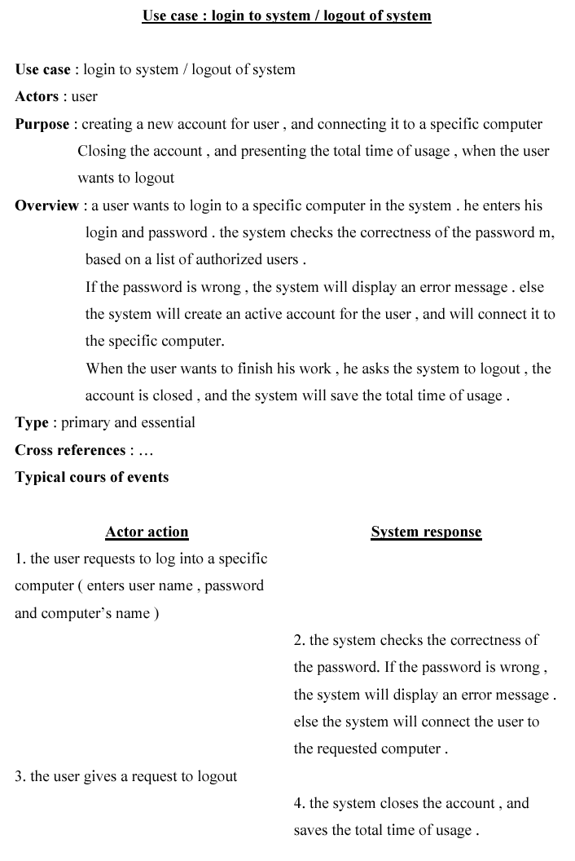

Slide 22
