Slide 1


Fair Division among Families
(Ezekiel 47:14)
Erel Segal-Halevi
Based on joint works with:
Shmuel Nitzan – Bar Ilan University
Warut Suksompong – Oxford University
Sophie Bade – Royal Holloway University of London

Slide 2

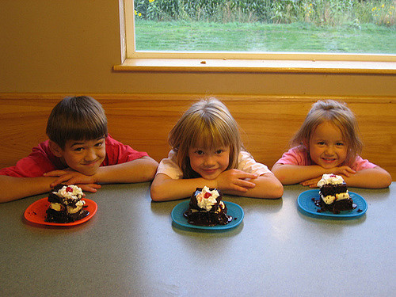

Individual vs. Family Goods
Different preferences;
Different shares;
Each agent should believe his share is “good enough“.
Different preferences;
Same share;
Each agent should believe his family‘s share is “good enough“.

Slide 3
Social Choice Theory
Voting theory:
all agents
are affected
by group decision.
Fair division:
each agent
has a
personal share.
Fair division among families

Slide 4



Fair Division Settings
Resource type | Example | Challenge
1. Heterogeneous, divisible resource | cake, land | Fair and connected.
2. Homogeneous, divisible resources | fruits, electricity | Fair and Pareto-optimal.
3. Indivisible goods | jewels, houses | “Almost“ fair.

Slide 5
1. Heter. div. – Individuals
Fairness in an economy of individuals:
Envy-free (EF): each individal‘s utility in his share ≥ his utility in any other share.
Proportional (PR): each individal‘s utility in his share is ≥ (cake utility) / (# individuals).
Theorem (Stromquist, 1980):
For any number of individuals, there exists
a connected + EF + PR allocation.

Slide 6
1. Heter. div. – families
Fairness in an economy of families:
Envy-free (EF): each individal‘s utility in his family‘s share ≥ utility in another family‘s share.
Proportional (PR): each individal‘s utility in his family‘s share ≥ (cake utility) / (# families).
Theorem (with Shmuel Nitzan):
There might be no allocation that is both connected and EF and/or PR.

Slide 7
1. Heter. div. – families
Theorem 1-: There are instances with 2 families where no connected allocation is EF/PR.
Proof: There are a couple and a single. Each individual wants a distinct segment of the cake:
In any connected division, at least one individual gets a utility of 0.

Slide 8
2. Homog. div. – individuals
Fairness in an economy of individuals:
Envy-free (EF): each individal prefers his share to the shares of all other agents.
Fair-share guarantee (FS): each individal prefers his share to an equal split of resources.
Theorem (Varian, 1974):
If all preferences are monotone and convex,
then PO+EF+FS are compatible.

Slide 9
2. Homog. div. – families
Fairness in an economy of families:
Envy-free (EF): each individal prefers his family‘s share to shares of all other families.
Fair-share guarantee (FS): each individal prefers his family‘s share to an equal split.
Fairness is harder – all agents must agree.
Pareto-optimality is easier – all agents must agree to a Pareto-improvement.
Does a PO+EF / PO+FS allocation exist?

Slide 10
2. Homog. div. – families
Fairness in an economy of families:
Envy-free (EF): each individal prefers his family‘s share to shares of all other families.
Fair-share guarantee (FS): each individal prefers his family‘s share to the equal split.
Theorem (with Sophie Bade):
PO+EF - incompatile for 3 or more families;
compatible for 2 families.
PO+FS – always compatible.

Slide 11
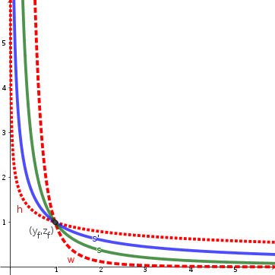
2. Homog. div. – families
Theorem 2-: With 3 families, a PO+EF division might not exist.
Proof: 3 families:
1 couple, 2 singles.
Cobb-Douglas prefs.
EF → each single must consume same bundle as family.
Singles consume same bundle→not PO.

Slide 12
2. Homog. div. – families
Theorem 2+: If individuals‘ preferences are represented by continuous utility functions, then a Pareto-optimal fair-share allocation exists.
Proof: Let F := set of all FS allocations.
X := FS allocation that maximizes sum of utilities
X exists by continuity and compactness of F.
X is FS since it is in F.
X is PO since a Pareto-improvement of X would also be in F, contradicing the maximality of X.

Slide 13
2. Homog. div. – families
Theorem 2++: If there are 2 families, and agents‘ preferences are continuous & convex, then a Pareto-optimal envy-free allocation exists.
Proof: Let X be a PO+FS allocation.
X exists by previous theorem.
X is EF. Suppose member i of family 1 envied family 2. Then i would prefer
(Endowment – X₁ ) over X₁. By convexity, i would prefer Endowment/2 to X₁ → X were not FS.

Slide 14
3. Indivisible – individuals
Fairness in an economy of individuals:
Envy-free-except-c (EFc): each individual weakly prefers his share to any other share when some c goods are removed from it.
1-of-c maximin-share (MMS): each individual weakly prefers his share to dividing the goods into c piles and getting the worst pile.
Theorem (Budish, 2011): for n individuals, an EF1 and 1-out-of-(n+1)-MMS allocation exists.

Slide 15
3. Indivisible – families
Fairness in an economy of families:
Envy-free-except-c (EFc): each individual weakly prefers his family‘s share to any other share when some c goods are removed from it.
1-of-c maximin-share (MMS): each individual weakly prefers his family‘s share to dividing the goods to c piles and getting the worst pile.
Theorem (with Warut Suksompong): for any finite integer c, even with 2 families, there might be no allocation that is EFc and/or 1-of-c-MMS.

Slide 16
3. Indivisible – families
Theorem 3-: for any finite integer c, there are instances with 2 families, with binary additive valuations, where no allocation is EFc and/or 1-of-c-MMS.
Proof: There are 2*c goods. For each distinct subset of c goods, each family has a member who assigns utility 1 to exactly these c goods and utility 0 to the other c goods.
In any allocation, at least one individual has utility 0, so for him, it is not EFc nor 1-of-c-MMS.

Slide 17
Interim Summary
Resource | Challenge | Individuals | Families
1. Het +Div | EF+CON PR+CON | Yes Yes | No for 2+ families No for 2+ families
2. Hom +Div | EF+PO FS+PO | Yes Yes | No for 3+ families Yes
3. Indiv | EFc 1-of-c-MMS | Yes (c=1) Yes (c=n+1) | No for 2+ families No for 2+ families
Unanimous fairness is too much to ask for.

Slide 18
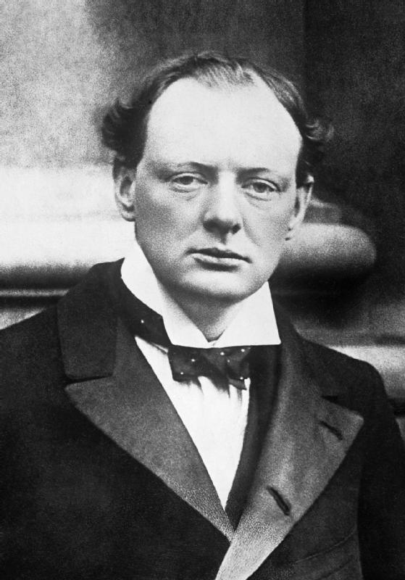
Democratic Fairness
“Democracy is the worst form of government.
...except all the others that have been tried.” (Winston Churchil)
Definition: h-democratic fairness (h∈[0,1]) := fairness in the eyes of at least a fraction h of the agents in each family.
We saw: 1-democratic fairness is impossible.
For what h is h-democratic fairness possible?

Slide 19
1. Heter. div. – democratic
Theorem 1+: For every integer k, for every k families, there exists a connected
1/k-democratic EF+PR division.
Proof: Run an existing protocol for finding a connected EF+PR division (Su, 1999).
Whenever a family has to choose the best of k pieces, let it choose using plurality voting.
At least 1/k members of each family are happy with the family‘s choice.

Slide 20

1. Heter. div. – democratic
Theorem 1+: For every integer k, for every k families, there is a connected 1/k-democratic EF+PR division.
Corollary: For every 2 families, we can find a connected allocation that will win a (weak) majority in a referendum.
Questions:
Can we get a support larger than 1/2?
Can we get a support of 1/2 with 3 families?

Slide 21
1. Heter. div. – democratic
Theorem 1-: For every integer k, there are instances with k families where no connected allocation is more than 1/k-democratic EF/PR.
Proof: A family with k members, and k-1 singles. Each individual wants distinct segment:
In any connected division, if two or more members of the family receive non-zero utility, then one single receives zero utility.

Slide 22

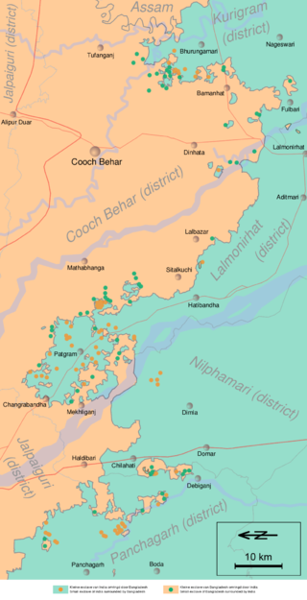
1. Heter. div. – democratic
Theorem 1-: For every integer k, there are instances with k families where no connected allocation is more than 1/k-democratic EF/PR.
With 2 families: cannot guarantee
the support of more than 1/2.
With 3 or more families: cannot
guarantee even a weak majority.
Possible solution: compromise
on the connectivity requirement.

Slide 23

1. Heter. div. – democratic
Example theorems (proofs in paper):
For 2 families with n individuals in total:
There is a 1-democratic EF+PR division with n connected-components;
There might be no 1-democratic EF+PR division with less than n components.
For 3 families with n individuals in total:
There is a 1/2-democratic EF+PR division with n/2+2 connected-components;
There might be no 1/2-democratic EF+PR division with less than n/4 components.

Slide 24
1. Heter. div. – exact
Definition. Given N agents, an Exact(N,K)-partition of an interval is a partition into K pieces that all N agents consider exactly equal.
Much stronger than envy-free division.
Lemma (Alon, 1987): A Exact(N,K)-partition of an interval can be attained using (K-1)*N cuts, and this number is tight.
Example for N=4, K=2:

Slide 25
1. Heter. div. – democratic
A 1/2-democratic EF+PR division for 3 families:
Each individual marks x with val(0,x)=1/3.
Each family i finds median m_{i} of its members‘ points. W.l.o.g. m₁ ≤ m₂ ≤ m₃ ,
Give [0, m₁ ] to family 1. This piece is worth:
* at least 1/3 to 1/2 of the members in family 1;
* at most 1/3 to 1/2 of the members in families 2, 3.
Find an Exact(n/2,2)-division of [m₁,1] among these n/2 members; this requires n/2 cuts.
All in all: n/2+1 cuts, so n/2+2 components.

Slide 26
1. Heter. div. – democratic
Proof of negative part for 3 families:
3 families, each individual wants a distinct interval:
To give each agent positive value: n components.
Unifying two components of the same group removes 3 components and “zeroes“ 2 agents.
We can “zero“ at most n/2 agents;
so we can unify at most n/4 times;
so we can remove at most 3 n/4 components;
so we remain with at least n/4 components.

Slide 27
1. Heter. div. – democratic
Open questions:
[Combinatorial] How many components we need for 3 families (between n/4 and n/2+2)?
  * Useful for small families only.
[Geometric] Can we have a connected fair division of a 2-dimensional resource?

Slide 28
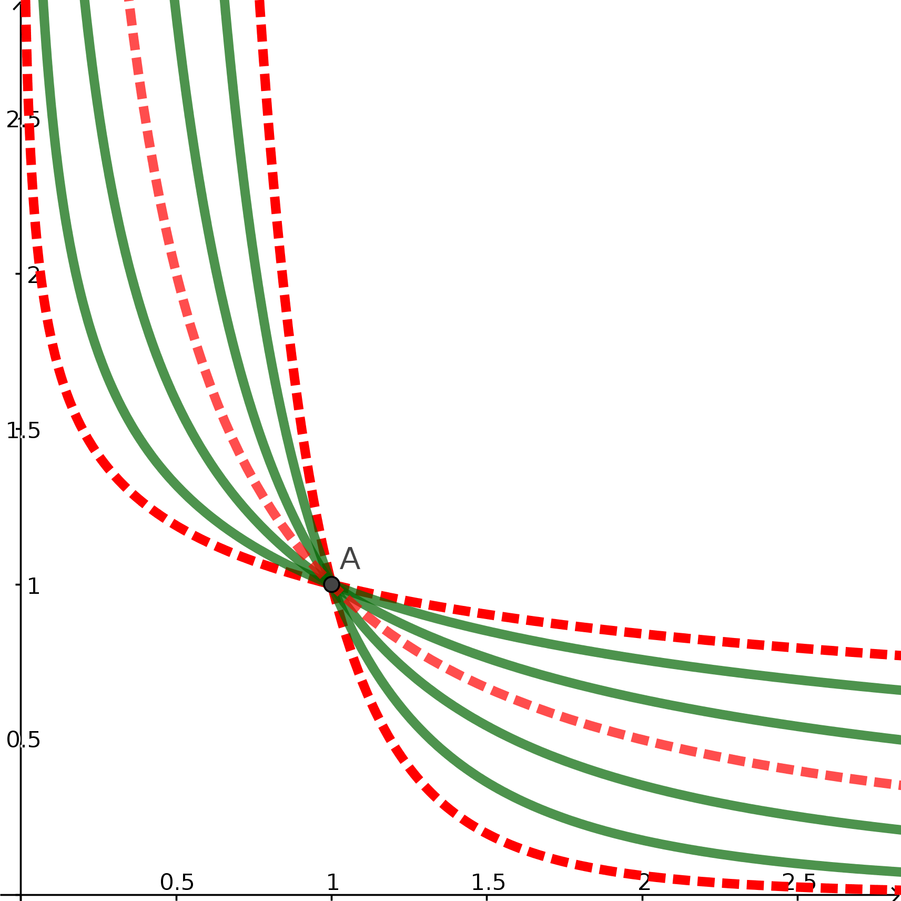
2. Homog. div. – democratic
Theorem 2-: With 2k-1 families, There might be no PO allocation that is EF for more than 1/k the members in each group.
Proof: 2k-2 singles + family with k members.
Example for k = 3 →
If at least two members of the family are EF – the allocation is not PO.

Slide 29
2. Homog. div. – democratic
Open question: with 3 or 4 families, is there always a PO allocation that is EF for at least 1/2 the members in each family?
In other words: can we find a PO allocation that will win a (weak) majority in a referendum?

Slide 30

3. Indivisible – democratic
Theorem 3+: For every integer k and k families, there is a 1/k-democratic “EF–2“ allocation.
Proof idea:
Put all goods on a line.
Treat the line as a cake.
Find a connected 1/k-democratic EF division.
“Slide“ the cuts to be between the goods.
* This creates less than 2 “envy units“.

Slide 31
3. Indivisible – democratic
Theorem 3++: For k=2 families, there is a 1/2-democratic EF1 allocation.
Proof: EF1: same as Theorem 3+, but now the
cut-sliding creates only 1 “envy unit“.
Corollary: For 2 families, there is an allocation that may win a (weak) majority in a referendum.
Can we get a support larger than 1/2?
Can we get a support of 1/2 with 3 families?

Slide 32
3. Indivisible – democratic
Theorem 3+: The following are attainable:
For k families: 1/k-democratic EF2.
For k ≤ 4 families: a 1/k-democratic EF1.
Proof: Run a protocol for individuals (Bilo et al. 2018), applying plurality voting like Theorem 1+.
Corollary: For 2 families, there is an allocation that may win a (weak) majority in a referendum.
Can we get a support larger than 1/2?
Can we get a support of 1/2 with 3 families?

Slide 33
3. Indivisible – democratic
Theorem 3-: For every integer k, there are instances with k families with binary additive valuations, where no allocation is more than
1/k-democratic EF1 (proof in paper).
With 2 families: cannot guarantee
the support of more than 1/2.
With 3 or more families: cannot guarantee even a weak majority.
Possible solution: compromise on the
fairness requirement.

Slide 34
3. Indivisible – democratic
Theorem 3++: For every integer c ≥ 1, for 2 families, when all agents have binary additive valuations, there exists a (1 – 1/2^{c-1})-democratic
1-out-of-c MMS allocation. Examples:
1/2-democratic 1-out-of-2 MMS;
3/4-democratic 1-out-of-3 MMS;
7/8-democratic 1-out-of-4 MMS;

Slide 35
3. Indivisible – democratic
Proof idea: Round-robin protocol with approval voting.
Each family in turn picks a good. To decide what to pick, the family uses weighted approval voting.
Each family member is assigned a potential based on his number of remaining wanted goods, and the number of goods he should receive for the fairness.
The potential of a “winning“ agent increases;
the potential of a “losing“ agent decreases.
The voting weight of an agent is his potential-decrease in case he loses.

Slide 36
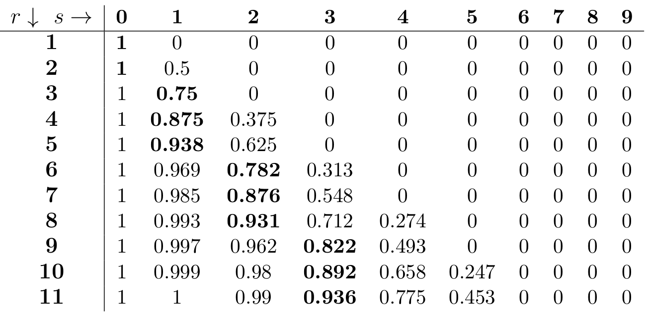
3. Indivisible – democratic
Potential table for round-robin protocol:
(boldface cells correspond to 1-of-3-MMS)

Slide 37
3. Indivisible – democratic
Proof idea (cont.):
Potentials are calculated such that, for each agent:
the potential increase in case he loses
≥ the potential decrease in case he loses
Hence, the total family potential always increases.
At the end, the potential is:
1 for an agent who feels the division is fair;
0 for an agent who feels it is unfair.
The fraction of happy agents is at least the smallest initial potential of an agent, which is (1 – 1/2^{c-1}).

Slide 38
3. Indivisible – democratic
We focus on 2 families with binary valuations.
Definition. Let s(r) be an integer function. A division is called s(r)-fair if every agent who assings utility 1 to r goods receives at least s(r) goods.
EF1: s(r) = floor(r/2).
1-out-of-c-MMS: s(r) = floor(r/c).

Slide 39
3. Indivisible – democratic
Theorem 3+++: For 2 binary families, we can find an h-democratic s(r)-fair allocation, with h ≥:

Slide 40
Summary
Resource | Challenge | h-democratic
1. Het +Div | EF+CON PR+CON | k families: h = 1/k. k families: h = 1/k.
2. Hom +Div | EF+PO FS+PO | 2k-1 families: h ≤ 1/k. k families: h = 1.
3. Indiv | EF2 / EF1 1-of-c-MMS | k families: h = 1/k. 2 binary families: 1 – 1/2^{c-1}

Slide 41
Conclusion
When dividing goods among families:
Unanimous fairness is usually impossible.
1/2-democratic fairness is often possible for the common case of 2 families.
Main open questions for 3 families:
Het+div: #components for envy-free?
Hom+div: PO 1/2-democratic envy-free?
Indiv: 1/2-democratic 1-of-c-MMS?
Thank you!

