Slide 1


Double Auctions in Markets for
Multiple Kinds of Goods
Erel Segal-Halevi
Avinatan Hassidim
Yonatan Aumann

Slide 2


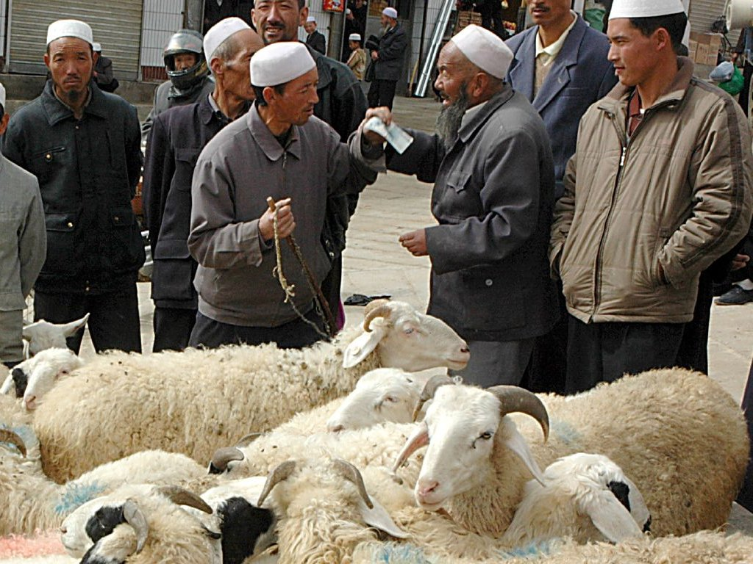
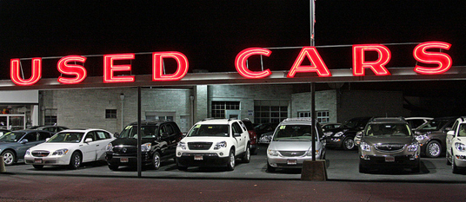
Two-Sided Markets
Both buyers and sellers have private valuations:
Image credit: pixabay
Image credit:
Wikipedia “Wireless network”
Image credit: Wikipedia “Haggling”
http://youtube.com/watch?v=7TxLKH0ortw&t=13s

Slide 3
Price-Equilibrium (Walras 1896)
Buyers
Value
Maximum gain-from-trade (GFT).
Exists in markets for multiple kinds of goods if all valuations are Gross-Substitutes
(= no complementarities)
Not truthful
k=5 efficient deals
Price
Sellers

Slide 4
Impossibility (Myerson & Satterthwaite 1983)
Buyers
Value
In a two-sided market, a truthful mechanism that attains the maximum gain-from-trade must run at a deficit (= requires subsidy).
k=5 efficient deals
Sellers

Slide 5
Market Design Goals
Truthful;
Budget-balanced (no deficit);
Asymptotically-maximal GFT (approaches maximum when market size approaches ∞);
Prior-free.
Buyers
Value
k=5 efficient deals
Sellers

Slide 6
Some Previous Mechanisms
 | Truth-ful | GFT Max-GFT | Multiple kinds of goods?
Price-Equilib. (Walras, 1896) | No | 1 (1st welf. thm) | Yes, gross-substitute vals.
McAfee (JET 1992) | Yes | 1 – 1/k (asymp. opt.) | No – only 1-kind 1-unit.
Colini-Baldeschi et al (EC ‘17) | Yes | 1/6 | Yes – buyers only.
Gonen & Egri (AAMAS ‘17) | Yes | 1/n | Yes – buyers and sellers.
MUDA (AAAI ‘18) | Yes | (asymp. opt.) | Many units but 1 kind.

Slide 7
MUDA (AAAI 2018)
Split traders randomly to “left” and “right”. in each side:
1. Calculate Walrasian equilibrium
price (price in which demand=supply).
2. Let traders trade at price from
other side (guarantees truthfulness).

Slide 8
MUDA 0: Random Halving
Right
Left

Slide 9
MUDA 1: Equilibrium Calculation
Right
p_{L}
p_{R}
Left

Slide 10
MUDA 2: Posted Pricing
Right
p_{L}
p_{R}
Left

Slide 11
MUDA 2: Trade Loss
With 1 kind, # lost deals is O(ln k √k).
Right
p_{L}
p_{R}
Left

Slide 12
MUDA 2: Trade Loss
With 1 kind, approx. ratio is O(1-(ln k √k) / k).
Right
p_{L}
p_{R}
Left

Slide 13
Challenges extending to multi-kind
1. Truthfulness challenge: traders may strategize over what kinds to trade, even when prices are fixed.
2. Gain-from-trade challenge: small sampling errors in one kind may have large effects on other kinds.

Slide 14
Current assumptions
1. Each seller sells one kind.
2. Both buyers and sellers have gross-substitute valuations.

Slide 15
MIDA (Multi Item-kind Double Auction)
Split traders randomly. In each side:
1. Calculate equilibrium price-vector.
2. Traders trade at other price-vector:
Order sellers of same good randomly.
Order buyers randomly.
First buyer buys a best bundle
from first sellers and goes home.
First seller may go home at any time.

Slide 16




Truthfulness challenge
Theorem 1. If each seller sells multiple units of a single kind,
and all buyers and sellers have gross-substitute valuations,
then MIDA is truthful (ex-ante and ex-post).
Buyers
Sellers

Slide 17
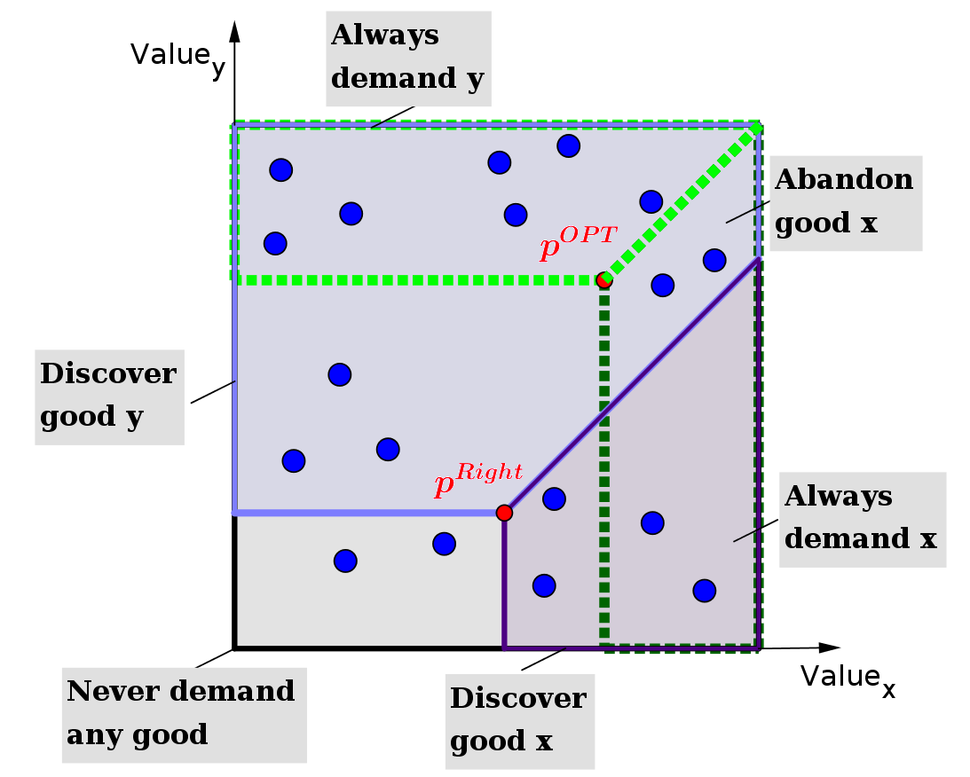
Efficiency challenge
Lemma (downward-demand-flow).
If a GS agent abandons a good whose price decreased, he must have discovered a good whose price decreased
even more.

Slide 18
Efficiency challenge
Theorem 2. If all traders have gross-substitute valuations, then the expected competitive ratio of MIDA is at least:
G = number of good-kinds;
M = max #units traded by one person;
k_{max} = max_{x} k_{x} ; k_{x} = #units of good x traded in optimal situation; c = k_{max} / k_{min}.

Slide 19
Previous Mechanisms
 | Truthful | GFT Max-GFT | Multiple kinds of goods?
Price-Equilib. (Walras, 1896) | No | 1 (1st welf. thm) | Yes, gross-substitute vals.
McAfee (JET 1992) | Yes | 1 – 1/k (asymp. opt.) | No – only 1-kind 1-unit.
Colini-Baldeschi et al (EC ‘17) | Yes | 1/6 | Yes – buyers only.
Gonen & Egri (AAMAS ‘17) | Yes | ~ 0.5 (simulations) | Yes – buyers and sellers.
MIDA (IJCAI ‘18) | Yes | 1 - ... (asymp. opt.) | Yes in one side; gross-substitute vals.

Slide 20
Open Question
Is there a double-auction mechanism that is:
truthful,
budget-balanced,
attains asymptotically-optimal GFT;
allows both buyers and sellers to trade multiple kinds of goods?

Slide 21
Acknowledments
Game theory seminar in BIU
Ron Peretz
Simcha Haber
Tom van der Zanden
Assaf Romm
Economic theory seminar in HUJI
Econ.&Comp. seminar in HUJI
Algorithms seminar in TAU
Game theory seminar in Technion

