Slide 1


Redividing the Cake
(Ezekiel 47:14)
Erel Segal-Halevi

Slide 2


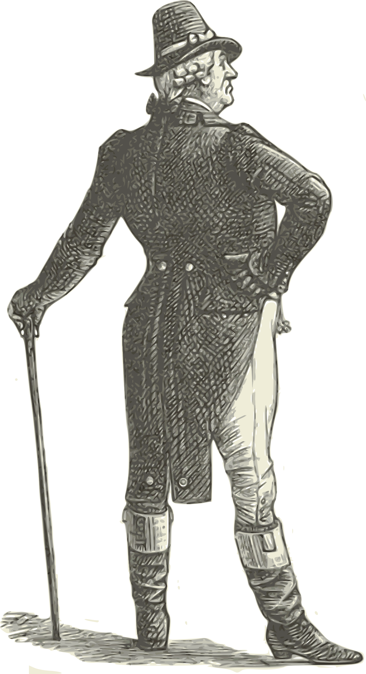


General Question
How to get from an existing, unfair division:
v_{i}
to a new, fair division:

Slide 3
Detailed Question
INPUT: Cake C; n agents;
Each agent j has a value-measure V_{j} on C.
Existing division: each j has a piece Z_{j} in C.
OUTPUT: allocate to each j a piece X_{j} in C.
DESIRED PROPERTIES (r, w are in [0,1]):
Fairness: For each j, V_{j} (X_{j} ) ≥ V_{j} (C) / n.
Ownership: For each j, V_{j} (X_{j} ) ≥ V_{j} (Z_{j}).
r-fairness: For each j, V_{j} (X_{j} ) ≥ r * V_{j} (C) / n.
w-ownership: For each j, V_{j} (X_{j} ) ≥ w * V_{j}(Z_{j}).
Q: What combinations of r,w are attainable?

Slide 4
Unrestricted pieces
Answer 1. r-fairness and w-ownership can be attained together if-and-only-if r+w ≤ 1.
“If” Proof idea: Create a convex combination of the existing division with an arbitrary fair division. O(n²) queries.
Caveat. pieces might be disconnected:

Slide 5
1-dimensional cake, connected pieces
Answer 2. If:
The cake C is a 1-dimensional interval.
Each piece must be a connected interval.
then, r-fairness and w-ownership cannot be attained together for any constant r>0, w>0.
Why? for every r>0 and integer k in {1,..,n}, there might be k agents who, in any r-fair division, get at most ~k/n of their old value.

Slide 6
Democratic Ownership
Definition. For every integer k in {1,…,n}, there are at least n-k agents who get
at least ~k/n of their old value.
By previous slide, this is the best we can hope for if we want r-fairness for r>0.
Revised question: what fairness
can be attained together with
democratic ownership?

Slide 7
1-dimensional cake, connected pieces
Answer 3. If:
The cake C is a 1-dimensional interval.
Each piece must be a connected interval.
then, democratic-ownership can be attained together with 1/3-fairness.
Proof idea:
Divide each Z_{j} among agents who want it most.
Pigeon principle: many Z_{j} are thinly-populated.
Value of agent j ≥ V_{j} (C ) / (2 n + #pieces – 1).
> V_{j} (C ) / 3 n

Slide 8
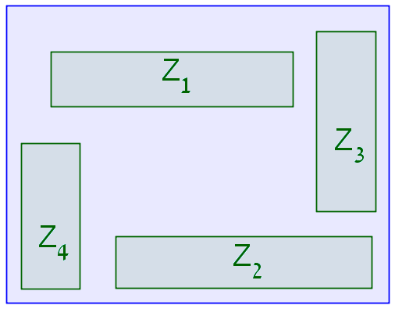
2-dimensional cakes
New challenge: division might have holes!
Rectangle cake and rectangle pieces:

Slide 9
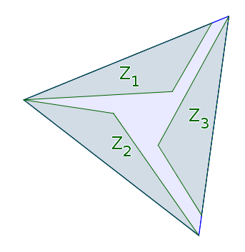
2-dimensional cakes
New challenge: division might have holes!
Convex cake and convex pieces:

Slide 10
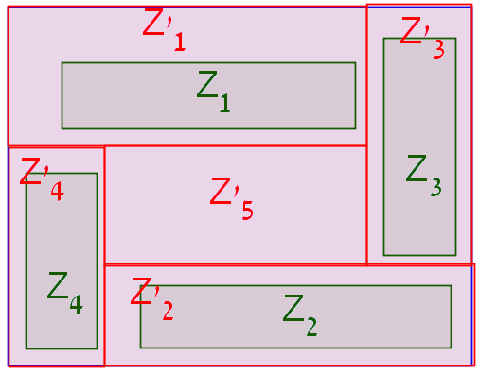
Allocation-completion step
Rectangle cake and rectangle pieces:
#holes < n.

Slide 11
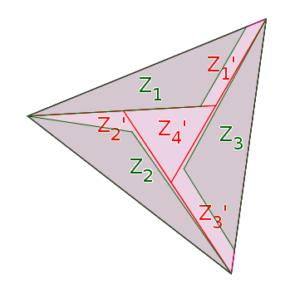
Allocation-completion step
Convex cake and convex pieces:
#holes < 2 n.

Slide 12
Fairness levels attainable together with democratic ownership
The value of agent j is at least:
V_{j} (C ) / (2 n + #pieces – 1).
Interval cake and pieces:
  #holes = 0, #pieces = n → 1/3-fairness.
Rectangle cake and pieces:
  #holes < n, #pieces < 2n → 1/4-fairness.
Convex cake and pieces:
  #holes < 2n, #pieces < 3n → 1/5-fairness.

Slide 13
Conclusion
To make fairness practical,
we must handle the:
existing allocation;
geometric requirements.
Thank you very much!

Slide 14
Open Questions
What is the largest r such that r-fairness is compatible with democratic ownership:
With 1-D connected intervals? (≥ 1/3).
With rectangles? (≥ 1/4).
With 2-D convex figures? (≥ 1/5).
With 2-D connected figures?
With squares?
With 3-D convex figures?
With two 1-D intervals per agent?

