Slide 1


Fairly Dividing a Cake after Some Parts were
Burnt in the Oven
(Ezekiel 47:14)
Erel Segal-Halevi
Inspired by:
Francis Su (1999): “Sperner’s Lemma in Fair Division“.
Oleg Musin (2014): “Around Sperner's lemma“.
Anna Bogomolnaia, Herve Moulin, Fedor Sandomirskiy & Elena Yanovskaya (2017): “Competitive Division of a Mixed Manna“.

Slide 2

Connected Envy-Free Cake-Cutting
Input: Cake C (interval [0,1]).
n agents with different value-densities.
Goal: Partition C to n connected intervals
such that no agent envies another agent.
v_{i}

Slide 3
Connected Envy-Free Cake-Cutting
Cake is good - all value-densities are positive:
– solution always exists (Stromquist 1980, Simmons 1980)
v_{i}

Slide 4
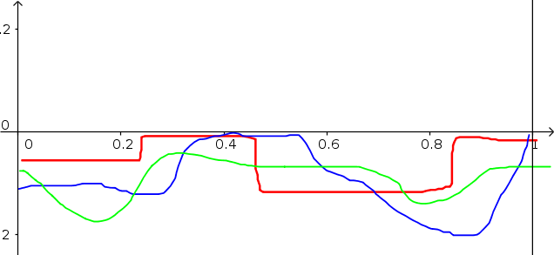
Connected Envy-Free Cake-Cutting
Cake is bad - all value-densities are negative:
– solution always exists (Su 1999)
v_{i}

Slide 5
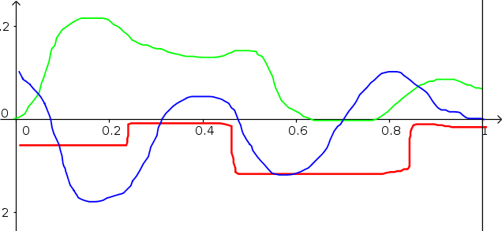
Connected Envy-Free Cake-Cutting
Cake is mixed – value densities are general:
- does a solution always exist?
v_{i}

Slide 6
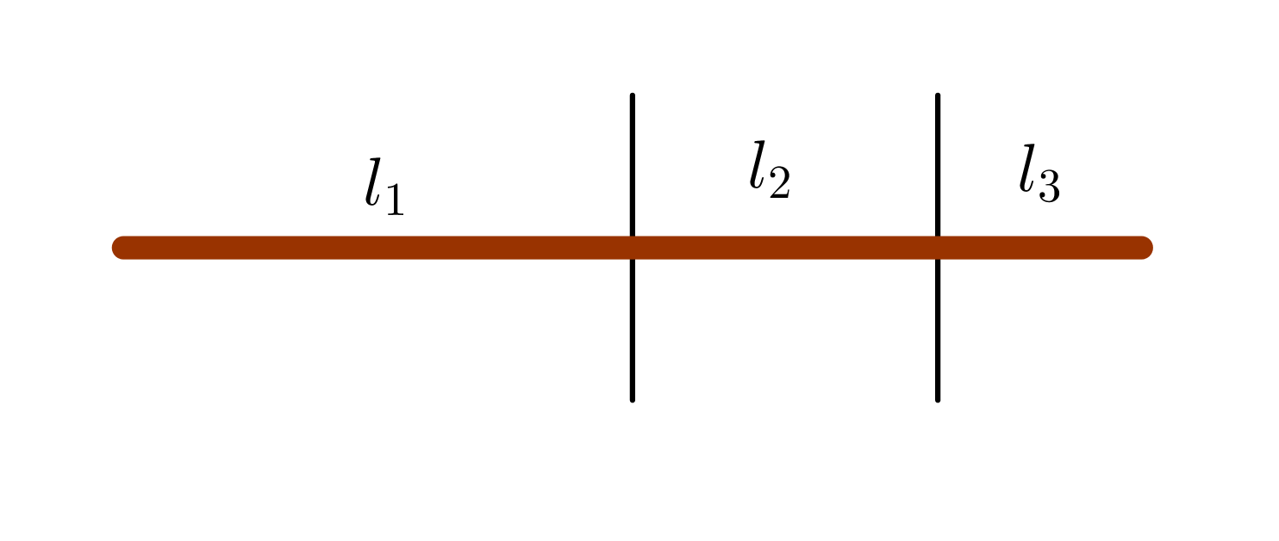
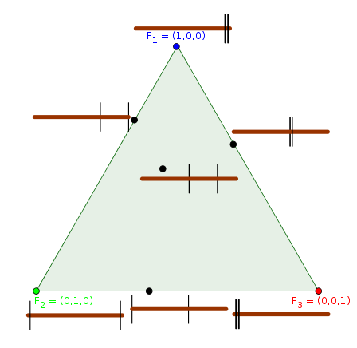
Simplex of Partitions
(based on Stromquist 1980)
Partition for 3 agents:
(l₁, l₂, l₃)
l₁+l₂+l₃ = 1
F₋₃
F₋₂
Envy-free division:
a point in which
each agent prefers
a different piece.
F₋₁

Slide 7
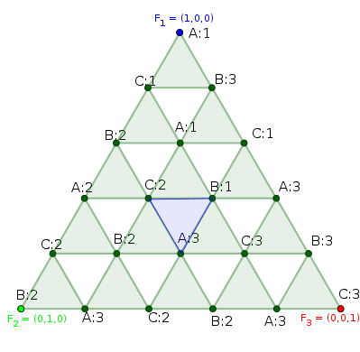
Triangulating the Simplex of Partitions
(Su 1999)
Approximate envy-free division:
Triangulate the simplex.
Assign each vertex to a different agent (A,B,C...) such that in each baby-simplex, all are represented .
Ask each agent to label all its vertices by the index of its favorite piece in that partition (1, 2, 3...).
Find a fully-labeled baby-simplex (with all labels 1,..,n).

Slide 8
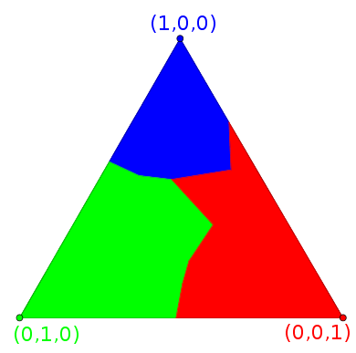

Old Key: Spener‘s lemma
A positive agent prefers
a non-empty piece.
→ A face is labeled only with its endpoints‘ labels.
→ Sperner‘s lemma: fully-labeled baby-simplex exists.
→ Approximately-envy-free division exists.

Slide 9
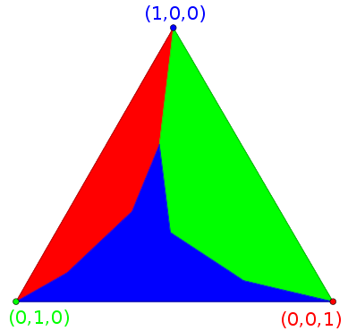

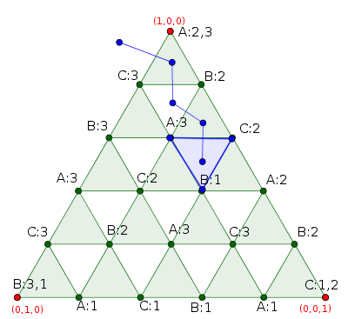
Old Key: Spener‘s lemma
A negative agent always prefers an empty piece.
→ In each main vertex, we can select one of the possible n-1 labels s.t. each face is labeled only with its endpoints‘ labels.
→ Sperner‘s lemma: fully-labeled simplex exists.
→ Approximately-envy-free division exists.

Slide 10
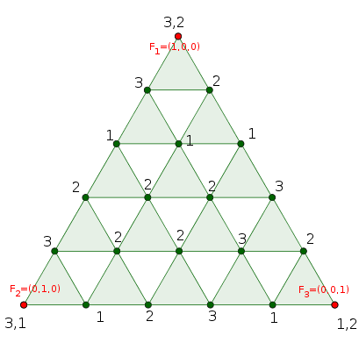
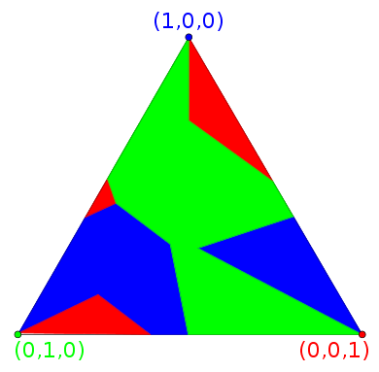
Old Key: Spener‘s lemma
A general agent sometimes prefers an empty piece and sometimes prefers a non-empty piece.
→ All labels may appear on a face.
→ Sperner‘s lemma is inapplicable!
Do you see any other pattern in the coloring or labeling?

Slide 11
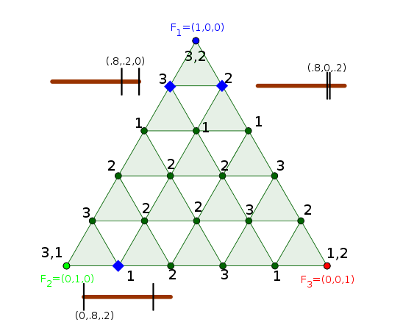
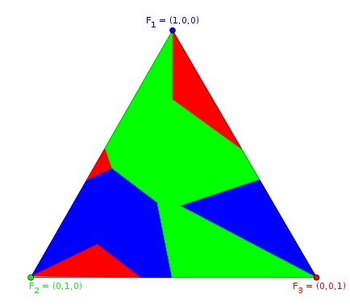
New Key #1: Consistency
Friends := points with the same ordered list of non-zero coordinates.
Consistent labeling := For every two friends x,y, x in F₋₃ and y in F_{-k,}: Lbl(y) = π_{-k}(Lbl(x)):
F₋₃
F₋₂
Lbl(x) | 1 (Left) | 2 (Right) | 3 (Empty)
π₋₃ | 1 | 2 | 3
π₋₂ | 1 | 3 | 2
π₋₁ | 2 | 3 | 1
F₋₁

Slide 12
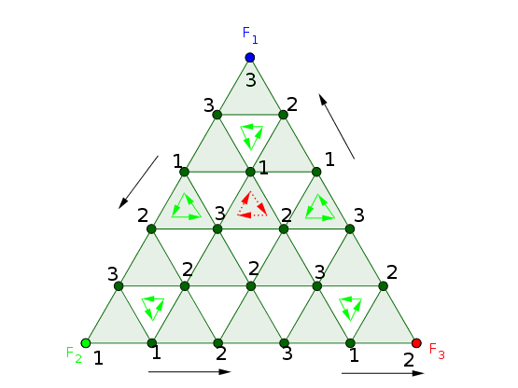
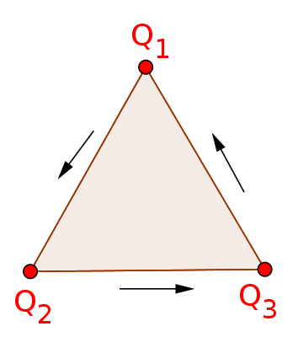
New Key #2: Degree of Labeling
Labeling ≡ linear mapping from triangulation vertices to vertices of some reference simplex Q:
Degree of mapping = net number of rounds (CCW=positive).
Interior degree = sum of degrees of baby-simplices (5-1=4).
Non-zero interior degree → fully-labeled baby-simplex.
Boundary degree = degree along boundary (1+1+1+1=4).

Slide 13
Proof Outline
Step | Proved for
1. n consistent agent-labelings → Combined consistent labeling. | Any n
2. Consistent labeling (boundary condition) →Nonzero boundary degree. | n = 3 (this paper) n = 4, prime (Meunier and Zerbib, `18)
3. For any labeling, interior degree = boundary degree. | Any n
4. Nonzero interior degree →At least 1 fully-labeled simplex →Approximate envy-free division. | Any n

Slide 14
Conclusion
A connected envy-free division exists for agents with arbitrary valuations (positive, negative or mixed), whenever their number is 4 or prime!
Open question:
does a connected envy-free division
exist for any number of agents?
v_{i}

Slide 15
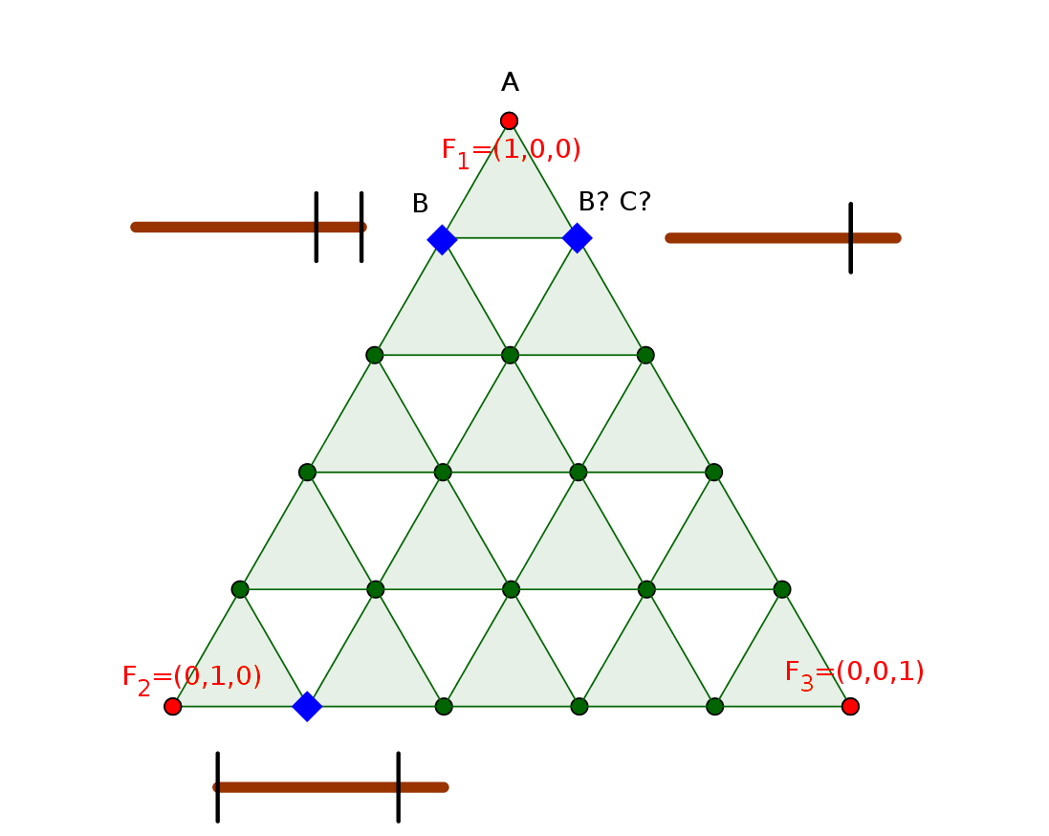
Step 1: n labelings → 1 labeling
We need to assign owners to vertices s.t.:
In each baby-simplex, each vertex belongs to a different owner.
Friends are assigned to the same owner.
Does not work with the equilateral triangulation.

Slide 16
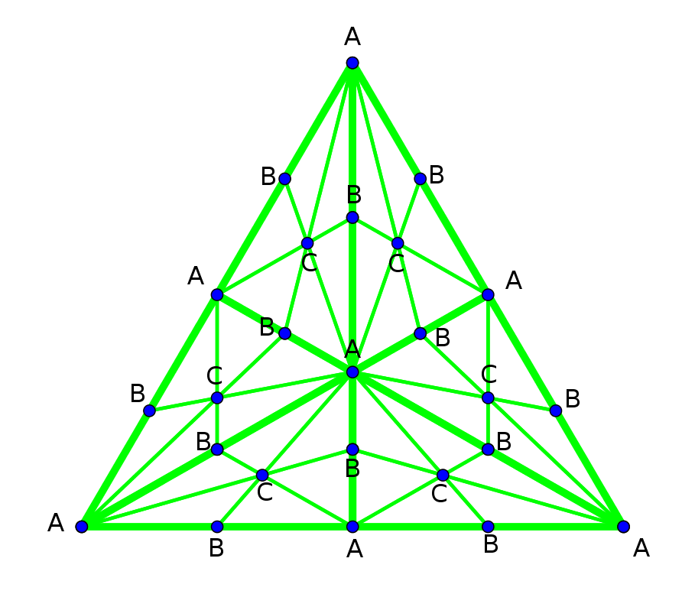
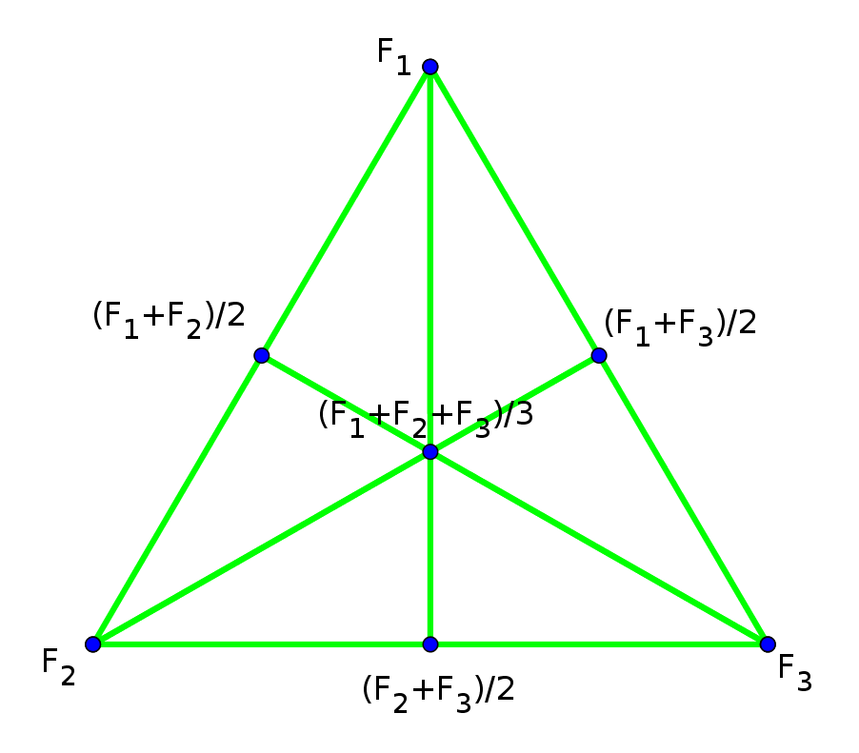
Step 1: n labelings → 1 labeling
We need to assign owners to vertices s.t.:
In each baby-simplex, each vertex belongs to a different owner.
Friends are assigned to the same owner.
Lemma: it works with barycentric triangulation
Open issue: computational complexity.

Slide 17
Step 2: Consistency → Boundary degree
Consistency:
If x,y are friends,
x in F₋₃ and y in F_{-k,}
then Lbl(y)=π_{-k}(Lbl(x)).
π₋₃ | 1 | 2 | 3 | Even
π₋₂ | 1 | 3 | 2 | Odd
π₋₁ | 2 | 3 | 1 | Even
Lemma: When n=3, if a labeling is consistent,
then labels on main vertices can be chosen such that: boundary-degree mod 3 ≠ 0.
Proof: By consistency, there are two cases:
(+) In each main-vertex i, the label-set contains i, or:
(-) In each main-vertex i, the label-set contains all except i.

Slide 18
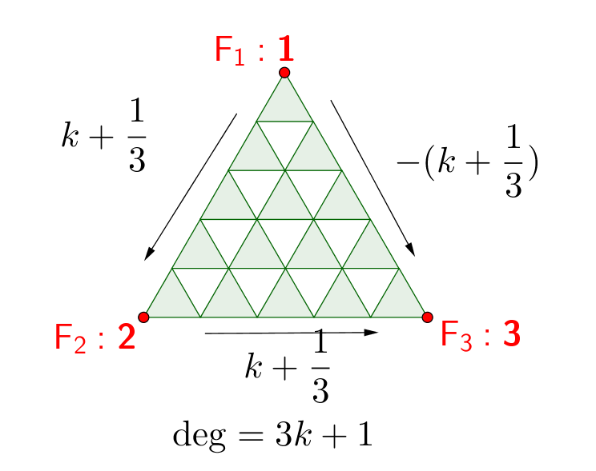
Step 2: Consistency → Boundary degree
Consistency:
If x,y are friends,
x in F₋₃ and y in F_{-k,}
then Lbl(y)=π_{-k}(Lbl(x)).
π₋₃ | 1 | 2 | 3 | Even
π₋₂ | 1 | 3 | 2 | Odd
π₋₁ | 2 | 3 | 1 | Even
Case (+): In each main-vertex i, the label-set contains i.

Slide 19
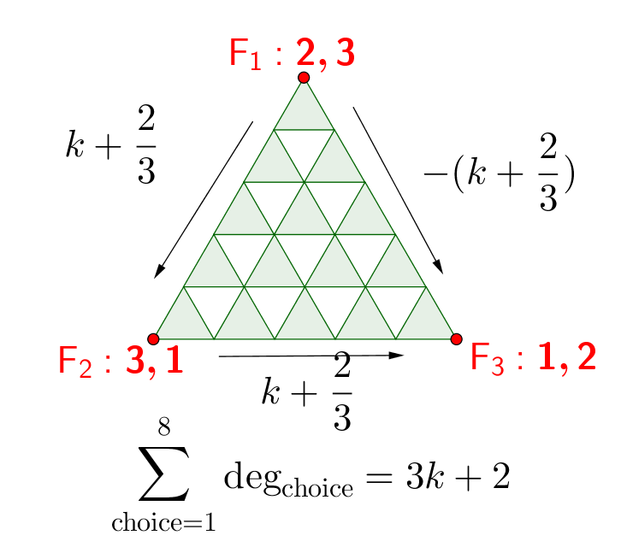
Step 2: Consistency → Boundary degree
Consistency:
If x,y are friends,
x in F₋₃ and y in F_{-k,}
then Lbl(y)=π_{-k}(Lbl(x)).
π₋₃ | 1 | 2 | 3 | Even
π₋₂ | 1 | 3 | 2 | Odd
π₋₁ | 2 | 3 | 1 | Even
Case (-): In each main-vertex i, the label-set contains all except i.
Calculate the sum of degrees over all 8 choices:

Slide 20
Step 2: Open question
Consistency for n agents:
If x,y are friends, x in F_{-n} and y in F_{-k,}
then Lbl(y) = π_{-k}(Lbl(x)) where:
π_{-k}(j) = j j < k
π_{-k}(j) = j +1 k <= j < n
π_{-k}(j) = k j = n
Conjecture: If a labeling is consistent,
then boundary-degree mod n ≠ 0.
We proved the conjecture for n=3.
Meunier and Zerbib (2018) proved it for any prime n.
When conjecture is true, connected envy-free division exists!

Slide 21
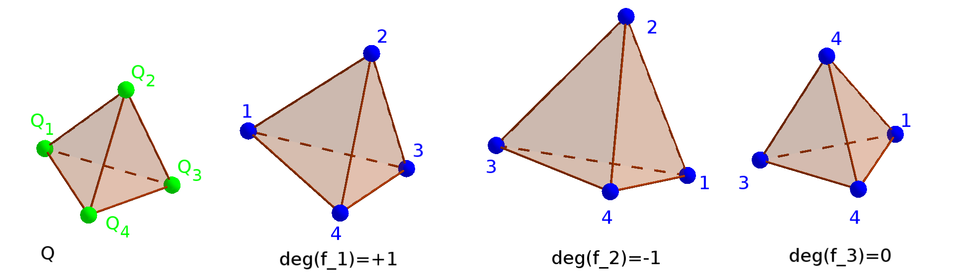
Step 3: Boundary degree = Interior degree
Definition:
Degree of labeling of an n-simplex in R^{n-1}
= sign of determinant of affine transformation to Q
= +1 if onto&no reflection, -1 if onto&one reflection,
0 if not onto.

Slide 22
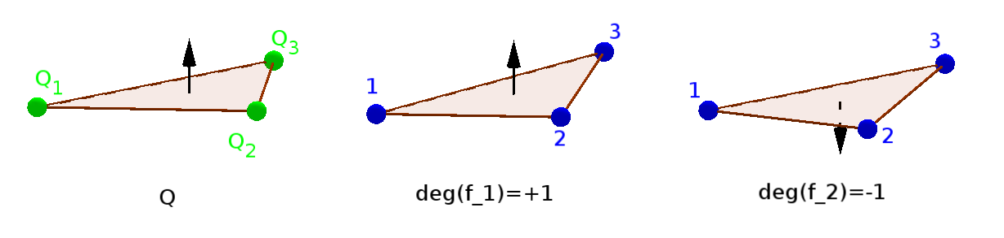
Step 3: Boundary degree = Interior degree
Definition:
Orientation of an (n-1)-simplex in R^{n-1}
= one of its two adjacent half-spaces.
Degree of labeling of an (n-1)-simplex in R^{n-1}
= sign of determinant of any affine transformation
to Q that perserves the orientation.

Slide 23
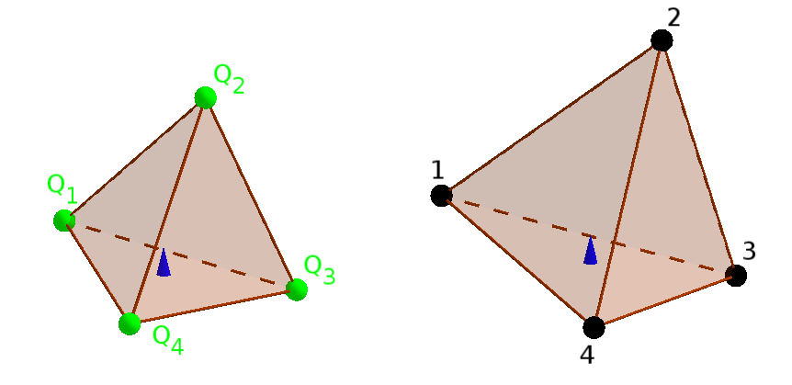


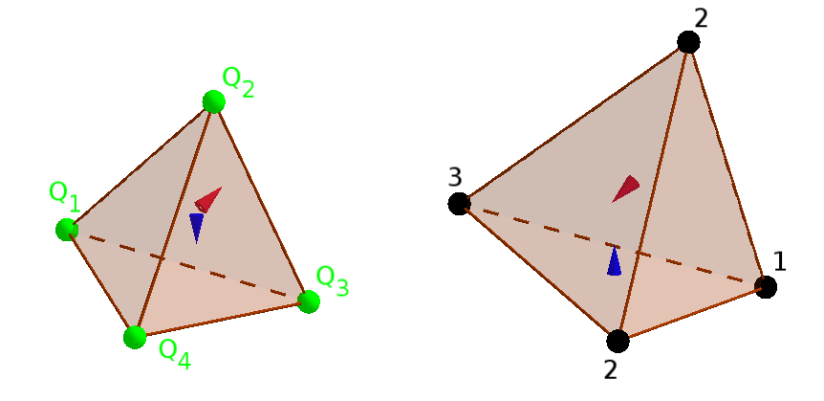
Step 3: Boundary degree = Interior degree
Lemma:
Degree of a labeling of an n-simplex in R^{n-1,}
= sum of degrees on each face oriented inwards:
deg = 1
deg = -1+1
deg = 0
deg = -1

Slide 24
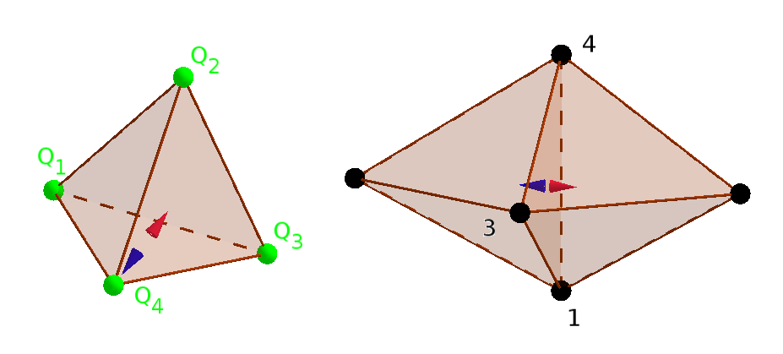
Step 3: Boundary degree = Interior degree
Lemma:
Sum of degrees of simplices in triangulation
= sum of degrees on each boundary face,
– since the internal faces cancel out:

Slide 25
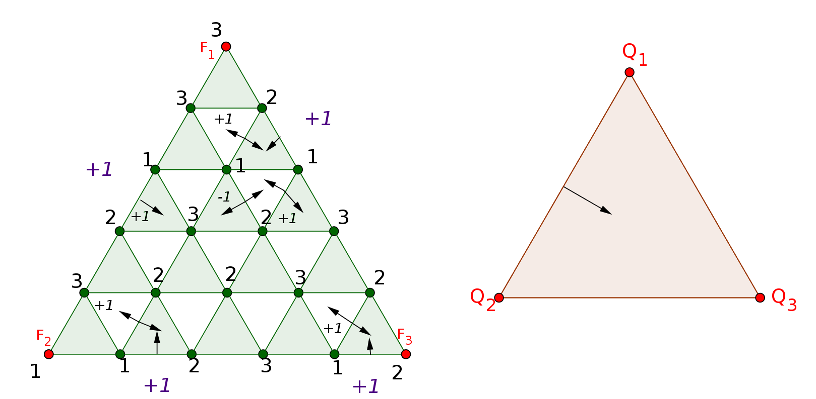
Step 3: Boundary degree = Interior degree
Definition: degree of triangulation labeling
= sum of degrees of each baby-simplex labeling.
Lemma: interior degree = sum of degrees on faces
= sum of degrees on faces of boundary = boundary degree.

Slide 26


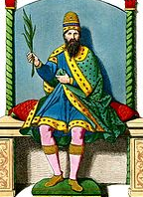

Dividing Goods that are Bads
(Midrash Rabba, Genesis 33:1)

