Slide 1


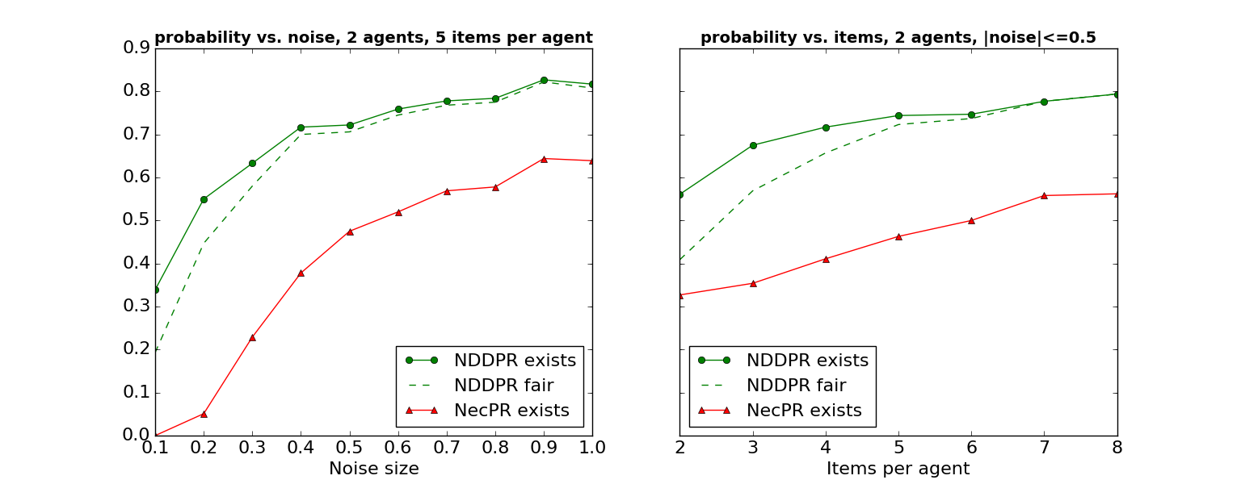
MUDA: A Truthful Multi-Unit Double-Auction Mechanism
Erel Segal-Halevi, Avinatan Hassidim, Yonatan Aumann
Two-sided markets
Examples
Both
Buyer values
10 items named 1,…,10. 2 agents. Here PR=EF=fair.
Example 1:
Alice: 10 > 9 > 8 > 7 > 6 > 5 > 4 > 3 > 2 > 1
Bob: 10 > 9 > 8 > 7 > 6 > 5 > 4 > 3 > 2 > 1
This unfair allocation is “possibly fair”, which shows that possible-fairness has low precision. It is not PDD-fair.
Example 2:
Alice: 10 > 9 > 8 > 7 > 6 > 5 > 4 > 3 > 2 > 1
Bob: 2 > 3 > 4 > 5 > 6 > 7 > 8 > 9 > 10 > 1
A “necessary-fair” allocation does not exist, which shows that necessary-fairness has low recall. But the marked allocation is NDD-fair.
Seller values
Existing Approaches
Theoretical Results
1. Necessary fairness = fair for all consistent utility functions.
2. Possible fairness = fair by at least one consistent function.
3. Score fairness = fair by a consistent function determined by a fixed mapping from ranking to utilities (e.g. Borda).
1 suffers from Low recall – few rankings admit a
necessarily-fair allocation.
2+3 suffer from Low precision – allocation
might be unfair for agents with a different utility function.
Characterization of NDD and PDD relations between bundles of items.
NDD-proportionality: exists iff M is a multiple of n and each agent has a different best item. In this case, it can be found in time O(M) by a simple algorithm
(reverse-alternating-picking-sequence).
NDD-envy-freeness: with n agents and at least 2n items, it is NP-complete to check existence. With 3 agents and M items, the complexity is an open question.
PDD Pareto-efficiency: equivalent to possible-PE.
NDD Pareto-efficiency: equivalent to necessary-PE.
Our Approach
Simulations
An additive utility function u has Diminishing Differences (DD) if:
u(best_item) – u(2nd_item) ≥ u(2nd_item) – u(3rd_item) ≥
u(3rd_item) – u(4th_item) ≥ … ≥ u([M-1]th_item - u(worst_item)
Rationale: agents care more about getting a high-value item than about not getting a low-value item.
Examples: Borda, lexicographic.
Fairness notions:
1. NDD fairness = fair by all consistent DD functions.
2. PDD fairness = fair by at least one consistent DD function.
Necessarily-fair → NDD-fair → PDD-fair → Possibly-fair
Each item has a “market value” ~ Unif[1,2].
Value of agent to item = market value + noise.
Noise ~ Unif[-A,A].
Noise size (A) in {0.1,..,1.0}. Item number (m) in {2,…,8}.
Conclusion: NDDPR provides both high precision and high recall.

