Slide 1


Fair Division of Electricity
(Ezekiel 47:14)
Research program
Erel Segal-Halevi
Joint work with: Dinesh Kumar Baghel
Image credit: https://www.weforum.org/projects/systems-of-cyber-resilience-electricity

Slide 2
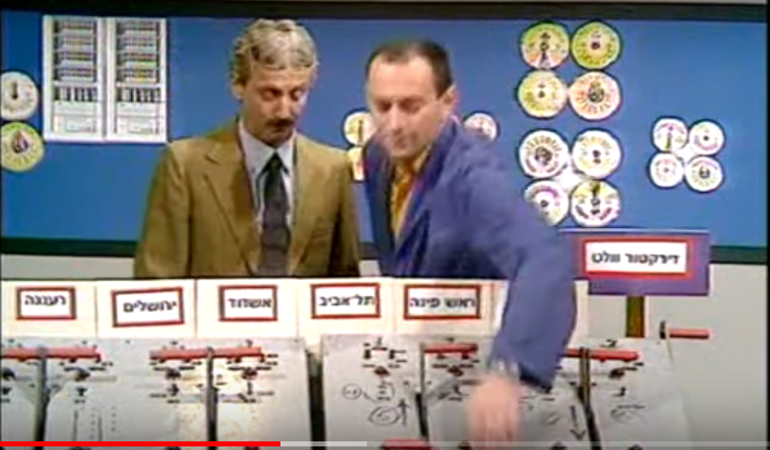
Motivation
In developing countries, total demand for electricity is larger than the supply.
Solution: load shedding.
Common practice: disconnecting entire regions.

Slide 3
Motivation
Current technology allows to disconnect individual houses.
Challenge: take individual preferences
into account.
Baseline work:
Oluwasuji, Malik, Zhang, Ramchurn: "Solving the fair electric load shedding problem in developing countries”.
IJCAI ’18, JAAMAS ’20.

Slide 4
Model
INPUT:
Total supply in kilowatts = S.
For each agent i in 1,...,n:
  size z_{i} in kilowatts.
  utility u_{i}(t) of being connected at t.
OUTPUT:
For each time t, subset A(t) of agents.
A(t) is feasible: Sum _{i in A(t)} z_{i} ≤ S.
Note: We assume that connections are binary (on/off)
Alternatively, we could consider fractional connections (e.g. connect an agent up to half its maximum size).

Slide 5
Cases
Identical sizes, uniform* utilities.
(* agents only care how much time they are connected).
Identical sizes, additive** utilities.
(** utility of agent i = integral of u_{i}(t) over connected time).
Different sizes, uniform utilities.
Different sizes, additive utilities.

Slide 6
1. Identical sizes, uniform utilities
q := floor(S/z) = #agents in every maximal feasible set.
Connect q agents each time.
Connect each agent q/n of the time.
Utility per agent: q/n of total utility.

Slide 7
2. Identical sizes, additive utilities
q := floor(S/z).
Construct a “cake” from q adjacent copies of the timeline of a week:
Divide the “cake” using any algorithm for proportional cake-cutting.
Utility per agent:
    ≥ 1/n of total cake utility.
    ≥ q/n of total week utility.

Slide 8
3. Different sizes, uniform utilities
Example: n=3 agents; S=30 [kW];
sizes 10, 20, 30 [kW].
Maximal feasible sets: {10,20} ; {30}.
What is a fair allocation of time?

Slide 9
3. Different sizes, uniform utilities:
Fractional approval voting
Fractional approval voting:
  INPUT: each of n agents approves one or more candidates.
  OUTPUT: each candidate is elected for a fraction of the time.
Electricity division:
  Candidates = maximal feasible sets.
  Agent i approves all sets containing i.

Slide 10
3. Different sizes, uniform utilities:
Fractional approval voting
Equivalent terms:
Bogomolnaia, Moulin, Stong (2005):
Collective choice under dichotomous preferences.
Duddy (2015):
Fair sharing under dichotomous preferences.
Aziz, Bogomolnaia, Moulin (2019):
Fair mixing: the case of dichotomous preferences.
Brandl, Brandt, Peters, Stricker (2021): Distribution rules under dichotomous preferences.

Slide 11
3. Different sizes, uniform utilities:
Fractional approval voting
Main fairness notions – Fair Share (FS):
Individual FS: each agent gets utility ≥ 1/n.
Group FS: For each group of q agents: total allotment to candidates approved by at least 1 member ≥ q/n.
2/3*{e,30-e} + 1/3*{30}
Egalitarian: each agent gets ≥ r;
maximize r
(given the sizes)
1/2*{10,20} + 1/2*{30}

Slide 12
3. Different sizes, uniform utilities:
Egalitarian allocation
Goal: Maximize r such that each agent can be connected at least r of the time.
NP-hard (reduction from Partition).
  # candidates is exponential in n.
Bin-packing lower bound:
  Pack agents into k bins of size S.
  Connect each bin 1/k of the time.
Not optimal. Example: S=2, sizes=1,1,1.
  k = 2; lower bound = 1/2;
  But r = q/n = 2/3 is possible.

Slide 13
3. Different sizes, uniform utilities:
Egalitarian allocation
q-times bin-packing lower bound:
  Pack agents into k bins of size S;
  put each agent in q different bins.
  Connect each bin 1/k of the time.
  Egalitarian value ≥ q/k.
Research questions:
  Can efficient bin-packing algorithms be adapted to q-times bin-packing?
  Is the q-times bin-packing lower bound always tight for some q ≥ 1?

Slide 14
3. Different sizes, uniform utilities
Research questions:
  What bin-packing algorithms can be adapted to q-times bin-packing?
  Is the q-times bin-packing lower bound always tight for some q ≥ 1?
  What efficient algorithms can be used to find a group-FS allocation?

Slide 15
4. Different sizes, additive utilities
Question (a): Let r be the egalitarian value of the sizes with uniform utilities.
  Can we guarantee each agent
  utility ≥ r with additive utilities?
Answer: Yes: Assuming utilities in each minute are uniform - partition each minute by the egalitarian solution.
  Too many cuts.

Slide 16
4. Different sizes, additive utilities
Question (b): can we guarantee each agent utility ≥ r with few cuts?
Answer: If egalitarian value comes from
q-times bin-packing with k bins (r = q/k):
Find a k-consensus division - a partition into k pieces that each agent 1,..., n-1 values at exactly 1/k.
  Requires ≤ (n-1)(k-1) cuts (Alon, 1987).
Agent n pick q pieces for its bins (util≥q/k);
every other bin gets arbitrary piece (util=q/k).

Slide 17
4. Different sizes, additive utilities:
Consensus division
k-consensus division is hard even when k=2 and all valuations are piecewise-constant:
Computing an approximate k-consensus division with n(k-1) cuts is PPA-hard (Filos-Ratsikas, Goldberg; 2018; Filos-Ratsikas, Hollender, Sotiraki, Zampetakis; 2020).
Deciding whether there exists a k-consensus division with n(k-1)-1 cuts is NP-hard (Filos-Ratsikas, Frederiksen, Goldberg, Zhang; 2018).
Questions:
Can electricity division be done with fewer cuts?
Can electricity division be done more efficiently?

Slide 18
4. Different sizes, additive utilities:
Hardness
Theorem. Egalitarian electricity division:
May require n-1 cuts;
May be PPA-hard to compute.
Proof. Given a 2-consensus division problem with
n-1 agents with valuations v₁,...,v_{n-1}, construct an electricity division problem with n agents:
n-1 agents: size S/(n-1), valuations v₁,...,v_{n-1}.
One agent: size S, valuation (v₁+...+v_{n-1})/(n-1).
An egalitarian electricity division with value 1/2
=== a consensus division among the n-1 agents. ***

Slide 19
4. Different sizes, additive utilities
Research questions:
  Are n-1 cuts always sufficient for egalitarian electricity division?
  How many cuts are needed for a group-FS division?
  Can we heuristically find an egalitarian / group-FS division with few cuts on realistic instances?

Slide 20
Extensions of Basic Model
  More complex supply constraints:
    S can change over time;
    Supply network with link capacities.
  More complex demands:
    z_{i} can change over time;
    Prices can be used to incentivize agents to reduce their size.
We are recruiting post-doctoral students

Slide 21
Conclusion
Electricity division is related to several classic problems:
  Proportional cake-cutting;
  Bin packing;
  Fractional approval voting;
  Consensus division.
Ideas may be applicable to other settings of social choice or fair division in which agents may have different sizes.

