Slide 1
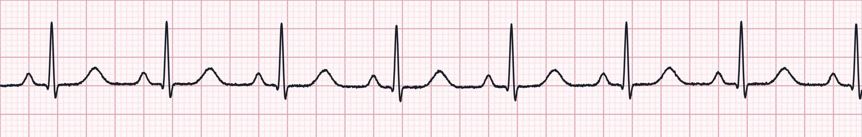
Cardiac Arrest Management & Rhythm Interpretation
Heart blocks, paced rhythms and 50 practice strips · Aligned to the 2025 AHA Guidelines for CPR & ECC
Notes:
Welcome. This module is built on the 2025 American Heart Association Guidelines for CPR and Emergency Cardiovascular Care and the paramedic-level National EMS Education Standards. Four parts: cardiac arrest management, heart block interpretation, paced rhythms, and a 50-strip interpretation practice set. Remind learners that local medical direction and protocols take precedence over anything on these slides.

Slide 2




What you will be able to do
1 Cardiac arrest
2 Heart blocks
3 Paced rhythms
4 Strip practice
Deliver high-quality CPR with minimal pauses
Run the VF/pVT and asystole/PEA pathways
Find and treat reversible causes
Manage the post-ROSC patient
Apply a 5-step rhythm approach
Differentiate 1st, 2nd (I & II) and 3rd degree
Recognize which blocks are unstable
Apply the bradycardia algorithm
Read atrial, ventricular and dual-chamber pacing
Spot failure to capture, sense or pace
Run transcutaneous pacing
Interpret 50 strips
Answer and field action after each
Notes:
Learning objectives. Part 1 covers the adult cardiac arrest algorithm. Parts 2 and 3 cover interpretation and field management of AV blocks and paced rhythms, tied to the bradycardia algorithm. Part 4 is 50 practice strips with interpretations.

Slide 3
Part 1 · Cardiac Arrest Management
High-quality CPR, early defibrillation, and a team that never stops pushing
Notes:
Section 1: adult cardiac arrest management.

Slide 4




2025 guideline points that shape our practice
One Chain of Survival
Epinephrine timing
Airway choice
A single chain now covers adults and children, in and out of hospital; recognition and early CPR stay the first links.
Nonshockable: give epinephrine as soon as feasible. Shockable: give it after initial defibrillation attempts fail.
BVM, supraglottic airway or ETT are all acceptable; choose by provider skill and success rate, without pausing CPR.
Physiologic monitoring
Refractory VF
Post-arrest care
Use waveform capnography to confirm airway placement, gauge CPR quality and spot ROSC early.
After repeated failed shocks, a vector change (anterior–posterior) or DSED may be considered per medical direction.
Avoid hypotension and hypoxia, prevent fever, get a 12-lead, and transport to a capable cardiac arrest centre.
Notes:
These are the practice-relevant themes of the 2025 AHA update. Emphasize: epinephrine ASAP in nonshockable rhythms; in shockable rhythms epinephrine follows the first failed shocks (commonly after the second shock). Airway: no single device is mandated - the best airway is the one your agency places with a high first-pass success rate without interrupting compressions. Refractory VF: vector change and double sequential external defibrillation are options some systems use; check your protocol. Instructors should verify current wording against the published 2025 guidelines and local protocol before teaching.

Slide 5

High-quality CPR is the intervention
100–120
5–6 cm
≥ 80%
< 10 s
compressions per minute
depth (2–2.4 in), full recoil
chest compression fraction goal
for any pause, incl. pre-shock
Rotate compressors every 2 minutes
Switch at rhythm checks; fatigue degrades depth before rate.
Ventilate, don't hyperventilate
30:2 without an advanced airway; 1 breath every 6 s (10/min) with one.
Let ETCO₂ coach you
Below 10 mmHg means improve compressions; aim for ≥ 20 mmHg.
Notes:
Compressions are the foundation everything else rests on. Rate 100-120, depth at least 5 cm but not more than 6 cm, allow full chest recoil, minimise interruptions so that compression fraction is as high as possible - at least 60% is the floor, 80% is the goal for a well-run team. Charge the defibrillator during compressions, and keep the pre- and post-shock pause under 10 seconds. Avoid excessive ventilation; it raises intrathoracic pressure and lowers coronary perfusion.

Slide 6
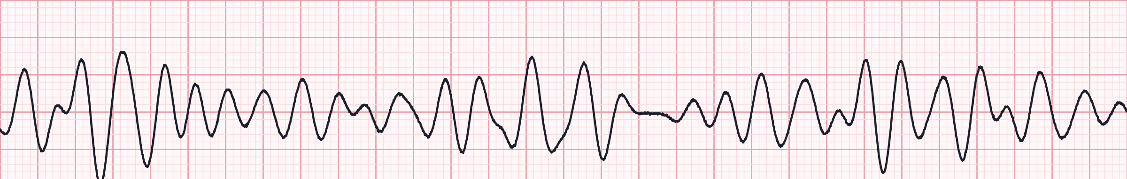
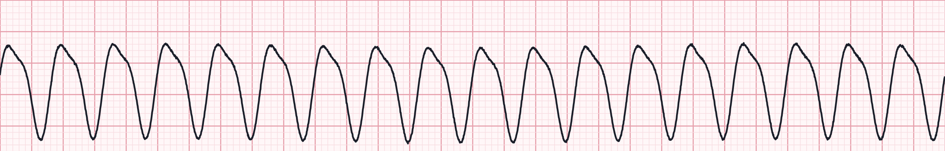
Shockable rhythms: VF and pulseless VT
Ventricular fibrillation
Shock 1
1
CPR 2 min · IV/IO access · pads on, monitor
2
Shock 2
Pulseless ventricular tachycardia
CPR 2 min · Epinephrine 1 mg q3–5 min · consider advanced airway + capnography
3
Shock 3
CPR 2 min · Amiodarone 300 mg (then 150 mg) or Lidocaine 1–1.5 mg/kg
Energy: biphasic per manufacturer (typically 120–200 J); if unknown, use the maximum. Resume CPR immediately after every shock.
4
Continue
Rhythm check every 2 min · treat H's & T's · consider vector change if refractory
Notes:
VF and pulseless VT are the only shockable arrest rhythms. Shock, then immediately resume CPR for 2 minutes without a pulse check. Epinephrine 1 mg IV/IO every 3-5 minutes after initial shocks have failed. Antiarrhythmic for shock-refractory VF/pVT: amiodarone 300 mg then 150 mg, or lidocaine 1-1.5 mg/kg then 0.5-0.75 mg/kg (max 3 mg/kg). Teaching point: the strips are synthetic but representative - coarse VF shows chaotic, irregular deflections with no identifiable QRS; monomorphic VT is wide, regular and rapid.

Slide 7
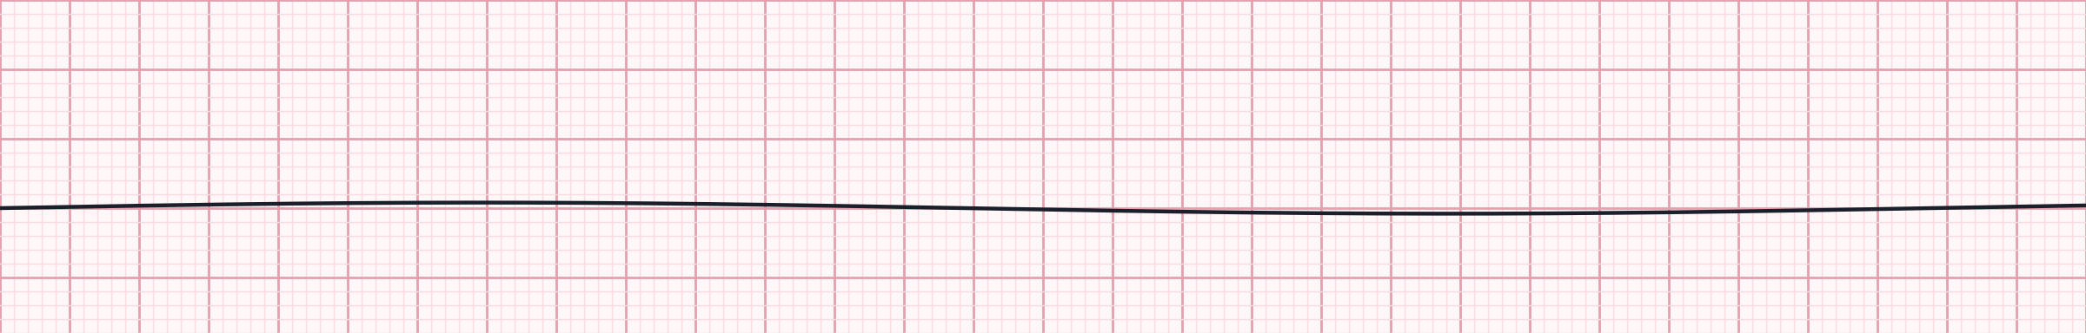
Nonshockable rhythms: asystole and PEA
Asystole — confirm in a second lead; check leads and gain
Start CPR
1
Pads on · rhythm check confirms nonshockable
2
Epinephrine ASAP
PEA — any organized rhythm without a pulse
1 mg IV/IO as soon as access is obtained, then every 3–5 min
3
Airway & capnography
BVM → SGA or ETT · 1 breath q6s · waveform ETCO₂
Key point: outcome hinges on finding the cause. A narrow, fast PEA often points to hypovolemia, tamponade or tension pneumothorax; wide and slow suggests hyperkalemia, toxins or massive MI.
4
Rhythm check q2 min
Shockable? Switch pathways · search H's & T's continuously
Notes:
Asystole and PEA are not shockable. Give epinephrine as early as possible - earlier epinephrine in nonshockable rhythms is associated with better ROSC and survival. Confirm asystole: check lead connections, increase gain, look in another lead (fine VF can masquerade). The lower strip shows an organized sinus rhythm - if there is no pulse, it is PEA. Treat the patient, not the monitor.

Slide 8

Arrest pharmacology at a glance
Drug | Indication | Adult dose (IV/IO) | Repeat / notes
Epinephrine | All arrest rhythms | 1 mg (0.1 mg/mL) | Every 3–5 min · ASAP in nonshockable; after initial shocks in VF/pVT
Amiodarone | Shock-refractory VF/pVT | 300 mg bolus | Second dose 150 mg
Lidocaine | Shock-refractory VF/pVT (alternative) | 1–1.5 mg/kg | Then 0.5–0.75 mg/kg · max 3 mg/kg
Magnesium sulfate | Torsades de pointes | 1–2 g | Not for routine use in other VF/pVT
Calcium chloride | Suspected hyperkalemia, Ca-channel blocker toxicity | 1 g (10 mL of 10%) | Not routine in arrest
Sodium bicarbonate | Hyperkalemia, TCA overdose | 1 mEq/kg | Not routine in arrest
Vasopressin, routine calcium and routine bicarbonate are not recommended. Flush every IO/IV push with 20 mL and keep compressions going during drug delivery.
Notes:
Drug doses per AHA adult cardiac arrest algorithm. Lidocaine and amiodarone are both acceptable for shock-refractory VF/pVT. Magnesium is for torsades only. Calcium and bicarbonate are for specific circumstances such as hyperkalemia or tricyclic overdose - not routine. Confirm agency formulary and concentrations.

Slide 9


Airway and capnography during resuscitation
Reading the ETCO₂ waveform
Start simple
BVM with OPA/NPA and 2-person seal; good oxygenation beats an early tube.
< 10 mmHg
Poor compressions or poor perfusion — push harder, swap compressor
10–20 mmHg
Acceptable; keep optimizing toward ≥ 20
Advance when ready
SGA or ETT — whichever your crew places quickly and reliably. Never stop compressions to intubate.
≥ 20 mmHg
Effective CPR
Ventilate gently
Abrupt rise to 35–45
Likely ROSC — check pulse at next rhythm check
1 breath every 6 s, about 1 second each, just enough for visible chest rise.
A flat trace after intubation means the tube is not in the trachea until proven otherwise.
Notes:
2025 guidance accepts BVM, supraglottic airway or endotracheal intubation in the out-of-hospital setting; the choice depends on provider skill and system success rates. Use continuous waveform capnography to confirm and monitor placement, and as a CPR quality gauge. A persistently low ETCO2 (<10 mmHg) after about 20 minutes of ALS is associated with very low likelihood of ROSC, but it should not be used in isolation to stop resuscitation.

Slide 10
Reversible causes: the H's and T's
H
Hypovolemia
T
Tension pneumothorax
Fluid bolus, control bleeding
Needle / finger decompression
H
Hypoxia
T
Tamponade, cardiac
Airway, O₂, effective ventilation
Fluids, rapid transport; ultrasound if available
H
Hydrogen ion (acidosis)
T
Toxins
Ventilation; bicarbonate if indicated
Specific antidote, e.g. naloxone, Ca²⁺, bicarbonate
H
Hypo-/Hyperkalemia
T
Thrombosis, pulmonary
Calcium + bicarbonate for high K⁺
Consider fibrinolysis per protocol; transport
H
Hypothermia
T
Thrombosis, coronary
Rewarm; handle gently
12-lead after ROSC, PCI-capable centre
Notes:
Run through the H's and T's out loud as a team at every rhythm check. Scene and history clues are your best tools: dialysis patient (hyperkalemia), drug paraphernalia (toxins), trauma or GI bleed (hypovolemia), recent surgery or immobility (PE), chest pain before collapse (coronary thrombosis). Point-of-care ultrasound, where used, can help identify tamponade and pneumothorax.

Slide 11
Refractory VF and the pit-crew team
VF persisting after ≥ 3 shocks
Compressor
Verify pad placement and skin contact; replace pads if needed
Consider a vector change to anterior–posterior pads
Consider double sequential defibrillation if your protocol includes it
Ensure the antiarrhythmic has been given
Think coronary occlusion: early transport to an ECPR / PCI centre if available
Recorder / timer
Airway
Patient
Team leader
Monitor / defib
IV / IO & meds
Notes:
Refractory VF: confirm pads are well placed, consider a vector change to anterior-posterior positioning, and - where your medical director has approved it - double sequential external defibrillation (DSED). The DOSE-VF trial suggested improved survival with both vector change and DSED compared with standard defibrillation. Pit-crew CPR: pre-assigned roles reduce chaos and pauses; the team leader stays hands-off, watches CPR quality and timing, and leads the H's and T's discussion. Closed-loop communication throughout.

Slide 12



After ROSC: protect the brain and the heart
SpO₂ 92–98%
ETCO₂ 35–45
SBP ≥ 90 · MAP ≥ 65
Titrate O₂ down; avoid hypoxia and hyperoxia
Normal ventilation, about 10 breaths/min
Fluids, then norepinephrine or epinephrine infusion
12-lead ECG
Neuro & glucose
Prevent fever
STEMI or suspected occlusion → PCI centre
GCS, pupils, glucose; treat seizures
Temperature control continues in hospital
Notes:
Post-cardiac arrest care begins the moment ROSC is achieved. Re-arrest is common in the first minutes, so keep pads on and anticipate. Targets: SpO2 92-98%, normocapnia (ETCO2 35-45 mmHg as a surrogate), SBP at least 90 and MAP at least 65 mmHg. Obtain a 12-lead ECG as soon as feasible; STEMI warrants emergent PCI. Check glucose. Temperature control and fever prevention continue in hospital. Transport to a cardiac arrest centre where available.

Slide 13


Special situations and termination of resuscitation
Opioid-associated
Pregnancy
Termination (TOR)
Pulse present, poor breathing: ventilate + naloxone
No pulse: standard ACLS first; naloxone must not delay CPR
Observe for re-sedation after ROSC
Manual left uterine displacement during CPR
Early advanced airway; avoid hyperventilation
If ≥ 20 weeks: alert obstetrics for resuscitative delivery; rapid transport
Apply your validated BLS/ALS TOR rule
Typical: arrest not EMS-witnessed, no shock, no ROSC
Low ETCO₂ supports but never decides alone; contact medical direction
Notes:
Opioid-associated emergencies: naloxone is for the patient with a pulse and respiratory depression; in cardiac arrest, high-quality CPR and ventilation come first. Pregnancy: manual left uterine displacement to relieve aortocaval compression; if the uterus is at or above the umbilicus (about 20 weeks) and no ROSC, early notification for resuscitative hysterotomy - in the field this means rapid transport decisions. Termination of resuscitation: use your system's validated rule and consult medical direction; consider family and scene safety.

Slide 14
Part 2 · Heart Blocks
Atrioventricular conduction delays: from benign to life-threatening
Notes:
Section 2: AV blocks. We start with a systematic approach, then work through each block.

Slide 15
A 5-step approach to every strip
Normal sinus rhythm for reference: rate 75 · regular · upright P before every QRS · PR 0.16 s · QRS 0.08 s
1
2
3
4
5
Rate
Rhythm
P waves
PR interval
QRS width
6-second count × 10, or 300 ÷ large boxes
Regular, regularly irregular or irregularly irregular?
Present? Upright? One for every QRS?
Normal 0.12–0.20 s; constant or changing?
Narrow < 0.12 s; wide ≥ 0.12 s
Notes:
Use the same five steps every time. Paper: 25 mm/s, one small box 0.04 s, one large box 0.20 s. In AV blocks the PR interval and the P:QRS relationship are the key: ask 'Is there a P for every QRS, and a QRS for every P?' Then 'Is the PR constant?' Always treat the patient - correlate with perfusion.

Slide 16
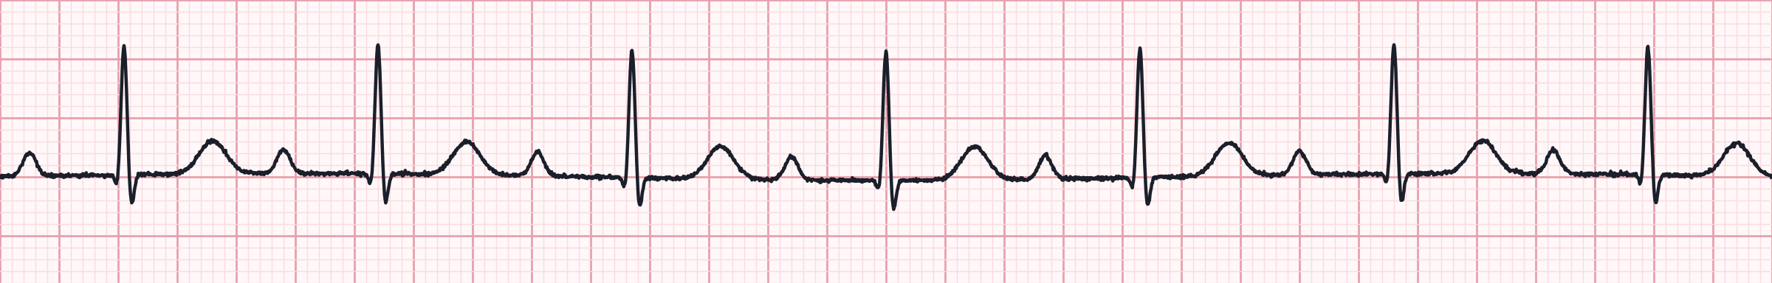

First-degree AV block
Lead II · 25 mm/s · 1 small box = 0.04 s · synthetic teaching strip
Rate | Usually normal (here ~70)
Rhythm | Regular
P waves | Normal; one P for every QRS
PR interval | > 0.20 s and constant (here 0.32 s)
QRS | Usually narrow
Clue: long but constant PR
A conduction delay, not a true block — every impulse gets through
Often benign: athletes, vagal tone, beta-blockers, CCBs, digoxin
New onset with an MI: monitor for progression
No specific treatment; treat the patient
Notes:
First-degree AV block: every P conducts, but slowly. PR is prolonged beyond 0.20 s (one large box) and stays the same beat to beat. Look for causes - medications, inferior MI, increased vagal tone. Usually asymptomatic and needs no treatment, but document and monitor.

Slide 17
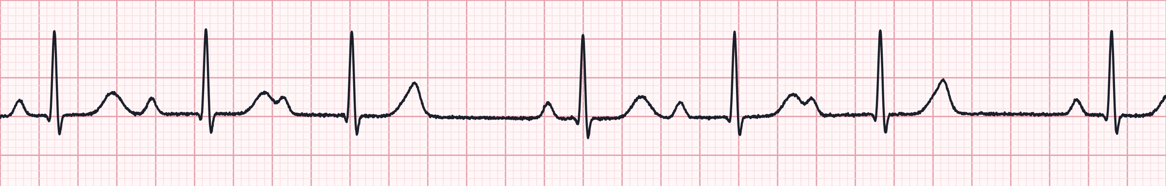
Second-degree AV block type I (Wenckebach)
Lead II · 25 mm/s · 1 small box = 0.04 s · synthetic teaching strip
Rate | Atrial normal; ventricular slightly slower
Rhythm | Regularly irregular — grouped beating
P waves | Normal; occasional P not followed by QRS
PR interval | Progressively lengthens until a beat drops
QRS | Usually narrow (block at AV node)
Clue: longer, longer, drop
Block usually at the AV node; often transient
Causes: inferior MI, vagal tone, AV-nodal drugs
Usually stable; if symptomatic, atropine is often effective
Monitor; pacing rarely needed
Notes:
Mobitz I / Wenckebach: the PR interval gets progressively longer until a P wave is not conducted, then the cycle restarts. Produces grouped beating. Here: PR 0.18, 0.28, 0.35, then a dropped QRS - a 4:3 pattern. The PR after the dropped beat is the shortest. Usually nodal, usually benign, atropine-responsive.

Slide 18
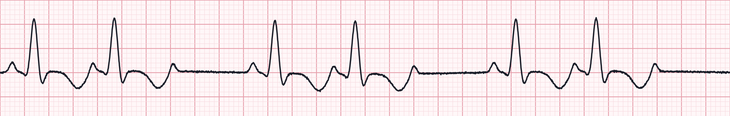
Second-degree AV block type II (Mobitz II)
Lead II · 25 mm/s · 1 small box = 0.04 s · synthetic teaching strip
Rate | Atrial normal; ventricular slower
Rhythm | Irregular when beats drop (here 3:2)
P waves | Normal; some P waves not conducted
PR interval | Constant on conducted beats
QRS | Often wide (infranodal block)
Clue: constant PR, sudden drop
Block below the AV node — can progress suddenly to complete block
Treat as unstable: pads on, prepare for TCP
Atropine often ineffective; do not delay pacing
Common with anterior MI
Notes:
Mobitz II: PR interval is fixed on conducted beats, then a P wave suddenly fails to conduct, without warning lengthening. Block is in the His-Purkinje system, so the QRS is often wide and escape rhythms are unreliable. High risk of progression to third-degree block or asystole. Apply pads early. Note: a 2:1 AV block cannot be classified as type I or II from a single strip - judge by QRS width and clinical picture and treat cautiously.

Slide 19
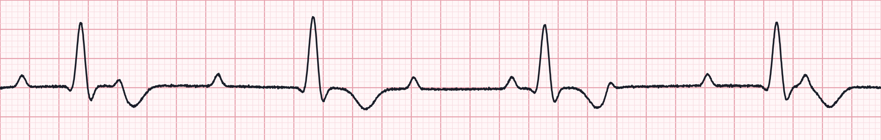
Third-degree (complete) AV block
Lead II · 25 mm/s · 1 small box = 0.04 s · synthetic teaching strip
Rate | Atrial 60–100; ventricular 20–40 (wide)
Rhythm | P–P regular; R–R regular; independent
P waves | Normal, but unrelated to QRS
PR interval | None — varies randomly (AV dissociation)
QRS | Narrow if junctional escape; wide if ventricular
Clue: P waves march through
No atrial impulses reach the ventricles
Usually symptomatic: hypotension, syncope, AMS
Transcutaneous pacing is first-line when unstable with wide QRS
Atropine may be tried but must not delay pacing
Notes:
Complete heart block: atria and ventricles beat independently. Map the P waves with calipers or paper - they march through at a regular rate (here about 90), sometimes hidden in QRS complexes or T waves. Ventricular escape here is about 38/min with wide complexes. Prepare to pace; consider epinephrine or dopamine infusion as a bridge.

Slide 20
Heart blocks side by side
Block | PR interval | P : QRS relationship | QRS | Risk | Field priority
1st degree | > 0.20 s, constant | 1 : 1 | Narrow | Low | Monitor; find cause
2nd type I | Lengthens, then drop | Some P not conducted | Narrow | Low–moderate | Atropine if symptomatic
2nd type II | Constant, then drop | Some P not conducted | Often wide | High | Pads on; prepare TCP
2 : 1 block | Constant on conducted | 2 P per QRS | Narrow or wide | Unclear | Treat by QRS & symptoms
3rd degree | Variable — no relation | AV dissociation | Wide or narrow | High | TCP; infusion bridge
Memory hook: “If some P's don't get through, then you have a Mobitz; if the PR goes long, long, long, then drop — it's Wenckebach; if P's and Q's don't agree, then you have a third degree.”
Notes:
Use this table as a review. Key discriminators are PR behaviour and the P:QRS relationship. Wide QRS and infranodal blocks (Mobitz II, complete heart block) are the dangerous ones - they respond poorly to atropine and need pacing.

Slide 21
Managing symptomatic bradycardia
Assess
HR typically < 50 and causing symptoms? Airway, O₂ if SpO₂ < 90%, IV, 12-lead, monitor
Go straight to pacing
Poor perfusion?
Hypotension · altered mental status · shock · ischemic chest pain · acute heart failure
Mobitz II or third-degree block with wide QRS — atropine rarely works
Heart transplant patients (denervated heart)
Severe instability: don't wait for atropine doses
Pacing: set rate ~60–70, increase mA to electrical capture, confirm mechanical capture by pulse; sedate/analgesia
Atropine
1 mg IV every 3–5 min · max 3 mg
If atropine fails
Transcutaneous pacing and/or dopamine 5–20 mcg/kg/min or epinephrine 2–10 mcg/min
Consult & transport
Expert consultation; transvenous pacing in hospital
Notes:
Adult bradycardia algorithm. First decide whether the bradycardia is causing the symptoms. Atropine 1 mg IV every 3-5 minutes up to 3 mg. If ineffective: transcutaneous pacing, or a chronotropic infusion - dopamine 5-20 mcg/kg/min or epinephrine 2-10 mcg/min. For high-degree blocks with wide QRS, move to pacing early. Confirm mechanical capture with a femoral pulse, not the carotid (muscle twitch artifact). Consider and treat causes: hypoxia, hyperkalemia, drug toxicity (beta-blocker, calcium channel blocker, digoxin), inferior MI.

Slide 22
Part 3 · Paced Rhythms
Recognizing normal pacing, spotting malfunction, and pacing in the field
Notes:
Section 3: permanent pacemaker rhythms, pacemaker malfunction, and transcutaneous pacing.

Slide 23
Reading a pacemaker: the spike and the code
I
Chamber paced
AAI
Paces and senses the atrium; inhibited by native P waves. Sinus node disease with intact AV conduction.
A · V · D (both)
II
Chamber sensed
VVI
Paces and senses the ventricle; fires only when the native rate falls below the set rate.
A · V · D · O (none)
III
Response to sensing
DDD
Paces and senses both chambers; tracks sinus P waves and paces the ventricle after them.
I inhibit · T trigger · D both
IV
Rate response
A pacer spike is a sharp vertical line. Spike → P = atrial capture. Spike → wide QRS = ventricular capture.
R = rate rises with activity
Notes:
The NBG code: position I is the chamber paced, II the chamber sensed, III how the device responds to a sensed beat, IV rate modulation. Most field patients have VVI(R) or DDD(R) devices. Spikes may be tiny with bipolar leads - turn up the gain or look in another lead. Ventricular-paced complexes are wide and look like a left bundle branch block.

Slide 24
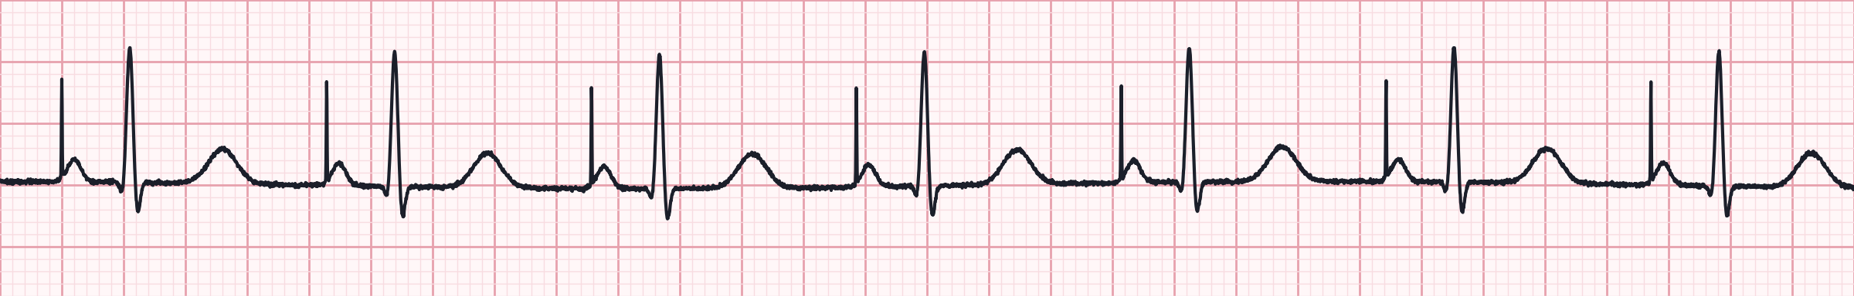
Atrial paced rhythm
Lead II · 25 mm/s · 1 small box = 0.04 s · synthetic teaching strip
Rate | The programmed rate (here 70)
Rhythm | Regular
P waves | Paced — each follows an atrial spike
PR interval | Normal (≈ 0.18 s)
QRS | Narrow — patient's own conduction
Clue: spike, then a P wave
Typical of AAI or DDD pacing for sinus node disease
Every spike followed by a P = atrial capture
Narrow QRS shows AV conduction is intact
Normal function; ask for the device card
Notes:
Atrial pacing: a spike immediately precedes a P wave, then normal conduction through the AV node produces a narrow QRS. Indicates sick sinus syndrome with intact AV conduction.

Slide 25
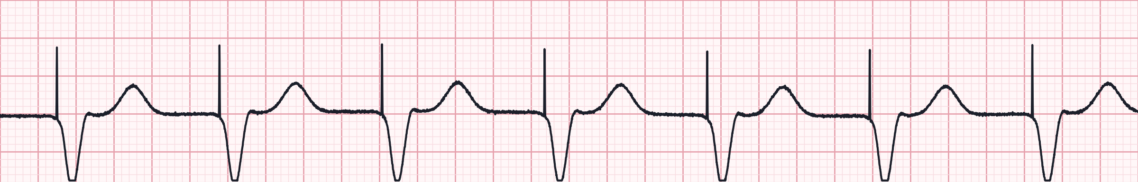
Ventricular paced rhythm
Lead II · 25 mm/s · 1 small box = 0.04 s · synthetic teaching strip
Rate | The programmed rate (here 70)
Rhythm | Regular
P waves | Absent or unrelated
PR interval | None
QRS | Wide, LBBB-like; T wave opposite the QRS
Clue: spike, then a wide QRS
Every spike followed by a wide QRS = 100% capture
Normal finding in VVI pacing
Wide paced QRS masks STEMI — rely on symptoms, Sgarbossa, transmit the 12-lead
Don't treat the wide QRS as VT
Notes:
Ventricular pacing from a right ventricular lead produces a wide complex with a left bundle branch block pattern and discordant T waves. That is normal for a paced beat. Ischemia is hard to read on a paced ECG; use Sgarbossa criteria and the clinical picture.

Slide 26
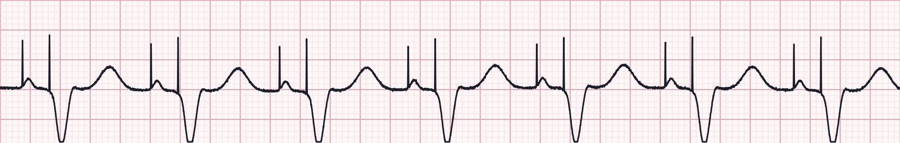
AV sequential (dual-chamber) pacing
Lead II · 25 mm/s · 1 small box = 0.04 s · synthetic teaching strip
Rate | The programmed rate (here 70)
Rhythm | Regular
P waves | Paced P after the atrial spike
AV delay | Spike-to-spike ≈ 0.18 s
QRS | Wide, after the ventricular spike
Clue: two spikes per beat
DDD pacing both chambers in sequence
Preserves atrial 'kick' for better cardiac output
If sinus is faster, the device tracks P waves and paces only the ventricle
Normal function
Notes:
Dual-chamber pacing: atrial spike, paced P, programmed AV delay, ventricular spike, wide paced QRS. When the native sinus rate exceeds the lower rate, the device senses the P and only paces the ventricle (atrial-sensed ventricular pacing).

Slide 27
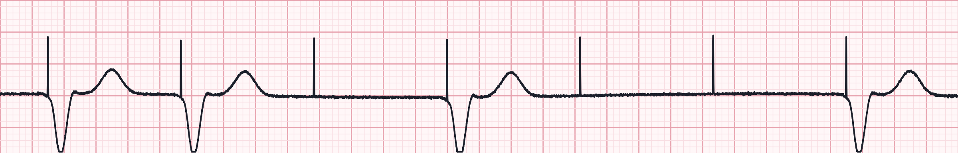
Malfunction 1: failure to capture
Lead II · 25 mm/s · 1 small box = 0.04 s · synthetic teaching strip
Rate | Ventricular rate slower than the spike rate
Rhythm | Irregular
Spikes | Regular, at the set rate
Capture | Some spikes not followed by a QRS
QRS | Wide when captured
Clue: spike with nothing after it
Pacer fires but the myocardium doesn't respond
Causes: lead displacement or fracture, battery depletion, hyperkalemia, ischemia, drugs
Symptomatic: pads on, transcutaneous pacing
Treat hyperkalemia if suspected
Notes:
Failure to capture: the device generates a stimulus but it does not depolarize the chamber - a spike with no P wave (atrial) or no QRS (ventricular) after it. If the patient is pacemaker-dependent this can cause severe bradycardia or asystole.

Slide 28
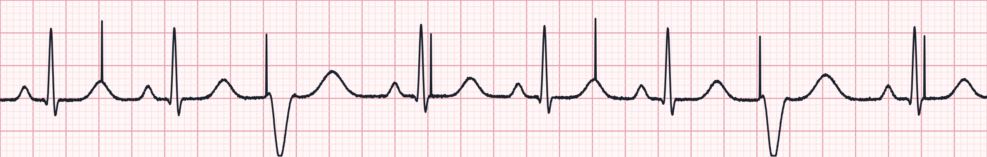
Malfunction 2: failure to sense (undersensing)
Lead II · 25 mm/s · 1 small box = 0.04 s · synthetic teaching strip
Rate | Native rate plus extra paced beats
Rhythm | Irregular
Spikes | Fixed rate, ignoring native QRS complexes
Capture | Only when the ventricle isn't refractory
QRS | Native narrow beats + some wide paced beats
Clue: spikes ignore native beats
Device doesn't 'see' the patient's own beats
Spikes landing on the T wave risk R-on-T VT/VF
Causes: lead problem, low sensing amplitude, new BBB
Monitor closely; pads ready; transport
Notes:
Undersensing: the pacemaker fails to detect intrinsic activity and fires anyway, competing with the native rhythm. Spikes appear at inappropriate places - inside QRS complexes or on T waves. A spike on the T wave can trigger VT or VF.

Slide 29
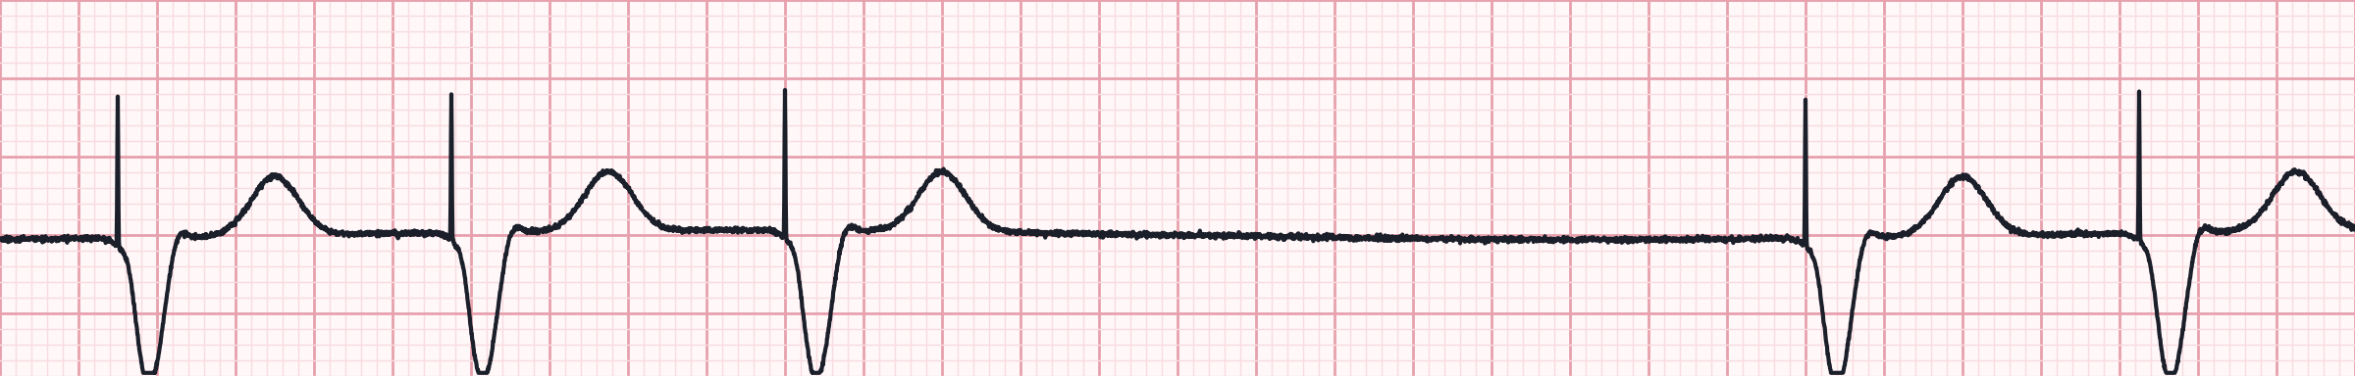
Malfunction 3: failure to pace (oversensing)
Lead II · 25 mm/s · 1 small box = 0.04 s · synthetic teaching strip
Rate | Below the programmed rate
Rhythm | Irregular — pauses
Spikes | Missing when they should appear
Capture | Normal on the beats that are paced
QRS | Wide paced beats
Clue: a pause with no spike
Device senses 'noise' (muscle activity, EMI, T waves) and withholds pacing
Pacemaker-dependent patients may become syncopal or asystolic
Pads on; TCP if pauses recur or patient is unstable
Note any electrical exposure / unusual activity
Notes:
Oversensing / failure to pace: the device inappropriately detects signals and inhibits output, producing a pause longer than the programmed interval with no spike. In hospital a magnet makes the device pace asynchronously; in the field, treat symptomatic pauses with transcutaneous pacing per protocol.

Slide 30
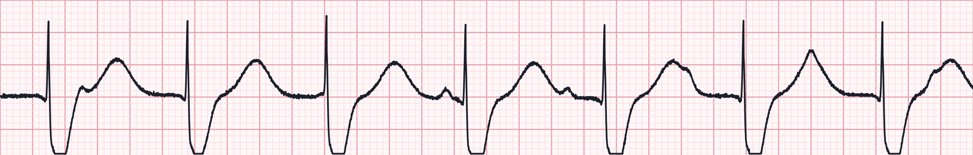
Transcutaneous pacing in the field
Electrical capture: every large pacing artifact is followed by a wide QRS and a broad T wave
Pads | Anterior–posterior preferred; clear of any device
Mode | Demand (synchronous) mode
Rate | 60–80/min
Output | Increase mA until every spike captures, then +10%
Comfort | Analgesia / sedation as soon as feasible
Confirm both kinds of capture
Electrical: wide QRS + T after every spike
Mechanical: palpable FEMORAL pulse at the paced rate, BP improves
Avoid the carotid — muscle twitch mimics a pulse
Reassess capture after every move
Notes:
Transcutaneous pacing is indicated for unstable bradycardia not responding to atropine, or immediately for high-degree blocks with wide QRS. Electrical capture is seen on the monitor; mechanical capture must be confirmed with a femoral pulse or improved perfusion. Not recommended for asystolic cardiac arrest.

Slide 31

Caring for the patient with a pacemaker or ICD
Identify the device
Cardiac arrest
ICD shocks
Bulge below the clavicle; ask for the device card — type, mode, rate, ICD or not.
Standard ACLS. Place pads ≥ 8 cm from the device, or anterior–posterior.
Safe to touch the patient. Repeated shocks: think VT storm — sedate, monitor, transport.
Bradycardia despite a pacer
Chest pain
Magnet
Suspect malfunction, hyperkalemia or drug toxicity. TCP if unstable.
Paced QRS hides ischemia. Use symptoms, Sgarbossa criteria and transmit the 12-lead.
Pacer → fixed-rate pacing; ICD → shocks suspended. Use only per protocol.
Notes:
Practical points for device patients. Defibrillation is safe but keep pads at least 8 cm from the generator (or use anterior-posterior placement) to avoid damaging it and to reduce current diversion. An ICD shock delivered while you touch the patient is felt as a mild jolt and is not dangerous. Multiple shocks suggest electrical storm or lead malfunction. Magnet use varies by device and protocol.

Slide 32
Part 4 · 50-Strip Interpretation Practice
Each strip is followed by its interpretation. Use the same 5 steps every time: rate, rhythm, P waves, PR, QRS.
Notes:
Fifty 6-second lead II strips covering everything in this course - sinus, junctional and ventricular rhythms, arrest rhythms, AV blocks and paced rhythms - in mixed order. Give learners time on each strip before advancing to the interpretation. The 6-second method: count QRS complexes in the strip and multiply by 10.

Slide 33

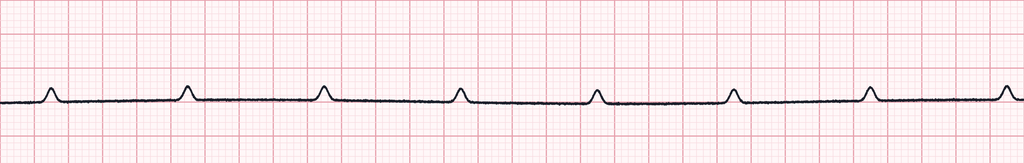
Strip 1 of 50
Pulseless; monitor shows only small bumps.
Lead II · 25 mm/s · 6-second strip (count QRS × 10)
1
Rate
2
Rhythm
3
P waves
4
PR interval
5
QRS
Notes:
Strip 1. Scenario: Pulseless; monitor shows only small bumps. Let learners work through the five steps. Answer on the next slide: P-wave asystole (ventricular standstill).

Slide 34

Strip 1 · Interpretation
P-wave asystole (ventricular standstill)
Rate | Atrial 75/min; ventricular 0
Rhythm | P–P regular; no QRS
P waves | Present, no QRS follows
PR interval | None
QRS | None
Field action
Treat as asystole: CPR, epinephrine
Pacing is not recommended in arrest
Notes:
Strip 1: P-wave asystole (ventricular standstill). Rate: Atrial 75/min; ventricular 0. Rhythm: P–P regular; no QRS. P waves: Present, no QRS follows. PR interval: None. QRS: None. Field action: Treat as asystole: CPR, epinephrine; Pacing is not recommended in arrest.

Slide 35
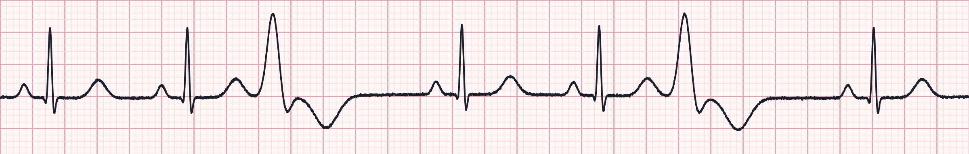
Strip 2 of 50
COPD patient with hypokalemia.
Lead II · 25 mm/s · 6-second strip (count QRS × 10)
1
Rate
2
Rhythm
3
P waves
4
PR interval
5
QRS
Notes:
Strip 2. Scenario: COPD patient with hypokalemia. Let learners work through the five steps. Answer on the next slide: Sinus rhythm with ventricular trigeminy.

Slide 36
Strip 2 · Interpretation
Sinus rhythm with ventricular trigeminy
Rate | ≈ 70/min (6-second count)
Rhythm | Regularly irregular — every 3rd beat early
P waves | Before sinus beats only
PR interval | 0.16 s on sinus beats
QRS | Two narrow, then one wide
Field action
Correct the cause: K⁺, hypoxia, ischemia
Monitor
Notes:
Strip 2: Sinus rhythm with ventricular trigeminy. Rate: ≈ 70/min (6-second count). Rhythm: Regularly irregular — every 3rd beat early. P waves: Before sinus beats only. PR interval: 0.16 s on sinus beats. QRS: Two narrow, then one wide. Field action: Correct the cause: K⁺, hypoxia, ischemia; Monitor.

Slide 37
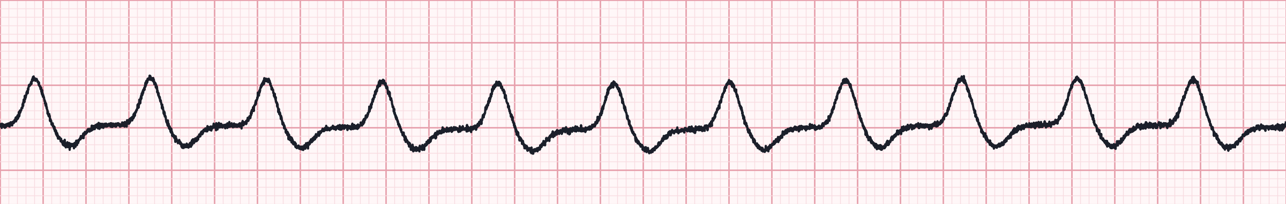
Strip 3 of 50
Recorded while compressions are ongoing.
Lead II · 25 mm/s · 6-second strip (count QRS × 10)
1
Rate
2
Rhythm
3
P waves
4
PR interval
5
QRS
Notes:
Strip 3. Scenario: Recorded while compressions are ongoing. Let learners work through the five steps. Answer on the next slide: CPR artifact.

Slide 38
Strip 3 · Interpretation
CPR artifact
Rate | ≈ 110/min (compressions)
Rhythm | Regular, matches compression rate
P waves | None
PR interval | None
QRS | Not cardiac — artifact
Field action
You cannot interpret a rhythm during compressions
Analyze during the planned 2-minute pause (< 10 s)
Notes:
Strip 3: CPR artifact. Rate: ≈ 110/min (compressions). Rhythm: Regular, matches compression rate. P waves: None. PR interval: None. QRS: Not cardiac — artifact. Field action: You cannot interpret a rhythm during compressions; Analyze during the planned 2-minute pause (< 10 s).

Slide 39
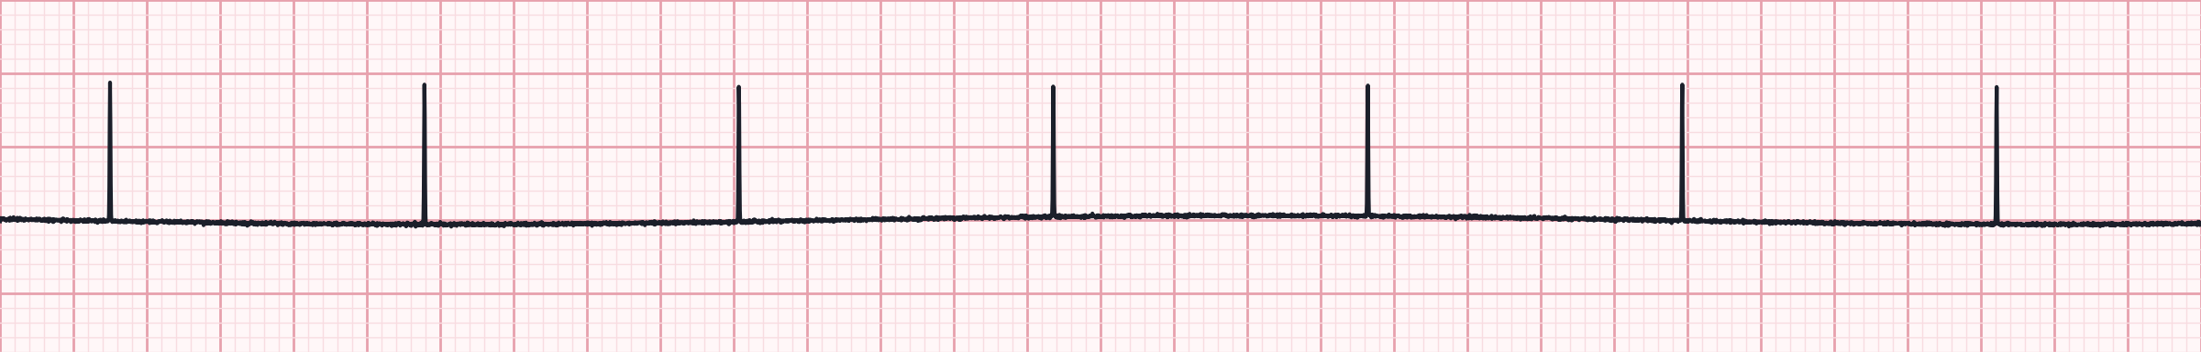
Strip 4 of 50
Pacemaker patient, unresponsive and pulseless.
Lead II · 25 mm/s · 6-second strip (count QRS × 10)
1
Rate
2
Rhythm
3
P waves
4
PR interval
5
QRS
Notes:
Strip 4. Scenario: Pacemaker patient, unresponsive and pulseless. Let learners work through the five steps. Answer on the next slide: Pacemaker spikes with no capture (underlying asystole).

Slide 40
Strip 4 · Interpretation
Pacemaker spikes with no capture (underlying asystole)
Rate | 0 — spikes only
Rhythm | Spikes regular; no QRS
P waves | None
PR interval | None
QRS | None
Pacer spikes | Regular, no capture
Field action
This is cardiac arrest: start CPR
Treat as asystole; place pads ≥ 8 cm from the device
Notes:
Strip 4: Pacemaker spikes with no capture (underlying asystole). Rate: 0 — spikes only. Rhythm: Spikes regular; no QRS. P waves: None. PR interval: None. QRS: None. Pacer spikes: Regular, no capture. Field action: This is cardiac arrest: start CPR; Treat as asystole; place pads ≥ 8 cm from the device.

Slide 41
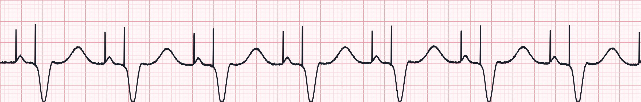
Strip 5 of 50
Dual-chamber pacemaker, routine transport.
Lead II · 25 mm/s · 6-second strip (count QRS × 10)
1
Rate
2
Rhythm
3
P waves
4
PR interval
5
QRS
Notes:
Strip 5. Scenario: Dual-chamber pacemaker, routine transport. Let learners work through the five steps. Answer on the next slide: AV sequential (dual-chamber) paced rhythm.

Slide 42
Strip 5 · Interpretation
AV sequential (dual-chamber) paced rhythm
Rate | 72/min
Rhythm | Regular
P waves | Paced P after each atrial spike
PR interval | AV delay ≈ 0.18 s (spike to spike)
QRS | Wide, after ventricular spike
Pacer spikes | Two per beat — atrial and ventricular
Field action
Both chambers paced and captured
Normal function
Notes:
Strip 5: AV sequential (dual-chamber) paced rhythm. Rate: 72/min. Rhythm: Regular. P waves: Paced P after each atrial spike. PR interval: AV delay ≈ 0.18 s (spike to spike). QRS: Wide, after ventricular spike. Pacer spikes: Two per beat — atrial and ventricular. Field action: Both chambers paced and captured; Normal function.

Slide 43
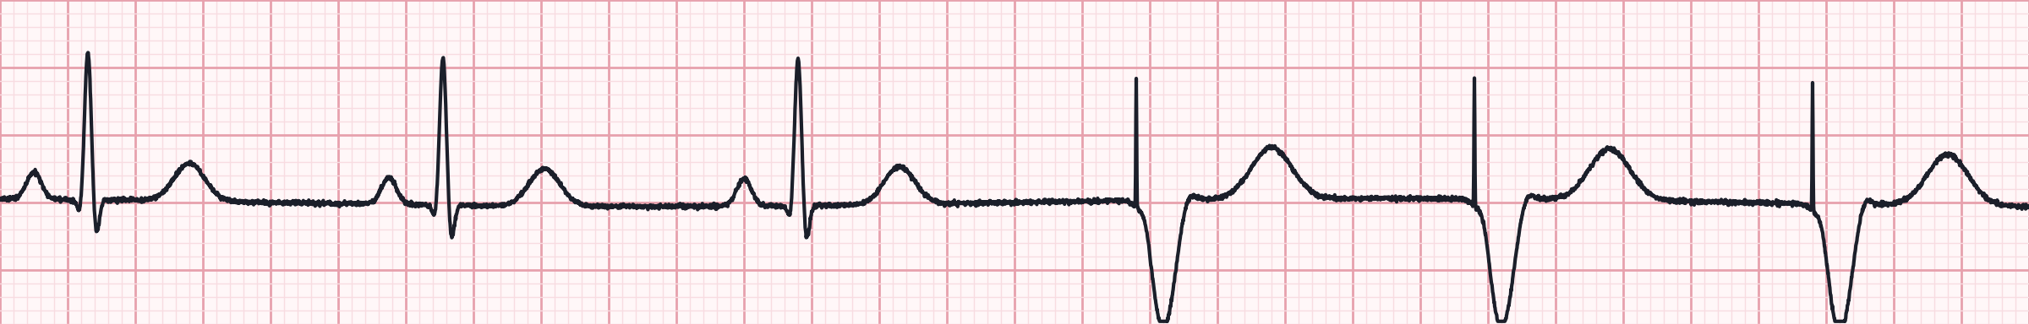
Strip 6 of 50
Sinus rate slows; pacemaker takes over.
Lead II · 25 mm/s · 6-second strip (count QRS × 10)
1
Rate
2
Rhythm
3
P waves
4
PR interval
5
QRS
Notes:
Strip 6. Scenario: Sinus rate slows; pacemaker takes over. Let learners work through the five steps. Answer on the next slide: Sinus rhythm with demand (VVI) ventricular pacing.

Slide 44
Strip 6 · Interpretation
Sinus rhythm with demand (VVI) ventricular pacing
Rate | 59/min
Rhythm | Irregular at the transition
P waves | Present on the first 3 beats only
PR interval | 0.16 s on native beats
QRS | Narrow native, then wide paced
Pacer spikes | Ventricular, only after the pause
Field action
Demand pacing: fires only when the native rate falls
Normal sensing and capture
Notes:
Strip 6: Sinus rhythm with demand (VVI) ventricular pacing. Rate: 59/min. Rhythm: Irregular at the transition. P waves: Present on the first 3 beats only. PR interval: 0.16 s on native beats. QRS: Narrow native, then wide paced. Pacer spikes: Ventricular, only after the pause. Field action: Demand pacing: fires only when the native rate falls; Normal sensing and capture.

Slide 45
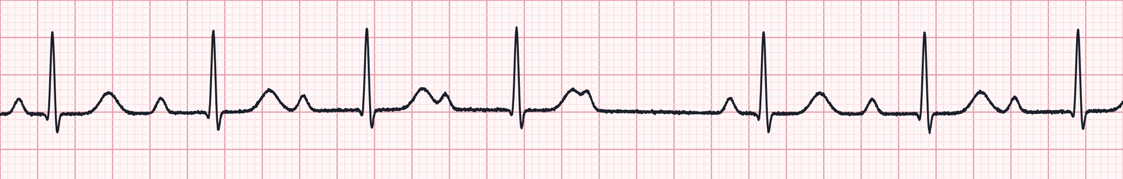
Strip 7 of 50
Elderly patient on digoxin.
Lead II · 25 mm/s · 6-second strip (count QRS × 10)
1
Rate
2
Rhythm
3
P waves
4
PR interval
5
QRS
Notes:
Strip 7. Scenario: Elderly patient on digoxin. Let learners work through the five steps. Answer on the next slide: 2nd-degree AV block type I (Wenckebach), 5:4.

Slide 46
Strip 7 · Interpretation
2nd-degree AV block type I (Wenckebach), 5:4
Rate | ≈ 70/min (6-second count)
Rhythm | Regularly irregular — grouped beats
P waves | Atrial 79/min; every 5th not conducted
PR interval | Progressively lengthens, then drop
QRS | Narrow (≈ 0.08 s)
Field action
Look for digoxin toxicity
Monitor; treat if symptomatic
Notes:
Strip 7: 2nd-degree AV block type I (Wenckebach), 5:4. Rate: ≈ 70/min (6-second count). Rhythm: Regularly irregular — grouped beats. P waves: Atrial 79/min; every 5th not conducted. PR interval: Progressively lengthens, then drop. QRS: Narrow (≈ 0.08 s). Field action: Look for digoxin toxicity; Monitor; treat if symptomatic.

Slide 47
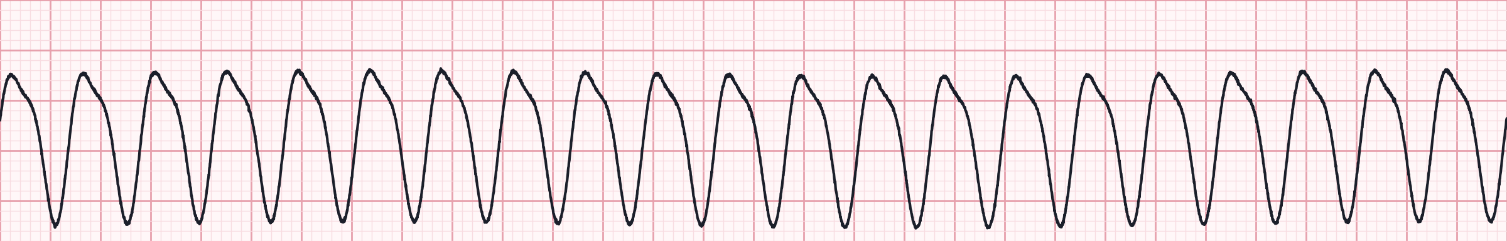
Strip 8 of 50
Patient pale, diaphoretic, BP 70 systolic — has a pulse.
Lead II · 25 mm/s · 6-second strip (count QRS × 10)
1
Rate
2
Rhythm
3
P waves
4
PR interval
5
QRS
Notes:
Strip 8. Scenario: Patient pale, diaphoretic, BP 70 systolic — has a pulse. Let learners work through the five steps. Answer on the next slide: Ventricular tachycardia (rapid).

Slide 48
Strip 8 · Interpretation
Ventricular tachycardia (rapid)
Rate | 210/min
Rhythm | Regular
P waves | Not seen
PR interval | None
QRS | Wide, uniform
Field action
Unstable VT with a pulse: synchronized cardioversion 100 J
Sedate if time allows; amiodarone after
Notes:
Strip 8: Ventricular tachycardia (rapid). Rate: 210/min. Rhythm: Regular. P waves: Not seen. PR interval: None. QRS: Wide, uniform. Field action: Unstable VT with a pulse: synchronized cardioversion 100 J; Sedate if time allows; amiodarone after.

Slide 49
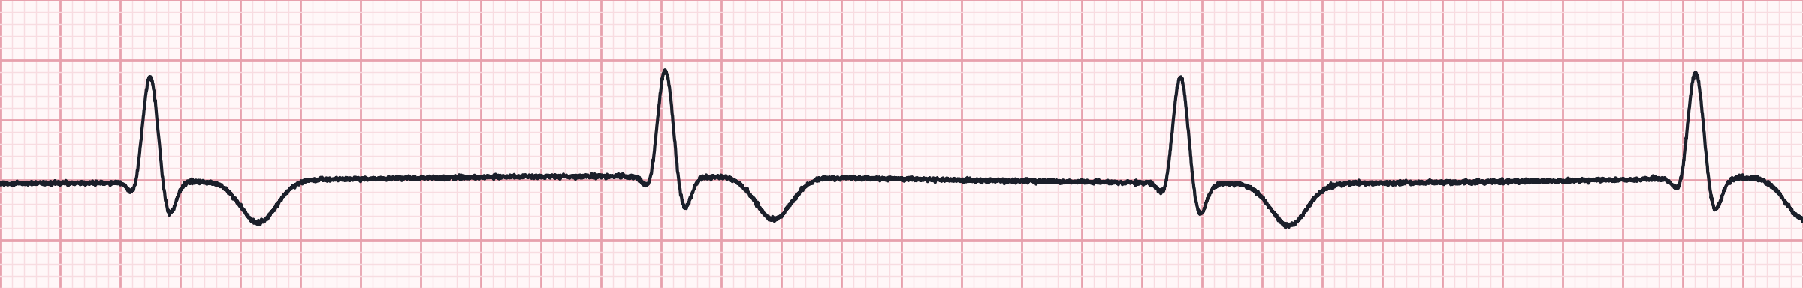
Strip 9 of 50
Unresponsive 82-year-old; weak carotid pulse, BP 70/40.
Lead II · 25 mm/s · 6-second strip (count QRS × 10)
1
Rate
2
Rhythm
3
P waves
4
PR interval
5
QRS
Notes:
Strip 9. Scenario: Unresponsive 82-year-old; weak carotid pulse, BP 70/40. Let learners work through the five steps. Answer on the next slide: Idioventricular rhythm.

Slide 50
Strip 9 · Interpretation
Idioventricular rhythm
Rate | 35/min
Rhythm | Regular
P waves | None
PR interval | None
QRS | Wide (≥ 0.12 s)
Field action
Ventricular escape — the heart's last back-up
Do NOT suppress with antiarrhythmics; pace / support perfusion
Notes:
Strip 9: Idioventricular rhythm. Rate: 35/min. Rhythm: Regular. P waves: None. PR interval: None. QRS: Wide (≥ 0.12 s). Field action: Ventricular escape — the heart's last back-up; Do NOT suppress with antiarrhythmics; pace / support perfusion.

Slide 51
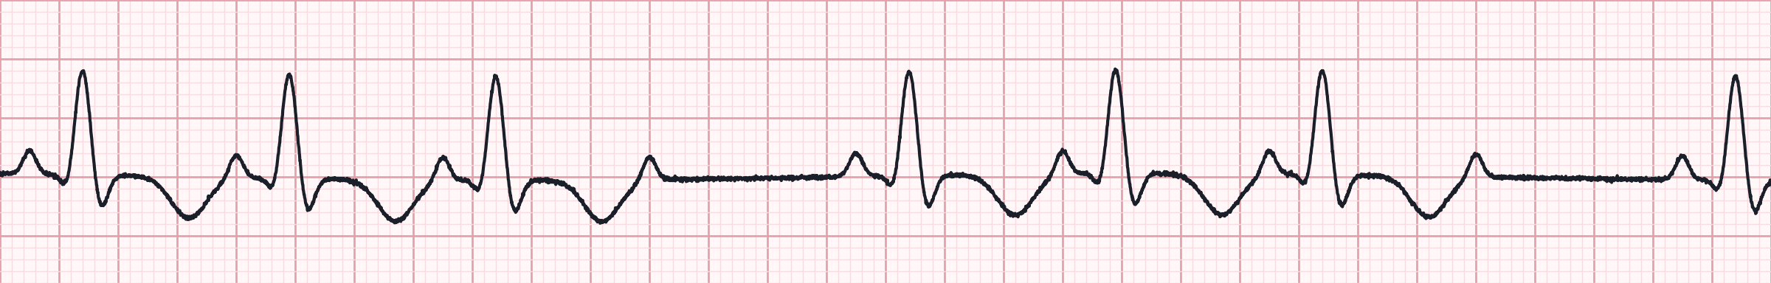
Strip 10 of 50
Syncope at home; now alert.
Lead II · 25 mm/s · 6-second strip (count QRS × 10)
1
Rate
2
Rhythm
3
P waves
4
PR interval
5
QRS
Notes:
Strip 10. Scenario: Syncope at home; now alert. Let learners work through the five steps. Answer on the next slide: 2nd-degree AV block type II (Mobitz II), 4:3.

Slide 52
Strip 10 · Interpretation
2nd-degree AV block type II (Mobitz II), 4:3
Rate | ≈ 70/min (6-second count)
Rhythm | Irregular
P waves | Atrial 86/min; every 4th not conducted
PR interval | 0.18 s, constant
QRS | Wide (≥ 0.12 s)
Field action
High risk of complete block
Pads on, prepare to pace, transport to PCI/cardiac centre
Notes:
Strip 10: 2nd-degree AV block type II (Mobitz II), 4:3. Rate: ≈ 70/min (6-second count). Rhythm: Irregular. P waves: Atrial 86/min; every 4th not conducted. PR interval: 0.18 s, constant. QRS: Wide (≥ 0.12 s). Field action: High risk of complete block; Pads on, prepare to pace, transport to PCI/cardiac centre.

Slide 53
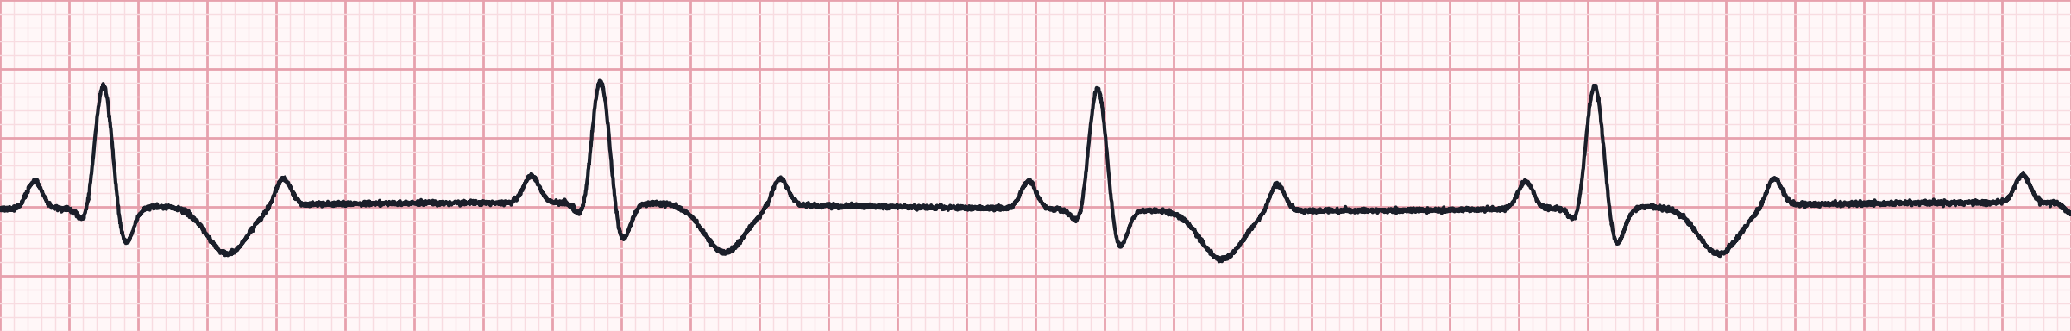
Strip 11 of 50
Fatigue and dyspnea, BP 88/52.
Lead II · 25 mm/s · 6-second strip (count QRS × 10)
1
Rate
2
Rhythm
3
P waves
4
PR interval
5
QRS
Notes:
Strip 11. Scenario: Fatigue and dyspnea, BP 88/52. Let learners work through the five steps. Answer on the next slide: 2nd-degree AV block, 2:1 conduction (wide).

Slide 54
Strip 11 · Interpretation
2nd-degree AV block, 2:1 conduction (wide)
Rate | 42/min
Rhythm | Regular
P waves | Atrial 83/min; 2 P waves per QRS
PR interval | 0.20 s, constant on conducted beats
QRS | Wide (≥ 0.12 s)
Field action
Wide QRS → likely infranodal (behaves like Mobitz II)
Pads on; pacing if unstable
Notes:
Strip 11: 2nd-degree AV block, 2:1 conduction (wide). Rate: 42/min. Rhythm: Regular. P waves: Atrial 83/min; 2 P waves per QRS. PR interval: 0.20 s, constant on conducted beats. QRS: Wide (≥ 0.12 s). Field action: Wide QRS → likely infranodal (behaves like Mobitz II); Pads on; pacing if unstable.

Slide 55
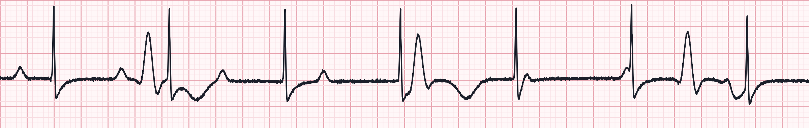
Strip 12 of 50
Pacing at 70/min, 40 mA; patient remains hypotensive.
Lead II · 25 mm/s · 6-second strip (count QRS × 10)
1
Rate
2
Rhythm
3
P waves
4
PR interval
5
QRS
Notes:
Strip 12. Scenario: Pacing at 70/min, 40 mA; patient remains hypotensive. Let learners work through the five steps. Answer on the next slide: Transcutaneous pacing WITHOUT capture.

Slide 56
Strip 12 · Interpretation
Transcutaneous pacing WITHOUT capture
Rate | Ventricular 30/min (escape); pacer 70/min
Rhythm | Pacer spikes regular; slow escape beats unrelated
P waves | Atrial 80/min
PR interval | None
QRS | Wide escape beats only
Pacer spikes | Large artifacts not followed by QRS
Field action
Increase mA until each spike is followed by a wide QRS
Check pad position (anterior–posterior)
Notes:
Strip 12: Transcutaneous pacing WITHOUT capture. Rate: Ventricular 30/min (escape); pacer 70/min. Rhythm: Pacer spikes regular; slow escape beats unrelated. P waves: Atrial 80/min. PR interval: None. QRS: Wide escape beats only. Pacer spikes: Large artifacts not followed by QRS. Field action: Increase mA until each spike is followed by a wide QRS; Check pad position (anterior–posterior).

Slide 57
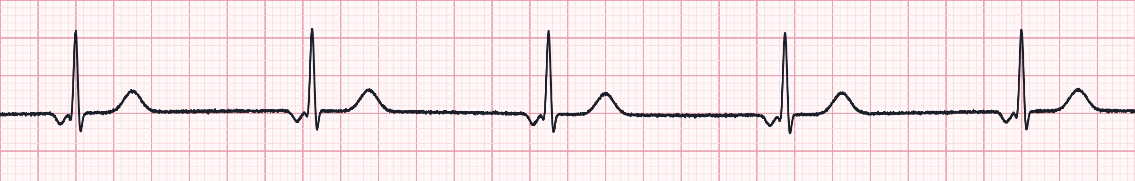
Strip 13 of 50
67-year-old on a beta-blocker, BP 100/64.
Lead II · 25 mm/s · 6-second strip (count QRS × 10)
1
Rate
2
Rhythm
3
P waves
4
PR interval
5
QRS
Notes:
Strip 13. Scenario: 67-year-old on a beta-blocker, BP 100/64. Let learners work through the five steps. Answer on the next slide: Junctional rhythm.

Slide 58
Strip 13 · Interpretation
Junctional rhythm
Rate | 48/min
Rhythm | Regular
P waves | Inverted, just before the QRS
PR interval | Short (< 0.12 s)
QRS | Narrow (≈ 0.08 s)
Field action
Junctional escape (40–60/min)
Treat as bradycardia if symptomatic; review medications
Notes:
Strip 13: Junctional rhythm. Rate: 48/min. Rhythm: Regular. P waves: Inverted, just before the QRS. PR interval: Short (< 0.12 s). QRS: Narrow (≈ 0.08 s). Field action: Junctional escape (40–60/min); Treat as bradycardia if symptomatic; review medications.

Slide 59
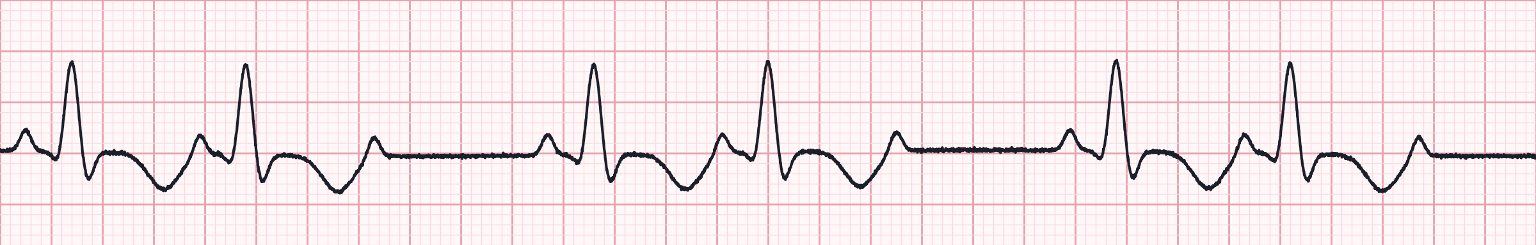
Strip 14 of 50
Anterior MI, BP 84/50, confused.
Lead II · 25 mm/s · 6-second strip (count QRS × 10)
1
Rate
2
Rhythm
3
P waves
4
PR interval
5
QRS
Notes:
Strip 14. Scenario: Anterior MI, BP 84/50, confused. Let learners work through the five steps. Answer on the next slide: 2nd-degree AV block type II (Mobitz II), 3:2.

Slide 60
Strip 14 · Interpretation
2nd-degree AV block type II (Mobitz II), 3:2
Rate | ≈ 60/min (6-second count)
Rhythm | Irregular
P waves | Atrial 88/min; some not conducted
PR interval | 0.18 s, constant
QRS | Wide (≥ 0.12 s)
Field action
Unstable — pads on, transcutaneous pacing
Atropine unlikely to work; don't delay pacing
Notes:
Strip 14: 2nd-degree AV block type II (Mobitz II), 3:2. Rate: ≈ 60/min (6-second count). Rhythm: Irregular. P waves: Atrial 88/min; some not conducted. PR interval: 0.18 s, constant. QRS: Wide (≥ 0.12 s). Field action: Unstable — pads on, transcutaneous pacing; Atropine unlikely to work; don't delay pacing.

Slide 61
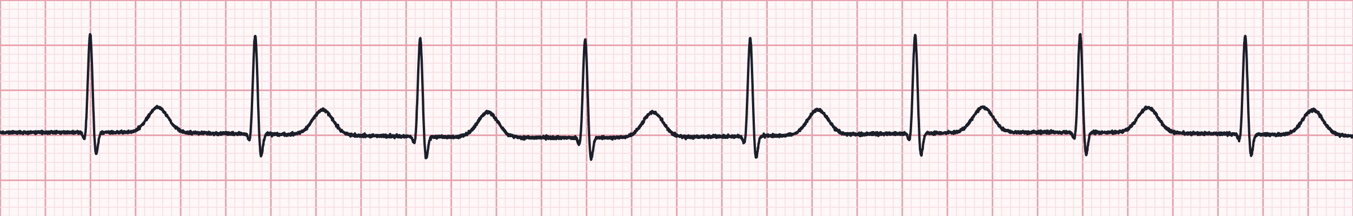
Strip 15 of 50
Patient taking digoxin, nauseated.
Lead II · 25 mm/s · 6-second strip (count QRS × 10)
1
Rate
2
Rhythm
3
P waves
4
PR interval
5
QRS
Notes:
Strip 15. Scenario: Patient taking digoxin, nauseated. Let learners work through the five steps. Answer on the next slide: Accelerated junctional rhythm.

Slide 62
Strip 15 · Interpretation
Accelerated junctional rhythm
Rate | 82/min
Rhythm | Regular
P waves | Not visible
PR interval | Not measurable
QRS | Narrow (≈ 0.08 s)
Field action
Rate 60–100 from the junction
Consider digoxin toxicity; monitor
Notes:
Strip 15: Accelerated junctional rhythm. Rate: 82/min. Rhythm: Regular. P waves: Not visible. PR interval: Not measurable. QRS: Narrow (≈ 0.08 s). Field action: Rate 60–100 from the junction; Consider digoxin toxicity; monitor.

Slide 63
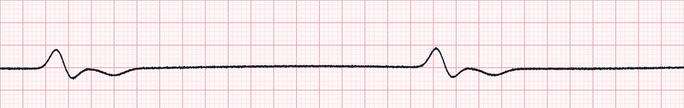
Strip 16 of 50
Arrest, 25 min of resuscitation, no ROSC.
Lead II · 25 mm/s · 6-second strip (count QRS × 10)
1
Rate
2
Rhythm
3
P waves
4
PR interval
5
QRS
Notes:
Strip 16. Scenario: Arrest, 25 min of resuscitation, no ROSC. Let learners work through the five steps. Answer on the next slide: Agonal rhythm.

Slide 64
Strip 16 · Interpretation
Agonal rhythm
Rate | < 20/min
Rhythm | Irregular / very slow
P waves | None
PR interval | None
QRS | Very wide, low amplitude
Field action
Dying heart — treat as PEA if pulseless
Often a terminal rhythm; consider TOR with medical direction
Notes:
Strip 16: Agonal rhythm. Rate: < 20/min. Rhythm: Irregular / very slow. P waves: None. PR interval: None. QRS: Very wide, low amplitude. Field action: Dying heart — treat as PEA if pulseless; Often a terminal rhythm; consider TOR with medical direction.

Slide 65
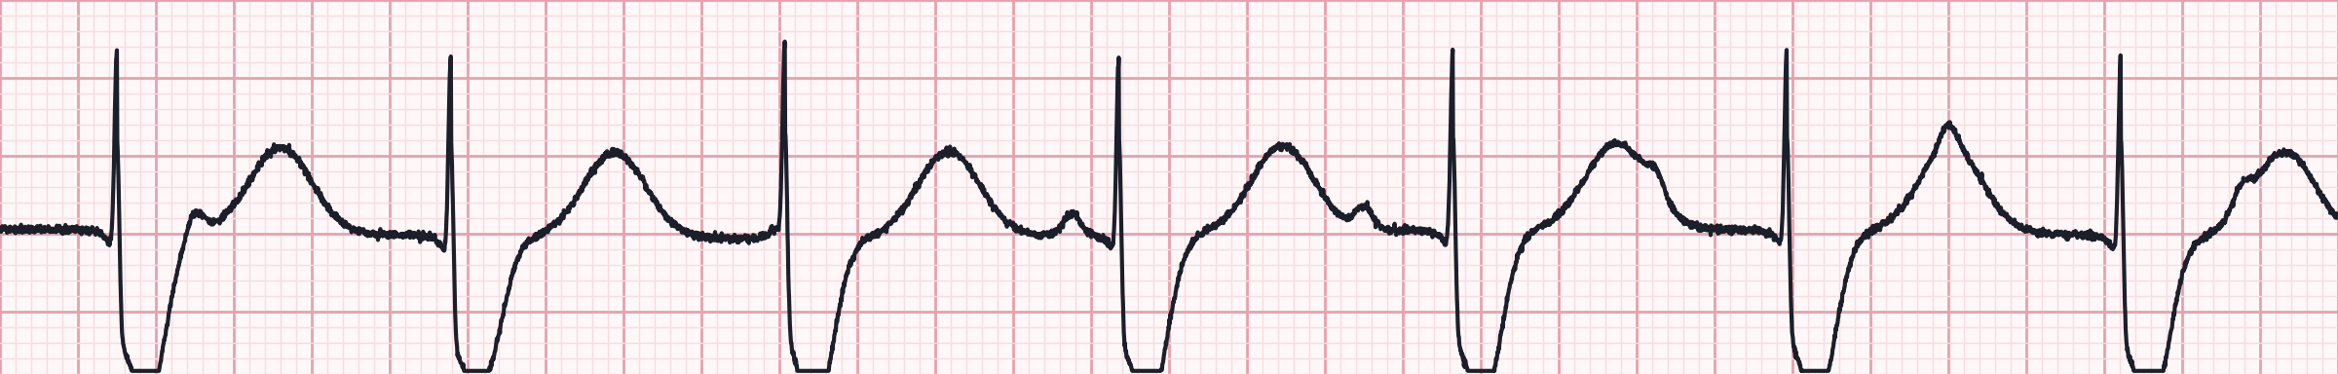
Strip 17 of 50
You are pacing a patient in complete heart block.
Lead II · 25 mm/s · 6-second strip (count QRS × 10)
1
Rate
2
Rhythm
3
P waves
4
PR interval
5
QRS
Notes:
Strip 17. Scenario: You are pacing a patient in complete heart block. Let learners work through the five steps. Answer on the next slide: Transcutaneous pacing with electrical capture.

Slide 66
Strip 17 · Interpretation
Transcutaneous pacing with electrical capture
Rate | 70/min
Rhythm | Regular
P waves | Obscured by artifact
PR interval | None
QRS | Wide, with large T wave after each spike
Pacer spikes | Large pacing artifacts at the set rate
Field action
Electrical capture confirmed — now check a FEMORAL pulse
Give analgesia / sedation
Notes:
Strip 17: Transcutaneous pacing with electrical capture. Rate: 70/min. Rhythm: Regular. P waves: Obscured by artifact. PR interval: None. QRS: Wide, with large T wave after each spike. Pacer spikes: Large pacing artifacts at the set rate. Field action: Electrical capture confirmed — now check a FEMORAL pulse; Give analgesia / sedation.

Slide 67
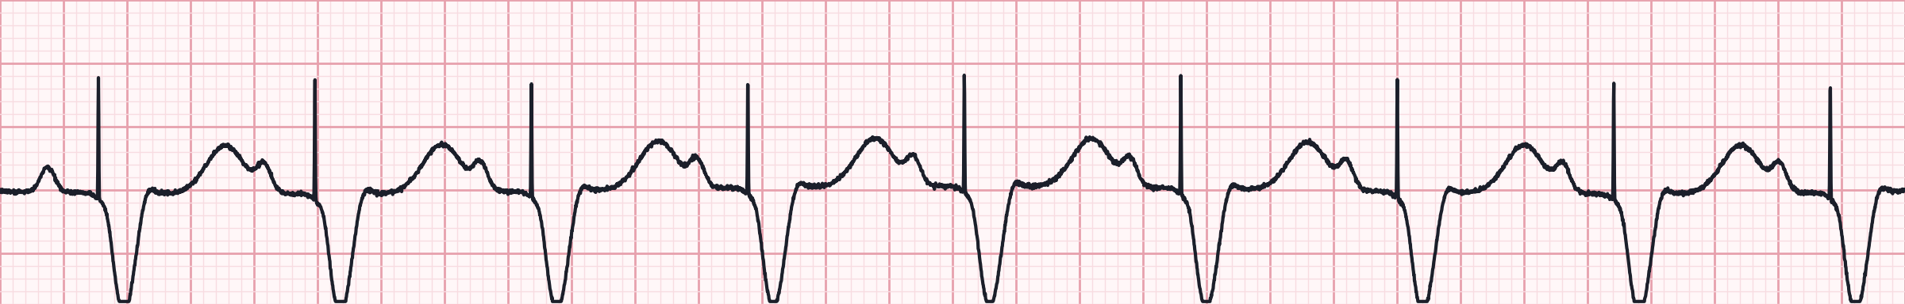
Strip 18 of 50
Pacemaker patient walking briskly — rate rises.
Lead II · 25 mm/s · 6-second strip (count QRS × 10)
1
Rate
2
Rhythm
3
P waves
4
PR interval
5
QRS
Notes:
Strip 18. Scenario: Pacemaker patient walking briskly — rate rises. Let learners work through the five steps. Answer on the next slide: Atrial-sensed, ventricular paced rhythm.

Slide 68
Strip 18 · Interpretation
Atrial-sensed, ventricular paced rhythm
Rate | 88/min
Rhythm | Regular
P waves | Native sinus P waves
PR interval | ≈ 0.16 s (P to V spike)
QRS | Wide, after each ventricular spike
Pacer spikes | Ventricular only, after each P
Field action
Device tracks the sinus rate (DDD/VDD)
Normal function
Notes:
Strip 18: Atrial-sensed, ventricular paced rhythm. Rate: 88/min. Rhythm: Regular. P waves: Native sinus P waves. PR interval: ≈ 0.16 s (P to V spike). QRS: Wide, after each ventricular spike. Pacer spikes: Ventricular only, after each P. Field action: Device tracks the sinus rate (DDD/VDD); Normal function.

Slide 69
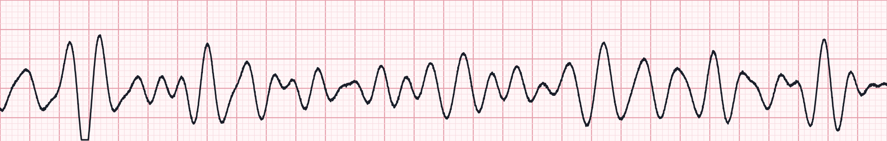
Strip 19 of 50
Witnessed collapse in a shopping centre; pulseless.
Lead II · 25 mm/s · 6-second strip (count QRS × 10)
1
Rate
2
Rhythm
3
P waves
4
PR interval
5
QRS
Notes:
Strip 19. Scenario: Witnessed collapse in a shopping centre; pulseless. Let learners work through the five steps. Answer on the next slide: Coarse ventricular fibrillation.

Slide 70
Strip 19 · Interpretation
Coarse ventricular fibrillation
Rate | Not measurable
Rhythm | Chaotic
P waves | None
PR interval | None
QRS | No identifiable QRS
Field action
Shock immediately, resume CPR 2 min
Epinephrine after initial shocks fail; amiodarone / lidocaine
Notes:
Strip 19: Coarse ventricular fibrillation. Rate: Not measurable. Rhythm: Chaotic. P waves: None. PR interval: None. QRS: No identifiable QRS. Field action: Shock immediately, resume CPR 2 min; Epinephrine after initial shocks fail; amiodarone / lidocaine.

Slide 71
Strip 20 of 50
Pacemaker patient with a syncopal episode.
Lead II · 25 mm/s · 6-second strip (count QRS × 10)
1
Rate
2
Rhythm
3
P waves
4
PR interval
5
QRS
Notes:
Strip 20. Scenario: Pacemaker patient with a syncopal episode. Let learners work through the five steps. Answer on the next slide: Pacemaker failure to pace (oversensing).

Slide 72
Strip 20 · Interpretation
Pacemaker failure to pace (oversensing)
Rate | ≈ 50/min (6-second count)
Rhythm | Irregular — long pause
P waves | None
PR interval | None
QRS | Wide paced beats
Pacer spikes | Absent during a 2.6-second pause
Field action
Device sensed 'noise' and withheld pacing → pause
Pads on; TCP if pauses recur or unstable
Notes:
Strip 20: Pacemaker failure to pace (oversensing). Rate: ≈ 50/min (6-second count). Rhythm: Irregular — long pause. P waves: None. PR interval: None. QRS: Wide paced beats. Pacer spikes: Absent during a 2.6-second pause. Field action: Device sensed 'noise' and withheld pacing → pause; Pads on; TCP if pauses recur or unstable.

Slide 73
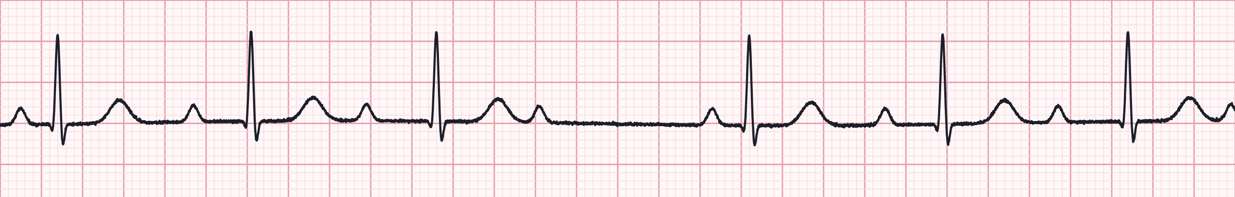
Strip 21 of 50
Athlete at rest, asymptomatic.
Lead II · 25 mm/s · 6-second strip (count QRS × 10)
1
Rate
2
Rhythm
3
P waves
4
PR interval
5
QRS
Notes:
Strip 21. Scenario: Athlete at rest, asymptomatic. Let learners work through the five steps. Answer on the next slide: 2nd-degree AV block type I (Wenckebach), 4:3.

Slide 74
Strip 21 · Interpretation
2nd-degree AV block type I (Wenckebach), 4:3
Rate | ≈ 60/min (6-second count)
Rhythm | Regularly irregular — grouped beats
P waves | Atrial 71/min; every 4th not conducted
PR interval | Lengthens 0.18 → 0.34 s, then drop
QRS | Narrow (≈ 0.08 s)
Field action
Benign in athletes / high vagal tone
Monitor only
Notes:
Strip 21: 2nd-degree AV block type I (Wenckebach), 4:3. Rate: ≈ 60/min (6-second count). Rhythm: Regularly irregular — grouped beats. P waves: Atrial 71/min; every 4th not conducted. PR interval: Lengthens 0.18 → 0.34 s, then drop. QRS: Narrow (≈ 0.08 s). Field action: Benign in athletes / high vagal tone; Monitor only.

Slide 75
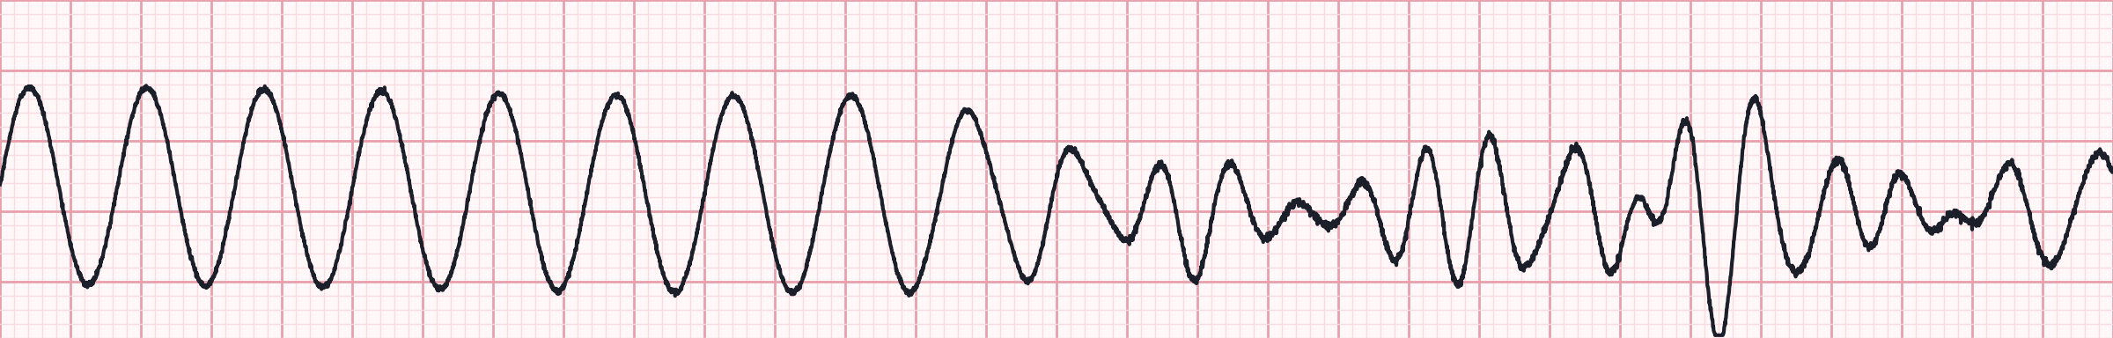
Strip 22 of 50
Patient with a pulse loses consciousness during the strip.
Lead II · 25 mm/s · 6-second strip (count QRS × 10)
1
Rate
2
Rhythm
3
P waves
4
PR interval
5
QRS
Notes:
Strip 22. Scenario: Patient with a pulse loses consciousness during the strip. Let learners work through the five steps. Answer on the next slide: VT degenerating into VF.

Slide 76
Strip 22 · Interpretation
VT degenerating into VF
Rate | VT ≈ 180/min → VF
Rhythm | Regular, then chaotic
P waves | None
PR interval | None
QRS | Wide, then no identifiable QRS
Field action
Now pulseless and shockable: defibrillate
Begin VF/pVT algorithm
Notes:
Strip 22: VT degenerating into VF. Rate: VT ≈ 180/min → VF. Rhythm: Regular, then chaotic. P waves: None. PR interval: None. QRS: Wide, then no identifiable QRS. Field action: Now pulseless and shockable: defibrillate; Begin VF/pVT algorithm.

Slide 77
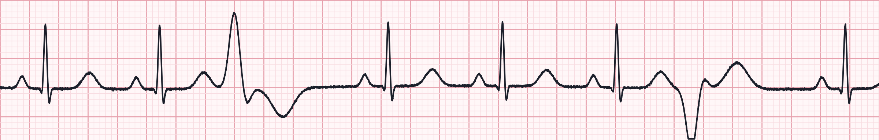
Strip 23 of 50
Septic patient, SpO₂ 86%.
Lead II · 25 mm/s · 6-second strip (count QRS × 10)
1
Rate
2
Rhythm
3
P waves
4
PR interval
5
QRS
Notes:
Strip 23. Scenario: Septic patient, SpO₂ 86%. Let learners work through the five steps. Answer on the next slide: Sinus rhythm with multifocal PVCs.

Slide 78
Strip 23 · Interpretation
Sinus rhythm with multifocal PVCs
Rate | ≈ 80/min (6-second count)
Rhythm | Irregular
P waves | Before sinus beats only
PR interval | 0.16 s on sinus beats
QRS | Narrow; PVCs of two different shapes
Field action
Multifocal = irritable myocardium
Fix hypoxia, check electrolytes, 12-lead
Notes:
Strip 23: Sinus rhythm with multifocal PVCs. Rate: ≈ 80/min (6-second count). Rhythm: Irregular. P waves: Before sinus beats only. PR interval: 0.16 s on sinus beats. QRS: Narrow; PVCs of two different shapes. Field action: Multifocal = irritable myocardium; Fix hypoxia, check electrolytes, 12-lead.

Slide 79
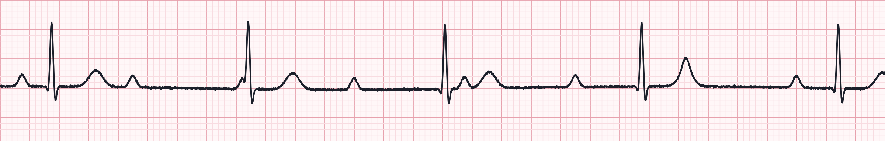
Strip 24 of 50
Inferior MI, alert, BP 104/66.
Lead II · 25 mm/s · 6-second strip (count QRS × 10)
1
Rate
2
Rhythm
3
P waves
4
PR interval
5
QRS
Notes:
Strip 24. Scenario: Inferior MI, alert, BP 104/66. Let learners work through the five steps. Answer on the next slide: 3rd-degree (complete) AV block, junctional escape.

Slide 80
Strip 24 · Interpretation
3rd-degree (complete) AV block, junctional escape
Rate | 45/min
Rhythm | Regular (R–R); P–P also regular
P waves | Atrial 80/min; unrelated to QRS
PR interval | None — varies (AV dissociation)
QRS | Narrow (≈ 0.08 s)
Field action
Junctional escape is more stable
Pads on; atropine may be tried; pace if unstable
Notes:
Strip 24: 3rd-degree (complete) AV block, junctional escape. Rate: 45/min. Rhythm: Regular (R–R); P–P also regular. P waves: Atrial 80/min; unrelated to QRS. PR interval: None — varies (AV dissociation). QRS: Narrow (≈ 0.08 s). Field action: Junctional escape is more stable; Pads on; atropine may be tried; pace if unstable.

Slide 81
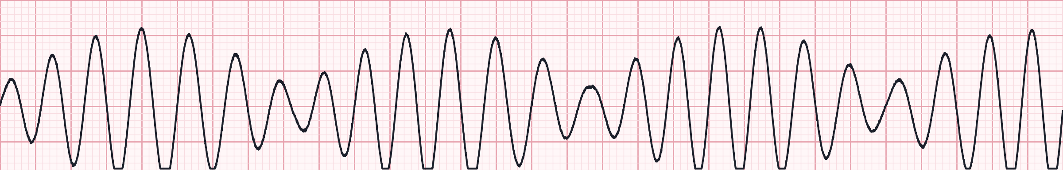
Strip 25 of 50
On methadone, long QT history; collapses.
Lead II · 25 mm/s · 6-second strip (count QRS × 10)
1
Rate
2
Rhythm
3
P waves
4
PR interval
5
QRS
Notes:
Strip 25. Scenario: On methadone, long QT history; collapses. Let learners work through the five steps. Answer on the next slide: Polymorphic VT — torsades de pointes.

Slide 82
Strip 25 · Interpretation
Polymorphic VT — torsades de pointes
Rate | ≈ 240/min
Rhythm | Irregular
P waves | None
PR interval | None
QRS | Wide, twisting around the baseline
Field action
Pulseless: defibrillate (unsynchronized)
Magnesium sulfate 1–2 g IV/IO
Notes:
Strip 25: Polymorphic VT — torsades de pointes. Rate: ≈ 240/min. Rhythm: Irregular. P waves: None. PR interval: None. QRS: Wide, twisting around the baseline. Field action: Pulseless: defibrillate (unsynchronized); Magnesium sulfate 1–2 g IV/IO.

Slide 83
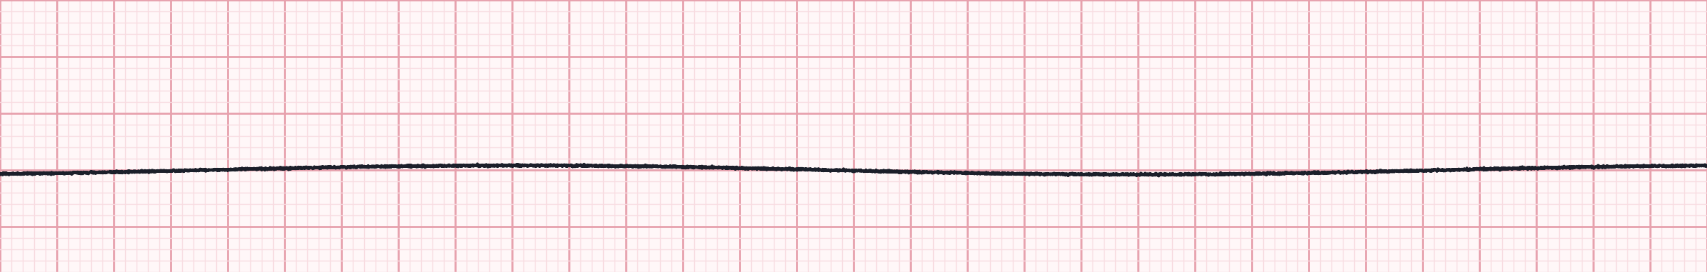
Strip 26 of 50
Found unresponsive, cool to touch; CPR started.
Lead II · 25 mm/s · 6-second strip (count QRS × 10)
1
Rate
2
Rhythm
3
P waves
4
PR interval
5
QRS
Notes:
Strip 26. Scenario: Found unresponsive, cool to touch; CPR started. Let learners work through the five steps. Answer on the next slide: Asystole.

Slide 84
Strip 26 · Interpretation
Asystole
Rate | 0 — no electrical activity
Rhythm | None
P waves | None
PR interval | None
QRS | None
Field action
Confirm in 2 leads; check leads and gain
CPR + epinephrine ASAP; consider TOR criteria
Notes:
Strip 26: Asystole. Rate: 0 — no electrical activity. Rhythm: None. P waves: None. PR interval: None. QRS: None. Field action: Confirm in 2 leads; check leads and gain; CPR + epinephrine ASAP; consider TOR criteria.

Slide 85
Strip 27 of 50
Pacemaker patient with palpitations.
Lead II · 25 mm/s · 6-second strip (count QRS × 10)
1
Rate
2
Rhythm
3
P waves
4
PR interval
5
QRS
Notes:
Strip 27. Scenario: Pacemaker patient with palpitations. Let learners work through the five steps. Answer on the next slide: Pacemaker failure to sense (undersensing).

Slide 86
Strip 27 · Interpretation
Pacemaker failure to sense (undersensing)
Rate | ≈ 80/min (6-second count)
Rhythm | Irregular
P waves | Native P waves present
PR interval | 0.16 s on native beats
QRS | Mostly narrow native; some paced
Pacer spikes | Fixed rate, some land on QRS/T
Field action
Spikes fire regardless of native beats — risk of R-on-T
Monitor, transport; ensure pads are ready
Notes:
Strip 27: Pacemaker failure to sense (undersensing). Rate: ≈ 80/min (6-second count). Rhythm: Irregular. P waves: Native P waves present. PR interval: 0.16 s on native beats. QRS: Mostly narrow native; some paced. Pacer spikes: Fixed rate, some land on QRS/T. Field action: Spikes fire regardless of native beats — risk of R-on-T; Monitor, transport; ensure pads are ready.

Slide 87
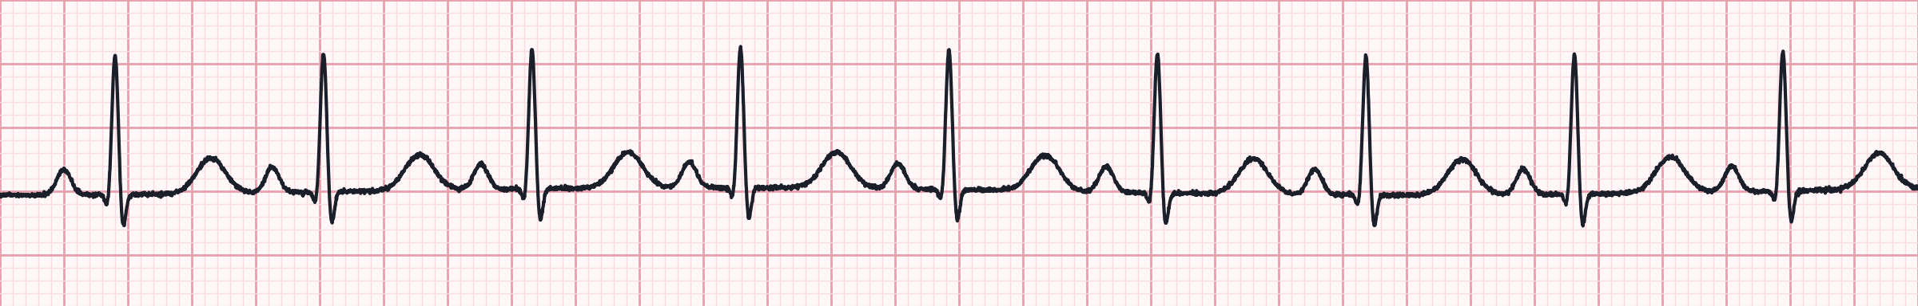
Strip 28 of 50
Monitor shows this — but NO carotid or femoral pulse.
Lead II · 25 mm/s · 6-second strip (count QRS × 10)
1
Rate
2
Rhythm
3
P waves
4
PR interval
5
QRS
Notes:
Strip 28. Scenario: Monitor shows this — but NO carotid or femoral pulse. Let learners work through the five steps. Answer on the next slide: Pulseless electrical activity (PEA).

Slide 88
Strip 28 · Interpretation
Pulseless electrical activity (PEA)
Rate | 92/min
Rhythm | Regular
P waves | Upright, one before each QRS
PR interval | 0.16 s
QRS | Narrow (≈ 0.08 s)
Field action
Organized rhythm + no pulse = PEA
CPR, epinephrine ASAP, hunt H's & T's (narrow + fast → mechanical cause)
Notes:
Strip 28: Pulseless electrical activity (PEA). Rate: 92/min. Rhythm: Regular. P waves: Upright, one before each QRS. PR interval: 0.16 s. QRS: Narrow (≈ 0.08 s). Field action: Organized rhythm + no pulse = PEA; CPR, epinephrine ASAP, hunt H's & T's (narrow + fast → mechanical cause).

Slide 89
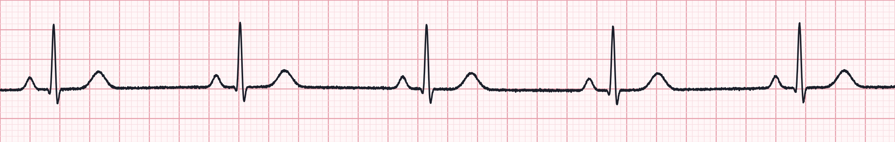
Strip 29 of 50
Fit 30-year-old runner, routine monitoring.
Lead II · 25 mm/s · 6-second strip (count QRS × 10)
1
Rate
2
Rhythm
3
P waves
4
PR interval
5
QRS
Notes:
Strip 29. Scenario: Fit 30-year-old runner, routine monitoring. Let learners work through the five steps. Answer on the next slide: Sinus bradycardia.

Slide 90
Strip 29 · Interpretation
Sinus bradycardia
Rate | 48/min
Rhythm | Regular
P waves | Upright, one before each QRS
PR interval | 0.16 s
QRS | Narrow (≈ 0.08 s)
Field action
Asymptomatic: no treatment
If symptomatic: atropine 1 mg IV, then pacing / infusion
Notes:
Strip 29: Sinus bradycardia. Rate: 48/min. Rhythm: Regular. P waves: Upright, one before each QRS. PR interval: 0.16 s. QRS: Narrow (≈ 0.08 s). Field action: Asymptomatic: no treatment; If symptomatic: atropine 1 mg IV, then pacing / infusion.

Slide 91
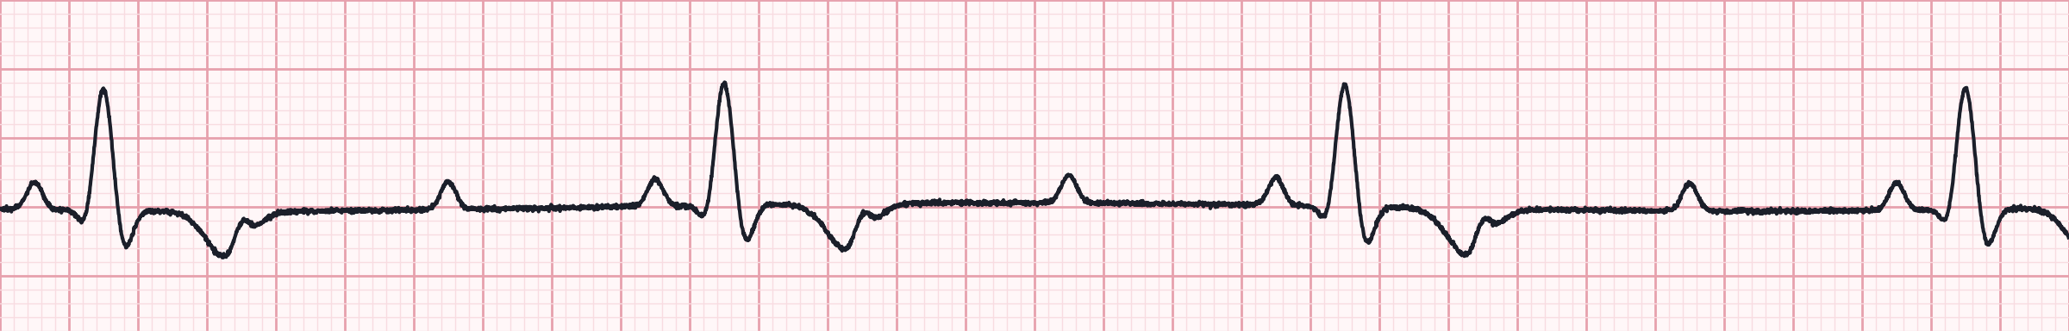
Strip 30 of 50
Syncope, HR in the 30s, BP 76/40.
Lead II · 25 mm/s · 6-second strip (count QRS × 10)
1
Rate
2
Rhythm
3
P waves
4
PR interval
5
QRS
Notes:
Strip 30. Scenario: Syncope, HR in the 30s, BP 76/40. Let learners work through the five steps. Answer on the next slide: Advanced (high-grade) AV block, 3:1.

Slide 92
Strip 30 · Interpretation
Advanced (high-grade) AV block, 3:1
Rate | 33/min
Rhythm | Regular
P waves | Atrial 100/min; 3 P waves per QRS
PR interval | 0.20 s, constant on conducted beats
QRS | Wide (≥ 0.12 s)
Field action
High-grade block — treat like complete heart block
Transcutaneous pacing; epinephrine / dopamine bridge
Notes:
Strip 30: Advanced (high-grade) AV block, 3:1. Rate: 33/min. Rhythm: Regular. P waves: Atrial 100/min; 3 P waves per QRS. PR interval: 0.20 s, constant on conducted beats. QRS: Wide (≥ 0.12 s). Field action: High-grade block — treat like complete heart block; Transcutaneous pacing; epinephrine / dopamine bridge.

Slide 93
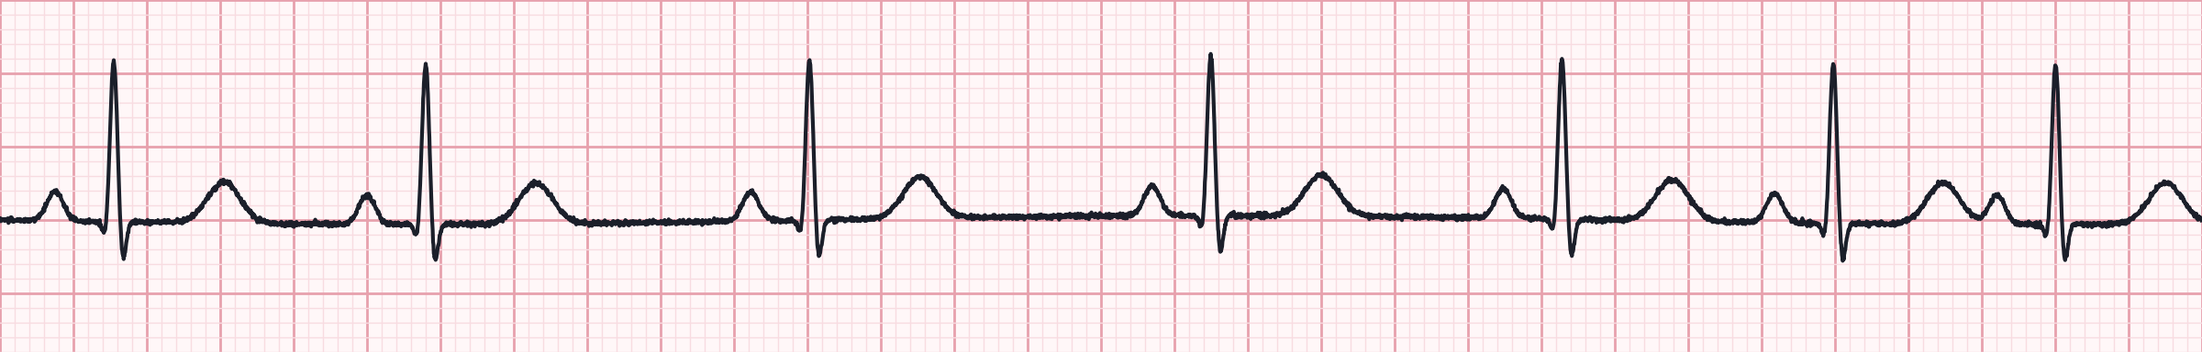
Strip 31 of 50
Healthy 19-year-old; rate varies with breathing.
Lead II · 25 mm/s · 6-second strip (count QRS × 10)
1
Rate
2
Rhythm
3
P waves
4
PR interval
5
QRS
Notes:
Strip 31. Scenario: Healthy 19-year-old; rate varies with breathing. Let learners work through the five steps. Answer on the next slide: Sinus arrhythmia.

Slide 94
Strip 31 · Interpretation
Sinus arrhythmia
Rate | ≈ 70/min (6-second count)
Rhythm | Irregular — cyclic with respiration
P waves | Upright, identical, one before each QRS
PR interval | 0.16 s, constant
QRS | Narrow (≈ 0.08 s)
Field action
Normal variant, common in the young
No treatment
Notes:
Strip 31: Sinus arrhythmia. Rate: ≈ 70/min (6-second count). Rhythm: Irregular — cyclic with respiration. P waves: Upright, identical, one before each QRS. PR interval: 0.16 s, constant. QRS: Narrow (≈ 0.08 s). Field action: Normal variant, common in the young; No treatment.

Slide 95
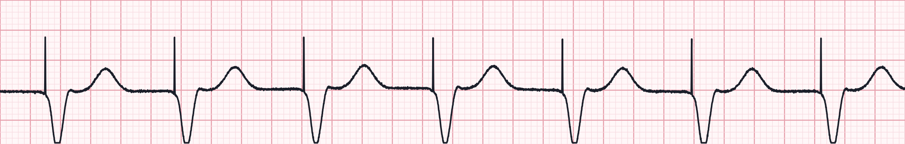
Strip 32 of 50
History of complete heart block; feels well.
Lead II · 25 mm/s · 6-second strip (count QRS × 10)
1
Rate
2
Rhythm
3
P waves
4
PR interval
5
QRS
Notes:
Strip 32. Scenario: History of complete heart block; feels well. Let learners work through the five steps. Answer on the next slide: Ventricular paced rhythm (100% capture).

Slide 96
Strip 32 · Interpretation
Ventricular paced rhythm (100% capture)
Rate | 70/min
Rhythm | Regular
P waves | Not seen
PR interval | None
QRS | Wide, after each spike
Pacer spikes | Ventricular — before each QRS
Field action
Normal ventricular pacing
Wide paced QRS hides STEMI — use clinical picture / Sgarbossa
Notes:
Strip 32: Ventricular paced rhythm (100% capture). Rate: 70/min. Rhythm: Regular. P waves: Not seen. PR interval: None. QRS: Wide, after each spike. Pacer spikes: Ventricular — before each QRS. Field action: Normal ventricular pacing; Wide paced QRS hides STEMI — use clinical picture / Sgarbossa.

Slide 97
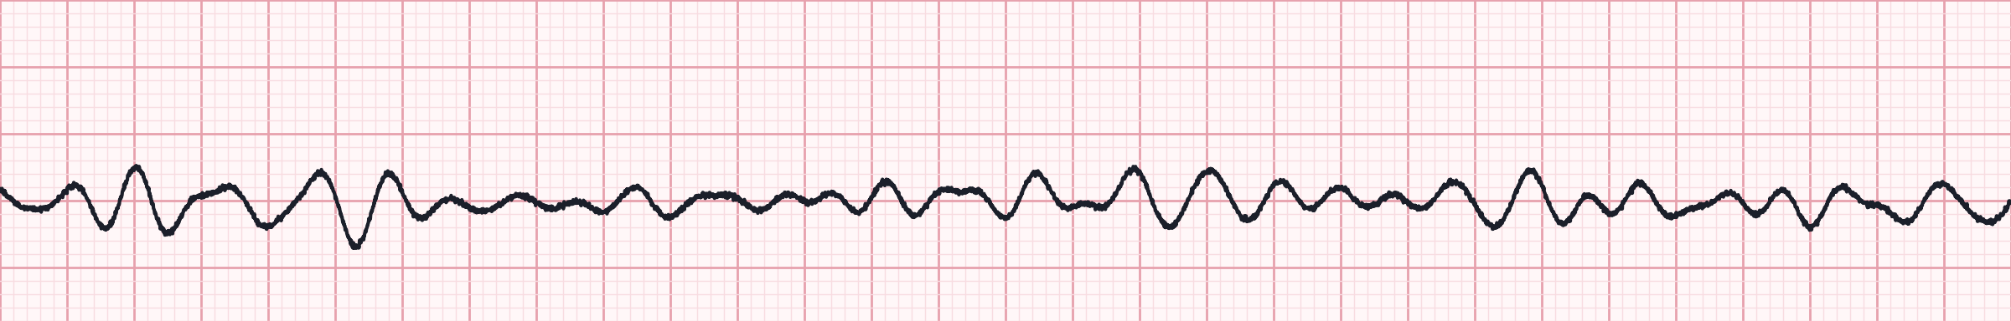
Strip 33 of 50
Unwitnessed arrest, ~10 min down-time; CPR in progress.
Lead II · 25 mm/s · 6-second strip (count QRS × 10)
1
Rate
2
Rhythm
3
P waves
4
PR interval
5
QRS
Notes:
Strip 33. Scenario: Unwitnessed arrest, ~10 min down-time; CPR in progress. Let learners work through the five steps. Answer on the next slide: Fine ventricular fibrillation.

Slide 98
Strip 33 · Interpretation
Fine ventricular fibrillation
Rate | Not measurable
Rhythm | Chaotic, low amplitude
P waves | None
PR interval | None
QRS | No identifiable QRS
Field action
Still shockable — defibrillate
Confirm it isn't asystole: check leads and gain
Notes:
Strip 33: Fine ventricular fibrillation. Rate: Not measurable. Rhythm: Chaotic, low amplitude. P waves: None. PR interval: None. QRS: No identifiable QRS. Field action: Still shockable — defibrillate; Confirm it isn't asystole: check leads and gain.

Slide 99
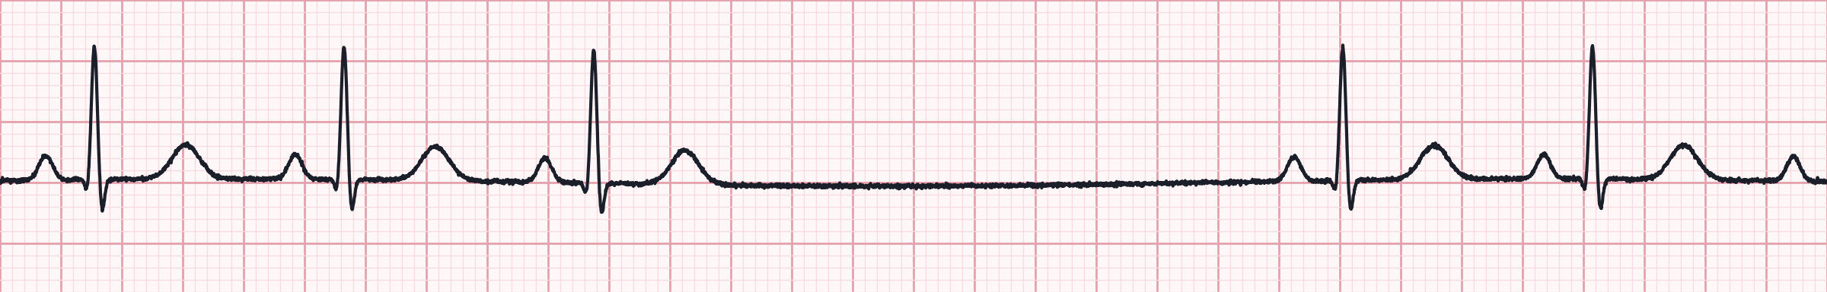
Strip 34 of 50
80-year-old with a near-syncope episode.
Lead II · 25 mm/s · 6-second strip (count QRS × 10)
1
Rate
2
Rhythm
3
P waves
4
PR interval
5
QRS
Notes:
Strip 34. Scenario: 80-year-old with a near-syncope episode. Let learners work through the five steps. Answer on the next slide: Sinus rhythm with sinus arrest (pause).

Slide 100
Strip 34 · Interpretation
Sinus rhythm with sinus arrest (pause)
Rate | ≈ 50/min (6-second count)
Rhythm | Regular, interrupted by a 2.5-second pause
P waves | Upright; none during the pause
PR interval | 0.16 s
QRS | Narrow (≈ 0.08 s)
Field action
Symptomatic pauses suggest sick sinus syndrome
Pads on; atropine / pacing if symptomatic
Notes:
Strip 34: Sinus rhythm with sinus arrest (pause). Rate: ≈ 50/min (6-second count). Rhythm: Regular, interrupted by a 2.5-second pause. P waves: Upright; none during the pause. PR interval: 0.16 s. QRS: Narrow (≈ 0.08 s). Field action: Symptomatic pauses suggest sick sinus syndrome; Pads on; atropine / pacing if symptomatic.

Slide 101
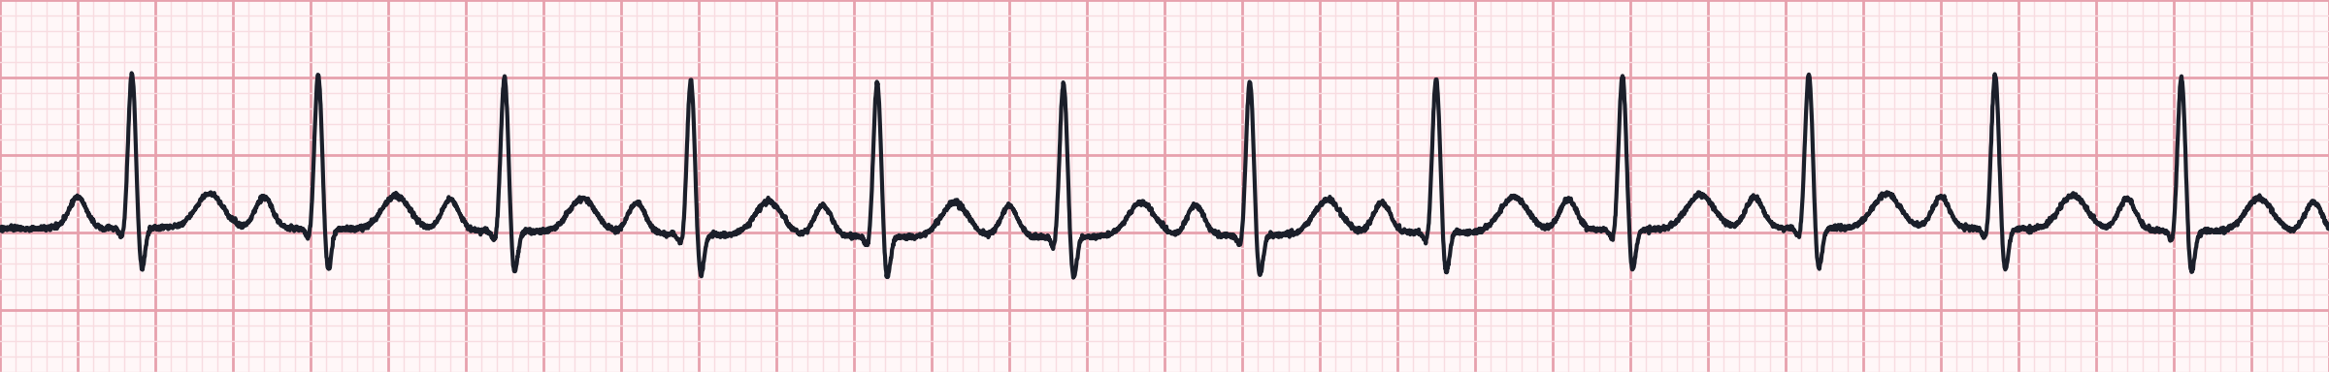
Strip 35 of 50
Febrile 70-year-old, BP 96/60.
Lead II · 25 mm/s · 6-second strip (count QRS × 10)
1
Rate
2
Rhythm
3
P waves
4
PR interval
5
QRS
Notes:
Strip 35. Scenario: Febrile 70-year-old, BP 96/60. Let learners work through the five steps. Answer on the next slide: Sinus tachycardia.

Slide 102
Strip 35 · Interpretation
Sinus tachycardia
Rate | 125/min
Rhythm | Regular
P waves | Upright, one before each QRS
PR interval | 0.14 s
QRS | Narrow (≈ 0.08 s)
Field action
A response, not a primary problem — treat the cause
Fever, sepsis, hypovolemia, pain, hypoxia
Notes:
Strip 35: Sinus tachycardia. Rate: 125/min. Rhythm: Regular. P waves: Upright, one before each QRS. PR interval: 0.14 s. QRS: Narrow (≈ 0.08 s). Field action: A response, not a primary problem — treat the cause; Fever, sepsis, hypovolemia, pain, hypoxia.

Slide 103
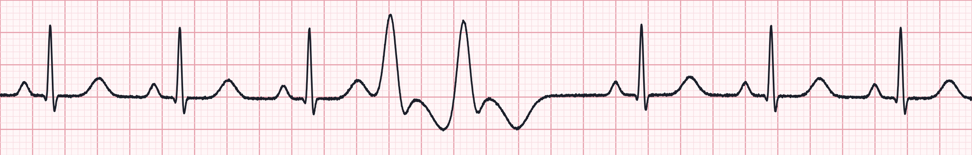
Strip 36 of 50
55-year-old, post-MI, feels 'skipped beats'.
Lead II · 25 mm/s · 6-second strip (count QRS × 10)
1
Rate
2
Rhythm
3
P waves
4
PR interval
5
QRS
Notes:
Strip 36. Scenario: 55-year-old, post-MI, feels 'skipped beats'. Let learners work through the five steps. Answer on the next slide: Sinus rhythm with a PVC couplet.

Slide 104
Strip 36 · Interpretation
Sinus rhythm with a PVC couplet
Rate | ≈ 80/min (6-second count)
Rhythm | Irregular at the couplet
P waves | Before sinus beats only
PR interval | 0.16 s on sinus beats
QRS | Narrow; two consecutive wide PVCs
Field action
Couplets suggest an irritable ventricle
Monitor closely; 12-lead; treat ischemia
Notes:
Strip 36: Sinus rhythm with a PVC couplet. Rate: ≈ 80/min (6-second count). Rhythm: Irregular at the couplet. P waves: Before sinus beats only. PR interval: 0.16 s on sinus beats. QRS: Narrow; two consecutive wide PVCs. Field action: Couplets suggest an irritable ventricle; Monitor closely; 12-lead; treat ischemia.

Slide 105
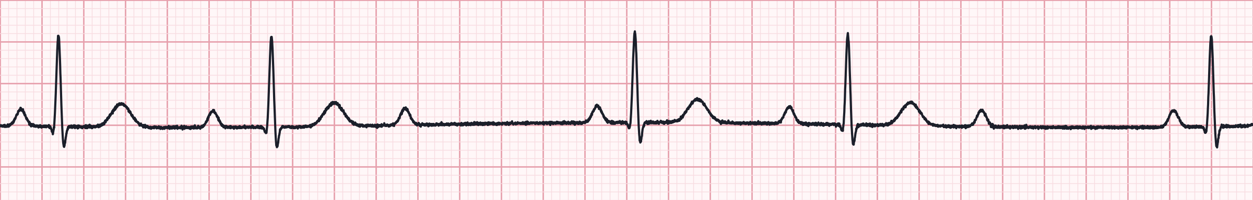
Strip 37 of 50
Inferior MI, mildly lightheaded.
Lead II · 25 mm/s · 6-second strip (count QRS × 10)
1
Rate
2
Rhythm
3
P waves
4
PR interval
5
QRS
Notes:
Strip 37. Scenario: Inferior MI, mildly lightheaded. Let learners work through the five steps. Answer on the next slide: 2nd-degree AV block type I (Wenckebach), 3:2.

Slide 106
Strip 37 · Interpretation
2nd-degree AV block type I (Wenckebach), 3:2
Rate | ≈ 50/min (6-second count)
Rhythm | Regularly irregular — grouped beats
P waves | Atrial 65/min; some not conducted
PR interval | 0.18 → 0.28 s, then dropped beat
QRS | Narrow (≈ 0.08 s)
Field action
Usually nodal, often transient
Atropine if symptomatic
Notes:
Strip 37: 2nd-degree AV block type I (Wenckebach), 3:2. Rate: ≈ 50/min (6-second count). Rhythm: Regularly irregular — grouped beats. P waves: Atrial 65/min; some not conducted. PR interval: 0.18 → 0.28 s, then dropped beat. QRS: Narrow (≈ 0.08 s). Field action: Usually nodal, often transient; Atropine if symptomatic.

Slide 107

Strip 38 of 50
Trauma patient, pale, BP 88/60.
Lead II · 25 mm/s · 6-second strip (count QRS × 10)
1
Rate
2
Rhythm
3
P waves
4
PR interval
5
QRS
Notes:
Strip 38. Scenario: Trauma patient, pale, BP 88/60. Let learners work through the five steps. Answer on the next slide: Sinus tachycardia.

Slide 108
Strip 38 · Interpretation
Sinus tachycardia
Rate | 140/min
Rhythm | Regular
P waves | Upright, close to the preceding T
PR interval | 0.12 s
QRS | Narrow (≈ 0.08 s)
Field action
Compensating for hypovolemia — don't slow it down
Hemorrhage control, fluids/blood, rapid transport
Notes:
Strip 38: Sinus tachycardia. Rate: 140/min. Rhythm: Regular. P waves: Upright, close to the preceding T. PR interval: 0.12 s. QRS: Narrow (≈ 0.08 s). Field action: Compensating for hypovolemia — don't slow it down; Hemorrhage control, fluids/blood, rapid transport.

Slide 109

Strip 39 of 50
62-year-old with palpitations.
Lead II · 25 mm/s · 6-second strip (count QRS × 10)
1
Rate
2
Rhythm
3
P waves
4
PR interval
5
QRS
Notes:
Strip 39. Scenario: 62-year-old with palpitations. Let learners work through the five steps. Answer on the next slide: Sinus rhythm with a unifocal PVC.

Slide 110
Strip 39 · Interpretation
Sinus rhythm with a unifocal PVC
Rate | ≈ 80/min (6-second count)
Rhythm | Regular except for one early beat
P waves | Absent before the early wide beat
PR interval | 0.16 s on sinus beats
QRS | Narrow; the PVC is wide and bizarre
Field action
Isolated PVCs: treat the patient, not the ectopy
Check K⁺/Mg²⁺ risk, ischemia, hypoxia
Notes:
Strip 39: Sinus rhythm with a unifocal PVC. Rate: ≈ 80/min (6-second count). Rhythm: Regular except for one early beat. P waves: Absent before the early wide beat. PR interval: 0.16 s on sinus beats. QRS: Narrow; the PVC is wide and bizarre. Field action: Isolated PVCs: treat the patient, not the ectopy; Check K⁺/Mg²⁺ risk, ischemia, hypoxia.

Slide 111

Strip 40 of 50
Pulseless 59-year-old, CPR started by bystander.
Lead II · 25 mm/s · 6-second strip (count QRS × 10)
1
Rate
2
Rhythm
3
P waves
4
PR interval
5
QRS
Notes:
Strip 40. Scenario: Pulseless 59-year-old, CPR started by bystander. Let learners work through the five steps. Answer on the next slide: Monomorphic ventricular tachycardia.

Slide 112
Strip 40 · Interpretation
Monomorphic ventricular tachycardia
Rate | 170/min
Rhythm | Regular
P waves | Not seen
PR interval | None
QRS | Wide, uniform
Field action
Pulseless VT = shock (defibrillation dose)
With a pulse and unstable: synchronized 100 J
Notes:
Strip 40: Monomorphic ventricular tachycardia. Rate: 170/min. Rhythm: Regular. P waves: Not seen. PR interval: None. QRS: Wide, uniform. Field action: Pulseless VT = shock (defibrillation dose); With a pulse and unstable: synchronized 100 J.

Slide 113

Strip 41 of 50
Patient has a pacemaker for sick sinus syndrome.
Lead II · 25 mm/s · 6-second strip (count QRS × 10)
1
Rate
2
Rhythm
3
P waves
4
PR interval
5
QRS
Notes:
Strip 41. Scenario: Patient has a pacemaker for sick sinus syndrome. Let learners work through the five steps. Answer on the next slide: Atrial paced rhythm.

Slide 114
Strip 41 · Interpretation
Atrial paced rhythm
Rate | 70/min
Rhythm | Regular
P waves | Each P preceded by a pacer spike
PR interval | 0.18 s
QRS | Narrow (≈ 0.08 s)
Pacer spikes | Atrial — before each P wave
Field action
Normal atrial pacing — device working
Ask for device card; note rate
Notes:
Strip 41: Atrial paced rhythm. Rate: 70/min. Rhythm: Regular. P waves: Each P preceded by a pacer spike. PR interval: 0.18 s. QRS: Narrow (≈ 0.08 s). Pacer spikes: Atrial — before each P wave. Field action: Normal atrial pacing — device working; Ask for device card; note rate.

Slide 115

Strip 42 of 50
Inferior STEMI patient, alert, BP 118/70.
Lead II · 25 mm/s · 6-second strip (count QRS × 10)
1
Rate
2
Rhythm
3
P waves
4
PR interval
5
QRS
Notes:
Strip 42. Scenario: Inferior STEMI patient, alert, BP 118/70. Let learners work through the five steps. Answer on the next slide: Sinus bradycardia with 1st-degree AV block.

Slide 116
Strip 42 · Interpretation
Sinus bradycardia with 1st-degree AV block
Rate | 50/min
Rhythm | Regular
P waves | Upright, one before each QRS
PR interval | 0.30 s, constant
QRS | Narrow (≈ 0.08 s)
Field action
Watch for progression in inferior MI
Atropine only if symptomatic
Notes:
Strip 42: Sinus bradycardia with 1st-degree AV block. Rate: 50/min. Rhythm: Regular. P waves: Upright, one before each QRS. PR interval: 0.30 s, constant. QRS: Narrow (≈ 0.08 s). Field action: Watch for progression in inferior MI; Atropine only if symptomatic.

Slide 117

Strip 43 of 50
72-year-old on diltiazem, routine transport.
Lead II · 25 mm/s · 6-second strip (count QRS × 10)
1
Rate
2
Rhythm
3
P waves
4
PR interval
5
QRS
Notes:
Strip 43. Scenario: 72-year-old on diltiazem, routine transport. Let learners work through the five steps. Answer on the next slide: Sinus rhythm with 1st-degree AV block.

Slide 118
Strip 43 · Interpretation
Sinus rhythm with 1st-degree AV block
Rate | 65/min
Rhythm | Regular
P waves | Upright, one before each QRS
PR interval | 0.28 s, constant
QRS | Narrow (≈ 0.08 s)
Field action
Benign conduction delay; monitor
Note AV-nodal blocking medications
Notes:
Strip 43: Sinus rhythm with 1st-degree AV block. Rate: 65/min. Rhythm: Regular. P waves: Upright, one before each QRS. PR interval: 0.28 s, constant. QRS: Narrow (≈ 0.08 s). Field action: Benign conduction delay; monitor; Note AV-nodal blocking medications.

Slide 119

Strip 44 of 50
58-year-old, dizzy after standing; now feels well.
Lead II · 25 mm/s · 6-second strip (count QRS × 10)
1
Rate
2
Rhythm
3
P waves
4
PR interval
5
QRS
Notes:
Strip 44. Scenario: 58-year-old, dizzy after standing; now feels well. Let learners work through the five steps. Answer on the next slide: Normal sinus rhythm.

Slide 120
Strip 44 · Interpretation
Normal sinus rhythm
Rate | 75/min
Rhythm | Regular
P waves | Upright, one before each QRS
PR interval | 0.16 s
QRS | Narrow (≈ 0.08 s)
Field action
Normal rhythm — look for a non-cardiac cause of the dizziness
Orthostatic vitals, glucose, history
Notes:
Strip 44: Normal sinus rhythm. Rate: 75/min. Rhythm: Regular. P waves: Upright, one before each QRS. PR interval: 0.16 s. QRS: Narrow (≈ 0.08 s). Field action: Normal rhythm — look for a non-cardiac cause of the dizziness; Orthostatic vitals, glucose, history.

Slide 121

Strip 45 of 50
Grey, diaphoretic 78-year-old, BP 70/40.
Lead II · 25 mm/s · 6-second strip (count QRS × 10)
1
Rate
2
Rhythm
3
P waves
4
PR interval
5
QRS
Notes:
Strip 45. Scenario: Grey, diaphoretic 78-year-old, BP 70/40. Let learners work through the five steps. Answer on the next slide: 3rd-degree (complete) AV block, ventricular escape.

Slide 122
Strip 45 · Interpretation
3rd-degree (complete) AV block, ventricular escape
Rate | 34/min
Rhythm | Regular (R–R); P–P also regular
P waves | Atrial 85/min; unrelated to QRS
PR interval | None — varies (AV dissociation)
QRS | Wide (≥ 0.12 s)
Field action
Unstable: transcutaneous pacing now
Infusion bridge: epinephrine 2–10 mcg/min or dopamine
Notes:
Strip 45: 3rd-degree (complete) AV block, ventricular escape. Rate: 34/min. Rhythm: Regular (R–R); P–P also regular. P waves: Atrial 85/min; unrelated to QRS. PR interval: None — varies (AV dissociation). QRS: Wide (≥ 0.12 s). Field action: Unstable: transcutaneous pacing now; Infusion bridge: epinephrine 2–10 mcg/min or dopamine.

Slide 123

Strip 46 of 50
Occurs 10 min after successful reperfusion in a STEMI patient.
Lead II · 25 mm/s · 6-second strip (count QRS × 10)
1
Rate
2
Rhythm
3
P waves
4
PR interval
5
QRS
Notes:
Strip 46. Scenario: Occurs 10 min after successful reperfusion in a STEMI patient. Let learners work through the five steps. Answer on the next slide: Accelerated idioventricular rhythm (AIVR).

Slide 124
Strip 46 · Interpretation
Accelerated idioventricular rhythm (AIVR)
Rate | 68/min
Rhythm | Regular
P waves | None
PR interval | None
QRS | Wide (≥ 0.12 s)
Field action
Classic reperfusion rhythm; usually transient
Do not treat with antiarrhythmics if perfusing
Notes:
Strip 46: Accelerated idioventricular rhythm (AIVR). Rate: 68/min. Rhythm: Regular. P waves: None. PR interval: None. QRS: Wide (≥ 0.12 s). Field action: Classic reperfusion rhythm; usually transient; Do not treat with antiarrhythmics if perfusing.

Slide 125

Strip 47 of 50
Weak and dizzy, BP 98/60.
Lead II · 25 mm/s · 6-second strip (count QRS × 10)
1
Rate
2
Rhythm
3
P waves
4
PR interval
5
QRS
Notes:
Strip 47. Scenario: Weak and dizzy, BP 98/60. Let learners work through the five steps. Answer on the next slide: 2nd-degree AV block, 2:1 conduction (narrow).

Slide 126
Strip 47 · Interpretation
2nd-degree AV block, 2:1 conduction (narrow)
Rate | 43/min
Rhythm | Regular
P waves | Atrial 86/min; 2 P waves per QRS
PR interval | 0.20 s, constant on conducted beats
QRS | Narrow (≈ 0.08 s)
Field action
Type can't be determined from 2:1 alone
Narrow QRS → likely nodal; atropine may help
Notes:
Strip 47: 2nd-degree AV block, 2:1 conduction (narrow). Rate: 43/min. Rhythm: Regular. P waves: Atrial 86/min; 2 P waves per QRS. PR interval: 0.20 s, constant on conducted beats. QRS: Narrow (≈ 0.08 s). Field action: Type can't be determined from 2:1 alone; Narrow QRS → likely nodal; atropine may help.

Slide 127
Strip 48 of 50
Pacemaker patient, presyncope, BP 86/50.
Lead II · 25 mm/s · 6-second strip (count QRS × 10)
1
Rate
2
Rhythm
3
P waves
4
PR interval
5
QRS
Notes:
Strip 48. Scenario: Pacemaker patient, presyncope, BP 86/50. Let learners work through the five steps. Answer on the next slide: Ventricular pacing with failure to capture.

Slide 128
Strip 48 · Interpretation
Ventricular pacing with failure to capture
Rate | ≈ 40/min (6-second count)
Rhythm | Irregular (ventricular)
P waves | Not seen
PR interval | None
QRS | Wide when captured; absent after some spikes
Pacer spikes | Regular — not all followed by QRS
Field action
Malfunction: lead displacement, battery, high threshold, hyperkalemia
Transcutaneous pacing if unstable; transport
Notes:
Strip 48: Ventricular pacing with failure to capture. Rate: ≈ 40/min (6-second count). Rhythm: Irregular (ventricular). P waves: Not seen. PR interval: None. QRS: Wide when captured; absent after some spikes. Pacer spikes: Regular — not all followed by QRS. Field action: Malfunction: lead displacement, battery, high threshold, hyperkalemia; Transcutaneous pacing if unstable; transport.

Slide 129

Strip 49 of 50
74-year-old with chest tightness.
Lead II · 25 mm/s · 6-second strip (count QRS × 10)
1
Rate
2
Rhythm
3
P waves
4
PR interval
5
QRS
Notes:
Strip 49. Scenario: 74-year-old with chest tightness. Let learners work through the five steps. Answer on the next slide: Sinus rhythm with ventricular bigeminy.

Slide 130
Strip 49 · Interpretation
Sinus rhythm with ventricular bigeminy
Rate | ≈ 80/min (6-second count)
Rhythm | Regularly irregular — every other beat early
P waves | Before sinus beats only
PR interval | 0.16 s on sinus beats
QRS | Alternating narrow and wide
Field action
Consider ischemia, electrolytes, digoxin
12-lead ECG; monitor for runs of VT
Notes:
Strip 49: Sinus rhythm with ventricular bigeminy. Rate: ≈ 80/min (6-second count). Rhythm: Regularly irregular — every other beat early. P waves: Before sinus beats only. PR interval: 0.16 s on sinus beats. QRS: Alternating narrow and wide. Field action: Consider ischemia, electrolytes, digoxin; 12-lead ECG; monitor for runs of VT.

Slide 131

Strip 50 of 50
Found on floor, GCS 11, BP 64 palpable.
Lead II · 25 mm/s · 6-second strip (count QRS × 10)
1
Rate
2
Rhythm
3
P waves
4
PR interval
5
QRS
Notes:
Strip 50. Scenario: Found on floor, GCS 11, BP 64 palpable. Let learners work through the five steps. Answer on the next slide: 3rd-degree (complete) AV block, slow ventricular escape.

Slide 132
Strip 50 · Interpretation
3rd-degree (complete) AV block, slow ventricular escape
Rate | 30/min
Rhythm | Regular (R–R); P–P also regular
P waves | Atrial 100/min; unrelated to QRS
PR interval | None — varies (AV dissociation)
QRS | Wide (≥ 0.12 s)
Field action
Peri-arrest: pace immediately
Prepare for arrest; consider hyperkalemia / drug toxicity
Notes:
Strip 50: 3rd-degree (complete) AV block, slow ventricular escape. Rate: 30/min. Rhythm: Regular (R–R); P–P also regular. P waves: Atrial 100/min; unrelated to QRS. PR interval: None — varies (AV dissociation). QRS: Wide (≥ 0.12 s). Field action: Peri-arrest: pace immediately; Prepare for arrest; consider hyperkalemia / drug toxicity.

Slide 133

Key takeaways
Built on the 2025 AHA Guidelines for CPR & ECC and the National EMS Education Standards. Always follow local protocols and medical direction.
Compressions first
Right drug, right time
PR and P:QRS tell the block
Spike → capture?
100–120/min, 5–6 cm, minimal pauses, ETCO₂-guided
Epi ASAP in nonshockable; after failed shocks in VF/pVT
Mobitz II and complete block → pace early
Every pacer spike needs a response; confirm TCP with a femoral pulse
Notes:
References: American Heart Association. 2025 American Heart Association Guidelines for Cardiopulmonary Resuscitation and Emergency Cardiovascular Care. Circulation. 2025. National Highway Traffic Safety Administration. National EMS Education Standards (paramedic). Cheskes S, et al. Defibrillation strategies for refractory ventricular fibrillation (DOSE-VF). N Engl J Med. 2022. ECG strips in this deck are synthetic teaching illustrations, not patient recordings.

