Slide 1
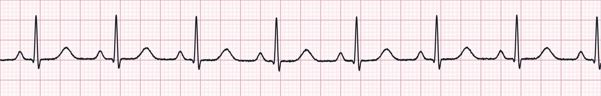
Cardiac Arrest Management & Rhythm Interpretation
Heart blocks and atrial rhythms for paramedics · Aligned to the 2025 AHA Guidelines for CPR & ECC
Notes:
Welcome. This module is built on the 2025 American Heart Association Guidelines for CPR and Emergency Cardiovascular Care and the paramedic-level National EMS Education Standards. Three parts: cardiac arrest management, heart block interpretation, and atrial rhythm interpretation. Remind learners that local medical direction and protocols take precedence over anything on these slides.

Slide 2



What you will be able to do
1 Cardiac arrest
2 Heart blocks
3 Atrial rhythms
Deliver high-quality CPR with minimal pauses
Run the VF/pVT and asystole/PEA pathways
Find and treat reversible causes
Manage the post-ROSC patient
Apply a 5-step rhythm approach
Differentiate 1st, 2nd (I & II) and 3rd degree
Recognize which blocks are unstable
Apply the bradycardia algorithm
Identify PACs, MAT, SVT, flutter and AF
Separate regular from irregular narrow tachycardia
Choose vagal, adenosine, rate control or cardioversion
Select synchronized energy correctly
Notes:
Learning objectives. Part 1 covers the adult cardiac arrest algorithm. Parts 2 and 3 cover interpretation and field management of AV blocks and atrial rhythms, tied to the bradycardia and tachycardia algorithms.

Slide 3
Part 1 · Cardiac Arrest Management
High-quality CPR, early defibrillation, and a team that never stops pushing
Notes:
Section 1: adult cardiac arrest management.

Slide 4




2025 guideline points that shape our practice
One Chain of Survival
Epinephrine timing
Airway choice
A single chain now covers adults and children, in and out of hospital; recognition and early CPR stay the first links.
Nonshockable: give epinephrine as soon as feasible. Shockable: give it after initial defibrillation attempts fail.
BVM, supraglottic airway or ETT are all acceptable; choose by provider skill and success rate, without pausing CPR.
Physiologic monitoring
Refractory VF
Post-arrest care
Use waveform capnography to confirm airway placement, gauge CPR quality and spot ROSC early.
After repeated failed shocks, a vector change (anterior–posterior) or DSED may be considered per medical direction.
Avoid hypotension and hypoxia, prevent fever, get a 12-lead, and transport to a capable cardiac arrest centre.
Notes:
These are the practice-relevant themes of the 2025 AHA update. Emphasize: epinephrine ASAP in nonshockable rhythms; in shockable rhythms epinephrine follows the first failed shocks (commonly after the second shock). Airway: no single device is mandated - the best airway is the one your agency places with a high first-pass success rate without interrupting compressions. Refractory VF: vector change and double sequential external defibrillation are options some systems use; check your protocol. Instructors should verify current wording against the published 2025 guidelines and local protocol before teaching.

Slide 5

High-quality CPR is the intervention
100–120
5–6 cm
≥ 80%
< 10 s
compressions per minute
depth (2–2.4 in), full recoil
chest compression fraction goal
for any pause, incl. pre-shock
Rotate compressors every 2 minutes
Switch at rhythm checks; fatigue degrades depth before rate.
Ventilate, don't hyperventilate
30:2 without an advanced airway; 1 breath every 6 s (10/min) with one.
Let ETCO₂ coach you
Below 10 mmHg means improve compressions; aim for ≥ 20 mmHg.
Notes:
Compressions are the foundation everything else rests on. Rate 100-120, depth at least 5 cm but not more than 6 cm, allow full chest recoil, minimise interruptions so that compression fraction is as high as possible - at least 60% is the floor, 80% is the goal for a well-run team. Charge the defibrillator during compressions, and keep the pre- and post-shock pause under 10 seconds. Avoid excessive ventilation; it raises intrathoracic pressure and lowers coronary perfusion.

Slide 6
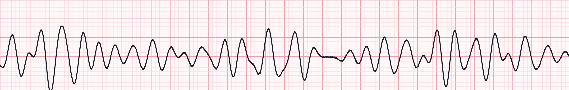
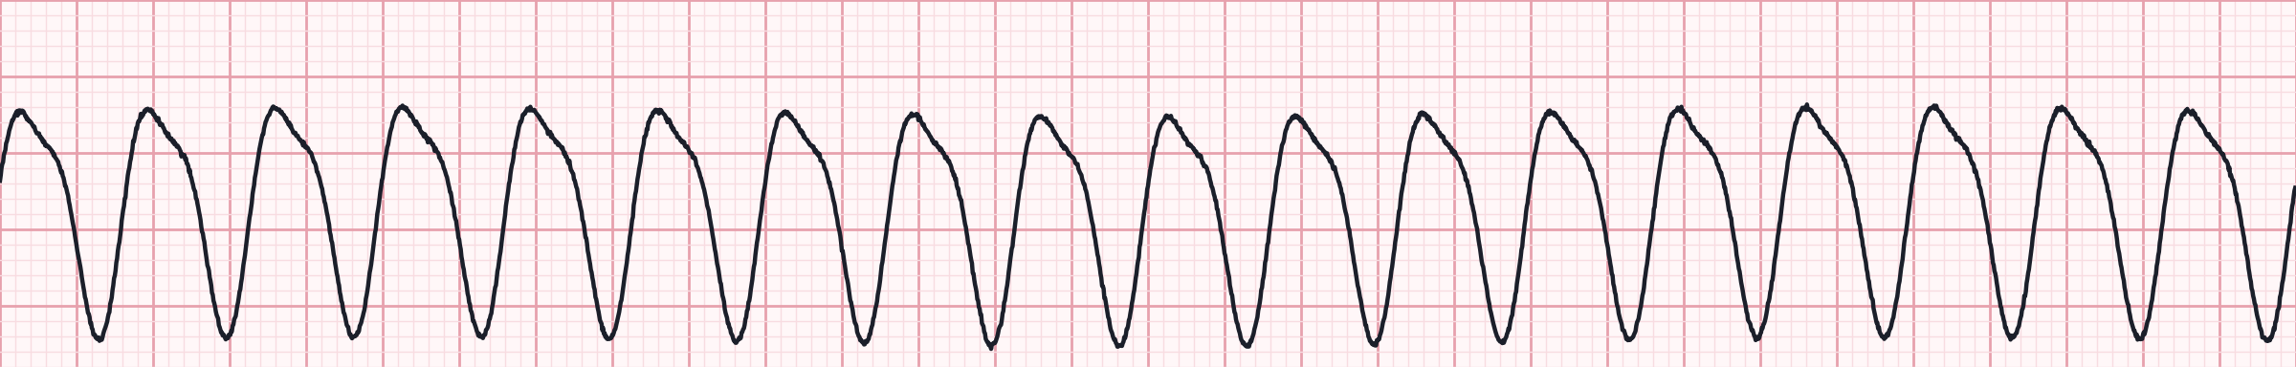
Shockable rhythms: VF and pulseless VT
Ventricular fibrillation
Shock 1
1
CPR 2 min · IV/IO access · pads on, monitor
2
Shock 2
Pulseless ventricular tachycardia
CPR 2 min · Epinephrine 1 mg q3–5 min · consider advanced airway + capnography
3
Shock 3
CPR 2 min · Amiodarone 300 mg (then 150 mg) or Lidocaine 1–1.5 mg/kg
Energy: biphasic per manufacturer (typically 120–200 J); if unknown, use the maximum. Resume CPR immediately after every shock.
4
Continue
Rhythm check every 2 min · treat H's & T's · consider vector change if refractory
Notes:
VF and pulseless VT are the only shockable arrest rhythms. Shock, then immediately resume CPR for 2 minutes without a pulse check. Epinephrine 1 mg IV/IO every 3-5 minutes after initial shocks have failed. Antiarrhythmic for shock-refractory VF/pVT: amiodarone 300 mg then 150 mg, or lidocaine 1-1.5 mg/kg then 0.5-0.75 mg/kg (max 3 mg/kg). Teaching point: the strips are synthetic but representative - coarse VF shows chaotic, irregular deflections with no identifiable QRS; monomorphic VT is wide, regular and rapid.

Slide 7
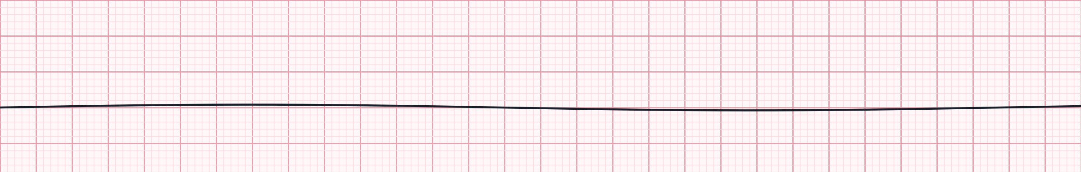
Nonshockable rhythms: asystole and PEA
Asystole — confirm in a second lead; check leads and gain
Start CPR
1
Pads on · rhythm check confirms nonshockable
2
Epinephrine ASAP
PEA — any organized rhythm without a pulse
1 mg IV/IO as soon as access is obtained, then every 3–5 min
3
Airway & capnography
BVM → SGA or ETT · 1 breath q6s · waveform ETCO₂
Key point: outcome hinges on finding the cause. A narrow, fast PEA often points to hypovolemia, tamponade or tension pneumothorax; wide and slow suggests hyperkalemia, toxins or massive MI.
4
Rhythm check q2 min
Shockable? Switch pathways · search H's & T's continuously
Notes:
Asystole and PEA are not shockable. Give epinephrine as early as possible - earlier epinephrine in nonshockable rhythms is associated with better ROSC and survival. Confirm asystole: check lead connections, increase gain, look in another lead (fine VF can masquerade). The lower strip shows an organized sinus rhythm - if there is no pulse, it is PEA. Treat the patient, not the monitor.

Slide 8

Arrest pharmacology at a glance
Drug | Indication | Adult dose (IV/IO) | Repeat / notes
Epinephrine | All arrest rhythms | 1 mg (0.1 mg/mL) | Every 3–5 min · ASAP in nonshockable; after initial shocks in VF/pVT
Amiodarone | Shock-refractory VF/pVT | 300 mg bolus | Second dose 150 mg
Lidocaine | Shock-refractory VF/pVT (alternative) | 1–1.5 mg/kg | Then 0.5–0.75 mg/kg · max 3 mg/kg
Magnesium sulfate | Torsades de pointes | 1–2 g | Not for routine use in other VF/pVT
Calcium chloride | Suspected hyperkalemia, Ca-channel blocker toxicity | 1 g (10 mL of 10%) | Not routine in arrest
Sodium bicarbonate | Hyperkalemia, TCA overdose | 1 mEq/kg | Not routine in arrest
Vasopressin, routine calcium and routine bicarbonate are not recommended. Flush every IO/IV push with 20 mL and keep compressions going during drug delivery.
Notes:
Drug doses per AHA adult cardiac arrest algorithm. Lidocaine and amiodarone are both acceptable for shock-refractory VF/pVT. Magnesium is for torsades only. Calcium and bicarbonate are for specific circumstances such as hyperkalemia or tricyclic overdose - not routine. Confirm agency formulary and concentrations.

Slide 9


Airway and capnography during resuscitation
Reading the ETCO₂ waveform
Start simple
BVM with OPA/NPA and 2-person seal; good oxygenation beats an early tube.
< 10 mmHg
Poor compressions or poor perfusion — push harder, swap compressor
10–20 mmHg
Acceptable; keep optimizing toward ≥ 20
Advance when ready
SGA or ETT — whichever your crew places quickly and reliably. Never stop compressions to intubate.
≥ 20 mmHg
Effective CPR
Ventilate gently
Abrupt rise to 35–45
Likely ROSC — check pulse at next rhythm check
1 breath every 6 s, about 1 second each, just enough for visible chest rise.
A flat trace after intubation means the tube is not in the trachea until proven otherwise.
Notes:
2025 guidance accepts BVM, supraglottic airway or endotracheal intubation in the out-of-hospital setting; the choice depends on provider skill and system success rates. Use continuous waveform capnography to confirm and monitor placement, and as a CPR quality gauge. A persistently low ETCO2 (<10 mmHg) after about 20 minutes of ALS is associated with very low likelihood of ROSC, but it should not be used in isolation to stop resuscitation.

Slide 10
Reversible causes: the H's and T's
H
Hypovolemia
T
Tension pneumothorax
Fluid bolus, control bleeding
Needle / finger decompression
H
Hypoxia
T
Tamponade, cardiac
Airway, O₂, effective ventilation
Fluids, rapid transport; ultrasound if available
H
Hydrogen ion (acidosis)
T
Toxins
Ventilation; bicarbonate if indicated
Specific antidote, e.g. naloxone, Ca²⁺, bicarbonate
H
Hypo-/Hyperkalemia
T
Thrombosis, pulmonary
Calcium + bicarbonate for high K⁺
Consider fibrinolysis per protocol; transport
H
Hypothermia
T
Thrombosis, coronary
Rewarm; handle gently
12-lead after ROSC, PCI-capable centre
Notes:
Run through the H's and T's out loud as a team at every rhythm check. Scene and history clues are your best tools: dialysis patient (hyperkalemia), drug paraphernalia (toxins), trauma or GI bleed (hypovolemia), recent surgery or immobility (PE), chest pain before collapse (coronary thrombosis). Point-of-care ultrasound, where used, can help identify tamponade and pneumothorax.

Slide 11
Refractory VF and the pit-crew team
VF persisting after ≥ 3 shocks
Compressor
Verify pad placement and skin contact; replace pads if needed
Consider a vector change to anterior–posterior pads
Consider double sequential defibrillation if your protocol includes it
Ensure the antiarrhythmic has been given
Think coronary occlusion: early transport to an ECPR / PCI centre if available
Recorder / timer
Airway
Patient
Team leader
Monitor / defib
IV / IO & meds
Notes:
Refractory VF: confirm pads are well placed, consider a vector change to anterior-posterior positioning, and - where your medical director has approved it - double sequential external defibrillation (DSED). The DOSE-VF trial suggested improved survival with both vector change and DSED compared with standard defibrillation. Pit-crew CPR: pre-assigned roles reduce chaos and pauses; the team leader stays hands-off, watches CPR quality and timing, and leads the H's and T's discussion. Closed-loop communication throughout.

Slide 12



After ROSC: protect the brain and the heart
SpO₂ 92–98%
ETCO₂ 35–45
SBP ≥ 90 · MAP ≥ 65
Titrate O₂ down; avoid hypoxia and hyperoxia
Normal ventilation, about 10 breaths/min
Fluids, then norepinephrine or epinephrine infusion
12-lead ECG
Neuro & glucose
Prevent fever
STEMI or suspected occlusion → PCI centre
GCS, pupils, glucose; treat seizures
Temperature control continues in hospital
Notes:
Post-cardiac arrest care begins the moment ROSC is achieved. Re-arrest is common in the first minutes, so keep pads on and anticipate. Targets: SpO2 92-98%, normocapnia (ETCO2 35-45 mmHg as a surrogate), SBP at least 90 and MAP at least 65 mmHg. Obtain a 12-lead ECG as soon as feasible; STEMI warrants emergent PCI. Check glucose. Temperature control and fever prevention continue in hospital. Transport to a cardiac arrest centre where available.

Slide 13



Special situations and termination of resuscitation
Opioid-associated
Pregnancy
Termination (TOR)
Pulse present, poor breathing: ventilate + naloxone
No pulse: standard ACLS first; naloxone must not delay CPR
Observe for re-sedation after ROSC
Manual left uterine displacement during CPR
Early advanced airway; avoid hyperventilation
If ≥ 20 weeks: alert obstetrics for resuscitative delivery; rapid transport
Apply your validated BLS/ALS TOR rule
Typical: arrest not EMS-witnessed, no shock, no ROSC
Low ETCO₂ supports but never decides alone; contact medical direction
Notes:
Opioid-associated emergencies: naloxone is for the patient with a pulse and respiratory depression; in cardiac arrest, high-quality CPR and ventilation come first. Pregnancy: manual left uterine displacement to relieve aortocaval compression; if the uterus is at or above the umbilicus (about 20 weeks) and no ROSC, early notification for resuscitative hysterotomy - in the field this means rapid transport decisions. Termination of resuscitation: use your system's validated rule and consult medical direction; consider family and scene safety.

Slide 14
Part 2 · Heart Blocks
Atrioventricular conduction delays: from benign to life-threatening
Notes:
Section 2: AV blocks. We start with a systematic approach, then work through each block.

Slide 15
A 5-step approach to every strip
Normal sinus rhythm for reference: rate 75 · regular · upright P before every QRS · PR 0.16 s · QRS 0.08 s
1
2
3
4
5
Rate
Rhythm
P waves
PR interval
QRS width
6-second count × 10, or 300 ÷ large boxes
Regular, regularly irregular or irregularly irregular?
Present? Upright? One for every QRS?
Normal 0.12–0.20 s; constant or changing?
Narrow < 0.12 s; wide ≥ 0.12 s
Notes:
Use the same five steps every time. Paper: 25 mm/s, one small box 0.04 s, one large box 0.20 s. In AV blocks the PR interval and the P:QRS relationship are the key: ask 'Is there a P for every QRS, and a QRS for every P?' Then 'Is the PR constant?' Always treat the patient - correlate with perfusion.

Slide 16
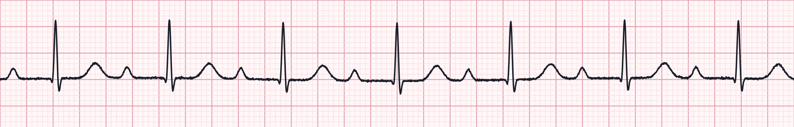

First-degree AV block
Lead II · 25 mm/s · 1 small box = 0.04 s · synthetic teaching strip
Rate | Usually normal (here ~70)
Rhythm | Regular
P waves | Normal; one P for every QRS
PR interval | > 0.20 s and constant (here 0.32 s)
QRS | Usually narrow
Clue: long but constant PR
A conduction delay, not a true block — every impulse gets through
Often benign: athletes, vagal tone, beta-blockers, CCBs, digoxin
New onset with an MI: monitor for progression
No specific treatment; treat the patient
Notes:
First-degree AV block: every P conducts, but slowly. PR is prolonged beyond 0.20 s (one large box) and stays the same beat to beat. Look for causes - medications, inferior MI, increased vagal tone. Usually asymptomatic and needs no treatment, but document and monitor.

Slide 17
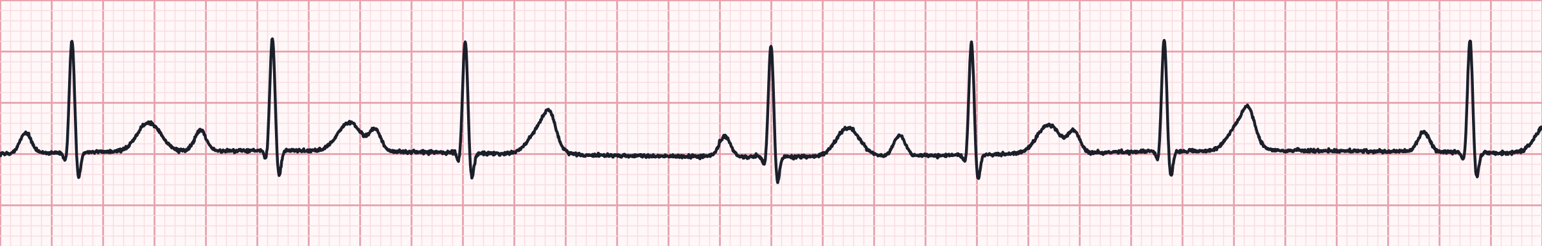
Second-degree AV block type I (Wenckebach)
Lead II · 25 mm/s · 1 small box = 0.04 s · synthetic teaching strip
Rate | Atrial normal; ventricular slightly slower
Rhythm | Regularly irregular — grouped beating
P waves | Normal; occasional P not followed by QRS
PR interval | Progressively lengthens until a beat drops
QRS | Usually narrow (block at AV node)
Clue: longer, longer, drop
Block usually at the AV node; often transient
Causes: inferior MI, vagal tone, AV-nodal drugs
Usually stable; if symptomatic, atropine is often effective
Monitor; pacing rarely needed
Notes:
Mobitz I / Wenckebach: the PR interval gets progressively longer until a P wave is not conducted, then the cycle restarts. Produces grouped beating. Here: PR 0.18, 0.28, 0.35, then a dropped QRS - a 4:3 pattern. The PR after the dropped beat is the shortest. Usually nodal, usually benign, atropine-responsive.

Slide 18
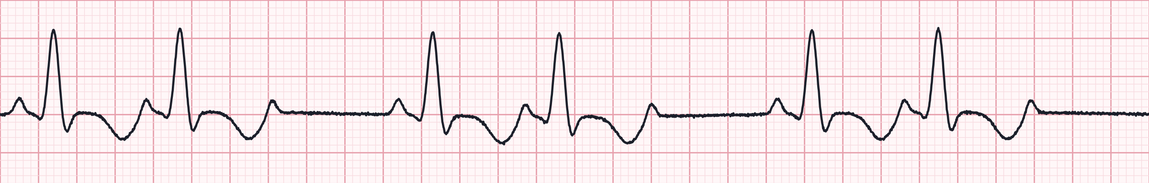
Second-degree AV block type II (Mobitz II)
Lead II · 25 mm/s · 1 small box = 0.04 s · synthetic teaching strip
Rate | Atrial normal; ventricular slower
Rhythm | Irregular when beats drop (here 3:2)
P waves | Normal; some P waves not conducted
PR interval | Constant on conducted beats
QRS | Often wide (infranodal block)
Clue: constant PR, sudden drop
Block below the AV node — can progress suddenly to complete block
Treat as unstable: pads on, prepare for TCP
Atropine often ineffective; do not delay pacing
Common with anterior MI
Notes:
Mobitz II: PR interval is fixed on conducted beats, then a P wave suddenly fails to conduct, without warning lengthening. Block is in the His-Purkinje system, so the QRS is often wide and escape rhythms are unreliable. High risk of progression to third-degree block or asystole. Apply pads early. Note: a 2:1 AV block cannot be classified as type I or II from a single strip - judge by QRS width and clinical picture and treat cautiously.

Slide 19
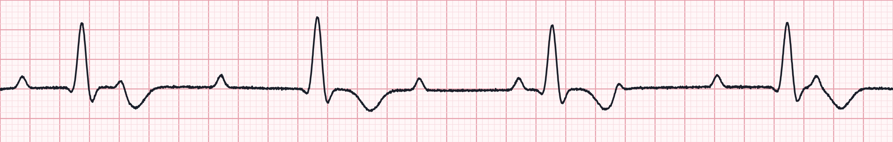
Third-degree (complete) AV block
Lead II · 25 mm/s · 1 small box = 0.04 s · synthetic teaching strip
Rate | Atrial 60–100; ventricular 20–40 (wide)
Rhythm | P–P regular; R–R regular; independent
P waves | Normal, but unrelated to QRS
PR interval | None — varies randomly (AV dissociation)
QRS | Narrow if junctional escape; wide if ventricular
Clue: P waves march through
No atrial impulses reach the ventricles
Usually symptomatic: hypotension, syncope, AMS
Transcutaneous pacing is first-line when unstable with wide QRS
Atropine may be tried but must not delay pacing
Notes:
Complete heart block: atria and ventricles beat independently. Map the P waves with calipers or paper - they march through at a regular rate (here about 90), sometimes hidden in QRS complexes or T waves. Ventricular escape here is about 38/min with wide complexes. Prepare to pace; consider epinephrine or dopamine infusion as a bridge.

Slide 20
Heart blocks side by side
Block | PR interval | P : QRS relationship | QRS | Risk | Field priority
1st degree | > 0.20 s, constant | 1 : 1 | Narrow | Low | Monitor; find cause
2nd type I | Lengthens, then drop | Some P not conducted | Narrow | Low–moderate | Atropine if symptomatic
2nd type II | Constant, then drop | Some P not conducted | Often wide | High | Pads on; prepare TCP
2 : 1 block | Constant on conducted | 2 P per QRS | Narrow or wide | Unclear | Treat by QRS & symptoms
3rd degree | Variable — no relation | AV dissociation | Wide or narrow | High | TCP; infusion bridge
Memory hook: “If some P's don't get through, then you have a Mobitz; if the PR goes long, long, long, then drop — it's Wenckebach; if P's and Q's don't agree, then you have a third degree.”
Notes:
Use this table as a review. Key discriminators are PR behaviour and the P:QRS relationship. Wide QRS and infranodal blocks (Mobitz II, complete heart block) are the dangerous ones - they respond poorly to atropine and need pacing.

Slide 21
Managing symptomatic bradycardia
Assess
HR typically < 50 and causing symptoms? Airway, O₂ if SpO₂ < 90%, IV, 12-lead, monitor
Go straight to pacing
Poor perfusion?
Hypotension · altered mental status · shock · ischemic chest pain · acute heart failure
Mobitz II or third-degree block with wide QRS — atropine rarely works
Heart transplant patients (denervated heart)
Severe instability: don't wait for atropine doses
Pacing: set rate ~60–70, increase mA to electrical capture, confirm mechanical capture by pulse; sedate/analgesia
Atropine
1 mg IV every 3–5 min · max 3 mg
If atropine fails
Transcutaneous pacing and/or dopamine 5–20 mcg/kg/min or epinephrine 2–10 mcg/min
Consult & transport
Expert consultation; transvenous pacing in hospital
Notes:
Adult bradycardia algorithm. First decide whether the bradycardia is causing the symptoms. Atropine 1 mg IV every 3-5 minutes up to 3 mg. If ineffective: transcutaneous pacing, or a chronotropic infusion - dopamine 5-20 mcg/kg/min or epinephrine 2-10 mcg/min. For high-degree blocks with wide QRS, move to pacing early. Confirm mechanical capture with a femoral pulse, not the carotid (muscle twitch artifact). Consider and treat causes: hypoxia, hyperkalemia, drug toxicity (beta-blocker, calcium channel blocker, digoxin), inferior MI.

Slide 22
Part 3 · Atrial Rhythms
When the atria take over: ectopy, re-entry, flutter and fibrillation
Notes:
Section 3: atrial and supraventricular rhythms, linked to the adult tachycardia algorithm.

Slide 23
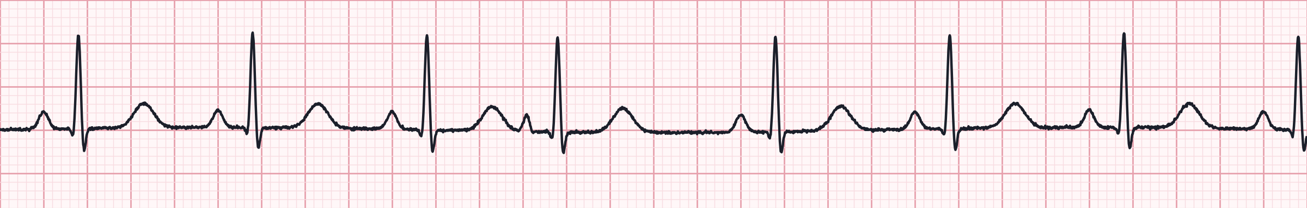
Premature atrial contractions (PACs)
Lead II · 25 mm/s · 1 small box = 0.04 s · synthetic teaching strip
Rate | Underlying rhythm rate
Rhythm | Irregular where the PAC occurs
P waves | Early P with different shape (4th beat)
PR interval | Normal or slightly different
QRS | Narrow; usually followed by a non-compensatory pause
Clue: early beat, odd P wave
Ectopic atrial focus fires before the SA node
Triggers: caffeine, nicotine, stress, hypoxia, electrolytes
Usually no treatment; correct the cause
Frequent PACs can herald AF or SVT
Notes:
PACs: an early beat with an abnormal P wave that comes from somewhere other than the SA node. The QRS is usually narrow. The pause after the PAC is typically non-compensatory because the SA node is reset. Look at the 4th complex on this strip - early, peaked P wave, normal QRS.

Slide 24
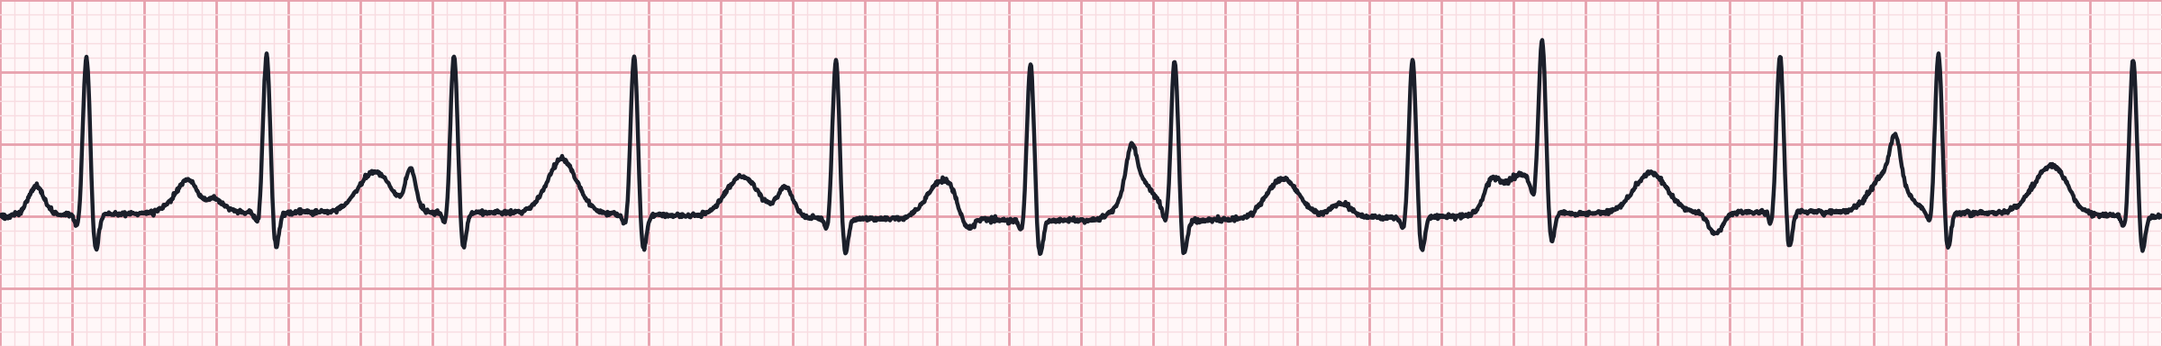
Multifocal atrial tachycardia (MAT)
Lead II · 25 mm/s · 1 small box = 0.04 s · synthetic teaching strip
Rate | > 100 (wandering atrial pacemaker if < 100)
Rhythm | Irregularly irregular
P waves | At least 3 different morphologies
PR interval | Varies with each P
QRS | Narrow
Clue: 3+ P-wave shapes
Classic in COPD, hypoxia, pneumonia, sepsis
Treat the underlying cause — oxygen, bronchodilators
Cardioversion is not effective
Often mistaken for AF — look for distinct P waves
Notes:
MAT: multiple ectopic atrial foci, so P waves change shape and PR intervals vary. It is irregularly irregular like AF, but has discernible P waves before each QRS. Strongly associated with COPD and hypoxia. Synchronized cardioversion does not work; treatment is of the underlying respiratory or metabolic problem.

Slide 25
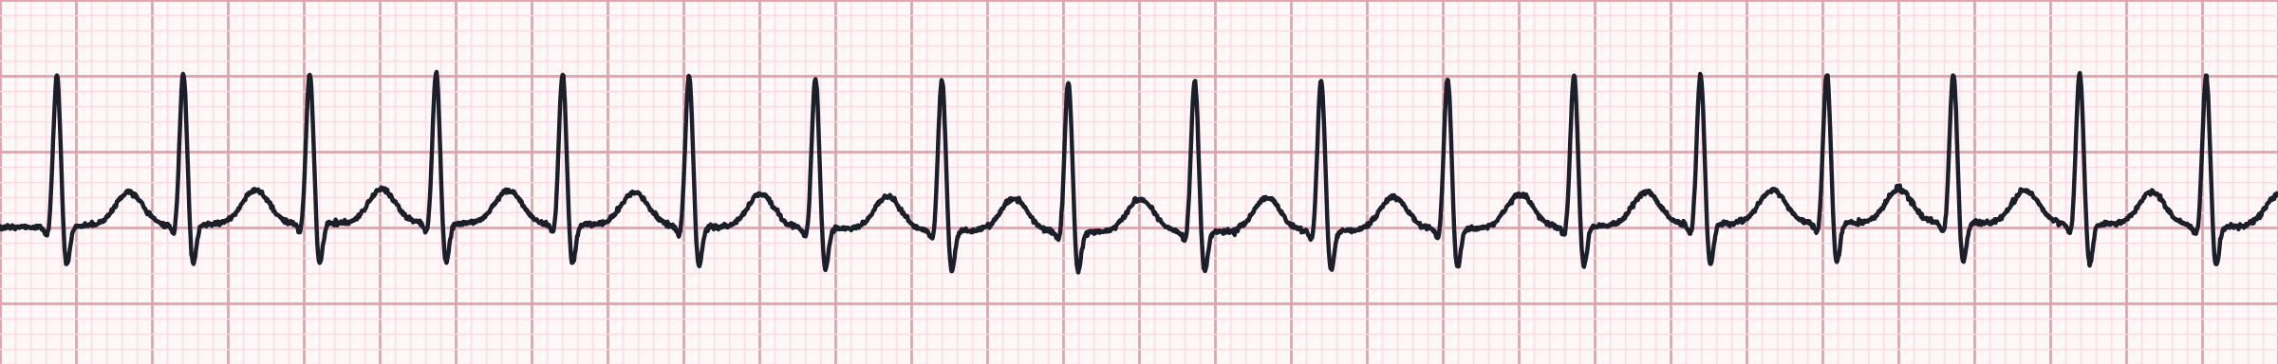
Supraventricular tachycardia (SVT)
Lead II · 25 mm/s · 1 small box = 0.04 s · synthetic teaching strip
Rate | 150–250 (here ~180)
Rhythm | Regular
P waves | Usually hidden in QRS or T waves
PR interval | Not measurable
QRS | Narrow (< 0.12 s)
Stable? Vagal, then adenosine
Usually AV-nodal re-entry: sudden onset and offset
Modified Valsalva (strain, then lie flat, legs raised)
Adenosine 6 mg rapid IV push + flush; then 12 mg
Unstable: synchronized cardioversion 50–100 J
Notes:
SVT usually refers to re-entrant tachycardia (AVNRT or AVRT). Regular, narrow, rapid, P waves not visible. Stable: vagal manoeuvres first - the modified Valsalva is more effective than standard. Then adenosine 6 mg rapid IV push in a proximal (antecubital) vein with a 20 mL flush; if no conversion, 12 mg. Warn the patient about transient chest discomfort and a sense of doom. Record a strip during adenosine - it may unmask flutter waves. Unstable: synchronized cardioversion.

Slide 26
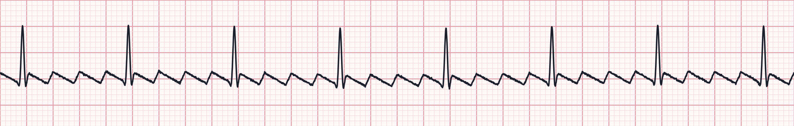
Atrial flutter
Lead II · 25 mm/s · 1 small box = 0.04 s · synthetic teaching strip
Rate | Atrial ~300; ventricular depends on ratio
Rhythm | Usually regular (here 4:1 ≈ 75)
P waves | Flutter waves — sawtooth, best in II, III, aVF
PR interval | Not measured
QRS | Narrow
Clue: sawtooth F waves
Regular narrow tachycardia at ~150? Suspect 2:1 flutter
Stable: rate control (diltiazem or beta-blocker per protocol)
Unstable: synchronized cardioversion 50–100 J
Adenosine won't convert it but may reveal F waves
Notes:
Atrial flutter: a macro re-entry circuit in the right atrium producing flutter waves at about 300/min. Conduction is often 2:1 (ventricular rate ~150) or 4:1 (~75). A regular narrow tachycardia at exactly 150 should make you hunt for hidden flutter waves. Flutter responds well to low-energy synchronized cardioversion when unstable.

Slide 27
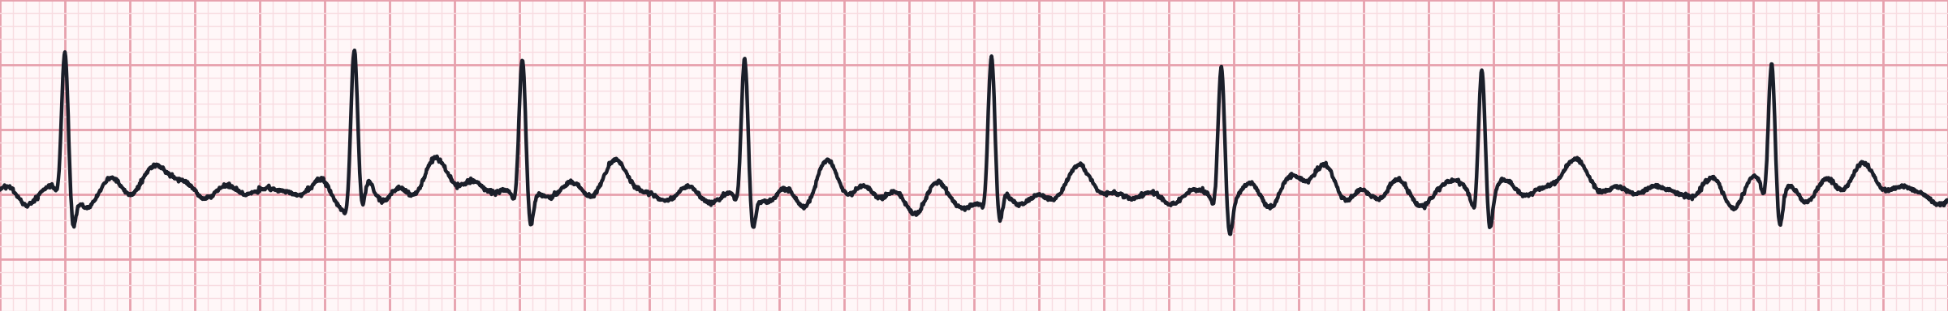
Atrial fibrillation
Lead II · 25 mm/s · 1 small box = 0.04 s · synthetic teaching strip
Rate | Atrial 350–600; ventricular variable
Rhythm | Irregularly irregular
P waves | Absent — fibrillatory baseline
PR interval | None
QRS | Narrow (wide if aberrancy or pre-excitation)
Clue: irregularly irregular, no P
Rapid ventricular response > 100–110 often causes symptoms
Stable: rate control — diltiazem 0.25 mg/kg over 2 min or beta-blocker
Unstable: synchronized cardioversion 120–200 J biphasic
Irregular, wide, very fast? Think WPW — avoid AV-nodal blockers
Notes:
Atrial fibrillation: chaotic atrial activity, no P waves, irregularly irregular ventricular response. Ask about onset (stroke risk if > 48 hours), anticoagulants, and symptoms. Stable with RVR: rate control per protocol. Unstable: synchronized cardioversion 120-200 J biphasic. Pre-excited AF (WPW): irregular, very fast, wide and bizarre QRS - adenosine, diltiazem, beta-blockers, digoxin and amiodarone can be dangerous; cardioversion or procainamide per protocol.

Slide 28

Atrial rhythms side by side
Rhythm | Rate | Regularity | P waves | First-line (stable)
PACs | Underlying | Irregular at the PAC | Early, abnormal | Treat cause
MAT | > 100 | Irregularly irregular | ≥ 3 morphologies | Treat hypoxia / COPD
SVT | 150–250 | Regular | Hidden | Vagal → adenosine
Atrial flutter | ~150 (2:1) or ~75 (4:1) | Usually regular | Sawtooth F waves | Rate control
Atrial fibrillation | Variable | Irregularly irregular | None; fibrillatory | Rate control
Narrow and irregular? Look for P waves: distinct and varied → MAT; none → AF. Narrow, regular and exactly ~150 → suspect 2:1 flutter.
Notes:
Summary table. The two big discriminators for narrow-complex rhythms are regularity and P wave appearance.

Slide 29
Tachycardia with a pulse: stable or unstable?
Unstable → synchronized cardioversion
Stable → identify and treat
Hypotension · acutely altered mental status · signs of shock · ischemic chest discomfort · acute heart failure
Narrow, regular (SVT)
Vagal manoeuvres → adenosine 6 mg rapid push, then 12 mg
Narrow, irregular (AF / flutter)
Rate control: diltiazem or beta-blocker per protocol
Wide QRS (≥ 0.12 s)
Treat as VT until proven otherwise; adenosine only if regular and monomorphic; consider amiodarone or procainamide; expert consult
Narrow, regular
50–100 J
Narrow, irregular (AF)
120–200 J biphasic
Wide, regular
100 J
Wide, irregular
Defibrillation dose (unsynchronized)
Notes:
Adult tachycardia with a pulse algorithm. First question: is the tachycardia causing instability? If yes, synchronized cardioversion - sedate if time allows. Energy guide: narrow regular 50-100 J; narrow irregular (AF) 120-200 J biphasic; wide regular 100 J; wide irregular (polymorphic VT) - defibrillate, do not synchronize. If stable: obtain a 12-lead, classify by QRS width and regularity. Re-sync after every cardioversion - many monitors default back to unsynchronized mode.

Slide 30
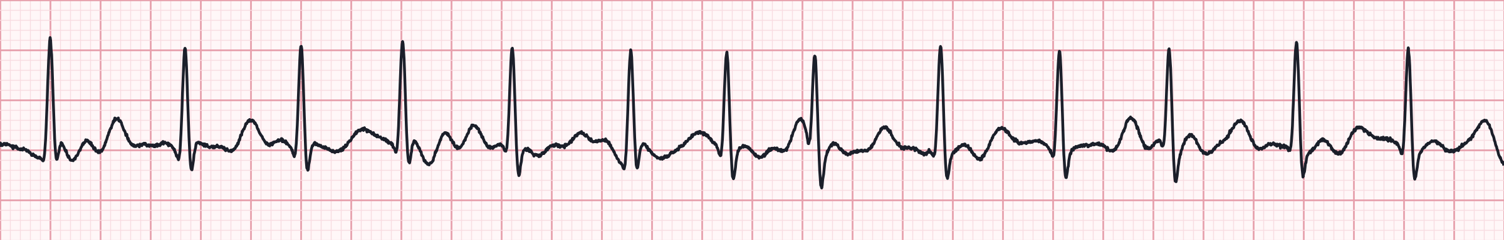
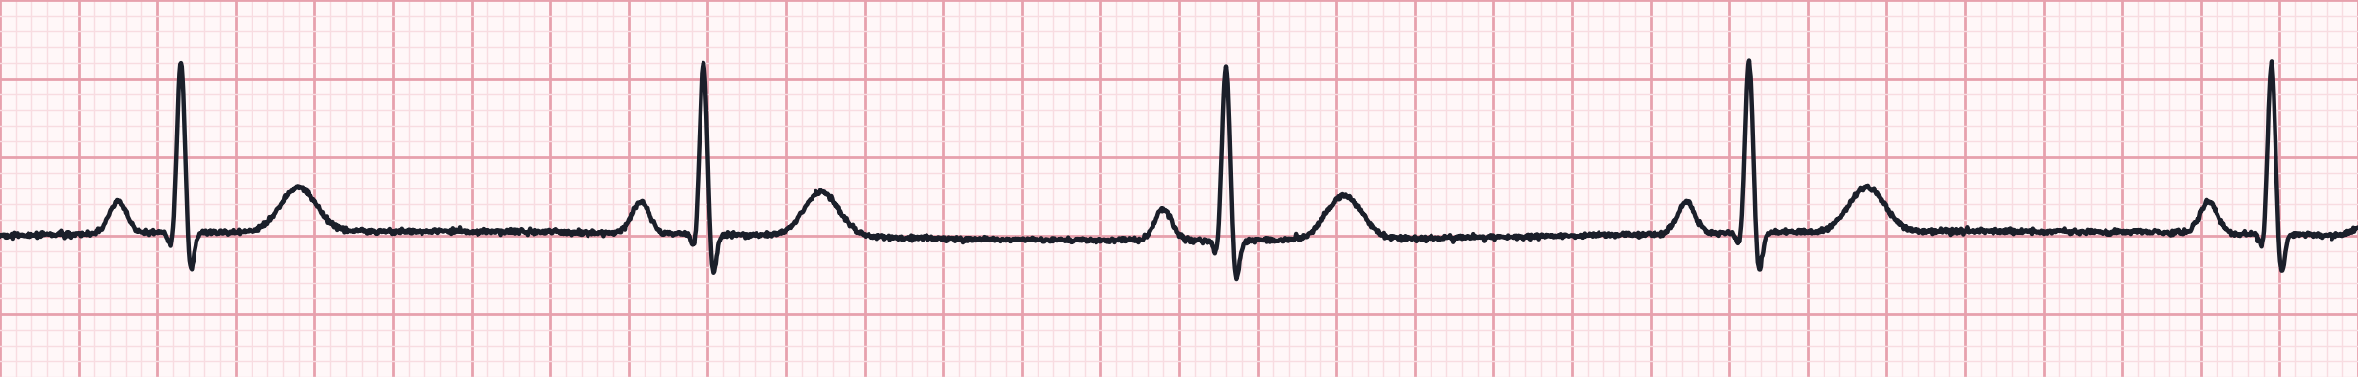
Practice: name these rhythms
A
Use the 5 steps
Rate
Rhythm
P waves
PR
QRS
B
C
Notes:
Give learners 2-3 minutes per strip. Answers on the next slide. A: atrial fibrillation with rapid ventricular response. B: sinus bradycardia. C: second-degree AV block type I (Wenckebach).

Slide 31
Practice answers
A
Atrial fibrillation with RVR
Irregularly irregular, ~140/min, no P waves, narrow QRS. Stable → rate control; unstable → sync 120–200 J.
B
Sinus bradycardia
Regular ~45/min, upright P before every QRS, normal PR. Treat only if symptomatic: atropine 1 mg.
C
2nd-degree AV block type I
PR lengthens beat by beat until a P is not conducted; grouped beating, narrow QRS.
Notes:
Discuss how each was identified using the five steps. Ask: which of these would you expect to respond to atropine? (B and C, if symptomatic.)

Slide 32

Key takeaways
Built on the 2025 AHA Guidelines for CPR & ECC and the National EMS Education Standards. Always follow local protocols and medical direction.
Compressions first
Right drug, right time
PR and P:QRS tell the block
Stable vs unstable decides
100–120/min, 5–6 cm, minimal pauses, ETCO₂-guided
Epi ASAP in nonshockable; after failed shocks in VF/pVT
Mobitz II and complete block → pace early
Unstable tachycardia → synchronized cardioversion
Notes:
References: American Heart Association. 2025 American Heart Association Guidelines for Cardiopulmonary Resuscitation and Emergency Cardiovascular Care. Circulation. 2025. National Highway Traffic Safety Administration. National EMS Education Standards (paramedic). Cheskes S, et al. Defibrillation strategies for refractory ventricular fibrillation (DOSE-VF). N Engl J Med. 2022. ECG strips in this deck are synthetic teaching illustrations, not patient recordings.

