Slide 1
Should or Shouldn´t

Slide 2

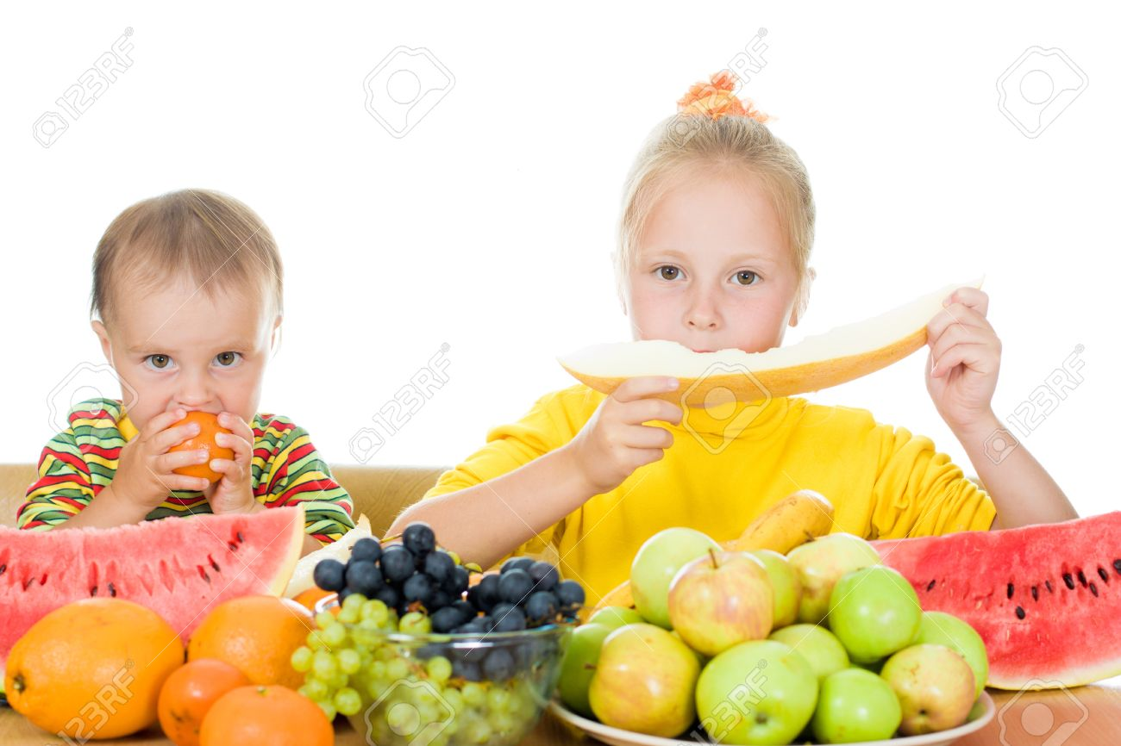
Should: Something that is a good or positive idea
Children SHOULD eat fruits everyday

Slide 3
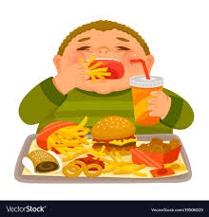

Shouldn’t: Something that is a bad or negative idea
Children SHOULDN’T eat junk food everyday

Slide 4
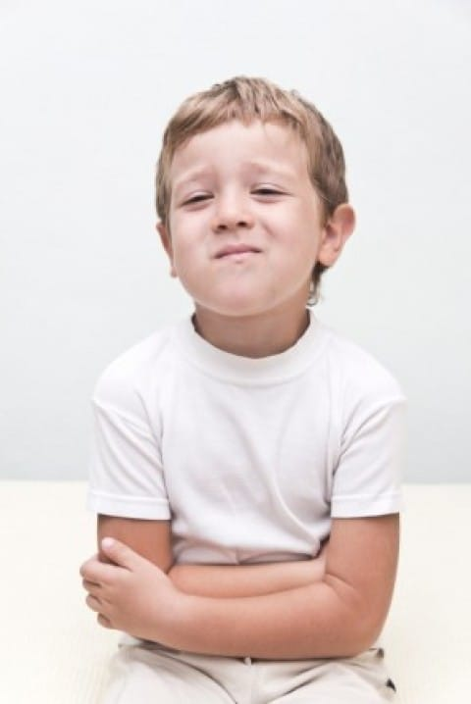
This is Mark, he has a stomachache
He_______ eat candies today.
He_______ take medicine.
He_______ visit the doctor.

Slide 5
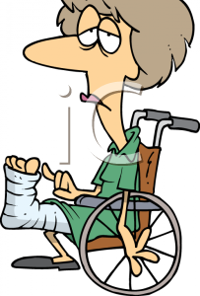
This is Maggie,she has a broken leg.
She _______ rest at home.
She________ jump in the park.
She________ play soccer.

Slide 6
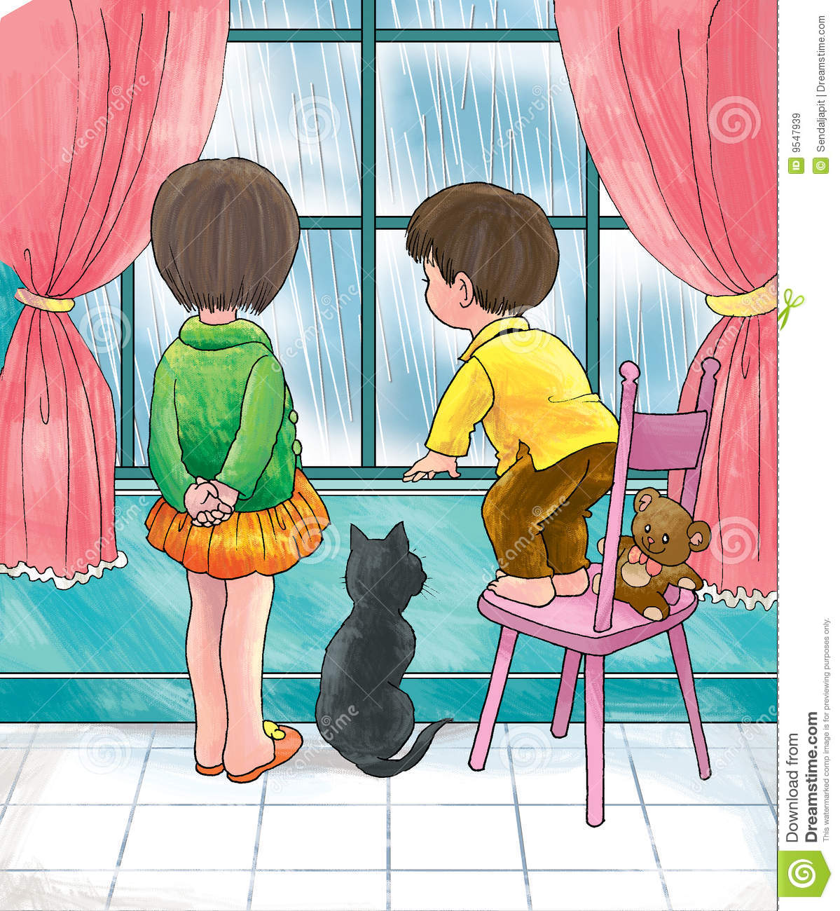
This are Alex and Wanda, it´s raining outside today.
They_______ play outside today.
They_______ drink something hot.
They_______wear a raincoat if they go out.

Slide 7
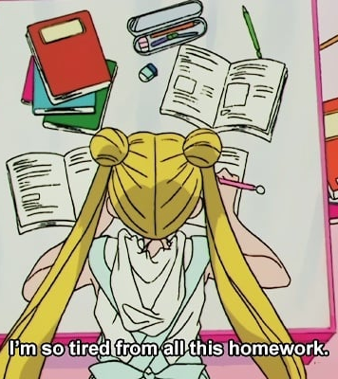
This is Serena, she has homework.
She _______ play with her smartphone now.
She______ hurry up and finish.
She______ ask for help.

