Slide 1
Frequently Asked Questions
Correctness of FormlSlicer

Slide 2
Question 1: Why can you compose the effects of projection of transition to projection of execution step?
Answer: The concurrent transitions are not interfering one another. (1) Each transition, its source state and destination state, occur in one orthogonal region; so state configuration can be combined together. (2) For relevant variables, each concurrent transition should write to a different variable in the original model. (more questions)

Slide 3
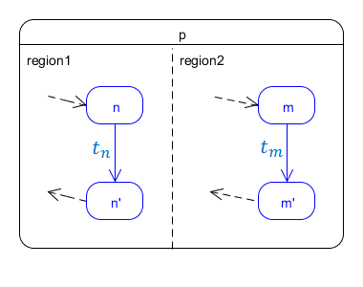

Slide 4
Question 1.1: But Concurrent Transitions can write different values to a same variable.
Answer: Yes. Then in the original model, the value of this variable will appear conflicted / un-deterministic. Similarly, in the sliced model, the value of this variable will also appear conflicted / un-deterministic after we compose the effects of all concurrent transitions to one execution step. In this case, the sliced model still faithfully simulate the behaviour of the original model.
Notes:
Slicer does not help you resolve conflicts. It just takes away irrelevant details so that the part that gets conflicted becomes more obvious.

Slide 5
Question 2: What is that model you are using throughout the slide?
Answer: It is a state machine consisting of a default start state and a big composite state. That composite state consists of many orthogonal regions. Each orthogonal region contains one sub-state machine which is the feature-oriented state machine.
It is not strictly an SPL model. Some people call that a 150% model because there might be some feature components that overlap with each other or some features mutually exclusive with one another. It can be converted to an SPL model.

Slide 6
Question 3: Why does each execution step consist of a set of transitions?
Answer: Because the state machine we are proving here is a concurrent state machine. It is possible that many transitions occur at the same time. In this case we need to consider all of the transitions as “one step”. Sometimes, there might be only one transition occurring. To generalize both cases, we use a set because a set can contain one or multiple transitions.

Slide 7
Question 4: Is it possible to have an execution step that consist of zero transitions?
Only in the sliced model, you can have an execution step that consists of all epsilon. This is especially the case when each of all concurrent transitions in an execution step the original model is projected to epsilon in the sliced model. Then the composed execution step in the sliced model will consist of all epsilon.
In this case, the sliced model does not do anything when that execution step occurs in the original model.

Slide 8
Question 5: You say the execution trace in original model is a subset of the execution trace in sliced model. Is this all what’s required for your model Slicer?
Answer: This is just the basic correctness property. When the subset relation holds, the sliced model is correct. However, the closer the set of execution trace in original model to the set of execution trace in sliced model, the more precise the sliced model is.
(Draw diagram to illustrate)

Slide 9
Question 6: How do you get the state transition rule?
Similar to the state transition rule for hierarchical state machines in:
Daniel Varro. A formal semantics of uml statecharts by model transition systems. In Graph Transformation, pages 378{392. Springer, 2002.
Jianwei Niu, Joanne M Atlee, and Nancy A Day. Template semantics for model-based notations. Software Engineering, IEEE Transactions on, 29(10):866{882, 2003.
FORML thesis by Pourya Shaker

Slide 10
Question 7: Why can’t exited(t) include all ancestors of source state and entered(t) include all ancestors of destination state?
Answer: You can do that as well; the state transition rule will still be correct in our model. However, there will be OVERLAPPING states in exited(t) and entered(t) because the source state and destination state must share at least one common ancestor in our model. This makes the state transition rule not very elegant.

