Slide 1
Resolving Schematic Discrepancy in the Integration of Entity-Relationship Schemas (Implementation)
P15
Lai Xiaoni (U077151L)
Qiao Li (U077194E)
Saw Woei Yuh (U077146X)
Wang Yong (U077138Y)

Slide 2
Content
Introduction and Motivation
Ontology Approach
Implementation
Data Structure
Parser
Algorithms
Evaluation
Results
Limitation and Challenges
Conclusion

Slide 3
Introduction and Motivation
Schema integration
Occurrence of Schematic Discrepancies
Implement existence algorithm
Resolve schematic discrepancies by transforming meta-data into entities
Keep the information and constraints of original schemas

Slide 4
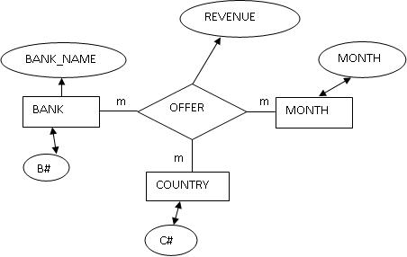
An example of schematic disprepancies
DB1:

Slide 5
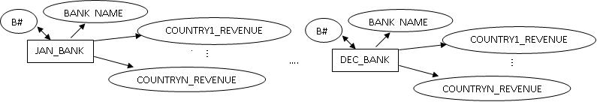
An example of schematic discrepancies
DB2:

Slide 6
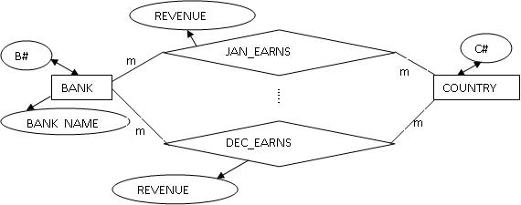
An example of schematic discrepancies
DB3:

Slide 7
Ontology Approach
Define ontology

Slide 8
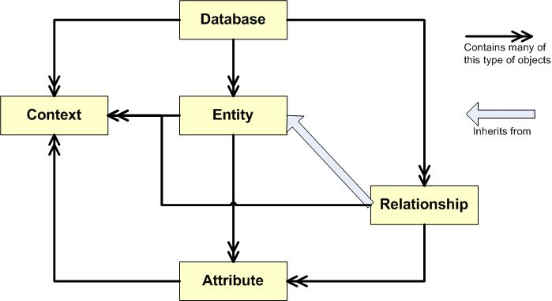
Data Structure

Slide 9
Elevated schema
Input : Elevated Schema
modified version of original ER schema that are constructed using representation of ontology symbols.
Users have to specify the discrepant meta-attributes, cardinality constraints and attribute types
Need for a more detailed definition

Slide 10
Our Elevated Schema
Ontology Type
0 -> m: 1
1 -> m: m
2-> 1:1
3-> 1:m
JAN_BANK = bank[month='jan']
{
B#(2) = b#
BANK_NAME(2) = name
COUNTRY1_REVENUE(0) = revenue[country='c1', inherit ALL]
COUNTRY2_REVENUE(0) = revenue[country='c2', inherit ALL]
COUNTRY3_REVENUE(0) = revenue[country='c3', inherit ALL]
}

Slide 11
Our Elevated Schema
EARN
*EARN = earn
<COUNTRY(0)
BANK(0)
MONTH(0)>
{REVENUE(0) = revenue}
Entities
0 -> m
1 -> 1

Slide 12
Assumptions
Input File
Contains two database schema to be integrated
No duplicated entities or relationships
Entities come before relationships
Identification of Discrepancies
Indicated by meta-attributes
COUNTRY1_REVENUE(0) = revenue[country='c1', inherit ALL]
No general context for a Database
Contexts of database are represented by ontology of entity and relationship types

Slide 13
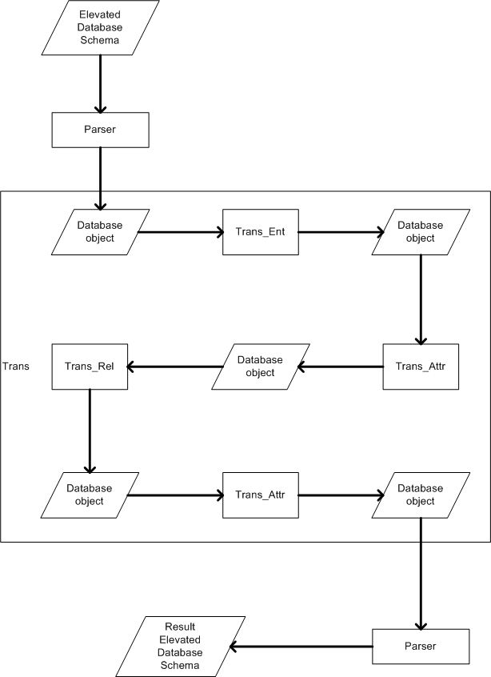
Four Major algorithms

Slide 14
TRANS_ENT
Input: Database object
Output: a new Database object containing entities (without discrepant contexts) and relationships.
Three Major Operations:
Discrepant Inherited Contexts of each Entity --> Entities, linked by a newly constructed Relationship
Attributes of each Entity --> Entities, linked by a newly constructed Relationship || Discrepant Contexts of Attributes waiting to be resolved later
Entities involved in original Relationships are replaced, according to the similarity of contexts.

Slide 15
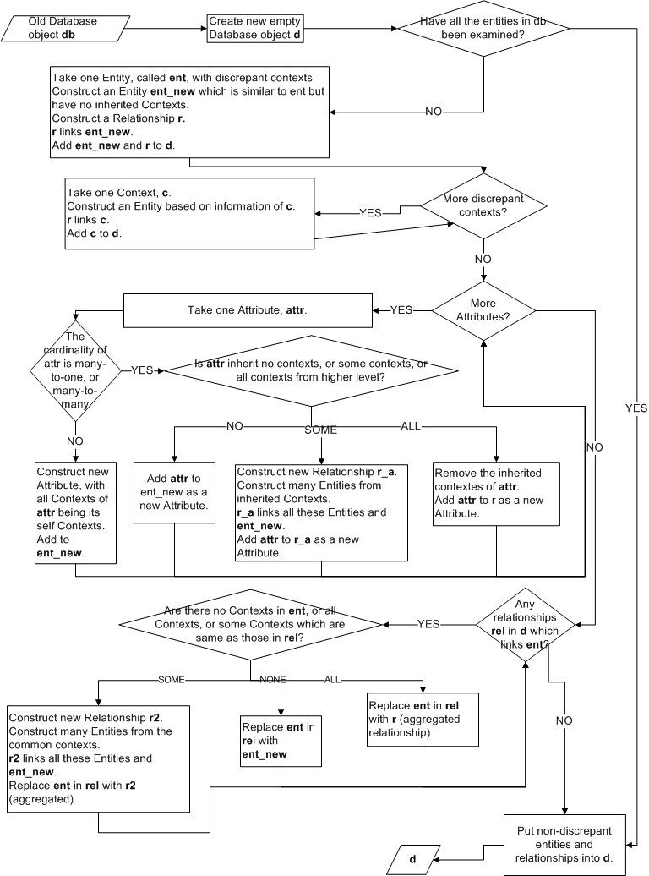

Slide 16
TRANS_REL
This algorithm deals with discrepant relationships.
The steps are very similar to the TRANS_ENT except that the third major operation is omitted.

Slide 17
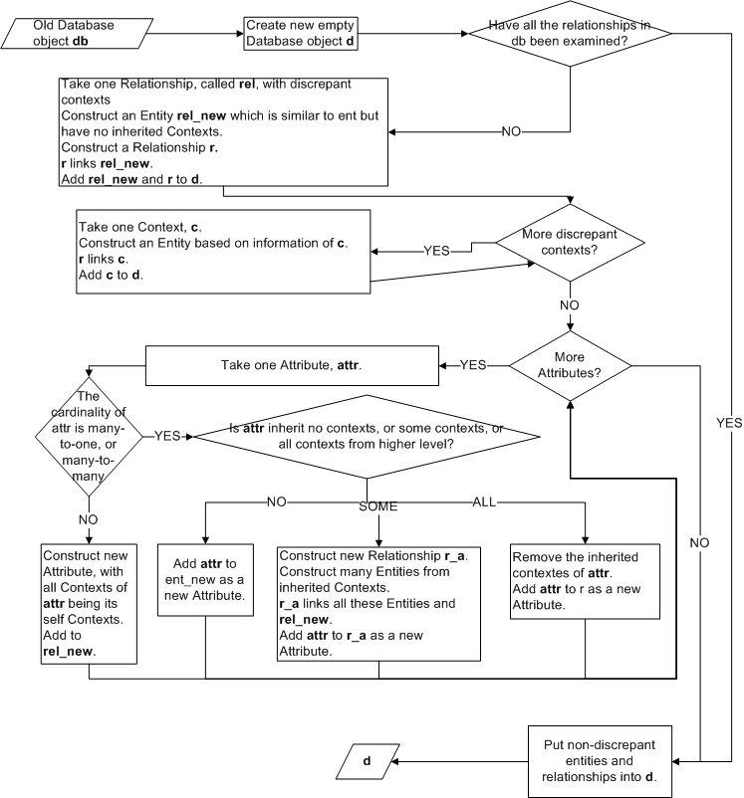

Slide 18
TRANS_ENT_ATTR
Implemented in Trans_ent.py
This algorithm examines the discrepant attributes of all entities in the database.
It goes through two major operations:
Self Contexts of each attribute --> Entities, linked by a newly constructed Relationship
each attribute --> Entity || added into the new Relationship as its Attribute

Slide 19
TRANS_REL_ATTR
This algorithm examines the discrepant attributes of all relationships in the database.
It goes through two major operations:
Self Contexts of each attribute --> Entities, linked by a newly constructed Relationship
each attribute --> Entity || added into the new Relationship as its Attribute

Slide 20
Union of Entities and Relationship
In the last step, duplicate entities and relationships are merged together
Detect: Same ontology, same attributes, Same meta-attributes
Action: Remove Duplicate; Merging Domain.
Written in two functions called unionEntities and unionRelationships.

Slide 21
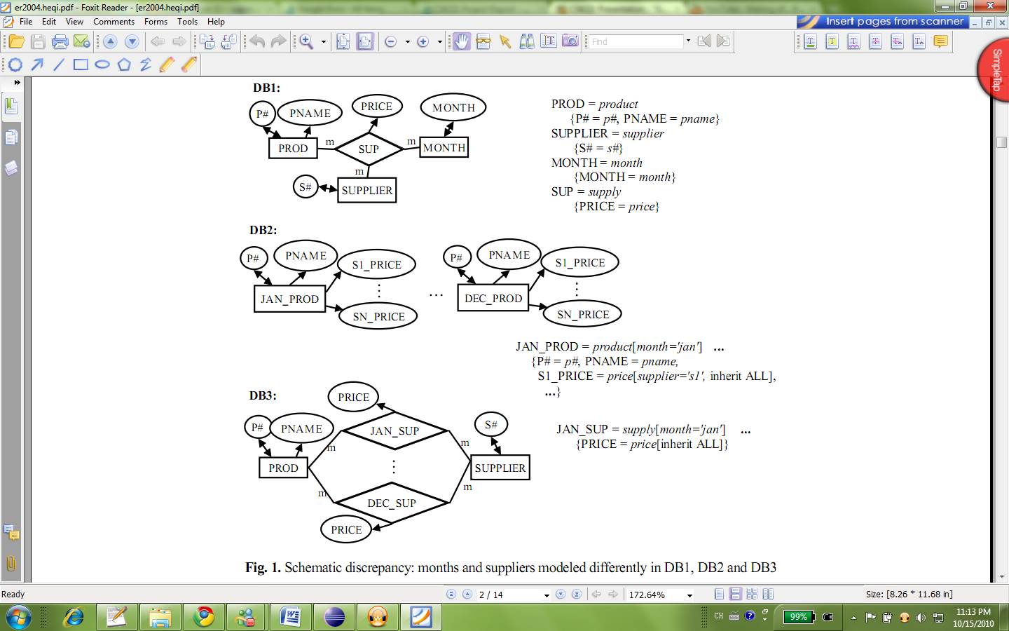
Demostrations
Examples given in An ontology based approach to the integration of entity-relationship schemas.

Slide 22
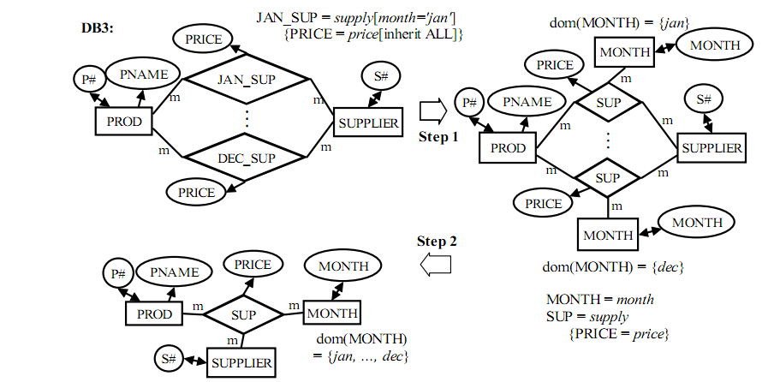
Demonstration – DB1 & DB3
Resolved discrepancies in relationship type with Trans_rel
.
Union

Slide 23
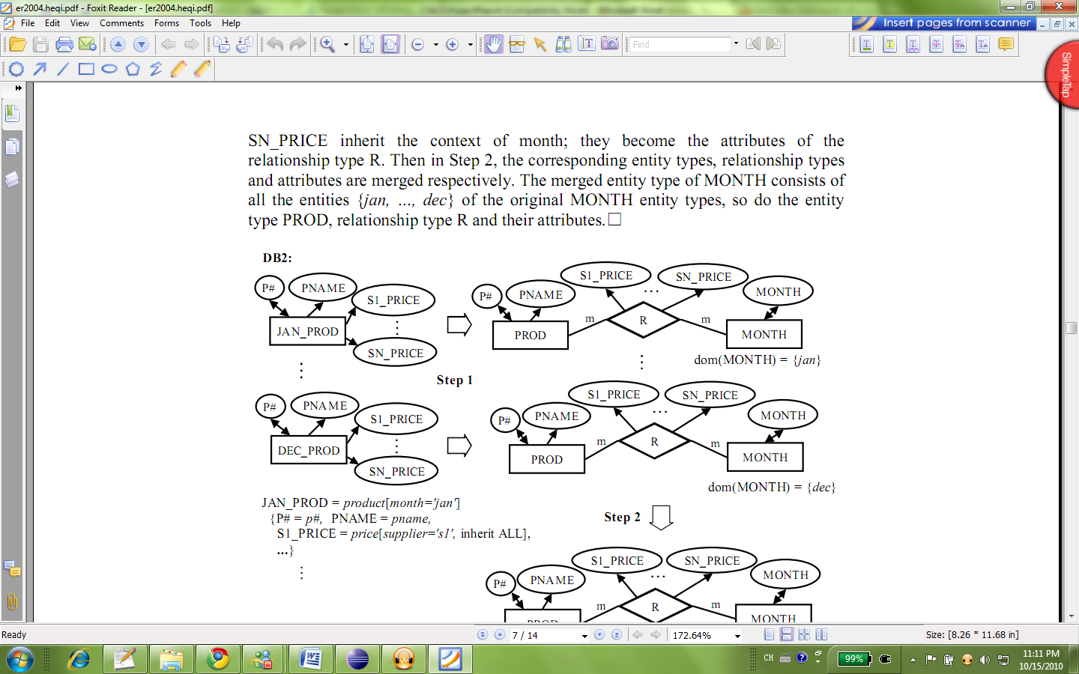
Demonstration – DB1 & DB2
Resolved discrepancies in relationship type with Trans_ent
.

Slide 24
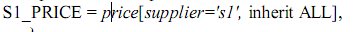
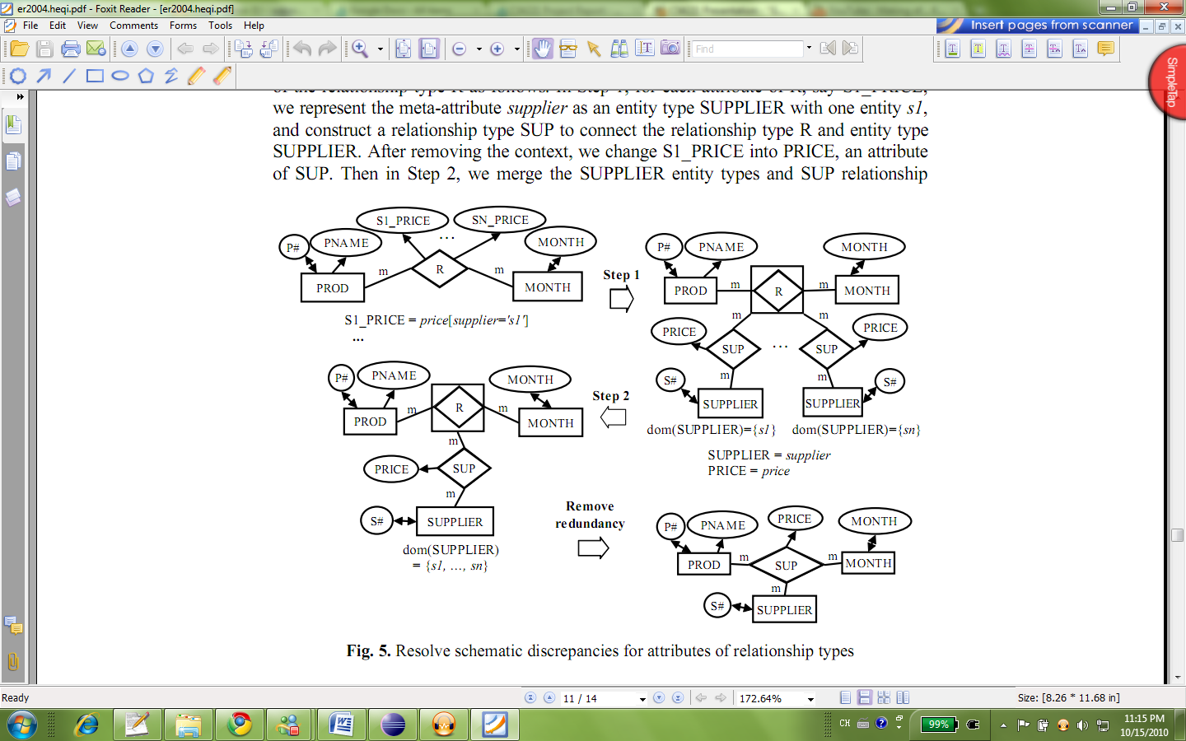
Demonstration – DB1 & DB2
Resolved discrepancies in relationship type with Trans_rel_attr
.
R2
R2
R2
R2

Slide 25
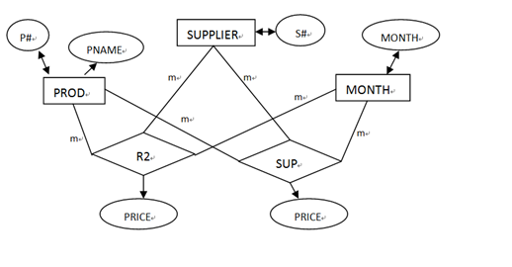
Demonstration – DB1 & DB2
Resolved discrepancies in relationship type with Trans_rel_attr
.
Desired
Our Result

Slide 26
Limitations and Challenges
1. Correct Translation to elevated schema
Users have to define precisely on every entity, relationships, attributes and their contexts according to our definition.
eg. if we do not specify JAN_EARNS is related with EARNS using the ontology type of earn with discrepant meta-attributes
*EARN = earn
<COUNTRY(0)
BANK(0)
MONTH(0)>
{REVENUE(0) = revenue}
*JAN_EARNS = earn[month='jan']
<BANK(0)
COUNTRY(0)>
{REVENUE(0) = revenue[ inherit ALL]} ...

Slide 27
Limitations and Challenges
2. Remove Redundant Aggregated Relationship Types
Our assumption:
Original schemas contain no aggregated relationship types and the end results should not contain aggregated relationship types either.
--> Some complicated schemas may not be solved.

Slide 28
Limitations and Challenges
3. Identification of Ontology in New Relationship Types
In the process of Trans, new Relationship objects are constructed. But...
It is difficult to decide which ontology type to take for this new relationship.
-->Unable to identify duplicated relationships if any, due to the lack of ontology type
Possible Solution:
Ask the users to identify the ontology type

Slide 29
Limitations and Challenges
4. Cases of attributes with only partial inheritance
Some attributes may only inherit some of contexts from entities or relationships. Our implementation involves this theoretic case.
Yet, no practical example is given in the report.

Slide 30
Conclusion
Our Achievements:
Implemented the algorithms
Detailed evaluation on our implementations
Clearly guide users to solve discrepancies in database schema integrations
Most importantly, we have thoroughly learned and understood the challenges in resolving discrepancies, features of real-life entity-relationship designs and the ontology approach.

Slide 31
Thanks you!

