Slide 1

XPath
--XML Path Language
Motivation of XPath
Data Model and Data Types
Node Types
Location Steps
Functions
XPath 2.0 Additional Functionality and its difference with XPath 1.0
XPath 1.0

Slide 2

Motivation
A desire to provide common syntax and semantics for functionality shared between XSLT and XPointer.
Primary purpose: navigation within a document
Also Provide basic facilities for manipulation of strings, numbers and booleans.
Current version: XPath 2.0. But XPath 1.0 is the more widely-used version.

Slide 3
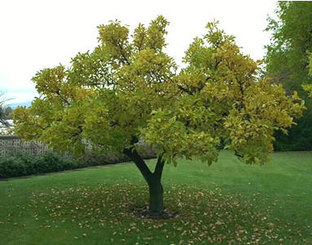
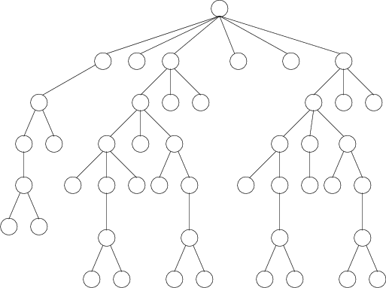
Data Model
XPath models an XML document as a tree of nodes.

Slide 4
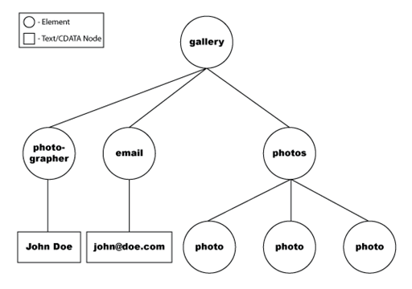
<gallery id="12345">
<photographer id="4532">John Doe</photographer>
<email>john@doe.com</email>
<photos id="2000">
<photo path="sun.jpg" width="16" height="16" />
<photo path="tree.jpg" width="16" height="16" />
<photo path="surf.jpg" width="16" height="16" />
</photos>
</gallery>
/gallery/photographer

Slide 5

Inside XML expressions…
Expression == a path through the document
Made from:
  Nodes
  Variables (hold values)
  Functions
  Return values (one of the four XPath data types)

Slide 6

XML Data Types
Numbers
String
Booleans
Node-set

Slide 7
The Number Data Type
A floating-point number
Special number value: NaN
Numeric operators:
+ | addition
- | subtraction | Needs to be preceded by whitespace
* | multiplication
div | division
mod | remainder | Same as % in Java

Slide 8
The String Data Type
A sequence of characters
A single character in XPath corresponds to a single Unicode abstract character rather than standard Unicode values

Slide 9
The Boolean Data Type
Values: true, false
An or expression
An and expression
Equality and relational expression:
=, !=, <=, <, >=, >
(would be complex if node-sets are involved)

Slide 10
=, !=, <=, <, >=, >
Neither object to be compared is a node-set and the operator is = and !=
  Different types → Convert to common types:
  If one operand is boolean, convert the other to boolean.
  Otherwise, if one operand is number, convert the other to number.
  Otherwise, if one operand is string, convert the other to string.

Slide 11
=, !=, <=, <, >=, >
Neither object to be compared is a node-set and the operator is <, <=, >, >=
convert both objects to numbers and compare the numbers according to IEEE754
Numbers are compared for equality according to IEEE754.
Two booleans are equal if either both are true or both are false.
Two strings are equal if and only if they consist of the same sequence
of UCS characters.

Slide 12
=, !=, <=, <, >=, >
If node-set is involved
How to compare?
  Both are node-sets → string-values of two nodes
  The other is a number → convert string-value of that node to number using number function
  The other is a string → string-value of that node and the string
  The other is a boolean → convert that node to boolean using boolean function

Slide 13
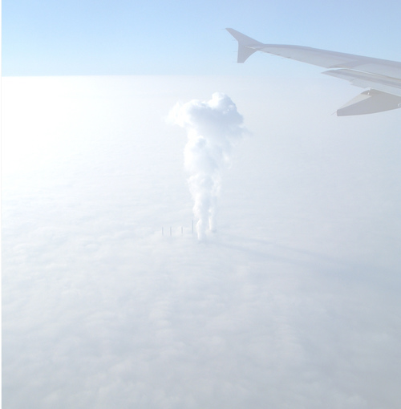
Node Types
The XPath tree contains nodes. There are seven types of node:
  root nodes
  Element nodes
  Text nodes
  Attribute nodes
  Namespace nodes
  Processing instruction nodes
  Comment nodes
Document order orders element nodes in order of the occurrence of their start-tag in the XML

Slide 14

Root Node and
Element Nodes
Root node: root of the tree
The string-value of root node is the concatenation of the string-values of all its text node descendants in document order
Element node: there is one for every element in the document
The string-value: same as root node
Unique IDs: An element node may have a unique identifier. This is the value of the attribute that is declared in the DTD as type ID.

Slide 15
Example: Root Node and Element Nodes
<?xml version="1.0"?>
<planets>
<planet language="English">
<name>Mercury</name>
<mass units="(Earth = 1)">.0553</mass>
<day units="days">58.65</day>
<radius units="miles">1516</radius>
<density units="(Earth = 1)">.983</density>
<distance units="million miles">43.4</distance><!--At perihelion-->
</planet>
</planets>

Slide 16
Attribute Nodes
Each element node (parent) has an associated set of attribute nodes (not child node of its parent element)
An element has attribute nodes only for attributes explicitly specified in the start-tag or empty-element tag of that element or explicitly declared in DTD.
At the end of your XPath expression, which is normally the element you want to select, add the at sign "@" plus the name of the attribute you wish to select.

Slide 17
Example: Attribute Nodes
<?xml version="1.0"?>
<planets>
<planet language="English">
<name>Mercury</name>
<mass units="(Earth = 1)">.0553</mass>
<day units="days">58.65</day>
<radius units="miles">1516</radius>
<density units="(Earth = 1)">.983</density>
<distance units="million miles">43.4</distance><!--At perihelion-->
</planet>
</planets>
Planets/planet/day@units

Slide 18

Namespace Nodes
Each element has an associated set of namespace nodes,
one for each distinct namespace prefix that is in scope for the element and
one for the default namespace if one is in scope for the element.

Slide 19
Example: Namespace Nodes
<?xml version="1.0"?>
<planets xmlns=“http://www.comp.nus.edu.sg/”>
<planets>
<planet language="English">
<name>Mercury</name>
<mass units="(Earth = 1)">.0553</mass>
<day units="days">58.65</day>
<radius units="miles">1516</radius>
<density units="(Earth = 1)">.983</density>
<distance units="million miles">43.4</distance><!--At perihelion-->
</planet>
</planets>

Slide 20
Processing Instruction Nodes and Comment Nodes
There is a processing instruction node/comment node for every processing instruction/comment, except for any processing instruction/comment that occurs within the document type declaration.
String-values:
  Processing Instruction Nodes: not include terminating ?>
  Comment Nodes: not include <!– and -->

Slide 21
Example: Processing and Comment Nodes
<?xml version="1.0"?>
<?xml-stylesheet type=“text/xsl” href=“planets.xsl”?>
<planets>
<planet language="English">
<name>Mercury</name>
<mass units="(Earth = 1)">.0553</mass>
<day units="days">58.65</day>
<radius units="miles">1516</radius>
<density units="(Earth = 1)">.983</density>
<distance units="million miles">43.4</distance><!--At perihelion-->
<!--Mercury Data-->
</planet>
</planets>

Slide 22
Text Nodes
Character data is grouped into text nodes.
Each character within a CDATA section is treated as character data.
  Example: <![CDATA[<]]> in the source document will result in a single < character in a text node in the tree.

Slide 23
Example: Text Nodes
<?xml version="1.0"?>
<?xml-stylesheet type=“text/xsl” href=“planets.xsl”?>
<planets>
<planet language="English">
<name>Mercury</name>
<mass units="(Earth = 1)">.0553</mass>
<day units="days">58.65</day>
<radius units="miles">1516</radius>
<density units="(Earth = 1)">.983</density>
<distance units="million miles">43.4</distance><!--At perihelion-->
<!--Mercury Data-->
</planet>
</planets>

Slide 24
Location Paths
To tell XPath software exactly where and what data to extract from an XML document.
A location path consists of one or more location steps, separated by / or //.
In Xpath, the location path can combine with the | or “pipe” character.
Complete version
/child::planets/child::planet/child::name[2]/text()
Abbreviated version
/planets/planet/name[2]/text()

Slide 25
Location Step
Each location step is made up of an axis, a node test, and zero or more predicates.
  axis :: node-test [predicate]
Example
child :: name [position() = 2]
<name> element
select child nodes
second <name> element

Slide 26
XPath 1.0 Axes
Each XPath location step must specify an axis.
Defines a node set relative to the current node.
Default axis is the child axis.
There are 13 XPath axes for version 1.0.

Slide 27
Example: Using ancestor axis
<?xml version="1.0"?>
<planets>
<planet language="English">
<name>Mercury</name>
<mass units="(Earth = 1)">.0553</mass>
<day units="days">58.65</day>
<radius units="miles">1516</radius>
<density units="(Earth = 1)">.983</density>
<distance units="million miles">43.4</distance>
</planet>
<planet language="English">
<name>Venus</name>
<mass units="(Earth = 1)">.815</mass>
<day units="days">116.75</day>
<radius units="miles">3716</radius>
<density units="(Earth = 1)">.943</density>
<distance units="million miles">66.8</distance>
</planet>
<planet language="English">
<name>Earth</name>
<mass units="(Earth = 1)">1</mass>
<day units="days">1</day>
<radius units="miles">2107</radius>
<density units="(Earth = 1)">1</density>
<distance units="million miles">128.4</distance>
</planet>
</planets>
location path: /planet/day/ancestor::planet
Results:
Mercury
Venus
Earth

Slide 28
Example: Using ancestor-or-self axis
<?xml version="1.0"?>
<planets>
<planet language="English">
<name>Mercury</name>
<mass units="(Earth = 1)">.0553</mass>
<day units="days">58.65</day>
<radius units="miles">1516</radius>
<density units="(Earth = 1)">.983</density>
<distance units="million miles">43.4</distance>
</planet>
<planet language="English">
<name>Venus</name>
<mass units="(Earth = 1)">.815</mass>
<day units="days">116.75</day>
<radius units="miles">3716</radius>
<density units="(Earth = 1)">.943</density>
<distance units="million miles">66.8</distance>
</planet>
<planet language="English">
<name>Earth</name>
<mass units="(Earth = 1)">1</mass>
<day units="days">1</day>
<radius units="miles">2107</radius>
<density units="(Earth = 1)">1</density>
<distance units="million miles">128.4</distance>
</planet>
</planets>
location path: /planet/day/ancestor-or-self::*
Results:
planets planet day
planets planet
planets

Slide 29
Example: Using descendant axis
<?xml version="1.0"?>
<planets>
<planet language="English">
<name>Mercury</name>
<mass units="(Earth = 1)">.0553</mass>
<day units="days">58.65</day>
<radius units="miles">1516</radius>
<density units="(Earth = 1)">.983</density>
<distance units="million miles">43.4</distance>
</planet>
<planet language="English">
<name>Venus</name>
<mass units="(Earth = 1)">.815</mass>
<day units="days">116.75</day>
<radius units="miles">3716</radius>
<density units="(Earth = 1)">.943</density>
<distance units="million miles">66.8</distance>
</planet>
<planet language="English">
<name>Earth</name>
<mass units="(Earth = 1)">1</mass>
<day units="days">1</day>
<radius units="miles">2107</radius>
<density units="(Earth = 1)">1</density>
<distance units="million miles">128.4</distance>
</planet>
</planets>
location path: //planet/descendant::*
Results:
planet name mass day radius density distance
planet name mass day radius density distance
planet name mass day radius density distance

Slide 30
Example: Using parent axis
<?xml version="1.0"?>
<planets>
<planet language="English">
<name>Mercury</name>
<mass units="(Earth = 1)">.0553</mass>
<day units="days">58.65</day>
<radius units="miles">1516</radius>
<density units="(Earth = 1)">.983</density>
<distance units="million miles">43.4</distance>
</planet>
<planet language="English">
<name>Venus</name>
<mass units="(Earth = 1)">.815</mass>
<day units="days">116.75</day>
<radius units="miles">3716</radius>
<density units="(Earth = 1)">.943</density>
<distance units="million miles">66.8</distance>
</planet>
<planet language="English">
<name>Earth</name>
<mass units="(Earth = 1)">1</mass>
<day units="days">1</day>
<radius units="miles">2107</radius>
<density units="(Earth = 1)">1</density>
<distance units="million miles">128.4</distance>
</planet>
</planets>
location path: //day/parent::*
Results:
planet planet planet

Slide 31
Example: Using following-sibling axis
<?xml version="1.0"?>
<planets>
<planet language="English">
<name>Mercury</name>
<mass units="(Earth = 1)">.0553</mass>
<day units="days">58.65</day>
<radius units="miles">1516</radius>
<density units="(Earth = 1)">.983</density>
<distance units="million miles">43.4</distance>
</planet>
<planet language="English">
<name>Venus</name>
<mass units="(Earth = 1)">.815</mass>
<day units="days">116.75</day>
<radius units="miles">3716</radius>
<density units="(Earth = 1)">.943</density>
<distance units="million miles">66.8</distance>
</planet>
<planet language="English">
<name>Earth</name>
<mass units="(Earth = 1)">1</mass>
<day units="days">1</day>
<radius units="miles">2107</radius>
<density units="(Earth = 1)">1</density>
<distance units="million miles">128.4</distance>
</planet>
</planets>
location path: /planets/planet[1]/mass/following-sibling::*
Results:
day radius density distance

Slide 32
Example: Using namespace axis
<?xml version="1.0"?>
<planets xmlns=http://www.comp.nus.edu.sg>
<planets>
<planet language="English">
<name>Mercury</name>
<mass units="(Earth = 1)">.0553</mass>
<day units="days">58.65</day>
<radius units="miles">1516</radius>
<density units="(Earth = 1)">.983</density>
<distance units="million miles">43.4</distance>
</planet>
<planet language="English">
<name>Venus</name>
<mass units="(Earth = 1)">.815</mass>
<day units="days">116.75</day>
<radius units="miles">3716</radius>
<density units="(Earth = 1)">.943</density>
<distance units="million miles">66.8</distance>
</planet>
</planets>
location path: namespace::*
Results:
http://www.comp.nus.edu.sg

Slide 33
Example: Using parent axis
<?xml version="1.0"?>
<planets>
<planet language="English">
<name>Mercury</name>
<mass units="(Earth = 1)">.0553</mass>
<day units="days">58.65</day>
<radius units="miles">1516</radius>
<density units="(Earth = 1)">.983</density>
<distance units="million miles">43.4</distance>
</planet>
<planet language="English">
<name>Venus</name>
<mass units="(Earth = 1)">.815</mass>
<day units="days">116.75</day>
<radius units="miles">3716</radius>
<density units="(Earth = 1)">.943</density>
<distance units="million miles">66.8</distance>
</planet>
<planet language="English">
<name>Earth</name>
<mass units="(Earth = 1)">1</mass>
<day units="days">1</day>
<radius units="miles">2107</radius>
<density units="(Earth = 1)">1</density>
<distance units="million miles">128.4</distance>
</planet>
</planets>
location path: //day/parent::*
Results:
planet planet planet

Slide 34
XPath 1.0 Abbreviated Syntax
There are a number of abbreviations in XPath syntax.
  self::node() can be written as .
  parent::node() can be written as ..
  child::nodename can be written as nodename
  attribute::nodename can be written as @nodename.
  /descendant-or-self::node()/ can be written as //

Slide 35
XPath 1.0 Node Tests
Node test tells XPath which of the nodes in the document are needed.
Types of node tests,
  * wildcard character matches any element or attribute name.
  Name matches a node with that name.
  comment() node test selects comment nodes.
  node() selects any type of node.
  processing-instruction() node test selects a processing instruction node.
  text() selects a text node.

Slide 36
XPath 1.0 Predicates
A location step has zero or more predicates.
Predicate gives more information about the nodes or nodes needed.
Able to use built-in XPath functions in predicates.

Slide 37
XPath 1.0 Boolean Functions
Boolean functions convert argument into boolean value.
    boolean function return boolean value.
    false function return false value
    not function reverse boolean value

Slide 38
XPath 1.0 Numeric Functions
XPath 1.0 has several numeric functions that operate on numbers.
    number function
    ceiling function return the smallest integer
    sum function add together the numeric values.

Slide 39
XPath 1.0 String Functions
XPath 1.0 has many string functions.
    concat (join all strings together.)
    contains (check if first string contains second string)
    normalize-space (remove leading and trailing whitespace and multiple consecutive whitespace is replaced with a single space)

Slide 40
XPath 1.0 Node-Set Operators and Functions
XPath 1.0 have few operators and functions to work on the node-sets.
/ and // operators used to create the location paths.
    count function return the number of nodes in node-set.
    position function return the position of the context node in the node-set.

Slide 41
XPath 2.0
Was published as a W3C Recommendation on January 23, 2007.
It represents an increase in the size and capability of he XPath language.
It supports atomic types(a single atomic value is regarded a sequence of length one), defined a built-in types in XML schema
Xpath 1.0 node-sets are replaced by node- sequences, which may be in order

Slide 42
Version 2.0 also offers a greatly expanded set of functions and operators
XPath 2.0 is in fact a subset of XQuery 1.0. It offers a for expression which is cut-down version of the “FLOWR" expressions in XQuery. It is possible to describe the language by listing the parts of XQuery that it leaves out: the main examples are the query prolog, element and attribute constructors, the remainder of the "FLWOR" syntax, and the typeswitchexpression.

