Slide 1
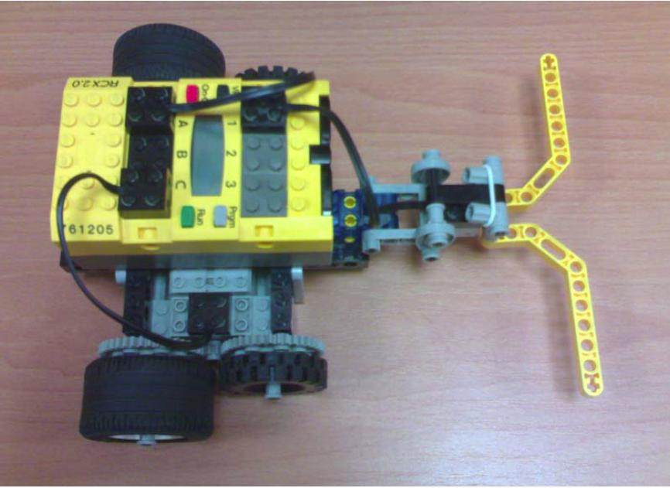
A maze-solving robot
needs to navigate through a 4X4 maze from the starting cell
able to reach the goal cell within 10 min
able to return the structure of the maze it has discovered

Slide 2
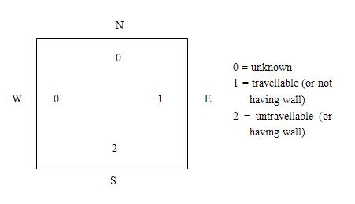
Algorithm
Data Structure: Square

Slide 3
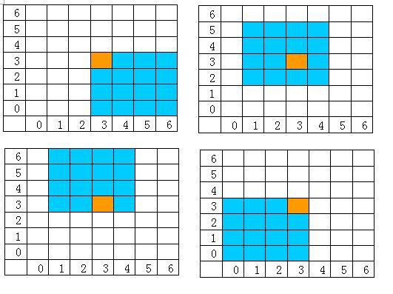
Algorithm
To represent a 4X4 maze without knowing starting point

Slide 4
Algorithm
Search: Exploration
Conditions of a legal square for the robot to move to :
the environment of robot’s heading direction in the robot’s current positioned square must be “unknown”;
the next square the robot is heading now must be within boundary of the maze;
this next square must be “untraveled”

Slide 5
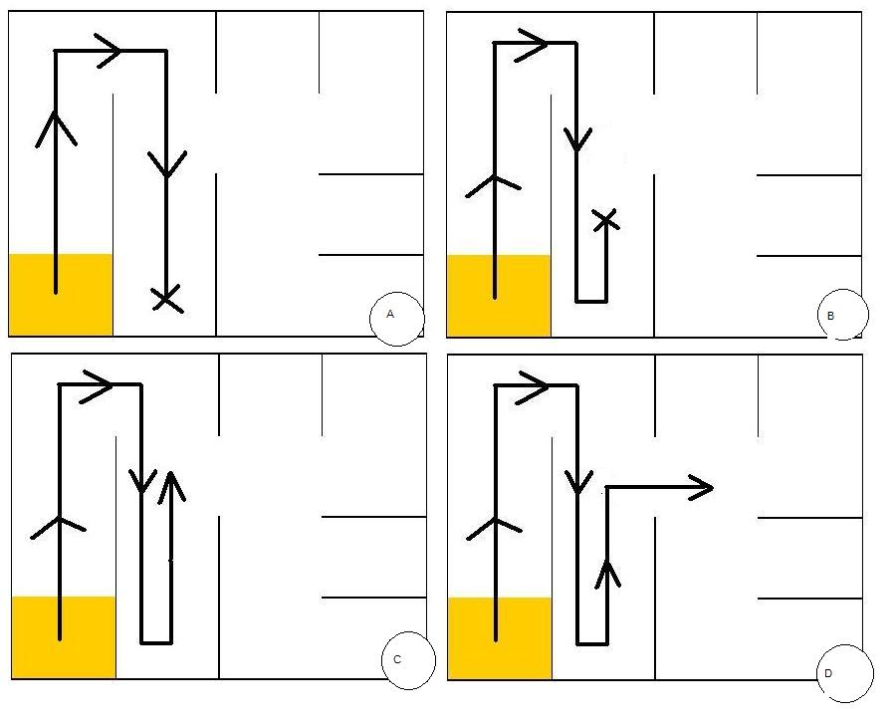
Algorithm
Search: Backtracking

