Slide 1
Artificial Fishes:
Physics, Locomotion, Perception, Behavior
Xiaoyuan Tu and Demetri Terzopoulos

Slide 2
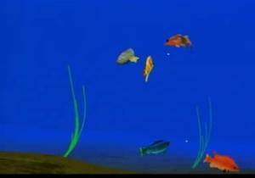
Imagine a virtual marine world…
Realistic fishes, aquatic plants
Swim gracefully
Searching for food, hunting prey fishes
Schooling behavior
Elaborate courtship rituals to secure mates
And etc…
Go Fish! Animation screenshot

Slide 3
Animation framework
Artificial fishes are autonomous agents whose appearance and complicated group interactions are as faithful as possible to nature’s own
Behavior
FISH
Basic physics of the animal and its environment
Form and superficial appearance
Bottom-up approach

Slide 4
Content of the Day
Background and overview
Physics-based Fish model and Locomotion
  Mechanics of spring-mass model
  How does it swims (force, motor controllers, pectoral fins)
Sensory Perception
Behavioral Modeling and Animation
Intention Generator
  Generic intention generator
  Collision detection, predator detection, hunger, libido…
Behavior Routines
Avoiding-static-obstacle, avoiding-fish, eating-food, mating, leaving, wandering, escaping, schooling
Artificial Fish Types
  Predators
  Prey
  Pacifists
Conclusion

Slide 5
Background
Lowest level of abstraction:
→ physics-based graphics modeling
Higher level of abstraction:
→ advanced behavioral animation
Tightly couple perception to action
Primitive reflexive behavior
combine
Motivational behavior

Slide 6
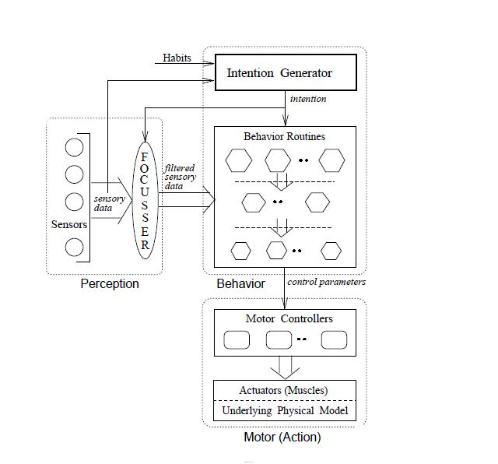
Overview
Dynamic model of the fish
The actuators
A set of motor controllers (MCs)
A set of virtual on-board sensors
Perpetual attention mechanism
Mediates between perception system and motor system
Intention generator

Slide 7
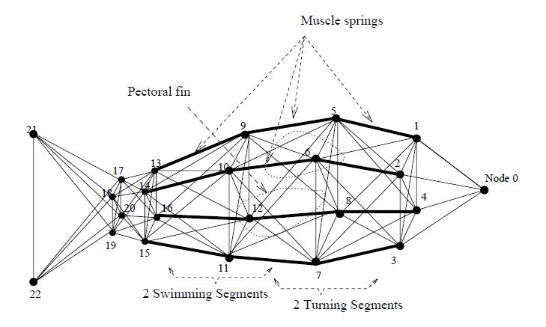
Physics-based Fish Model

Slide 8
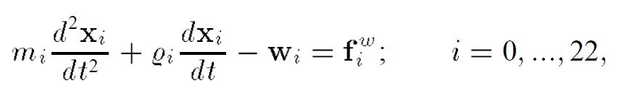
String-mass mechanics
Node i,j with mass mi, mj
eij(t) = ||rij|| - lij
wi= sum of Internal force fij(t)
Lagrange equation of motion on the dynamic fish
i
fij
j
fij(t)=cijeij/||rij||

Slide 9
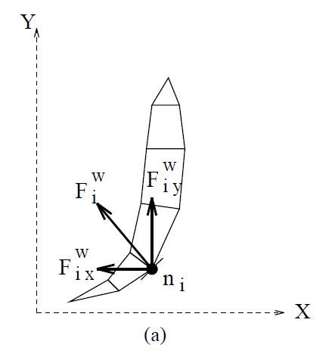
How to swim?
Periodically contracting the swimming segment springs on one side whilst relaxing their counterparts on the other sides
Inertia of water displaced propels the fish forward

Slide 10
Motor Controllers
Swim-MC
Swimming segment muscles
left-turn-MC
Turning segment muscles
right-turn-MC

Slide 11
speed
Found a set of maximal parameters which produce the fastest swimming speed
Swim-MC
{r1,s1,r2,s2}
Contraction amplitude and frequency control parameters
For anterior and posterior swim segment
(symmetry → one pair is sufficient

Slide 12
4 set of parameter values (30, 45, 60, 90)
angle
left-turn-MC
right-turn-MC
{r0,s0,r1,s1}
Contraction amplitude and frequency control parameters
For anterior and posterior turning segments
(symmetry → one pair is sufficient

Slide 13
Pectoral fins
Increase speed ← held close to body
Decrease speed ← extended
Pitching (up-and-down)
Yawing (side-to-side)
Only dynamic effect on locomotion is simulated → simplify model

Slide 14
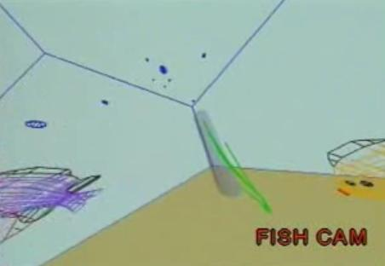
Sensory Perception
Vision Sensor
Temperature Sensor
Can access geometry, material property, and illumination information
Identify nearby objects and obtain their informations
(inside the programs, simply call the methods in these objects)
300 degree spherical angle

Slide 15
Behavioral modeling and Animation
At each time step, the intention generator issues an intention based on the fish's habits, mental states, and incoming sensory information
Choose and execute a behavior routine which runs the appropriate motor controllers
Whether it likes brightness
Darkness, cold, warmth,
Schooling, is male or
female

Slide 16
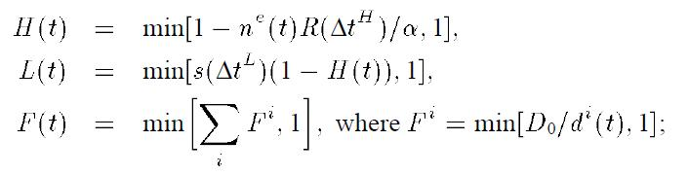
Mental States
Hunger H, Libido L, Fear F

Slide 17
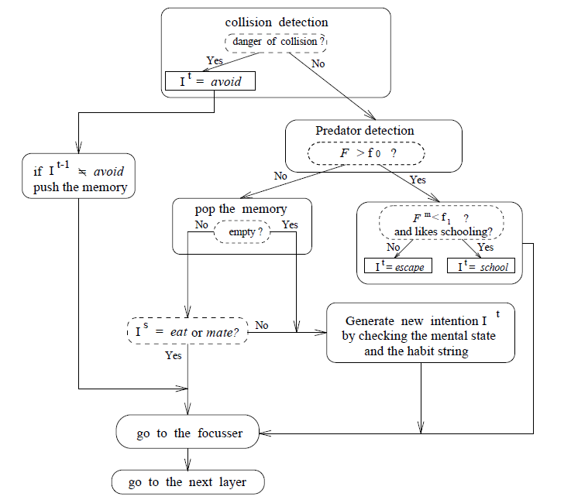
Intention Generator
High priority
Low priority

Slide 18
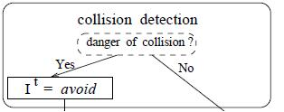
If any object penetrates the fish's collision sensitivity region, I = avoid
Large sensitivity region → “timid” fish
Small sensitivity region → “courageous” fish

Slide 19
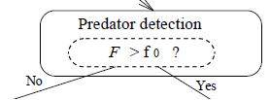
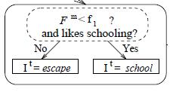
F = fear state variable
F0 = threshold
m = the most dangerous predator
f1 > f0
If no collision, no predators, then eat or mate accordingly

Slide 20
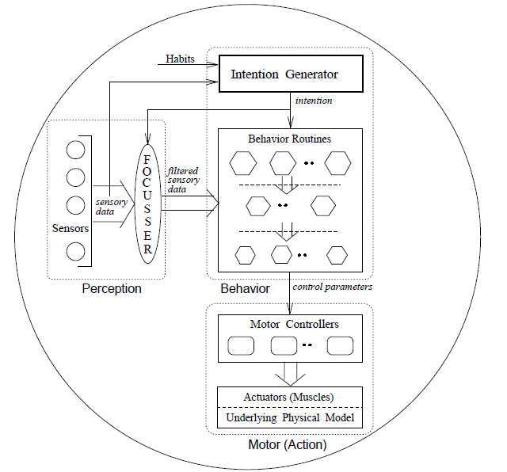
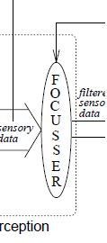
Focusser
Perpetual focus mechanism
→ paying special attention to environment relevant to intentional behavior

Slide 21
Memory mechanism
To achieve some persistence in its intentions → otherwise the fish perpetually change goals
Serves primarily to make longer duration behavior such as feeding and mating robust
Design of intention generator and focusser--> simplifies the model

Slide 22
Behavior Routines
Leaving
Mating
Avoiding-static-obstacle
Avoiding-fish
Wandering
Eating-food
Escaping
Schooling

Slide 23
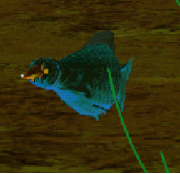
Artificial Fish Types
1. Predators (F = 0, L = 0)
– No predator detection
– escape, school, mate intentions disabled
– Cost
– suck in food
Pressure difference
produces vacuum force

Slide 24
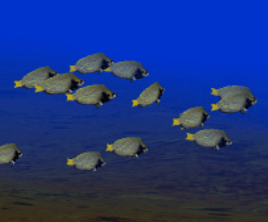
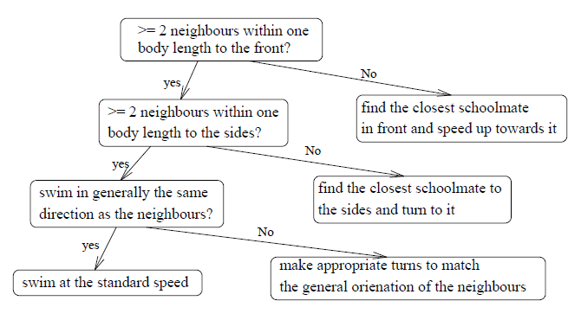
Artificial Fish Types
2. Prey
– Schooling, evading predators

Slide 25
Artificial Fish Types
3. Pacifists

