Slide 1
Google Docs Explorer
a Windows Explorer Shell on Google Docs Interface
Lai Xiaoni

Slide 2
Introduction
One-semester UROP project (CS3208)
After research on:
Google Docs Interface
Windows Explorer
Develop a system:
Google Docs Explorer
Its design
Its implementation
Its problems and future improvements

Slide 3
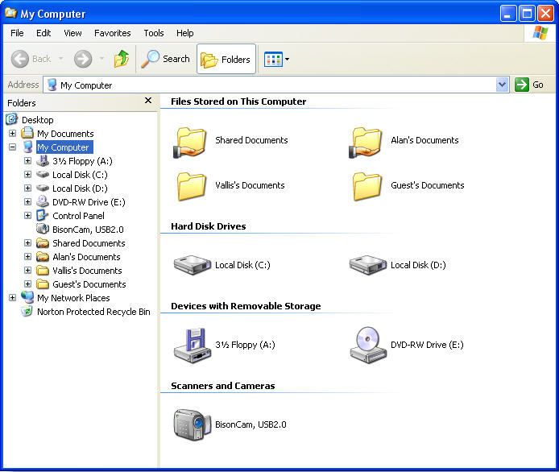
Research Review—Windows Explorer
an integrated file browsing tool used by Windows operating system for personal information management
User’s favorite choice in file browsing
Higher user performance
Especially on those files which locations are unknown

Slide 4
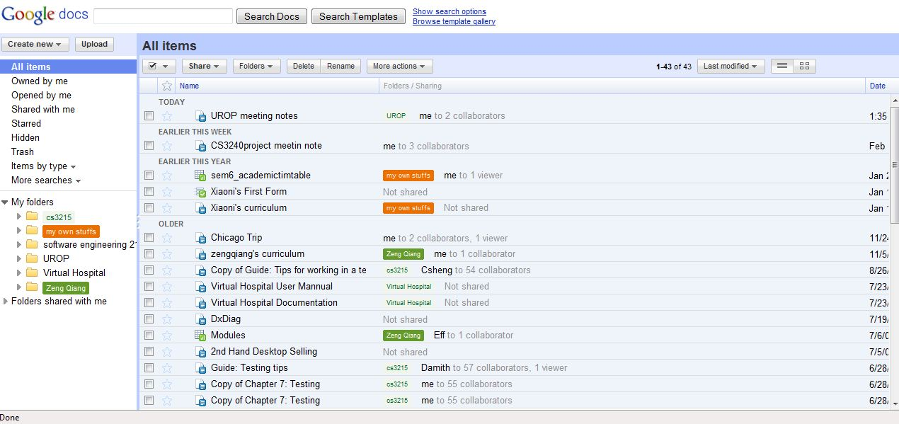
Research review—Google Docs Interface
The Create-organize interface
Folder feature – newly added in 2007
This causes a lot of confusion as :
-- Folders as tags
-- Cannot go more than 3 levels deeper
Very different from Windows Explorer

Slide 5
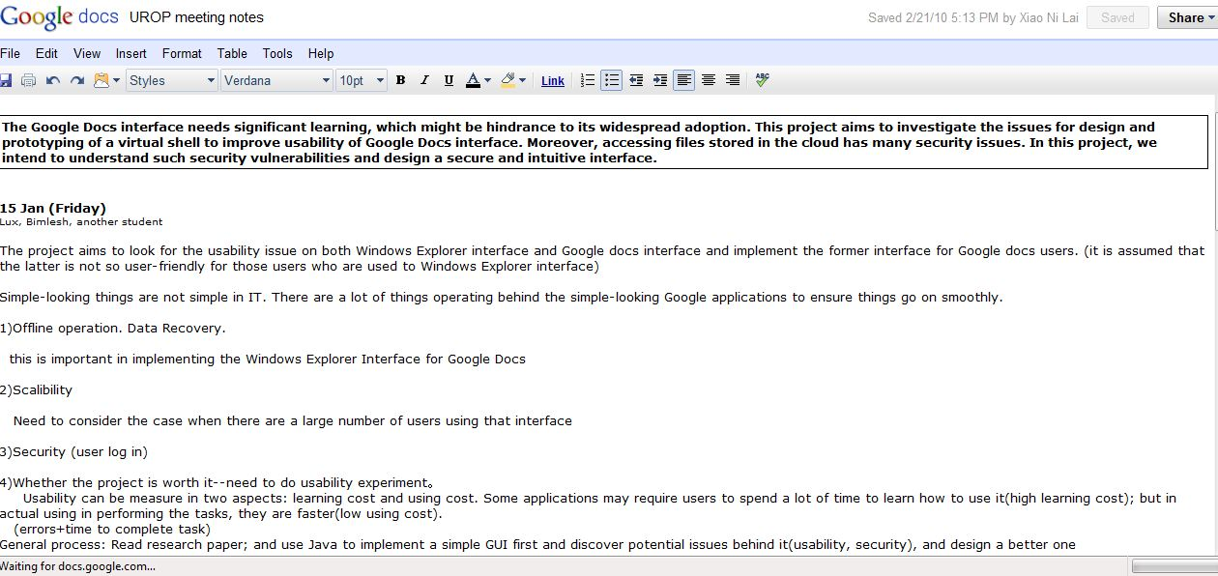
Research review—Google Docs Interface
The Edit-format interface
(Not included in scope)

Slide 6
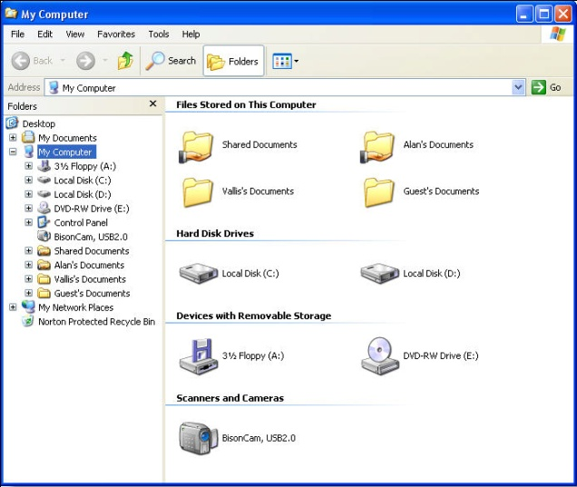
A Windows Shell Extension Built on Google Docs
Windows Explorer
Google Docs Interface

Slide 7
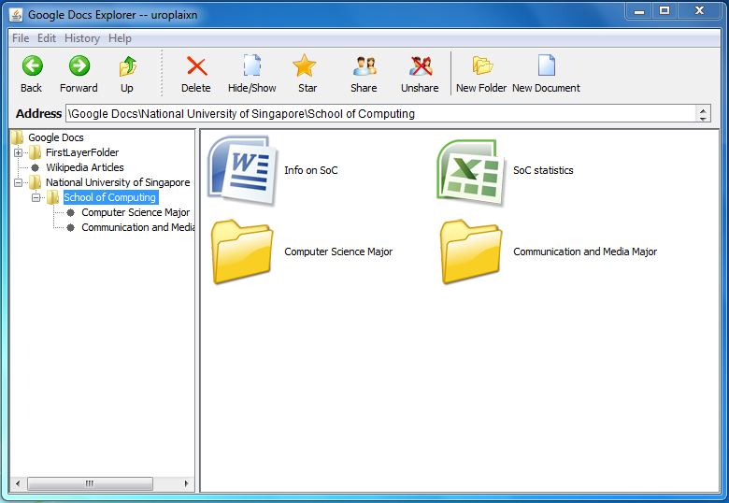
Google Docs Explorer

Slide 8
Design Goal
Google Docs Explorer is a tool to provide a usable, secure and Windows-explorer-like interface for users to manage their online documents in Google Docs.

Slide 9
User-System Interaction Process
User | System
Open the software. | Log In Window appears.
Enter Google Docs username and password. | Main Window appears.
Press various buttons on the Main Window. | Corresponding actions are taken.
Press “Exit”. | System exits.

Slide 10
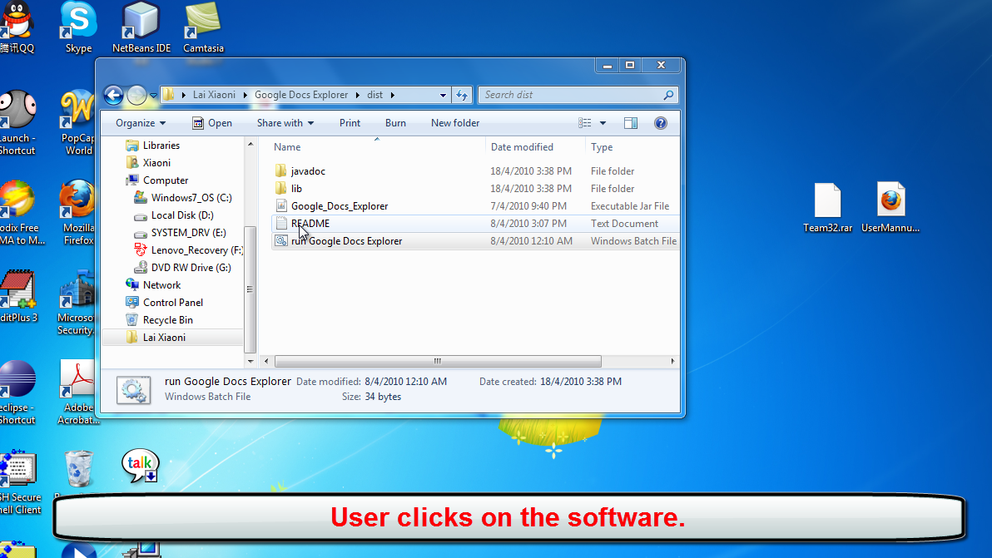
User-System Interaction Process

Slide 11
Functionalities
Viewing of documents
Expand or collapse any folder node in indented tree
Select a folder in the indented tree and all files under this folder are displayed on right pane
Move back or forward to select folders which are selected before
Move up one level in the folder hierarchy to select parent folder of the current one
Folder (1)
… Folder (2)
… Folder (5)
… Folder (4)
Folder (3)
Folder (6)
… Folder (7)
History Path
4
1
2
3

Slide 12
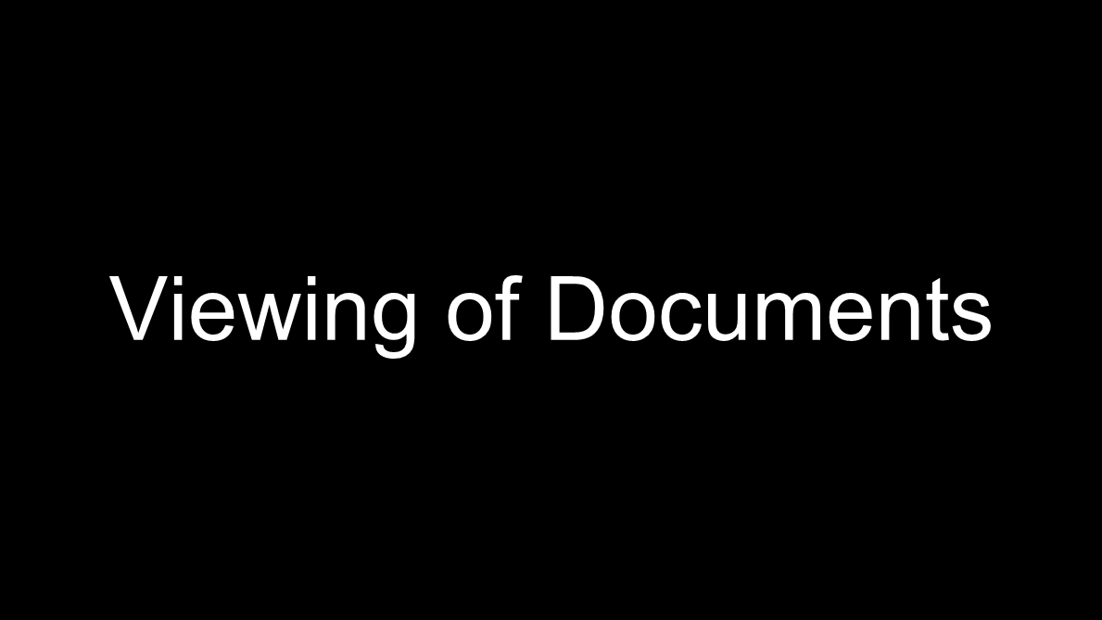
Functionalities
Viewing of Documents

Slide 13
Functionalities
Management of documents
Create a new Excel or Word document in the current selected folder
Create a new sub-folder in the current selected folder

Slide 14
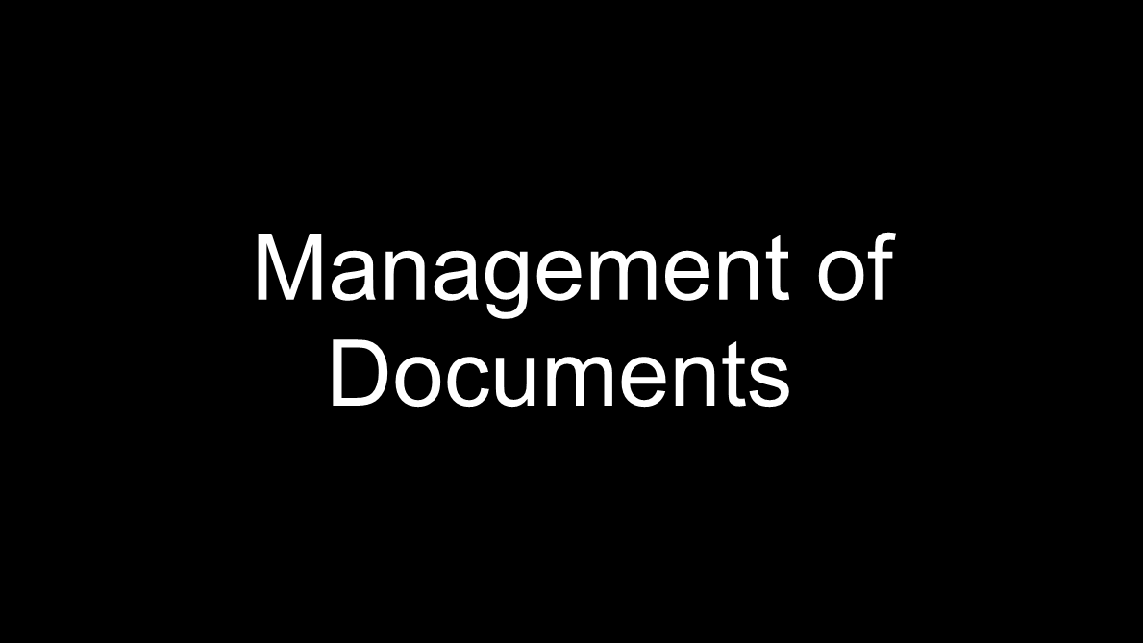
Functionalities
Management of documents

Slide 15
Functionalities
Updating any particular document
Open web page showing the contents of the document;
Delete the document or folder selected in the right pane;
Star or un-star the document selected in the right pane;
Hide or show the document selected in the right pane;
View properties of selected document;

Slide 16
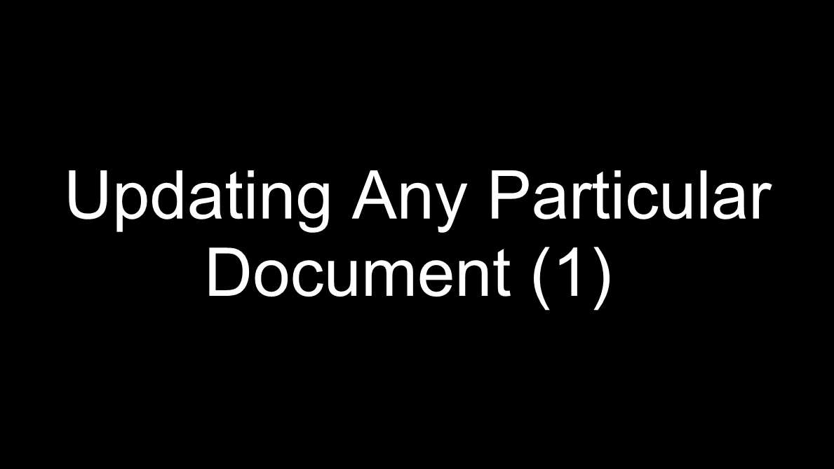
Functionalities
Updating any particular document

Slide 17
Functionalities
Updating any particular document
Share the document with other users and choose their permission status as Writer or Viewer, or delete their permission or access the document;

Slide 18
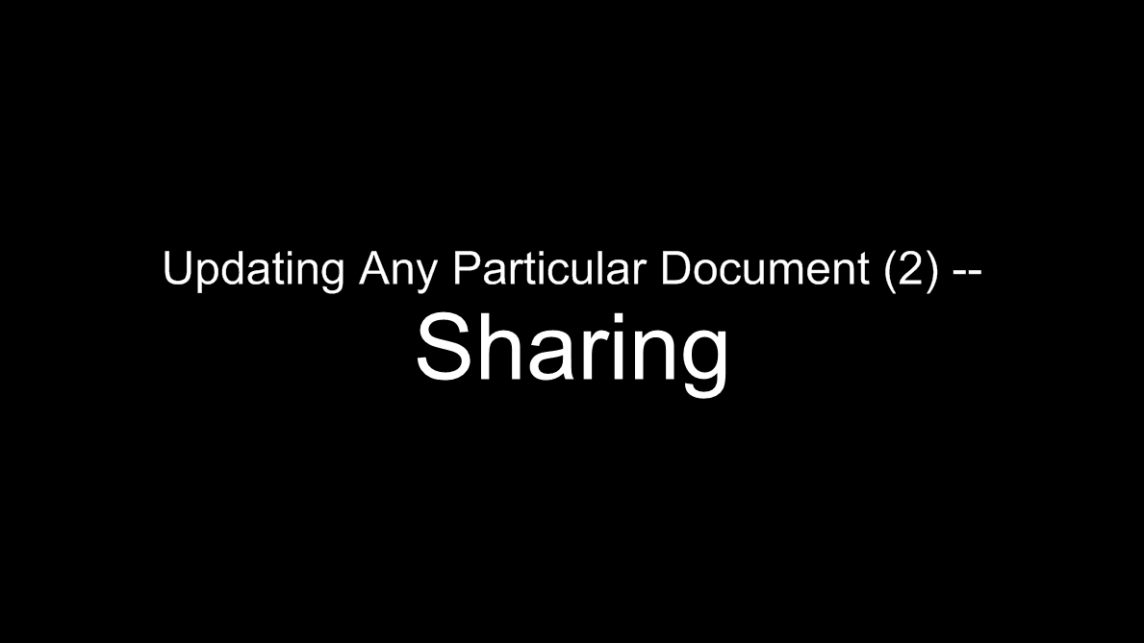
Functionalities
Updating any particular document

Slide 19
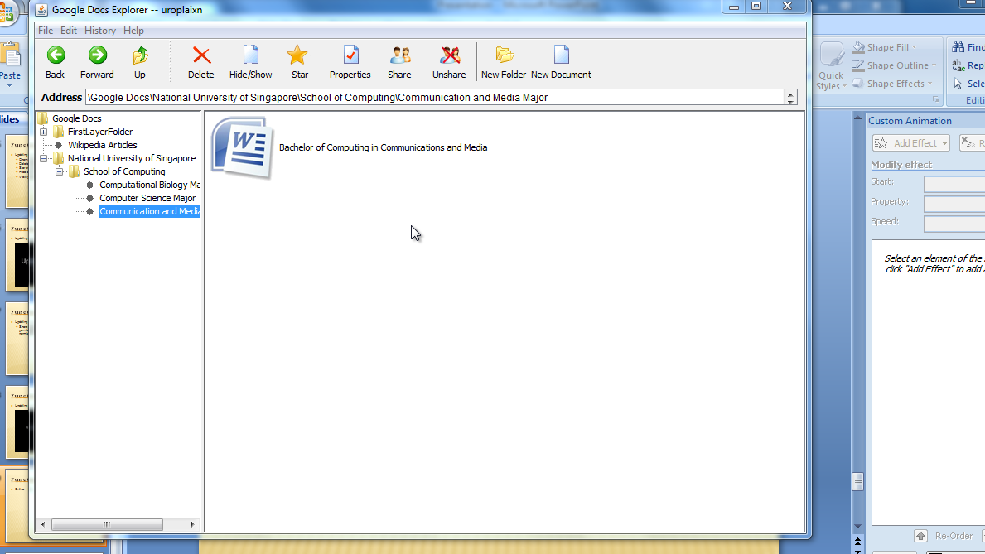
Functionalities
Online Help

Slide 20
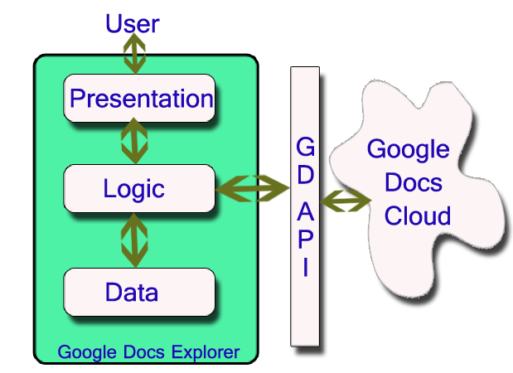
Architecture
Authentication Phase

Slide 21
Architecture
Interaction Phase (Viewing)

Slide 22
Architecture
Interaction Phase (Updating)

Slide 23
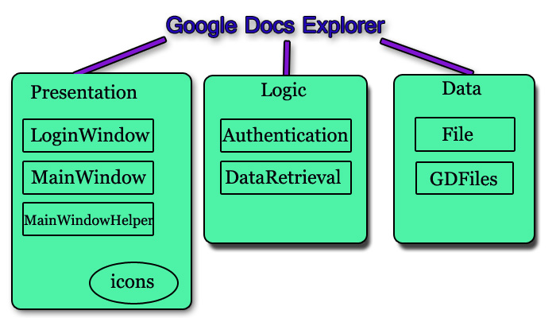
Detailed Structure of system

Slide 24
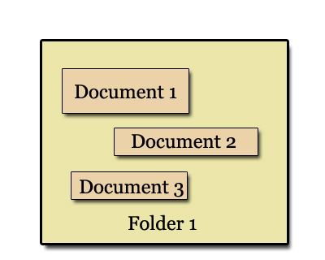
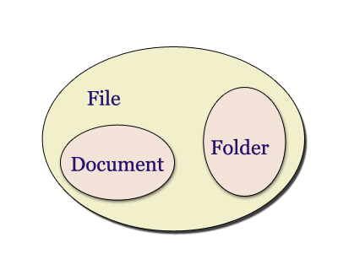
Data Structure

Slide 25
Detailed Structure of system
Javadoc

Slide 26
Is such a architecture good?
Trade-off
efficient file browsing during interaction phase
fast system start-up

Slide 27
Algorithms
“Download” method in “DataRetrieval”
recursive algorithm which retrieves all files from the top folder downwards to every leaf documents

Slide 28
rootFolder = retrieved from GDFiles; Download() { Entries[] = downloadTopFolders(); //retrieve folders that are one level deep Loop i from 0 to entries.size { Construct topfolder ,a File data structure using entries[i]; Add topfolder to child files of rootFolder; downloadRecurse(entries[i], topfolder); } } downloadRecurse (parentEntry, parentFolder) { //retrieve all WORD documents inside this folder Entries[] = downloadItemsInFolder (parentEntry, “document”); Loop i from 0 to entries.size { //store WORD documents to local memory Construct doc, a WORD document file using entries[i]; Add doc to child files of parentFolder; } //retrieve all EXCEL documents insdie this folder Entries[] = downloadItemsInFolder(parentEntry, “spreadsheet”); Loop i from 0 to entries.size { //store EXCEL documents to local memory Construct excl, a EXCEL document file using entries[i]; Add excl to child files of parentFolder; } //retrieve all sub folders inside this folder Entries[] =downloadFoldersInFolder (parentEntry); Loop i from 0 to entries.size { //store sub folders to local memory Construct sub, a Folder file using entries[i]; Add sub to child files of parentFolder; downloadRecurse (entries[i], sub); } }

Slide 29
Algorithms
“CreateTree” method in “MainWindow”
Is again a recursive algorithm
traverses from the top folder into folders in deeper levels, and creates tree nodes accordingly
During this process, each tree node is associated with a file.

Slide 30
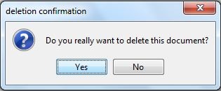
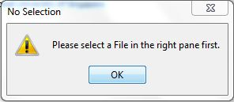
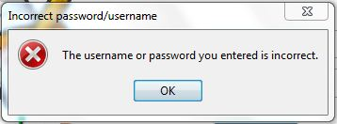
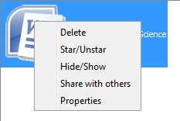
Is Google Docs Explorer Usable?
Yes!
Confirmation Window on Unrecoverable Actions
Warning Window on Actions having No Effect
Error Messages
Right Click Pop-up Window
Address Bar
Online Help
OnlineHelp

Slide 31
Is Google Docs Explorer Usable?
Yes!
It is usable for those who like the functions provided by Google Docs, but feel that windows explorer interface is more familiar to use in file browsing.

Slide 32
Is Google Docs Explorer Secure?
Yes!
Extracting and manipulating password from user
Store password as an array of characters
Clearing password immediately after use
Second-time Authentication When Opening Contents of One File

Slide 33
Conclusion
A concrete proof on the feasibility of developing a Windows explorer virtual shell replacing Google Docs interface.

Slide 34
Conclusion
Limitation of Google Documents List Data API
=> some problems are observed and they are all reported bugs in Google API forums.
Solutions?
=> Perhaps the solution to all these is to wait for a newer version of Google Docs API to appear.

Slide 35
Conclusion
Future Improvements
Add one more document type: POWERPOINT, or presentation.
Add in undo and redo functions.
Add in more sharing functions, such as sharing to a group of users.
Add in cut, copy and paste functions on specific file.
Enable dragging of items.
And et al…

Slide 36
Thank you!

