Slide 1
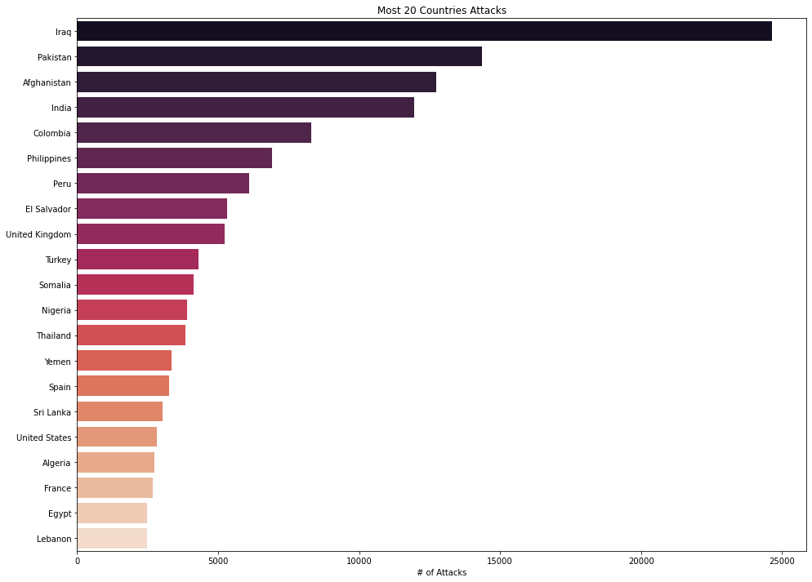
Top 20 countries which is affected by terrorist attacks

Slide 2
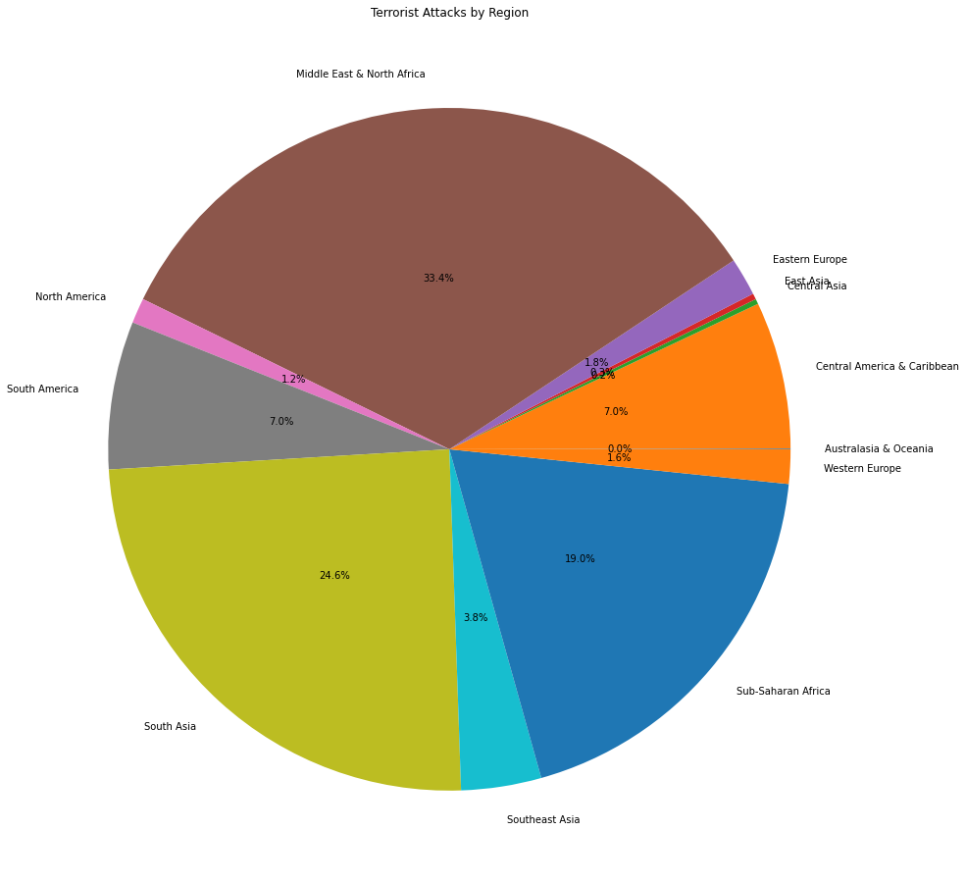
Analysis of attacks on continents

Slide 3
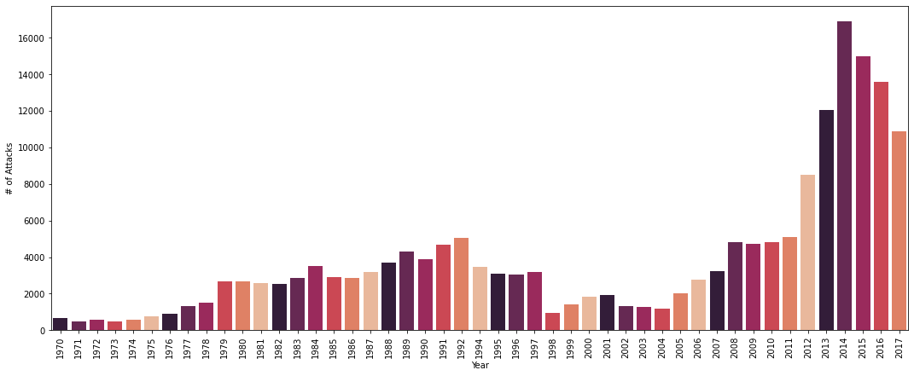
Analysis of attacks on years with column chart

Slide 4
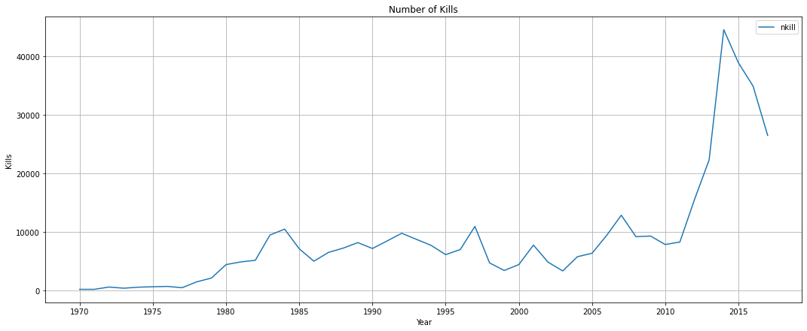
Analysis of attacks on years with line chart

Slide 5
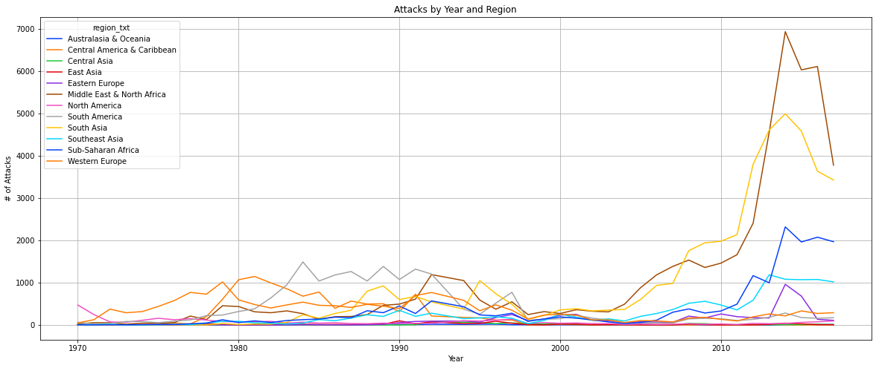
Analysis of attacks on years with line chart and areas

Slide 6
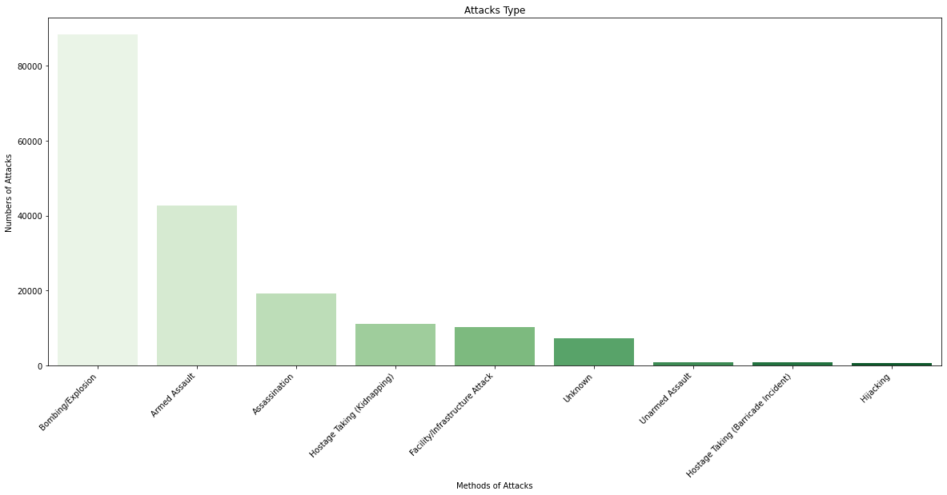
Distribution of the type and number of attacks

Slide 7
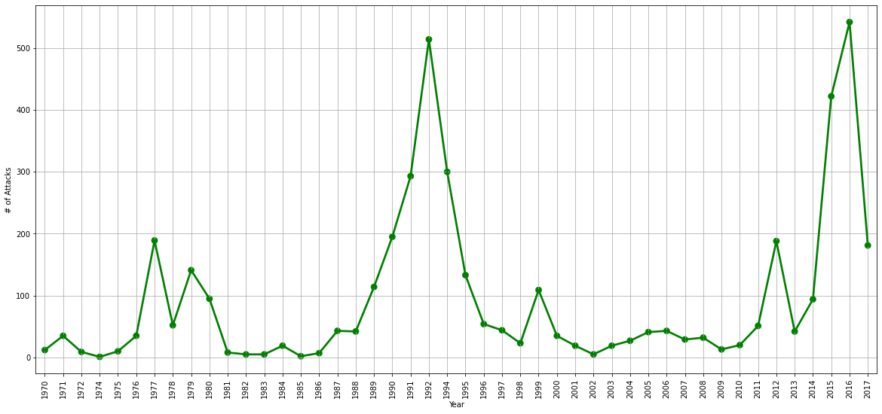
Distribution of the number of attacks by years

Slide 8
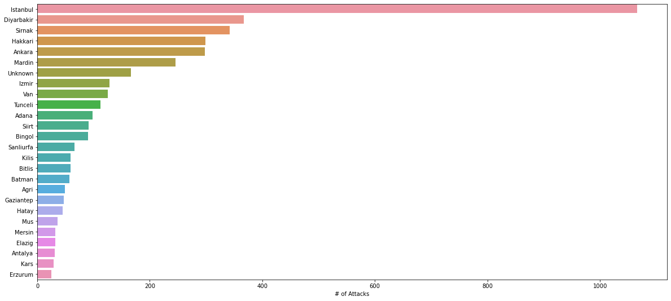
Distribution of the number of attacks by cities in Turkey

Slide 9
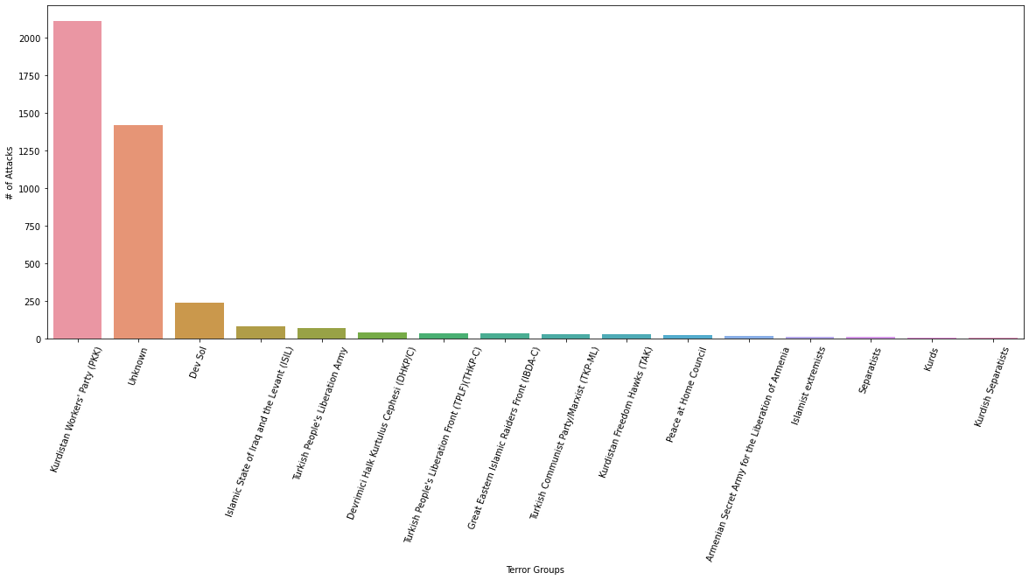
Distribution of the number of attacks by terrorist groups

Slide 10
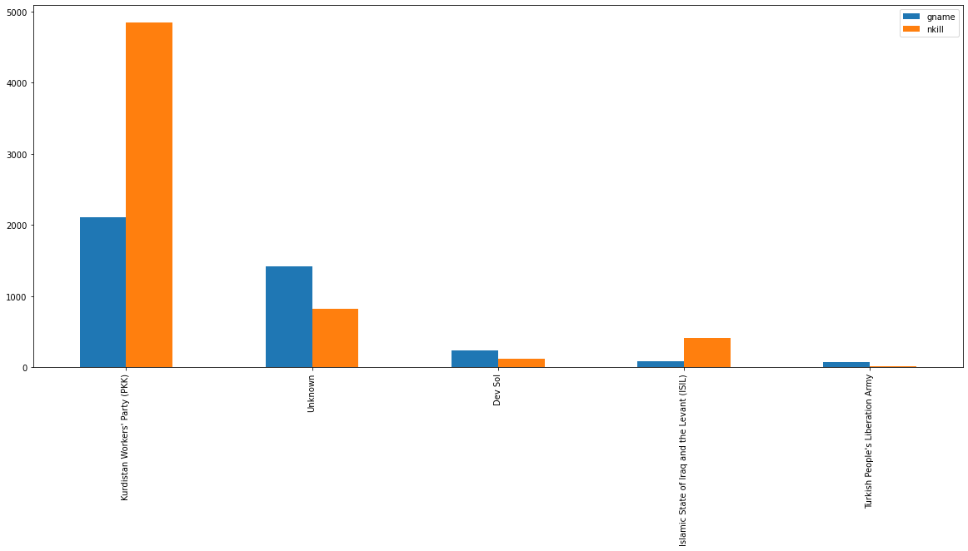
Distribution of the number of attacks by terrorist groups in Turkey

Slide 11
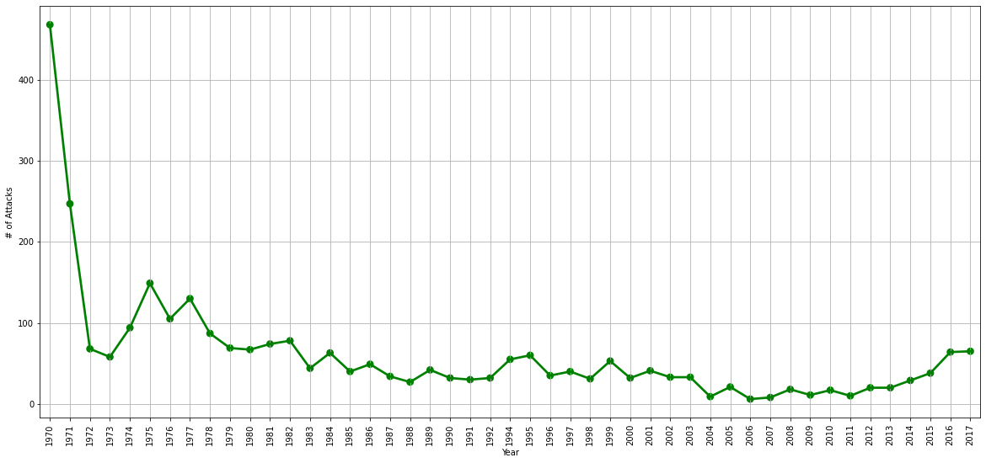
Distribution of the number of attacks by years in Turkey

Slide 12
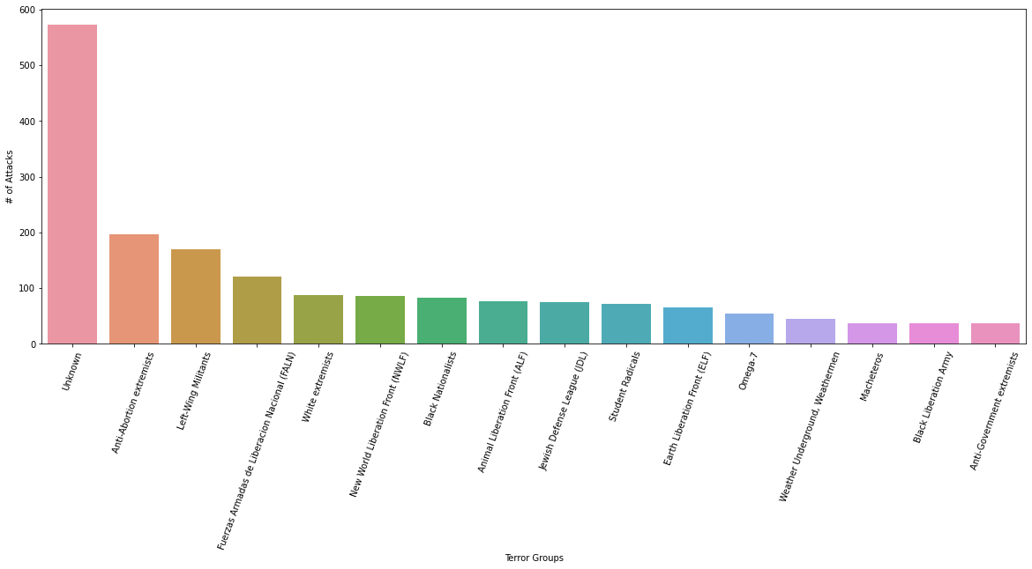
Distribution of the type and number of attacks in Turkey

Slide 13
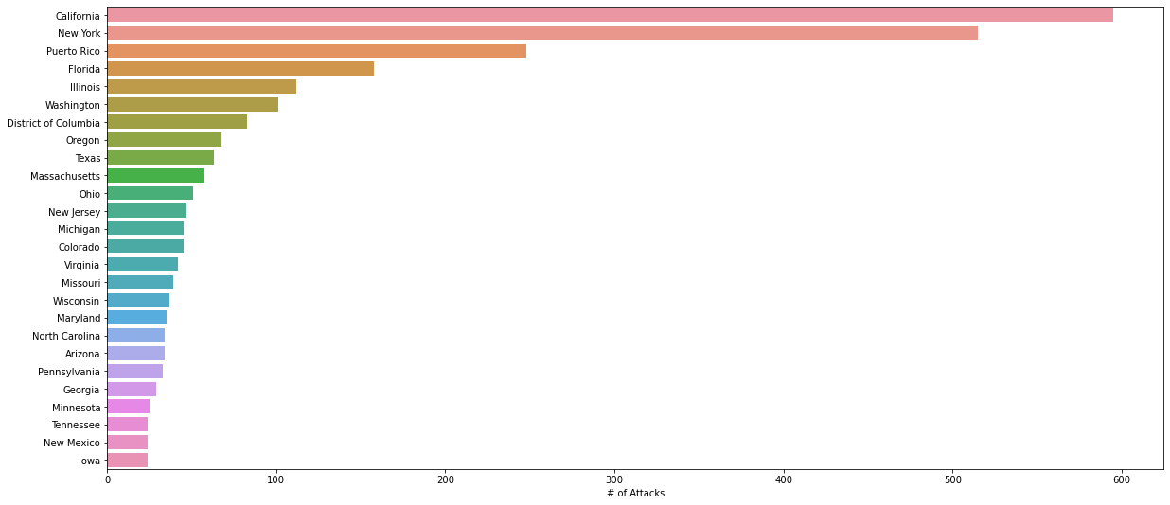
Distribution of the number of attacks by provinces in USA

Slide 14
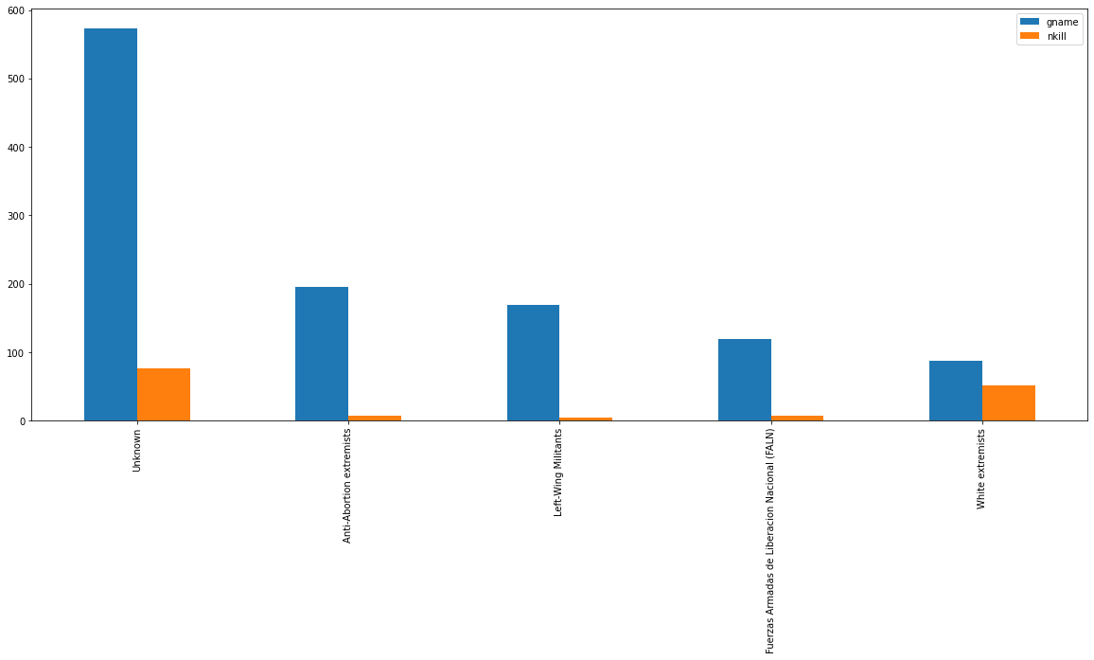
Distribution of the number of attacks by terrorist groups in USA

Slide 15
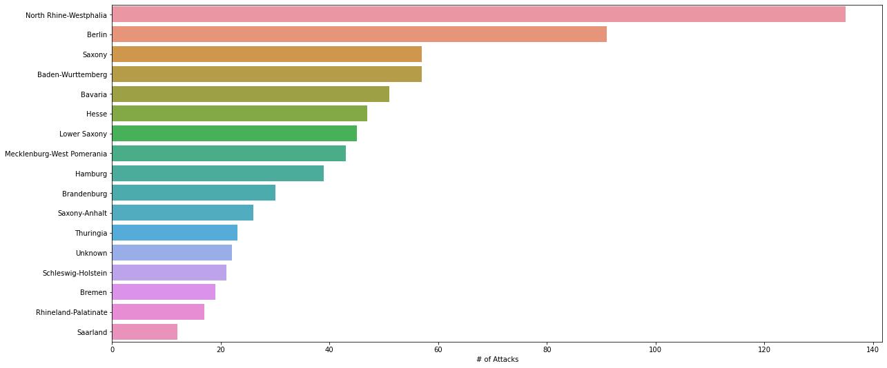
Distribution of the number of attacks by provinces in Germany

