Slide 1
Vıdeo Game SAles

Slide 2
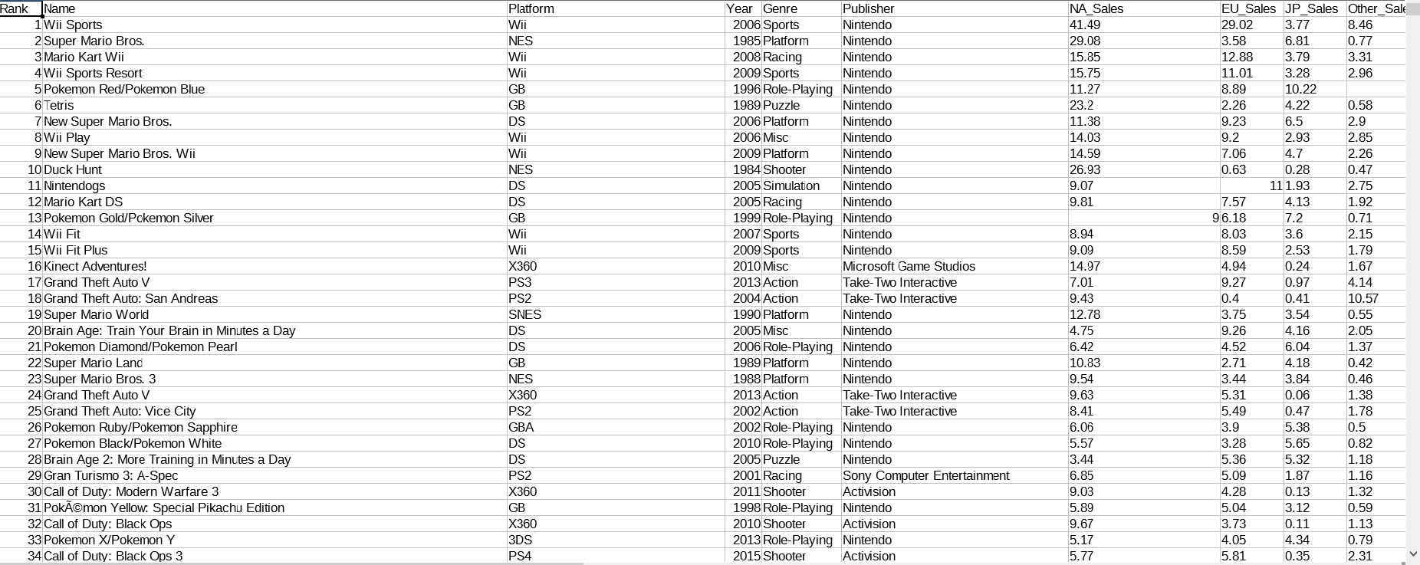

Slide 3
1. What ıs the type of the most preferred game around the world?
2. What ıs the company that sells the most games?
3. What ıs the type of the most preferred game ın Europe?
4. how many games are each age-approprıate accordıng to esrb?
5. How many games that sold over 5 mıllıon are ın Wıı platform?
6. Whıch type of game dıd Nıntendo company make the most?
7. How many percent of the sum game market does occur by the sales on Japanese market?
8. Whıch crıtıc scores of games are the more than 90?
9. What ıs the most preferred game type ın PC platform?
10.Whıch platform sold the most games?

Slide 4
İpek ÖRKEN – 140709021
Eren KARABACAK - 140709035

