Slide 1


PCA
Mert Eren
201726028

Slide 2
What is Principal components analysis (PCA)
Principal Component Analysis (PCA) is a dimensionality reduction technique used in data science to reduce the number of variables in a dataset while preserving as much of the original information as possible.
PCA is widely used in various fields, including finance, image processing, and natural language processing.
In PCA, the goal is to identify patterns in high-dimensional data by projecting it onto a lower-dimensional space.
The reduced dimensionality of the data makes it easier to visualize and interpret, while still capturing most of the variability in the original dataset.
PCA is based on the concepts of variance, covariance, eigenvectors, and eigenvalues.
In the following slides, we will explore these concepts in detail and show how PCA can be applied in Python to real-world datasets.

Slide 3

Before going deep
Eigenvalue
Eigenvektor
Variance
Covariance
Covariance Matrix

Slide 4
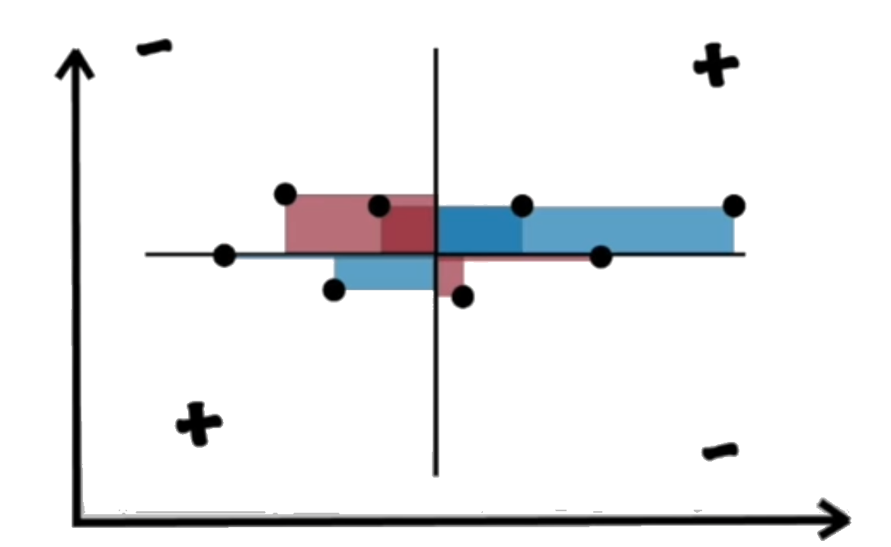
Variance
Variance is a measure of how spread out the data is from the average value.
Variance = (1/n) * Σ (xi - x̄)²
where:
n is the number of observations
Σ is the sum symbol
xi is the value of the i-th observation
x̄ is the mean of the observations

Slide 5
Covariance
Covariance is a measure of the joint variability of two random variables.
Cov(X, Y) = Σ [(xi - x̄)(yi - ȳ)] / (n - 1)
where:
Σ is the sum symbol
xi and yi are the values of the i-th observation of X and Y, respectively
x̄ and ȳ are the means of X and Y, respectively
n is the number of observations

Slide 6
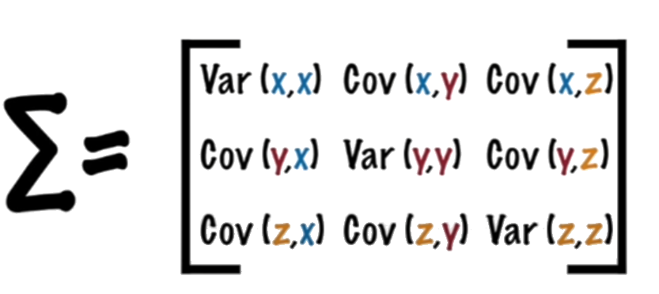
Covariance Matrix

Slide 7









Eigenvalue

Slide 8





Eigenvektor

Slide 9






Eigenvektor

Slide 10

Lets have a look at PCA
Standardize the data: The first step in PCA is to standardize the data by subtracting the mean from each data point and dividing by the standard deviation. This step ensures that all the variables are on the same scale and have the same importance in the analysis.
Calculate the covariance matrix: Next, we calculate the covariance matrix of the standardized data. The covariance matrix measures the relationship between the variables in the data and provides information about the spread of the data.
Calculate the eigenvectors and eigenvalues: We then calculate the eigenvectors and eigenvalues of the covariance matrix. The eigenvectors are the principal components of the data, and the eigenvalues represent the amount of variance in the data that is explained by each principal component.
Sort the eigenvectors: The eigenvectors are sorted in descending order according to their corresponding eigenvalues. This step ensures that the principal components that capture the most variance in the data are considered first.
Select the principal components: We then select the first k principal components, where k is the desired dimensionality of the reduced dataset. These k principal components are the new axes that we will use to represent the data.
Project the data onto the new axes: Finally, we project the original data onto the new axes to obtain the reduced dataset.

Slide 11
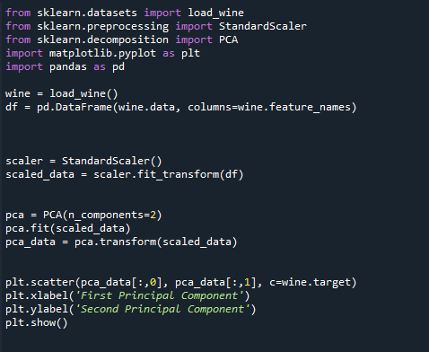
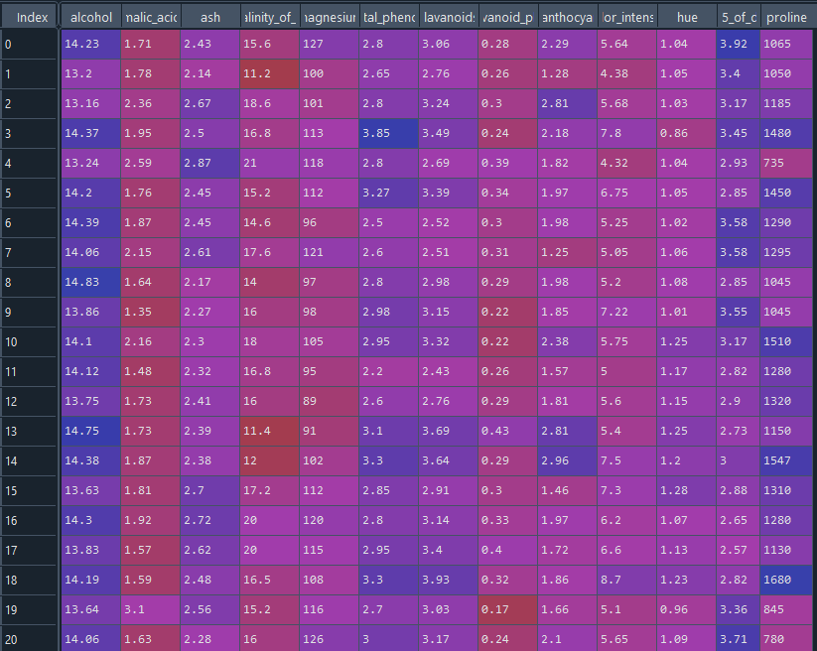


Code Section
The Wine dataset contains information about the chemical composition of three different types of wine from Italy.
Let's start by loading the Wine dataset into Python:
Part of Data

Slide 12
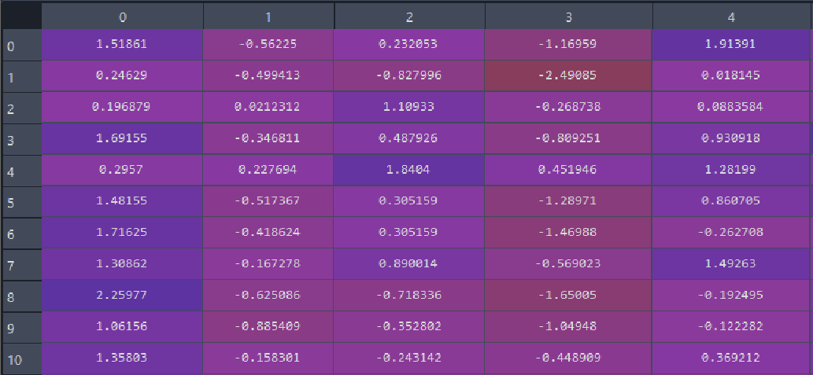



Code Section
Next, we will standardize the data by subtracting the mean and dividing by the standard deviation:
Part of Data

Slide 13

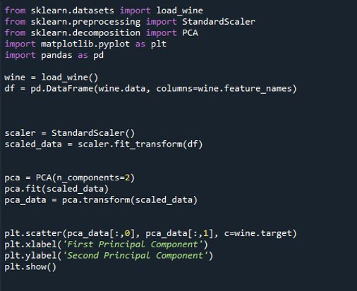



Code Section
We have reduced the dimensionality of the Wine dataset from 13 to 2 dimensions using PCA.
Part of Data

Slide 14

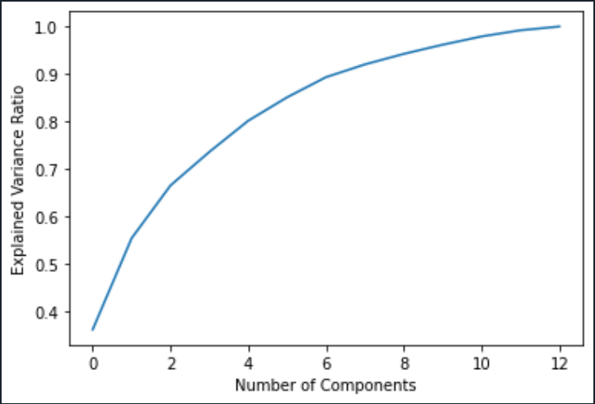
Code Section
Choosing the Number of Components
One important question in PCA is how many principal components to use for the reduced dataset.
A common approach is to use the "elbow method", which involves plotting the explained variance ratio as a function of the number of components and selecting the number of components at the "elbow" of the plot.
Let's use this method on the Wine dataset:
The resulting plot shows that the first two principal components capture over 50% of the variance in the Wine dataset, and that adding more components provides diminishing returns.
Therefore, we can choose to use the first two principal components as the reduced dataset.

Slide 15
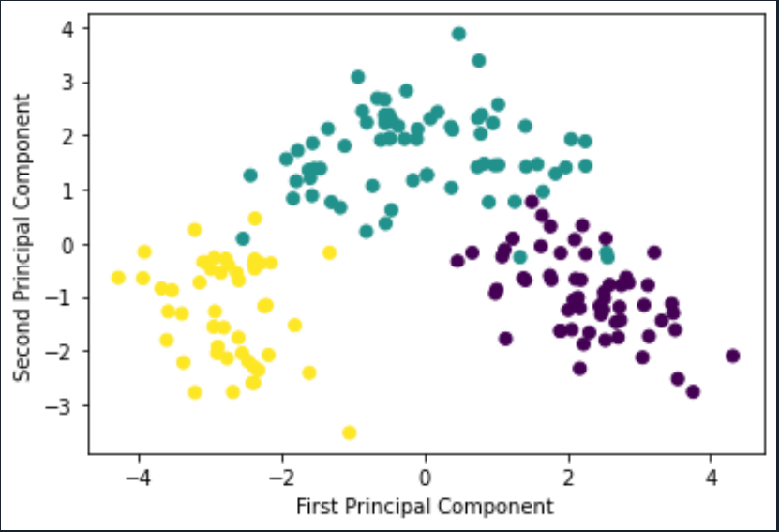


Code Section
We can visualize the results by plotting the transformed data:

Slide 16

Conculusion
PCA is a powerful technique for reducing the dimensionality of high-dimensional datasets.
It works by finding the principal components of the data, which capture the most important features of the data.
PCA can be applied to any dataset, as long as the data is standardized and the covariance matrix is computable.
PCA can be used for visualization, data compression, and feature selection.
However, choosing the number of components can be challenging and requires careful consideration of the trade-offs between dimensionality reduction and information loss.
Overall, PCA is a valuable tool in the data scientist's toolkit and should be considered when working with high-dimensional data.

Slide 17

Future Directions
Although PCA is a widely used technique, there are still areas for improvement.
One area is to develop better algorithms for computing principal components.
Another area is to extend PCA to handle non-linear data, which is more complex.
Researchers are also exploring how to use PCA for unsupervised learning, where patterns in the data are discovered without any prior knowledge.
Finally, PCA can be combined with other techniques like clustering and classification to create more powerful models.
Other related techniques include t-SNE, a tool for visualizing data, and autoencoders, which can learn useful features from data without supervision.

Slide 18
References
Abdi, H., & Williams, L. J. (2010). Principal component analysis. Wiley Interdisciplinary Reviews: Computational Statistics, 2(4), 433-459.
Jolliffe, I. (2002). Principal component analysis. John Wiley & Sons.
Wold, S., Esbensen, K., & Geladi, P. (1987). Principal component analysis. Chemometrics and intelligent laboratory systems, 2(1-3), 37-52.
Scikit-learn. (n.d.). PCA. Retrieved from https://scikit-learn.org/stable/modules/generated/sklearn.decomposition.PCA.html
Kaggle. (n.d.). Wine Quality. Retrieved from https://www.kaggle.com/uciml/red-wine-quality-cortez-et-al-2009

