Slide 1
Adaptive Framework Support through Self-Reflective Retrieval-Augmented Generation System
CSE 495/496 - Second Presentation
Eren Torlak
210104004090
Project Supervisor:
Dr. Salih Sarp
10.12.2024

Slide 2
Contents
Project Description
Chunking Problem
How I Solved Chunking Problem
Routing Mechanism
Example
Monitoring
Project Timeline
References

Slide 3
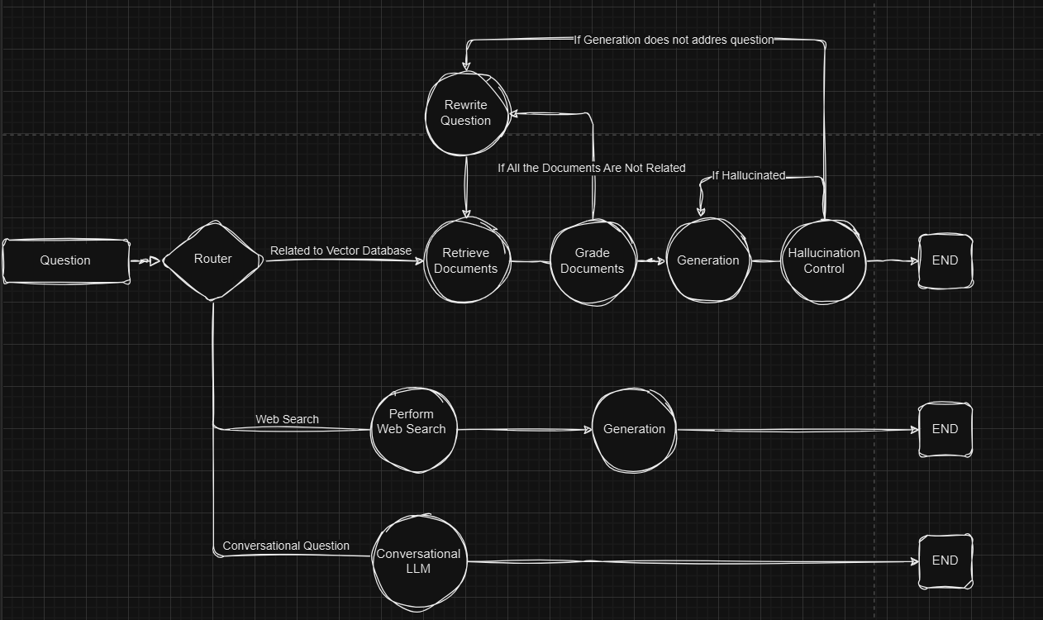
Project Description
The goal of this project is to integrate Self-RAG so that the model can leverage an internal knowledge base or perform web searches to gather relevant information and, through self-evaluation, generate more reliable and accurate outputs for newly created or in-house developed frameworks, such as software library documentation or APIs.

Slide 4
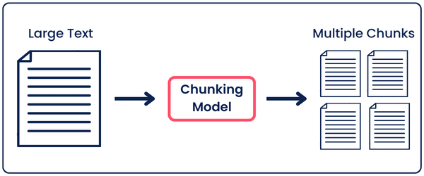
Chunking Problem
When code and documentation are combined in a single document, chunking becomes challenging because:
Code has a strict structure that can break if divided improperly.
Documentation needs context, and breaking it into arbitrary chunks can result in incomplete ideas.
Large Chunk Problem
When a query is made, large chunks may result in irrelevant or over-generalized results. Since the chunk covers a wide range of topics, the retrieved chunk might not directly answer the user's specific question.
When large chunks are used indexing them in a vector database can be inefficient.
Small Chunk Problem
Small chunks lose context, making it hard to understand code logic or complete ideas in documentation.
Example: Breaking up a function or documentation into tiny pieces can disrupt meaning, leading to incomplete or inaccurate responses.

Slide 5
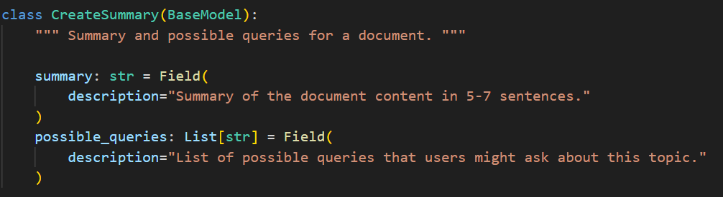
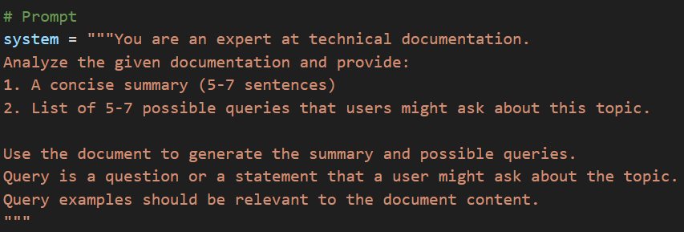
How I Solved Chunking Problem
For each page of code and documentation, I used an LLM to resolve the chunking problem by generating a summary and possible query examples for the content.
Processed the Entire Page: Instead of splitting content into arbitrary chunks, I used the LLM to process the entire page.
First, the LLM analyzed each page of code and documentation to understand the content. It then created a 5-7 sentence summary and 5-7 possible query examples that users might ask, helping the assistant understand the context of user queries.

Slide 6
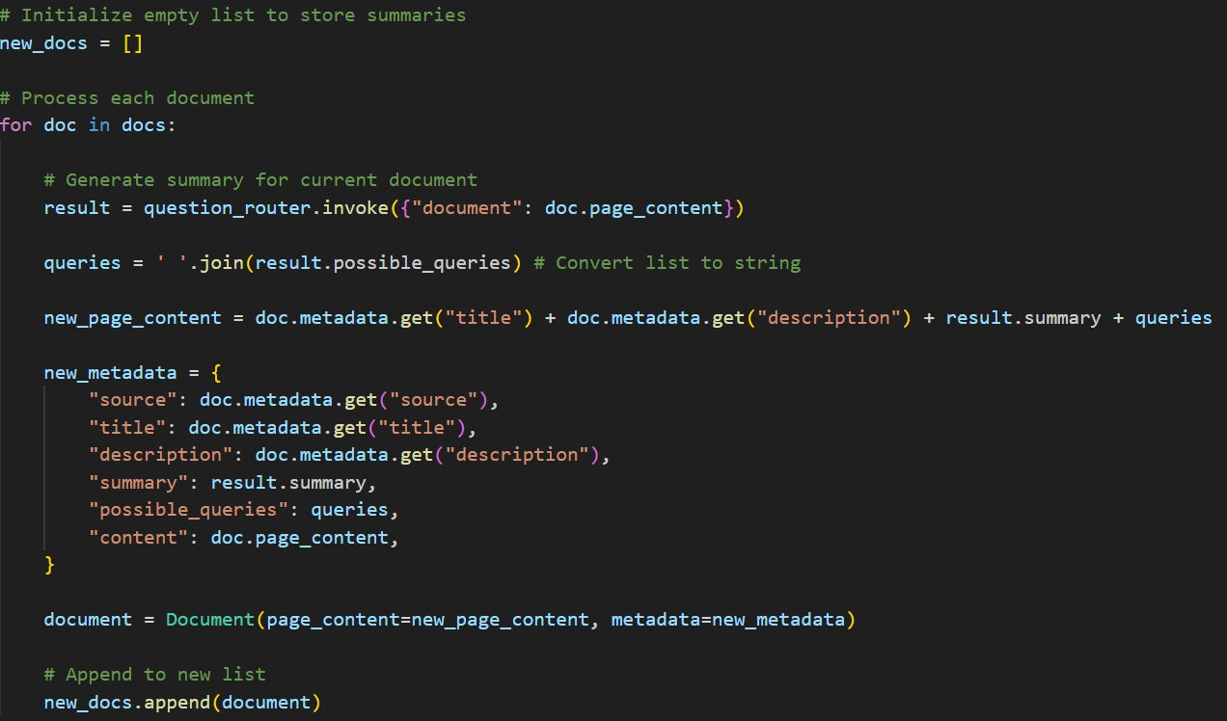
How I Solved Chunking Problem
Finally, I combined the summary and query examples with the original metadata (e.g., title, description) and stored as page content in a vector database.
Original page content is saved as metadata because when we retrieve the chunk we will get the real content from metadata.
This approach ensured that each page was properly summarized, indexed, and made easier to search, without losing important context or detail.

Slide 7
Routing Mechanism
This workflow manages dynamic, decision-driven tasks such as web searches, document retrieval, grading, and content generation. It starts by selecting the route based on the user's needs, whether that’s web_search, init_state, or conversation.
After initialization, relevant data is retrieved, and the documents are graded to determine if content should be generated, a query needs to be refined, or if the process should end.
The generate step checks the quality of the generated content, either ending the flow or refining the query for further iteration.

Slide 8
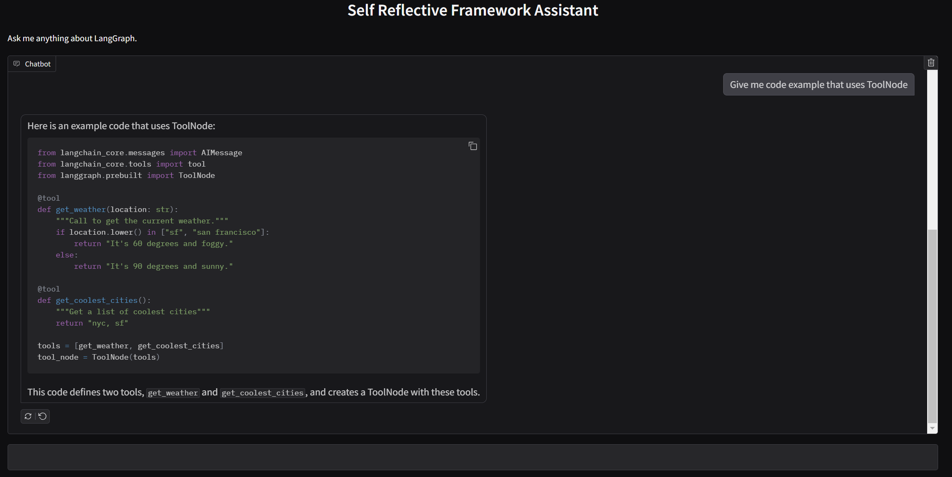
Example

Slide 9
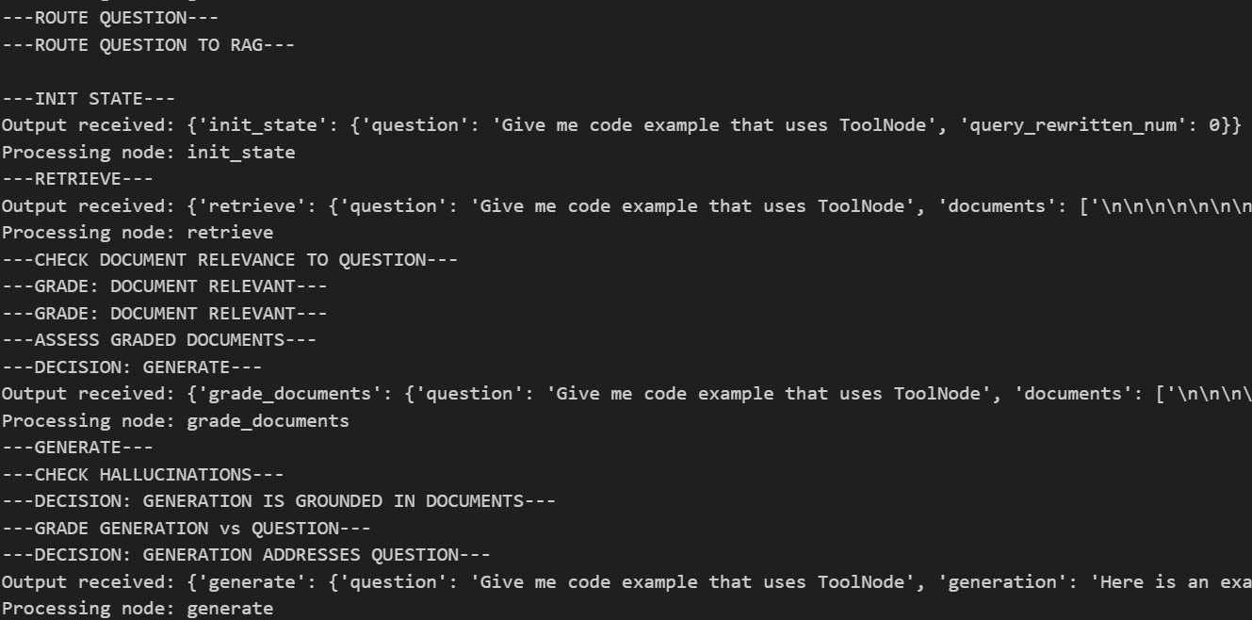
Example

Slide 10
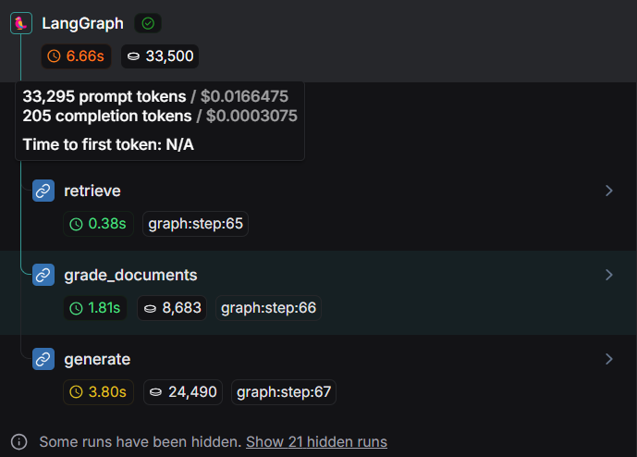
Monitoring

Slide 11

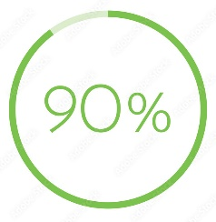



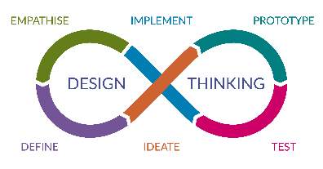
Project Timeline
Data Collection 25/10/24 - 10/11/24
10/11/24 - 25/11/24 Creating Vector Database
10/05/25 - end
Performance Evaluation
Designing and Implementing The System
25/11/24 - 10/05/25

Slide 12
References
https://selfrag.github.io/
https://arxiv.org/pdf/2310.11511
https://blog.gopenai.com/advanced-rag-with-self-correction-langgraph-no-hallucination-agents-groq-42cb6e5c0086
https://blog.gopenai.com/building-an-effective-rag-pipeline-a-guide-to-integrating-self-rag-corrective-rag-and-adaptive-ab7767f8ead1
https://github.com/langchain-ai/langgraph/blob/main/examples/rag/langgraph_self_rag.ipynb
https://smith.langchain.com/
https://www.gradio.app/docs/gradio/chatinterface

