Slide 1
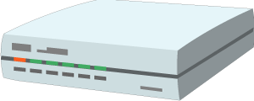
Cloud
Local network
Things Directory
Thing Description
Servient (Gateway)
WoT Thing
(Garage door controller)
Thing Description
Firmware
Forwarding proxy
WoT Scripting API
WoT Runtime
Thing Description
WoT Client
(Application)
WoT Interface
WoT Interface
WoT
Interface
Driver API
Local Hardware
1. Action request
1. Action request
2. Action response
2. Action response

