Slide 1
Predicting flight delay using classification
Beatriz Buquerin
Jamila Clayton
Gunnar Cukor
Mason Goss
Emma Resmini
Katie Stewart

Slide 2
Agenda
Team Introductions
Business Problem
Analytic Problem
Data
Methodology
Results of the Model
Demo
Deployment and Monitoring
Conclusions
Future Work
Questions

Slide 3

Introducing the team
Data team:
Emma Resmini
Beatriz Buquerin
Gunnar Cukor
Administrative team:
Jamila Clayton
Katie Stewart
Mason Goss

Slide 4
Business Problem
Client is experiencing increase in employees missing meetings due to flight delays
Client wants to choose air carrier with the least probability of delay
Our Objective: reduce the occurrence of employees missing meetings because of delayed flights
Stakeholders: the consulting firm (client), the firm’s employees, the travel department of the firm, and the client’s customers

Slide 5
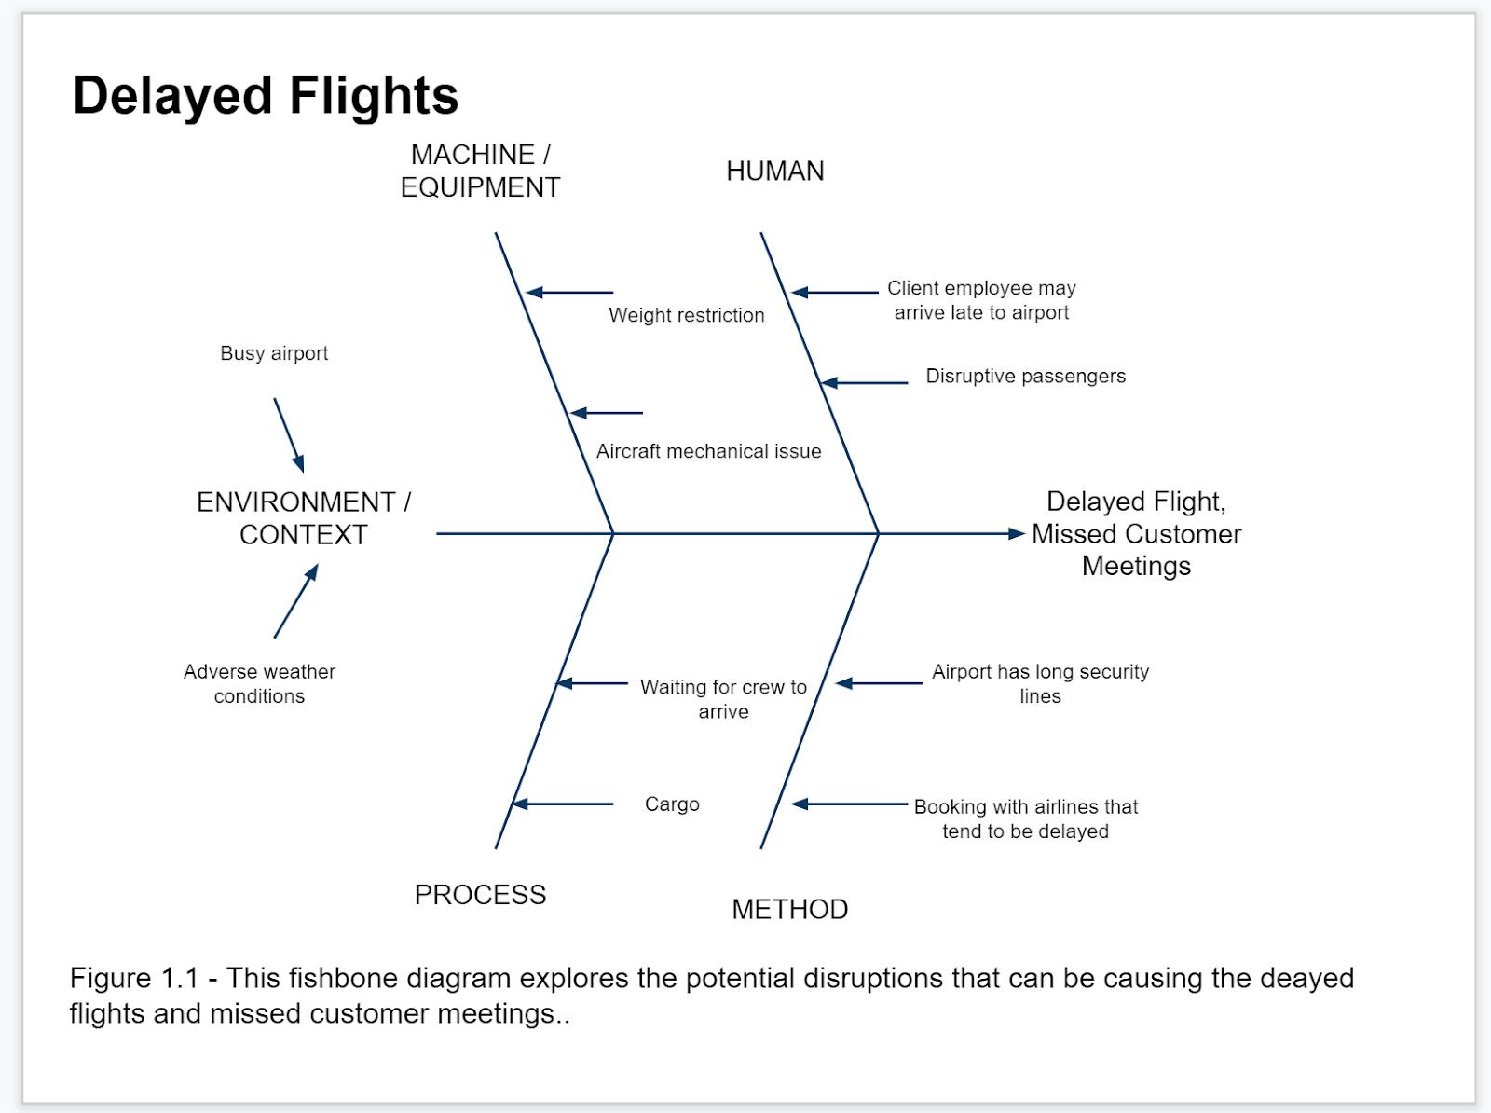

Slide 6
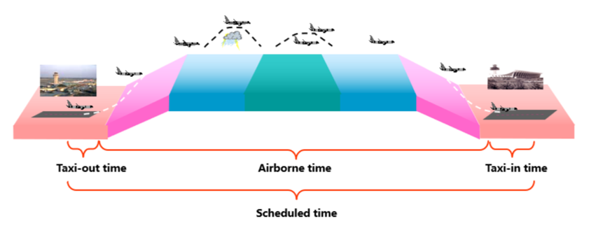
Various delay reasons
Flight time includes taxiing and airborne time
In 2020:
40% of delays caused by airline
30% of delays caused by "ripple effect"
20% of delays caused by air traffic control
Sources:
“Understanding the Reporting of Causes of Flight Delays and Cancellations”, Bureau of Transportation Statistics, https://www.bts.gov/topics/airlines-and-airports/understanding-reporting-causes-flight-delays-and-cancellations#q6
Ye, B., Liu, B., Tian, Y., & Wan, L. (2020). A Methodology for Predicting Aggregate Flight Departure Delays in Airports Based on Supervised Learning. Sustainability, 3–3. Retrieved from https://www.mdpi.com/2071-1050/12/7/2749.

Slide 7
Analytic problem
Model 1 (binary classifier)
On-time
Delayed
Model 2 (multiclass classifier)
On Time (0-15min)
Minor Delay (15-30 min)
Medium Delay (30-60 min)
Large Delay (60-90 min)
Gross Delay (90+ minutes)
We used two classification models to determine flight delay
A supervised learning technique with historical data was the best approach
Allows the client to both avoid airlines that experience delays more regularly and airlines that experience specifically long delays more regularly

Slide 8
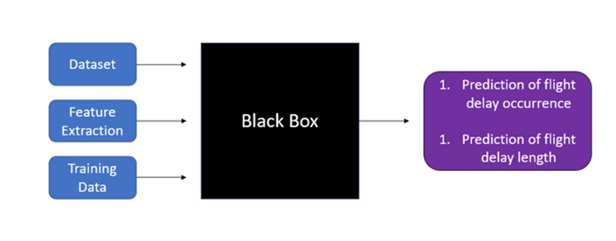
Black Box model

Slide 9
Data
Full Dataset:
Airline Delay and Cancellation Data (Kaggle)
Data from 10 years (2009-2018)
10 separate files
27 attributes (columns)
Categorical: origin, destination, airline, etc.
Numerical: departure delay, arrival delay, distance, etc.
Selected Dataset
5 years: 2014-2018
Data preparation:
Imputation
Extracting flights delayed by carrier
Remove defunct airlines
Create new column
Remove columns
Multicollinearity

Slide 10
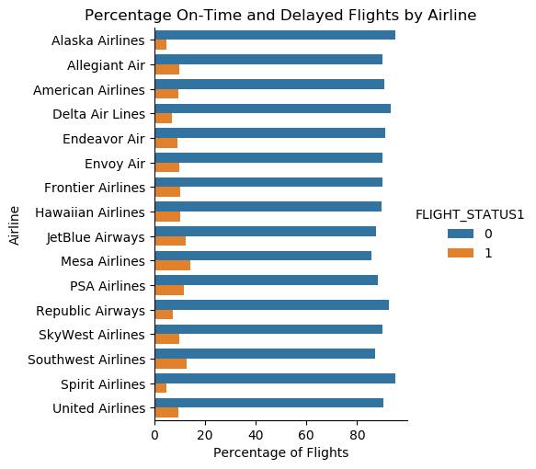
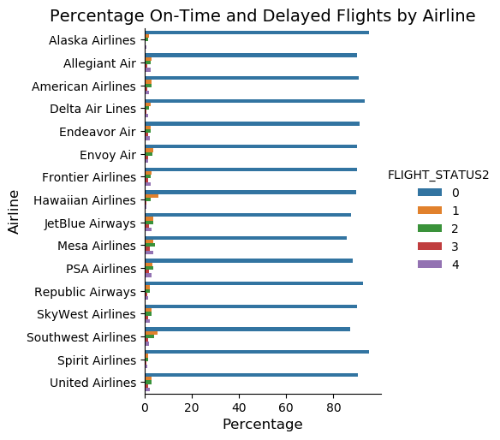
Comparing delays
On time versus Delay
5 delay length ranges
0 = on time
1 = delay
0 = no delay
1 = 15-30 mins
2 = 30-60 mins
3 = 60-90 mins
4 = 90+ mins

Slide 11
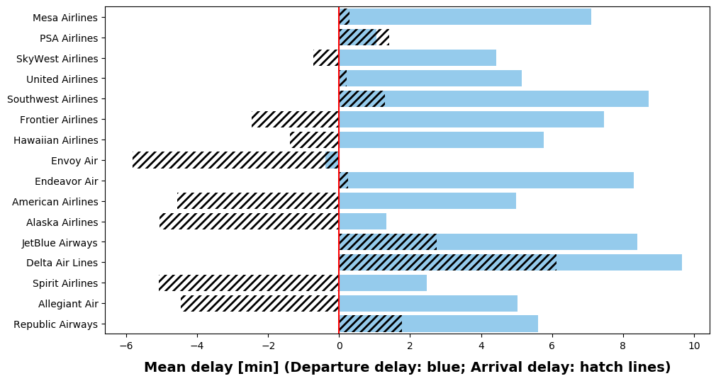
Comparing Arrival and Departure delays
Departure delays are often longer than arrival delays
flights sometimes even arrive earlier than schedule
Flights often "make up" for delays while airborne
At the end of a flight, the arrival delay is the actual delay

Slide 12
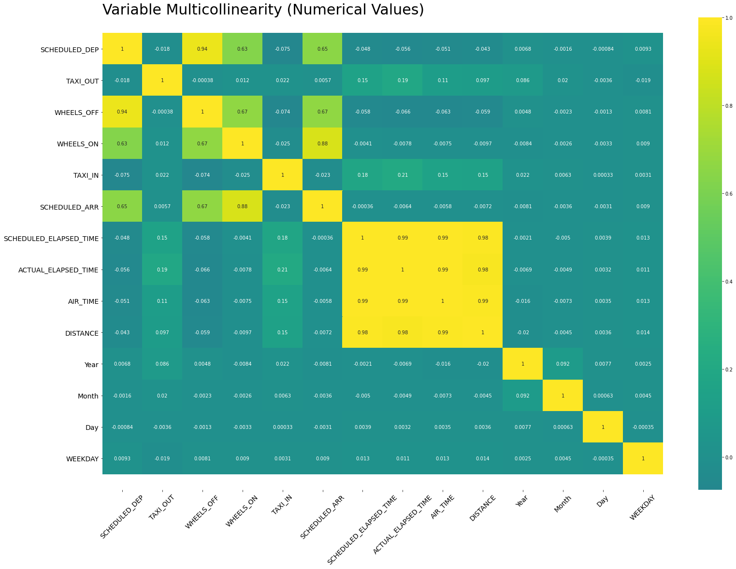
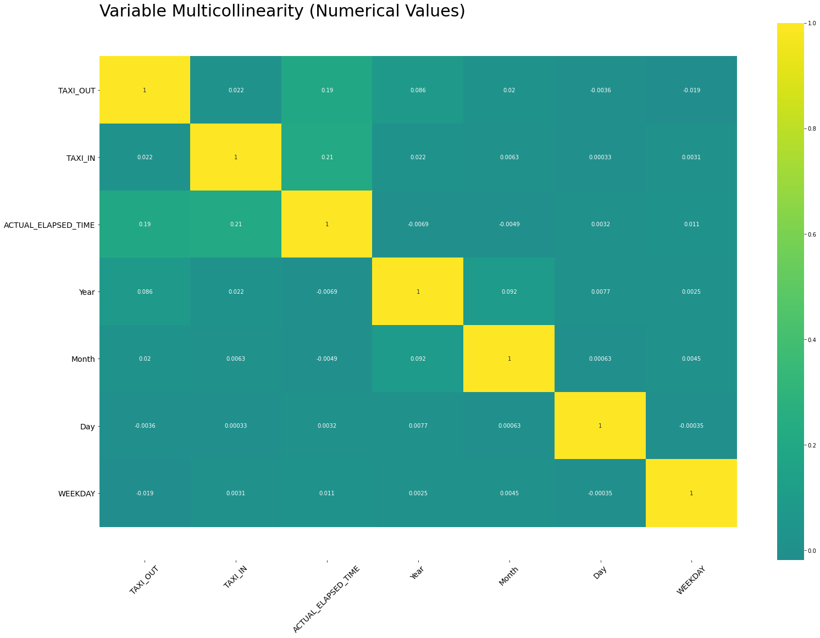
Multicollinearity
Before attribute removal:
After attribute removal:

Slide 13
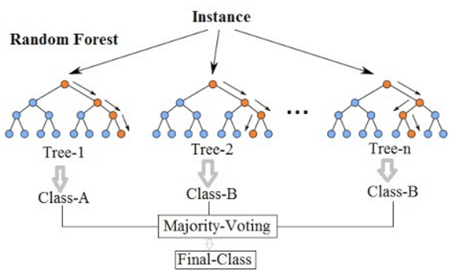
Methodology
Random Forest Classifier
Ensemble Learning Method
Resistant to overfitting
Efficient with large datasets
Accurate results, even with default parameters
Also tested: Logistic Regression
Returned poor results
Overfitting
High-dimensional dataset
Too many features
Source: https://medium.datadriveninvestor.com/classification-algorithms-in-machine-learning-85c0ab65ff4

Slide 14
Modeling and Testing
Python: scikit-learn
RandomForestClassifier(), build the random forest models
StratifiedKFold(), split the data into test/train sets
metrics, evaluate the quality of model predictions
cross_val_score(), validate the models

Slide 15
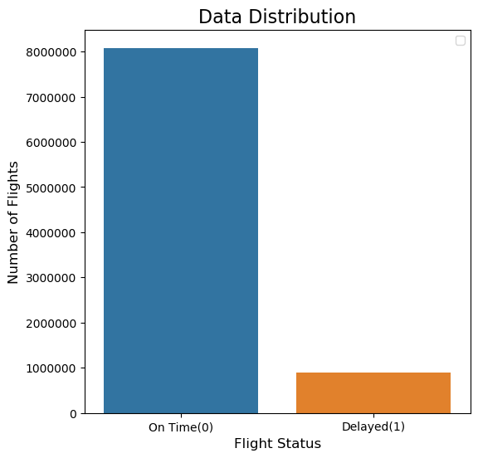
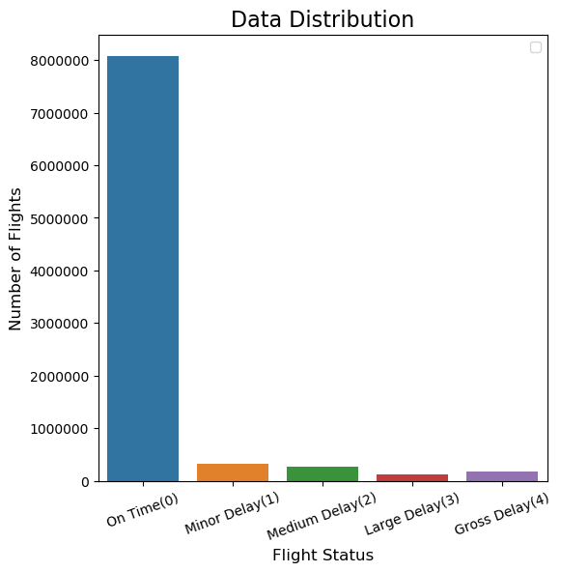
Modeling Steps
Class Imbalance on both models
Filter by airline
Data splitting
Hyperparameter tuning
Validation

Slide 16
Results
Model 1 (binary classifier) - 3 most frequently-appearing airlines
Carrier | On-Time | Delayed | Accuracy | Precision | Recall | Validation
Southwest Airlines | 83.8694 % | 16.1306 % | 96.4025 % | 89.2751 % | 97.3717 % | 0.95 accuracy, 0.0286 std. dev.
Delta Air Lines | 90.6162 % | 9.3838 % | 97.3058 % | 86.0444 % | 97.9879 % | 0.97 accuracy, 0.0203 std. dev.
American Airlines | 88.1315 % | 11.8685 % | 97.3436 % | 89.1113 % | 98.1383 % | 0.97 accuracy, 0.0010 std. dev.
Binary classification model:
Over 90% accuracy!
Better recall over precision
Steady validation results
Multi-classification model:
Over 90% accuracy
Poorer recall and precision
More consistent validation scores
Model 2 (multi-class classifier) - 3 most frequently-appearing airlines
Carrier | No Delay | 15-30 mins | 30-60 mins | 60-90 mins | 90+ mins | Accuracy | Precision | Recall | validation
Southwest Airlines | 82.4754 % | 9.7144 % | 4.2072 % | 1.8184 % | 1.7846 % | 93.6084 % | 80.0785 % | 89.7748 % | 0.94 accuracy, 0.0074 std. Dev.
Delta Air Lines | 89.3481 % | 6.0749 % | 2.0775 % | 1.0705 % | 1.429 % | 95.1704 % | 75.7975 % | 88.0152 % | 0.95 accuracy, 0.0046 std. Dev.
American Airlines | 87.1742 % | 6.3701 % | 2.9717 % | 1.6457 % | 1.8384 % | 95.0838 % | 77.5634 % | 87.8423 % | 0.95 accuracy, 0.0020 std. Dev.

Slide 17
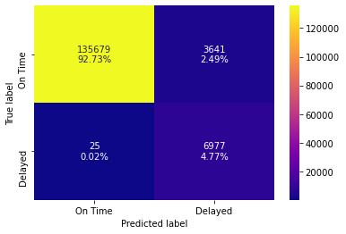
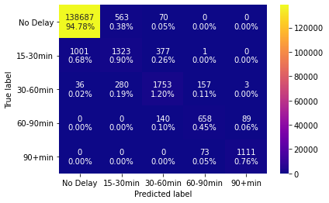
Visual results (Alaska airlines)

Slide 18
DEMO

Slide 19

Deployment and monitoring
Model Development
Model Deployment
Model Monitoring
Feedback From Production

Slide 20
conclusion
We delivered a model that helps the client make an informed decision on what airline to choose to avoid flight delays
Used two supervised classification models
Data was from a Kaggle public flight data set
Takes User input asking for what airline the user is interested in seeing
Returns a prediction of whether the flight will be delayed and if so what class of delay
Based solely on the carrier

Slide 21
Future work
Further improvements on Model 2
More data
Linear regression
Analysis of airports
When multiple airports are an option, which one is best?
Filtering dataset to one departure and arrival airport

Slide 22
Questions?

