Slide 1
Predicting SBA Loan Default
Emma Resmini
Data Scientist

Slide 2
Research Question
Using historical data, can we predict if a Small Business Administration (SBA) loan will default?
Background:
The SBA is an independent agency of the U.S. government that provides support to entrepreneurs and small businesses.
The SBA provides government-backed guarantee on a proportion of a loan made through partnering banks, credit unions, and other lenders.
About 1 in 6 SBA loans default¹
Notes:
Since SBA loans only guarantee a portion of the entire loan balance, banks will incur some losses if a small business defaults on the loan.

Slide 3
The Data
Kaggle¹
data from SBA
1973-2011
Variables include:
Loan amount, SBA-backed amount, loan term length, industry, location, number of employees
Target: Default or Paid in Full
Drawbacks:
Don’t know the type of loan
7(a) loan – most common
504 loan – long-term, fixed-rate financing
Microloan – loans of up to $50,000
Don’t know the interest rate
Notes:
28 columns

Slide 4
Data Cleaning
 | ApprovalFY | Term (Months) | DaysToDisbursement | DisbursementGross | Portion_SBA_Bank | Industry | Default
0 | 1995 | 60 | 59.0 | 15000.0 | 0.80 | NaN | False
1 | 1998 | 48 | 47.0 | 16000.0 | 0.80 | NaN | False
2 | 2002 | 120 | 26.0 | 260000.0 | 0.75 | 56.0 | False
3 | 2003 | 84 | 44.0 | 5000.0 | 0.50 | 45.0 | False
4 | 2001 | 60 | 136.0 | 161000.0 | 0.50 | 62.0 | False
Recoded values
Removed rows without target
Filtered out loan disbursed after 2010
Filtered out businesses with >1500 employees
Added new predictor variables
Sample of data variables

Slide 5
Not All Small Businesses Are Alike
 | Number of Employees | Loan Amount Disbursed (rounded) | Proportion backed by SBA | Term (Years) | Days Between Approval and Disbursement | Jobs Created | Jobs Retained
mean | 10.495758 | $199,218.90 | 0.711777 | 9.284157 | 113.912724 | 8.543356 | 10.813491
std | 24.503012 | $276,468.30 | 0.173326 | 6.592987 | 175.997823 | 239.433878 | 239.844954
min | 0.000000 | $4,000.00 | 0.028140 | 0.000000 | 0.000000 | 0.000000 | 0.000000
25% | 2.000000 | $43,000.00 | 0.500000 | 5.000000 | 31.000000 | 0.000000 | 0.000000
50% | 4.000000 | $100,000.00 | 0.750000 | 7.000000 | 60.000000 | 0.000000 | 1.000000
75% | 10.000000 | $237,000.00 | 0.850000 | 10.000000 | 120.000000 | 1.000000 | 4.000000
max | 1500.000000 | $11,446,320 | 1.000000 | 47.417000 | 8813.000000 | 8800.000000 | 9500.000000
Notes:
Number of employees range from 0-1500
Loan amount and term ranges widely vary – large loans, long terms…small loans, short terms

Slide 6
Where Is The Risk?
State default rates range from 7-28%
 | Florida | Georgia | District of Columbia | Nevada | Michigan
Paid in Full | 0.721804 | 0.757134 | 0.757441 | 0.766125 | 0.768607
Default | 0.278196 | 0.242866 | 0.242559 | 0.233875 | 0.231393
Industry default rates range from 10-30%
 | Real estate and rental and leasing | Finance and insurance | Transportation and warehousing | Information | Educational services
Paid in Full | 0.705212 | 0.707738 | 0.724143 | 0.745549 | 0.752514
Default | 0.294788 | 0.292262 | 0.275857 | 0.254451 | 0.247486
Notes:
Should not evaluate risk based on state…could have ethical concerns

Slide 7
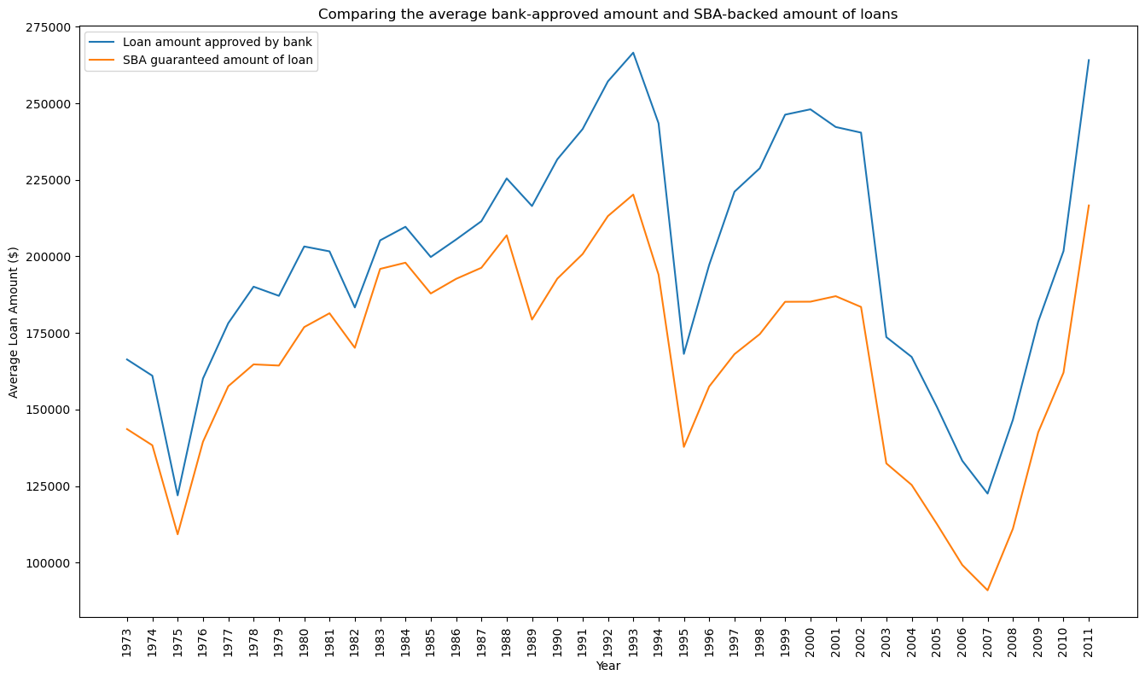
SBA Loan Trends
1970s “stagflation”
1995 – Federal Reserve raised interest rates from 3% to 6%
2008 Recession
Notes:
Stagflation - high inflation with slow economic growth
prime lending rate was above 21%
1995 - pause in economic growth
2008 Recession - high rates of unemployment and home foreclosures

Slide 8
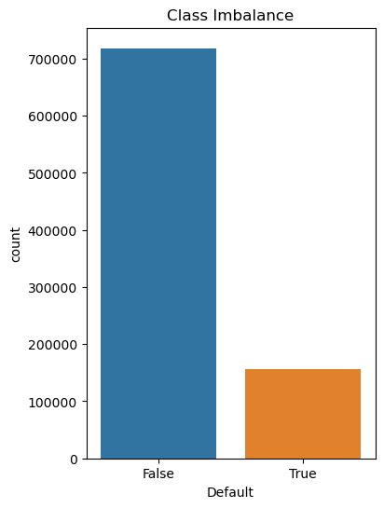
MODEL SELECTION
Model | Type | Description
Random Forest | Supervised classification | An ensemble method that builds multiple decision trees and aggregates the results.
Gradient Boosting |  | An ensemble method that makes new predictors from the mistakes of previous predictors.
Notes:
Class imbalance – 18% defaulted loans in data
Need good precision and recall
Outliers in numerical data

Slide 9
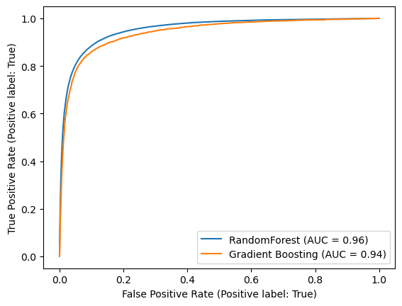
Results
Overall, Random Forest performed better
Score | Random Forest | Gradient Boosting
Accuracy | 0.92729 | 0.91899
Precision | 0.84185 | 0.81859
Recall | 0.73051 | 0.70259
F1 | 0.78224 | 0.75616
Fbeta | 0.81695 | 0.79242
Log Loss | 0.23081 | 0.22122

Slide 10
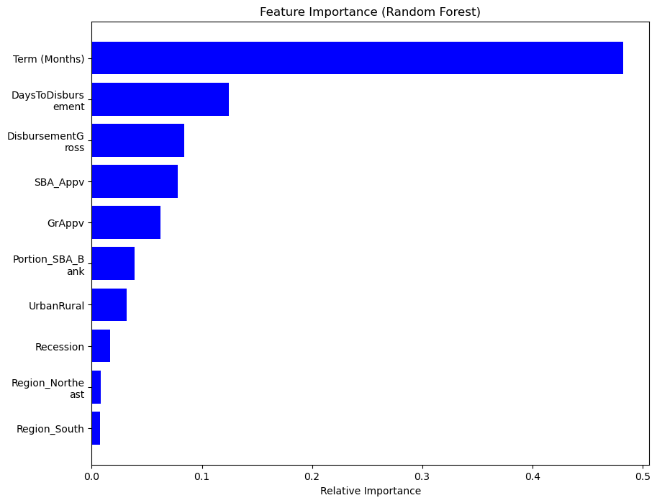
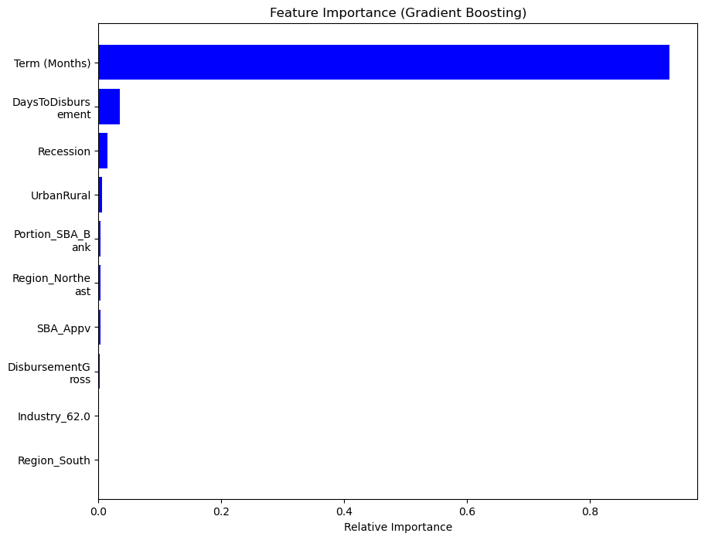
Feature Importance
Notes:
Long-term loans are considered riskier – more time to default
Long-term loans generally have higher interest rates
the number of days between approval and disbursement can have a large impact on a business that may be struggling financially

Slide 11
Conclusion and Future Considerations
Conclusion
Random Forest performed best at identifying loan defaults
Lower recall than desirable
Term length, days to disbursement most important features
Future Considerations:
Add on up-to-date data
Which businesses are most effected by online consumerism?
Rise in tech companies?
Include loan categories and interest rates
Optimize models
Notes:
No ethical concerns within this dataset specifically – possibly UrbanRural identifier
However, loan applications usually involve credit histories, and gender/racial biases could be present
Also, bias based on industry

Slide 12

Thank you!

