Slide 1
Final Project: Inspecting Data Regarding the Percent of Offenses Closed by Law Enforcement in 2019
Emma Resmini

Slide 2
Choosing a Topic
Choosing data from a credible source was a top priority
Also wanted a dataset that was created recently, so the resulting visualization is relevant
Primarily focused on government sites because of the many publicly available datasets
Eventually landed on crime statistics, and ultimately found the FBI UCR Program site

Slide 3
The Data
The data were collected by the FBI’s Uniform Crime Reporting (UCR) Program. By the UCR Program’s definitions, law enforcement agencies clear (or “close”) offenses in one of two ways:
Arrest
Exceptional means
Elements outside of law enforcement’s control (death of offender, victim refusing to cooperate, etc.)
The data are split by geographic region:
A broad nationwide figure
The four regions of the US (as defined by the Census Bureau)
The nine geographic sub-regions used by the UCR Program to compile their reports
Sources:
https://ucr.fbi.gov/crime-in-the-u.s/2019/crime-in-the-u.s.-2019/topic-pages/clearances
https://ucr.fbi.gov/crime-in-the-u.s/2019/crime-in-the-u.s.-2019/topic-pages/tables/table-26

Slide 4
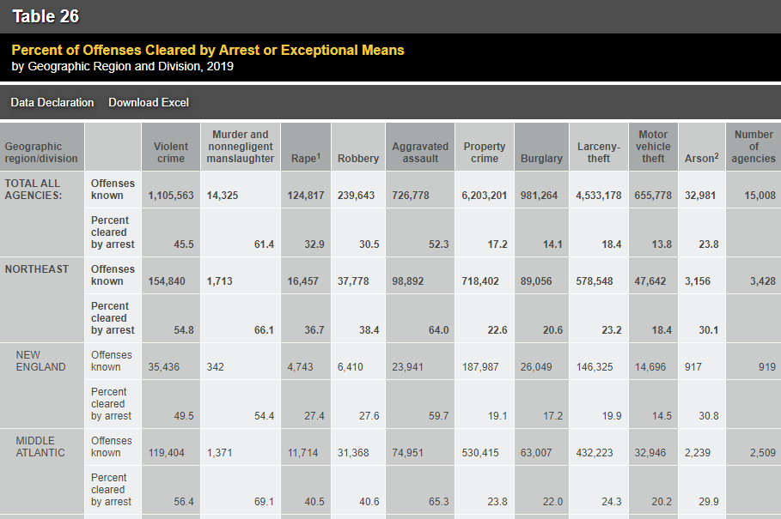
Considerations…
The data are downloaded as an Excel spreadsheet, however its original format is not readily usable for analyzing/visualization.
Within Excel, I changed the format from wide to long, making minor adjustments as needed, and converted to .csv.
All further analyzing and wrangling was done in R.
The UCR Program makes no distinction between offenses cleared by arrest and offenses cleared by exceptional means.
My plot visualizes the probability of an offense being cleared – by either means – so this was not of great concern.
The data on rape and arson offenses may not be as reliable as the data on the other offenses.
Rape offenses defined a certain way (i.e. not following the current UCR Program definition) are not included.
Not all law enforcement agencies report arson cases to the FBI, so the arson data may not be fully representative.
Table 26, “Percent of Offenses Cleared by Arrest or Exceptional Means by Geographic Region and Division, 2019”
https://ucr.fbi.gov/crime-in-the-u.s/2019/crime-in-the-u.s.-2019/topic-pages/tables/table-26

Slide 5
Packages
dplyr
Filtering, renaming, mutating, pipe function (very helpful!)
ggplot2
Making the plot
I prefer ggplot2 because of the many customizations it offers
plotly
Convert ggplot2 to plotly with ggplotly() function
Allows interactivity

Slide 6
Narrative of the Plot
I wanted to illustrate the (perhaps) surprisingly low rate of offenses being closed throughout the United States, maybe even more surprising given the assumption that some percentage of violent and property crimes go unreported.
It has been a frequent source of discussion within my family for nearly the past year, that a crime so terrifying and life-changing can happen to someone, and they may never get closure.

Slide 7
Final Product
The final visualization is a grouped barplot
The plot was made with ggplot, then converted to plotly using the ggplotly() function
The offense type is on the axis, while the probability of the offense being cleared is on the y-axis
With a grouped barplot, the viewer can easily compare the different probabilities of each offense being cleared among the different regions
Additionally, the groupings are in descending order, to add an additional narrative showing which crimes are most-to-least likely to be closed
The plot is color-filled by region.
The visualization shows how both offense type and location affect the probability of an offense being closed
I decided the nine geographic regions are not "obvious" by name alone, and the amount of information needed within the plot for clarification detracts from the content, whereas the four main regions are understood, at least by a US reader.
There is a text annotation on the plot to define “exceptional means” to reduce confusion
There is additional information when the user hovers over the bars:
Offense type
Count of offenses in the region
Percentage of offenses closed
Number of law enforcement agencies in the region
Population of the region

