Slide 1
DBIx::Class – The Perl ORM
Erez Schatz
30/11/2011

Slide 2
What is an ORM
Object Relational Mapping
Creates an abstraction layer between relational databases and an object-oriented system

Slide 3
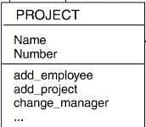

What is an ORM

Slide 4
What is an ORM
UPDATE employees SET name = 'Larry', age = '34', ...
SELECT name, age, salary ... FROM employees ....

Slide 5
What is an ORM
my $emp = ORM::Employee->new(
    'name' => 'Larry',
    'age' => '34',
    ...
    );

Slide 6
Why do we need it
Abstracts Database interaction
Works within application rules
No need to massage data back and forwards
Run methods on objects
Cross-Vendor DB support
NO SQL!

Slide 7
SQL woes
$sth = $dbh->prepare("SELET foo, bar FROM table WERE baz=?");

Slide 8
SQL woes
use DBI;
@driver_names = DBI->available_drivers;
%drivers = DBI->installed_drivers;
@data_sources = DBI->data_sources($driver_name, \%attr);
$dbh = DBI->connect($data_source, $username, $auth, \%attr);
$rv = $dbh->do($statement);
$rv = $dbh->do($statement, \%attr);
$rv = $dbh->do($statement, \%attr, @bind_values);
$sth = $dbh->prepare("SELET foo, bar FROM table WERE baz=?")
$ary_ref = $dbh->selectall_arrayref($statement);
$hash_ref = $dbh->selectall_hashref($statement, $key_field);

Slide 9
Why Don't We Need It
Abstracts a lot
Still needs knowledge of underlying mechanisms
No DB optimization
Many DB calls
Good in handling simple joins
Not that good in more complex ones
No DB checks for type and validation until runtime

Slide 10
DBIx::Class
Created by mst
Part of the Enlightened/Modern Perl
https://metacpan.org/module/DBIx::Class
http://dbix-class.org
http://lists.scsys.co.uk/mailman/listinfo/dbix-class
Irc.perl.org#dbix-class
perldoc DBIx::Class::Manual::DocMap

Slide 11
Install
$cpanm DBIx::Class

Slide 12


Slide 13
Convention over Configuration
├── Schema
│ ├── Result
│ │ ├── Employee.pm
│ │ ├── Breed.pm
│ │ ├── Vice.pm
│ │ ├── DogVice.pm
│ │ └── Department.pm
│ ├── ResultSet
│ │ ├── Employee.pm
│ │ ├── Vice.pm
│ │ └── Department.pm
├── Schema.pm

Slide 14
Schema
package Dogs::Schema;
use base qw/
DBIx::Class::Schema
/;
__PACKAGE__->load_namespaces();
1;

Slide 15
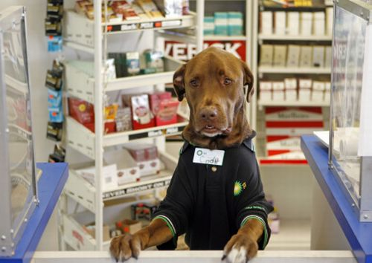

Slide 16

__PACKAGE__->add_columns(
'id' => {
'data_type' => 'integer',
'is_nullable' => 0,
'is_auto_increment' => 1,
},
'name' => {
'data_type' => 'varchar',
'is_nullable' => 0,
'default_value' => 'Rover',
},
'sex' => {
'data_type' => 'varchar',
'is_nullable' => 0,
},
);
__PACKAGE__->set_primary_key('id');

Slide 17
__PACKAGE__->load_components(
qw/InflateColumn::DateTime/
);
...
'timestamp' => {
'data_type' => 'datetime',
'is_nullable' => 0,
'set_on_create' => 1,
'set_on_update' => 1,
},

Slide 18

'breed_id' => {
'data_type' => 'integer',
'is_nullable' => 0,
},
'dept_id' => {
'data_type' => 'integer',
'is_nullable' => 0,
},
__PACKAGE__->add_unique_constraint( [ qw/breed_id/ ] );
__PACKAGE__->add_unique_constraint( [ qw/dept_id/ ] );

Slide 19
__PACKAGE__->belongs_to(
'department' => 'Dogs::Schema::Result::Department' => {
'foreign.id' => 'self.dept_id'
}
);
__PACKAGE__->has_one(
'breed' => 'Dogs::Schema::Result::Breed' => {
'foreign.id' => 'self.breed_id'
}
);

Slide 20
__PACKAGE__->has_many(
'dog_vice' => 'Dogs::Schema::Result::DogVice' => {
'foreign.dog_id' => 'self.id'
}
);
__PACKAGE__->many_to_many(
'vices' => 'dog_vice' => 'vice'
);
In Dogs::Schema::Result::Vice :
__PACKAGE__->has_many(
'dog_vice' => 'Dogs::Schema::Result::DogVice' => {
'foreign.vice_id' => 'self.id'
}
);
__PACKAGE__->many_to_many(
'employees' => 'dog_vice' => 'employee'
);

Slide 21

__PACKAGE__->add_columns(
'employee_id' => { 'data_type' => 'integer' },
'vice_id' => { 'data_type' => 'integer' },
);
__PACKAGE__->set_primary_key(qw/ employee_id vice_id /);
__PACKAGE__->belongs_to(
'employee' => 'Dogs::Schema::Result::Employee' => {
'foreign.id' => 'self.employee_id'
}
);
__PACKAGE__->belongs_to(
'vice' => 'Dogs::Schema::Result::Vice' => {
'foreign.id' => 'self.vice_id'
}
);

