Slide 1
Mondrian Multidimensional K-Anonymity
Students:
Alireza Ghorbani
Farshad Moradi Shahrbabak
Sobhan Bazoubandi
Based on:
Mondrian Multidimensional K-Anonymity (Kristen LeFevre David J. DeWitt Raghu Ramakrishnan University of Wisconsin, Madiso)

Slide 2
Motivation
Research on data privacy have lasted for more than ten years, lots of great papers have been published. However, only a few open source projects are available on Internet and most of them are using algorithms proposed before 2004! Fewer projects have been used in real life. Worse more, most people don’t even hear about it.
Such a tragedy!

Slide 3
Introduction
Optimal multidimensional anonymization is NP-hard
There is no efficient algorithm that can guarantee finding the optimal solution quickly for all possible datasets as they grow in size and complexity.
However, we introduce a simple greedy approximation algorithm, and experimental results.
This presentation covers the process of protecting users privacy and avoid joining table attacks in datasets while maintaining its utility using Mondrian k-anonymity anonymization technique.

Slide 4
Main algorithm
Anonymize(partition)
if (no allowable multidimensional cut for partition) return φ : partition →summary
else
dim ← choose dimension() fs ← frequency set(partition, dim) splitVal ← find median(fs) lhs ← {t ∈ partition : t.dim ≤ splitVal} rhs ← {t ∈ partition : t.dim > splitVal} return Anonymize(rhs) ∪ Anonymize(lhs)
Φ = domain of value vectors associated with the set of quasi-identifier attributes
1
2
3
lhs=left hand side
rhs=right hand side
4

Slide 5
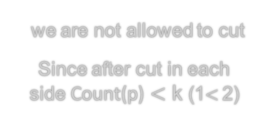
Allowable multidimensional cut for partition
1
After cut, distribution of points must be higher or equal to K ( Count(p) ≥ k )
If this condition was true, we have the right to cut our data (partition) again.
Let assume k=2
we are not allowed to cut
Since after cut in each side Count(p) $<$ k (1$<$2)
we are allowed to cut
Since after cut in each side Count(p) ≥ k (2 ≥ 2)
Notes:
f

Slide 6
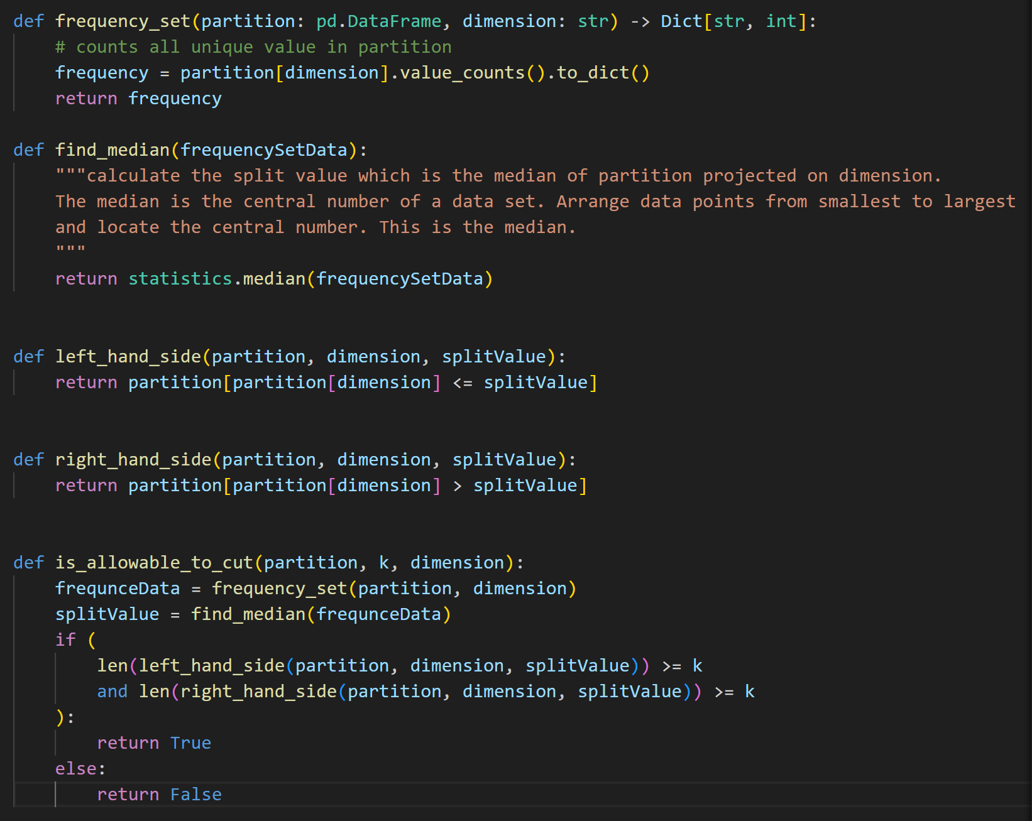
Check Allowable multidimensional cut for partition
1

Slide 7
Choose dimension
2
Range-Based Heuristic: This approach involves selecting the dimension with the widest range of values at each partitioning step. The rationale is that a wider range might indicate a higher level of diversity in the data, and splitting along this dimension could lead to more natural groupings that better preserve data utility.
Step1) For each dimension choose the max value and min value
Step2) Normalize the max values and min values
Step3) Calculate the normalize range between the maximum and minimum values in each dimension
Step4) The dimension with widest range is considered our chosen one.

Slide 8
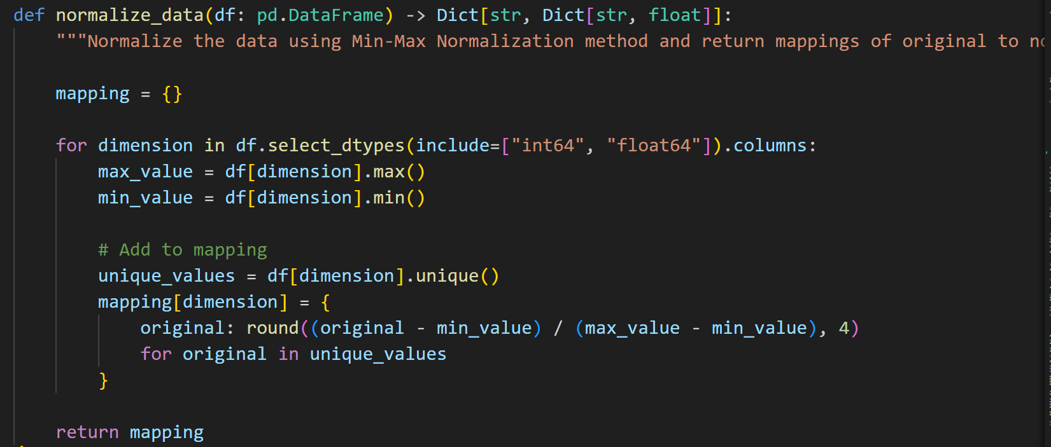
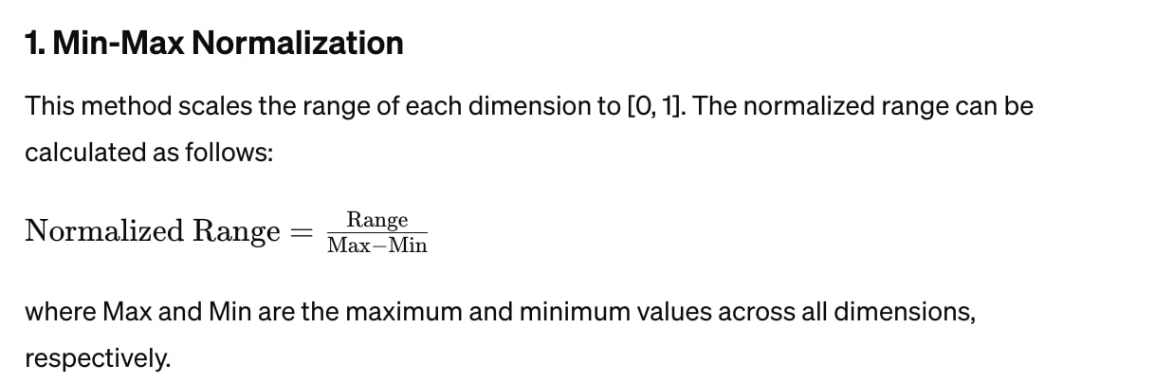
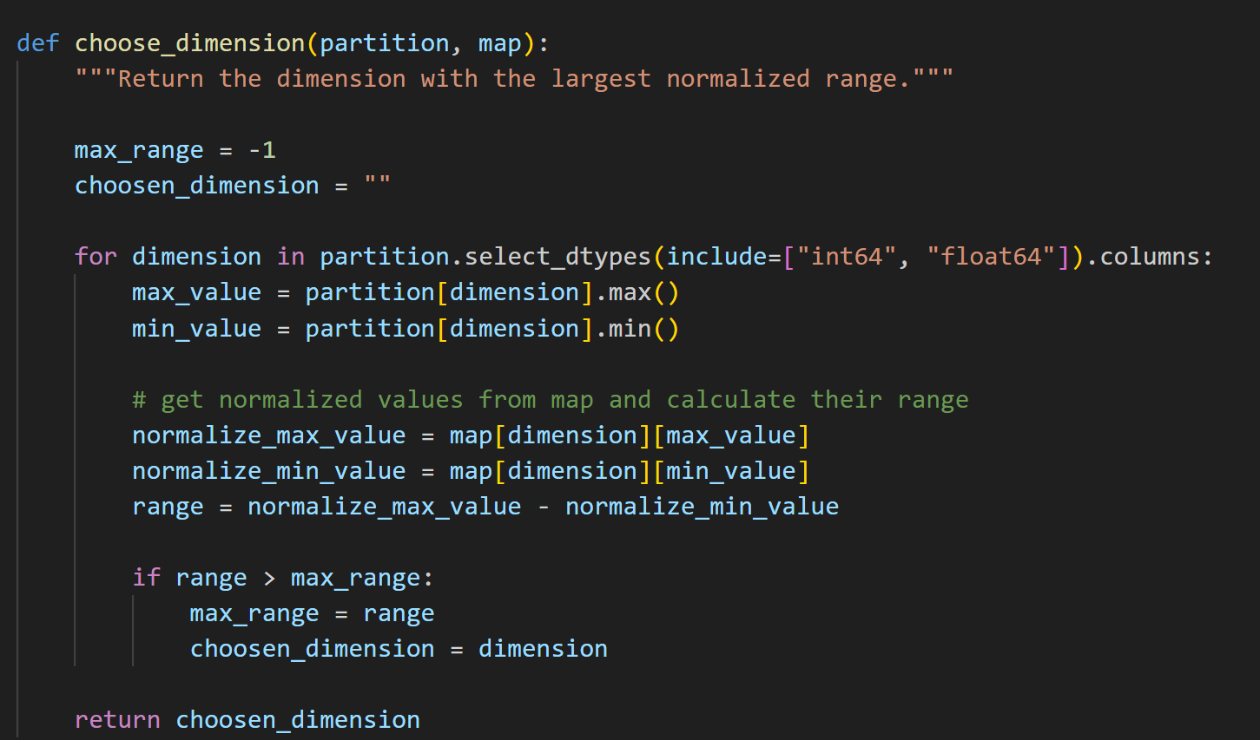
2

Slide 9
Frequency Set and Find Median
3
Frequency Set : It counts all unique dimension values in a given partition
Example for age dimension Frequency:{30:4, 50:2, 20:1}
Find Median : The median is the central number of a data set. Arrange data points from smallest to largest and locate the central number.
If our fs was odd
If our fs was even
Median
Median=
AVG These 2 points

Slide 10
3
4
Check Allowable multidimensional cut for partition
1

Slide 11
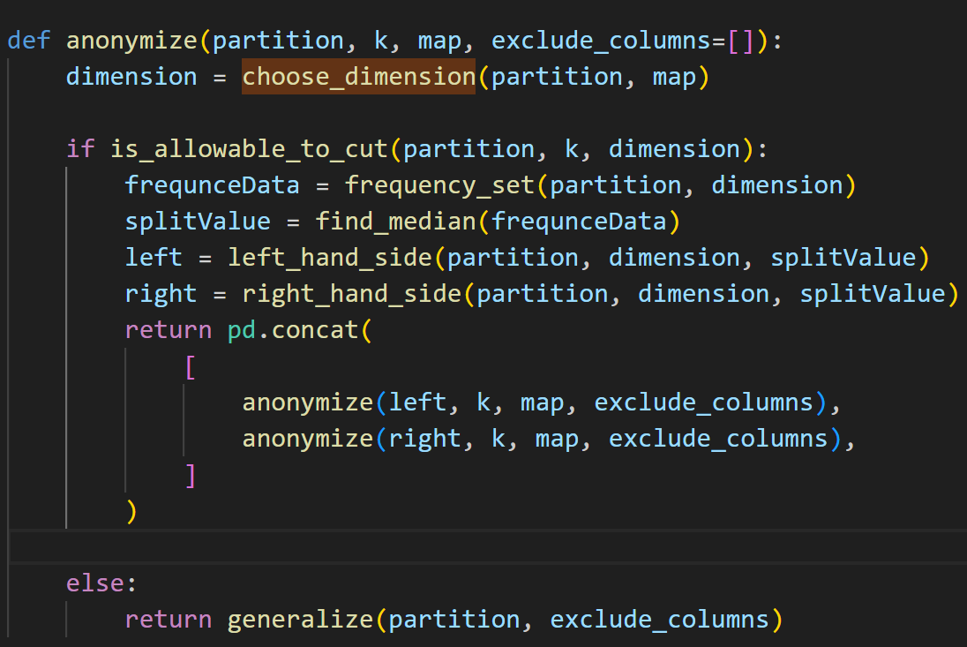
Anonymize
if (no allowable multidimensional cut for partition) return φ : partition →summary
else
dim ← choose dimension() fs ← frequency set(partition, dim) splitVal ← find median(fs) lhs ← {t ∈ partition : t.dim ≤ splitVal} rhs ← {t ∈ partition : t.dim > splitVal} return Anonymize(rhs) ∪ Anonymize(lhs)
1
2
1
3
2
4
3
4

Slide 12
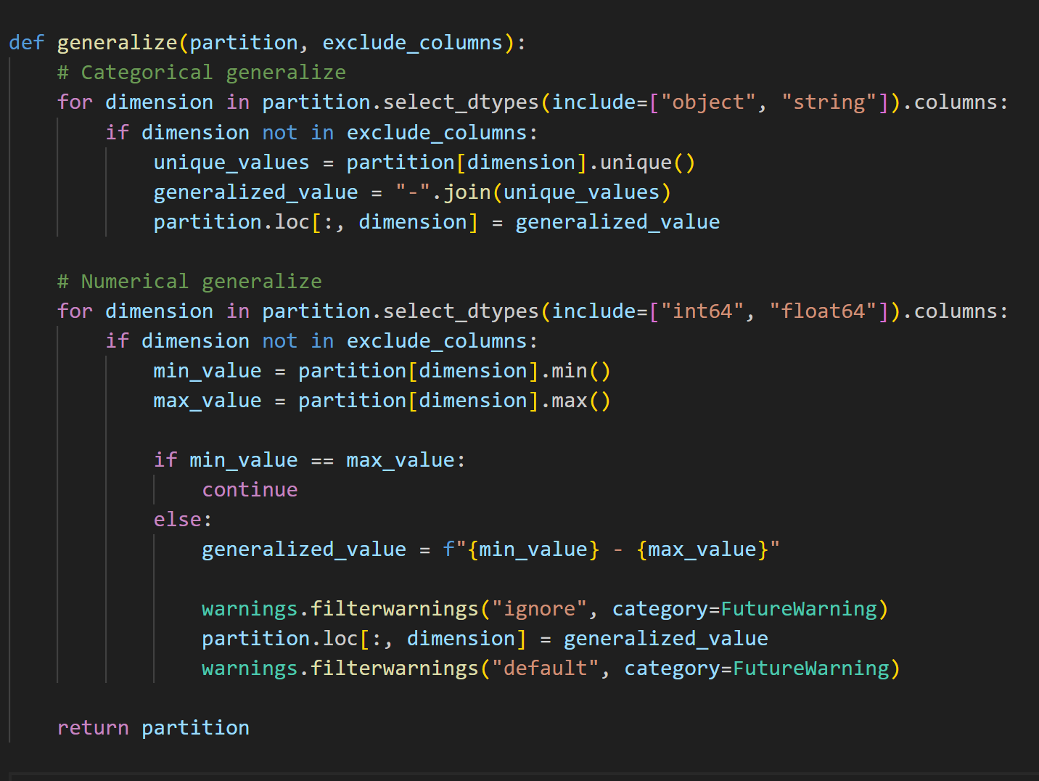
Generalize
In this project we represent two type of generalization:
Categorical*
Numerical
* : The reference article did not mention any methods for anonymizing data through categorical generalization; however, we have developed a method to reduce the probability of attacks.
Mondrian Multidimensional K-Anonymity (Kristen LeFevre David J. DeWitt Raghu Ramakrishnan University of Wisconsin, Madiso)

Slide 13
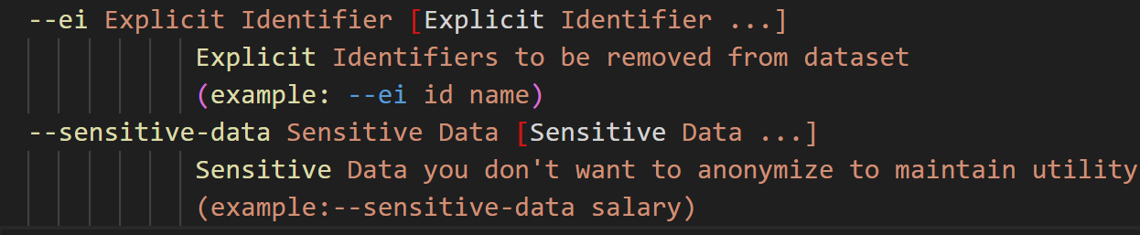
Important : In this approach, there is no need to anonymize the Explicit Identifier and Sensitive Data *.
Explicit Identifier: Must be removed from the dataset
Sensitive Data: To maintain utility, the value must be preserved and not anonymized
Resolve this issue by obtaining input from the command line

Slide 14
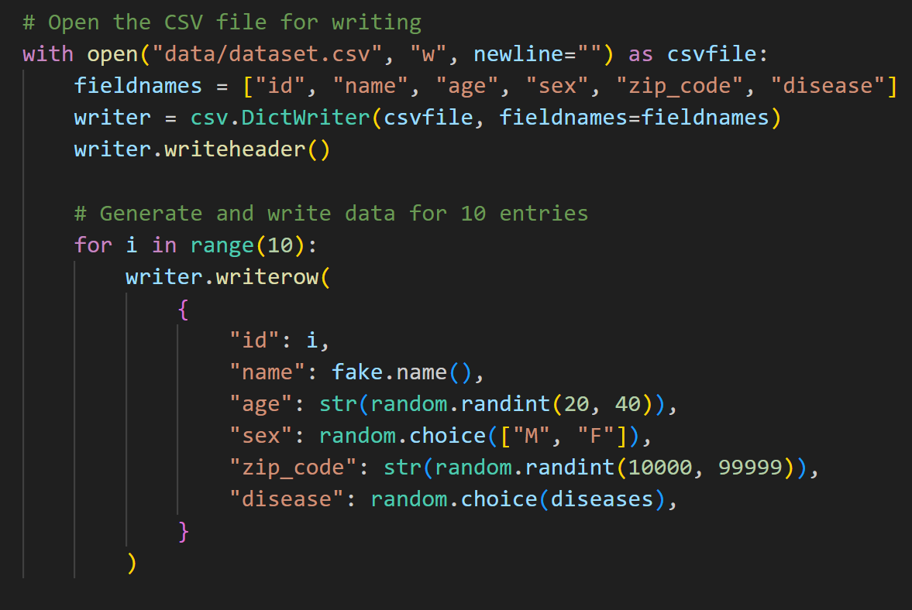
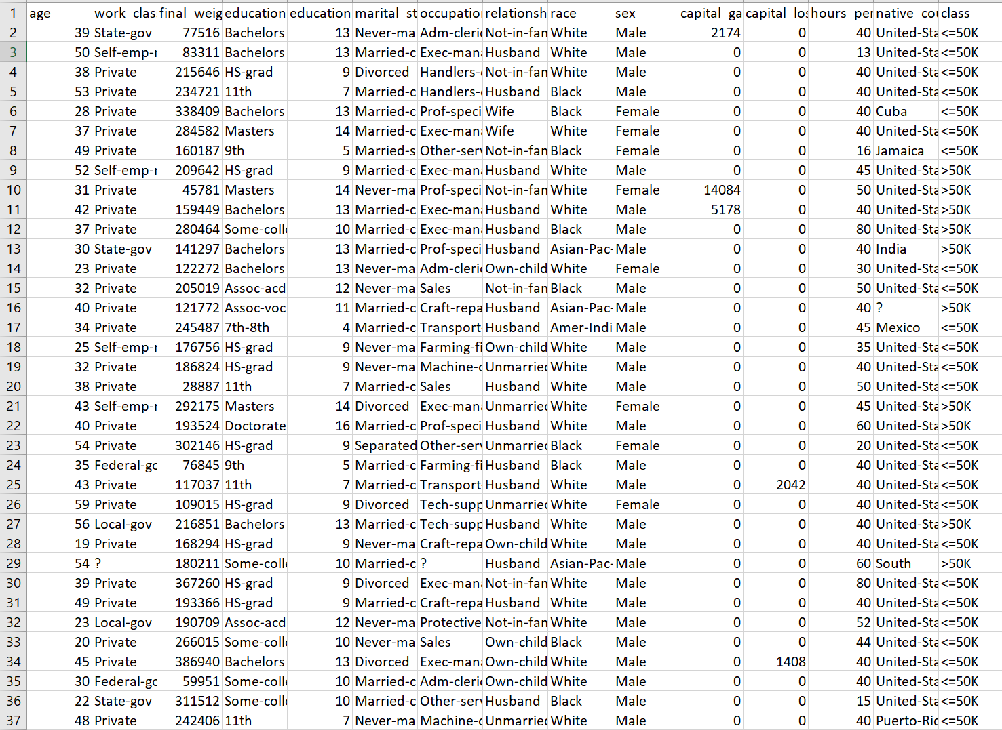
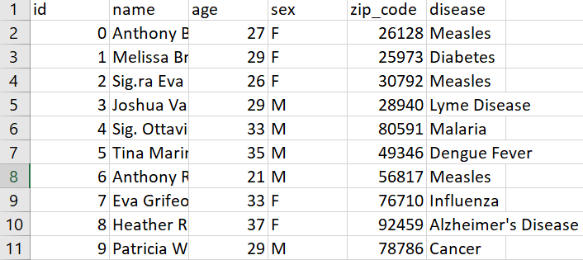
Datasets
Making fake dataset with faker library (used to test project)
Actual dataset(adult dataset)
Prepared a command line option to input the path of the custom dataset

Slide 15
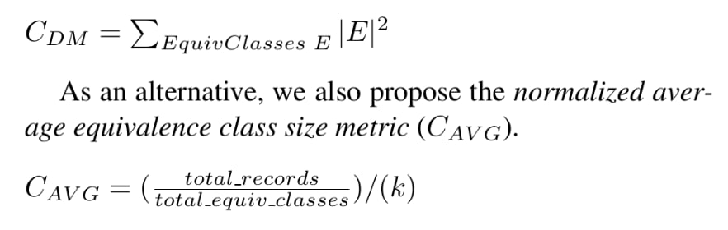
General-Purpose Quality Metrics
The anonymization process should generalize or perturb the original data as little as is necessary to satisfy the k-anonymity
Created a command line option to input the custom k-value

Slide 16
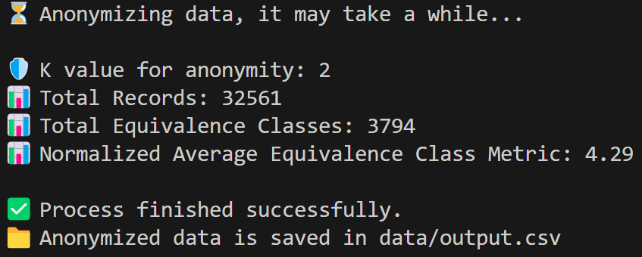
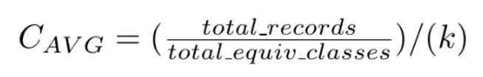
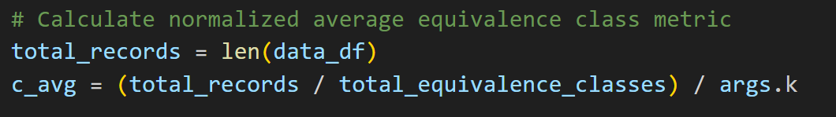
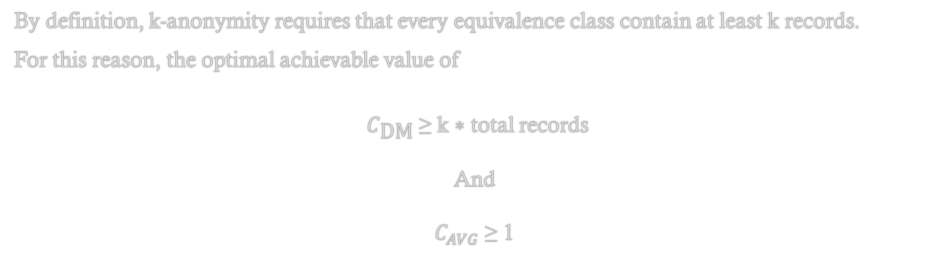
Bounds on Quality
By definition, k-anonymity requires that every equivalence class contain at least k records.
For this reason, the optimal achievable value of
$C_{\text{DM}}$ ≥ k ∗ total records And $C_{AVG}$ ≥ 1

Slide 17
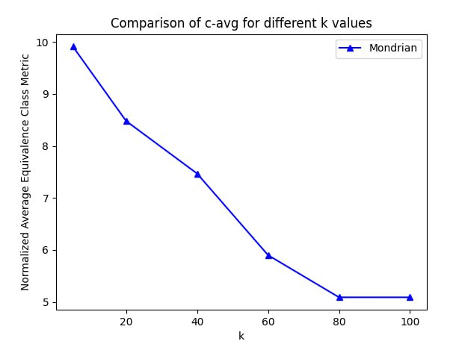
Experimental Evaluation

Slide 18


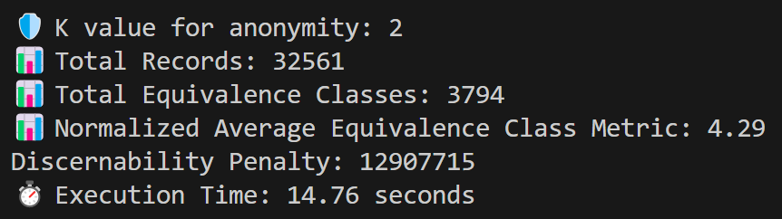
The Discernability Penalty (DP)
The Discernability Penalty (DP): It is a metric used in privacy-preserving data publishing, particularly in the context of k-anonymization. It quantifies the amount of information loss and the level of privacy protection in an anonymized dataset.
For an anonymized dataset with equivalence classes C1​,C2​,…,Cn​, where each Ci​ has ∣Ci​∣ records, the Discernability Penalty (DP) is given by:

Slide 19
Complexity
the time complexity is O(nlogn), where n = |T|

Slide 20
Thanks for your attention

