Slide 1

Incognito: Efficient Full Domain K-Anonymity

Slide 2
Anonymization:
Privacy Protection
Compliance with Regulations
Research and Analysis
Security Against Data Breaches

Slide 3
K-Anonymity refers to the level of re-identifiability within a dataset. Full-domain generalization involves remapping the entire domain of each quasi-identifier attribute in dataset T to a broader domain as part of its domain generalization process. In the presented study, we introduce an implementation framework for full-domain generalization, utilizing a multi-dimensional data model along with a set of algorithms, which we refer to as Incognito

Slide 4
Incognito:
Objective: Achieve Full-Domain K-Anonymity.
Approach:
Quasi-Identifier Generalization: Map attributes to more general domains.
Multi-Dimensional Model: Efficiently process and identify overlapping regions.
Key Focus:
Balancing Utility and Privacy: Optimize anonymization while maintaining data usefulness.
Result:
Provides a suite of algorithms for robust privacy protection in data sharing.
Application:
Ensuring individual privacy in sensitive data analysis.

Slide 5
Incognito:
A quasi-identifier attribute set is a collection of attributes in a dataset that, when combined with external information, may potentially lead to the re-identification of individuals. These attributes, if not properly protected, can pose a risk to individual privacy.
A frequency set in the context of data anonymization refers to a set of distinct combinations of quasi-identifier attribute values. Each combination occurs a specific number of times in the dataset.
K-Anonymity is a privacy concept that ensures that each record in a dataset is indistinguishable from at least "k-1" other records with respect to the quasi-identifier attributes. In other words, for a dataset to satisfy K-Anonymity, there must be at least "k" individuals who share the same set of quasi-identifier attribute values.
The subset property is a characteristic of a dataset that holds when a higher level of K-Anonymity is achieved as a result of having more attributes in the quasi-identifier set. In other words, if a dataset is K-Anonymous with a certain quasi-identifier set, it should also be K-Anonymous with any subset of that set.

Slide 6
Incognito:
The Incognito algorithm achieves full-domain K-Anonymity by generalizing quasi-identifier attributes. It employs a multi-dimensional data model for efficient processing. The algorithm identifies and handles overlapping regions in the generalization space to optimize the anonymization process. Incognito aims to strike a balance between data utility and privacy preservation. It provides a suite of algorithms to perform efficient generalization and achieve robust privacy protection.

Slide 7
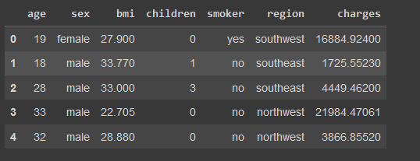
Data

Slide 8
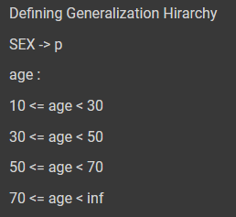
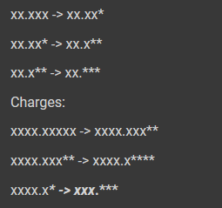

Slide 9
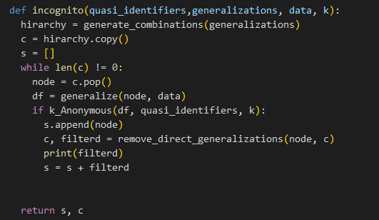
Implementation:

Slide 10

Result

